Slide 1
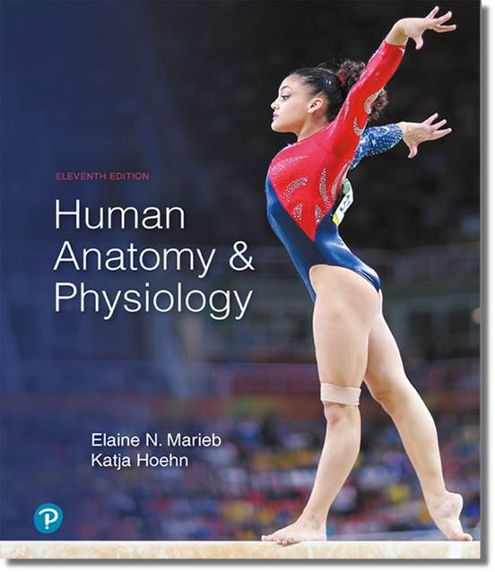
Human Anatomy and Physiology
Eleventh Edition
Chapter 09 Part B
Muscles and Muscle Tissue
PowerPoint® Lectures Slides prepared by Karen Dunbar Kareiva, Ivy Tech Community College
Copyright © 2019, 2016, 2013 Pearson Education, Inc. All Rights Reserved

Slide 2
9.5 Whole Muscle Contraction (1 of 2)
Same principles apply to contraction of both single fibers and whole muscles
Contraction produces muscle tension, the force exerted on load or object to be moved
Contraction may/may not shorten muscle
  Isometric contraction: no shortening; muscle tension increases but does not exceed load
  Isotonic contraction: muscle shortens because muscle tension exceeds load

Slide 3
9.5 Whole Muscle Contraction (2 of 2)
Force and duration of contraction vary in response to stimuli of different frequencies and intensities
Each muscle is served by at least one motor nerve
  Motor nerve contains axons of up to hundreds of motor neurons
  Axons branch into terminals, each of which forms NMJ with single muscle fiber
Motor unit is the nerve-muscle functional unit

Slide 4
The Motor Unit
Motor unit consists of the motor neuron and all muscle fibers (four to several hundred) it supplies
  Smaller the fiber number, the greater the fine control
Muscle fibers from a motor unit are spread throughout the whole muscle, so stimulation of a single motor unit causes only weak contraction of entire muscle

Slide 5
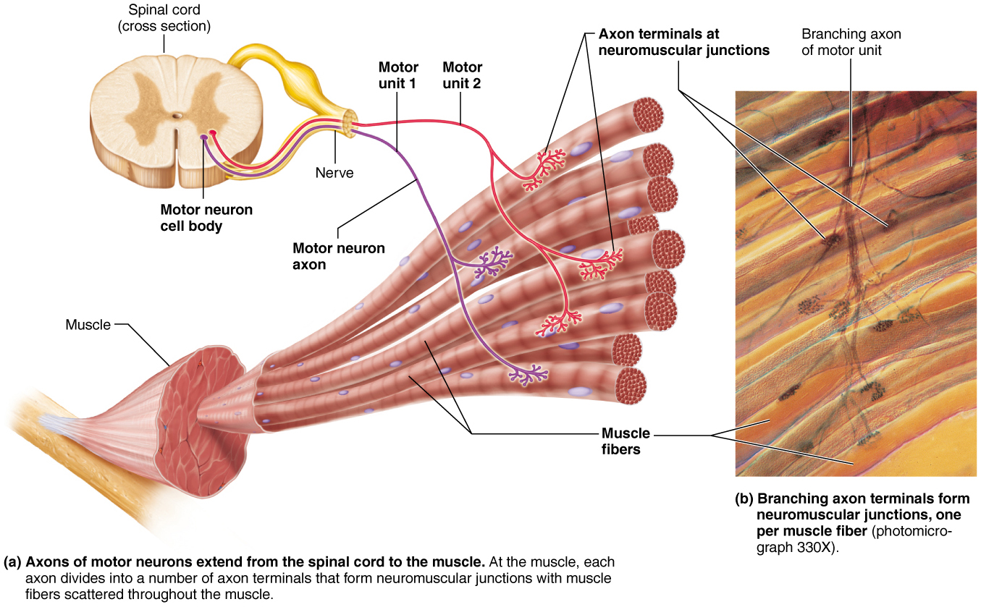
  A Motor Unit Consists of One Motor Neuron and All The Muscle Fibers it Innervates
Figure 9.10 A motor unit consists of one motor neuron and all the muscle fibers it innervates.

Slide 6
The Muscle Twitch (1 of 5)
Muscle twitch: simplest contraction resulting from a muscle fiber’s response to a single action potential from motor neuron
  Muscle fiber contracts quickly, then relaxes
Twitch can be observed and recorded as a myogram
  Tracing: line recording contraction activity

Slide 7
The Muscle Twitch (2 of 5)
Three phases of muscle twitch
  Latent period: events of excitation-contraction coupling
    No muscle tension seen
  Period of contraction: cross bridge formation
    Tension increases
  Period of relaxation: Ca²⁺ reentry into SR
    Tension declines to zero
Muscle contracts faster than it relaxes

Slide 8
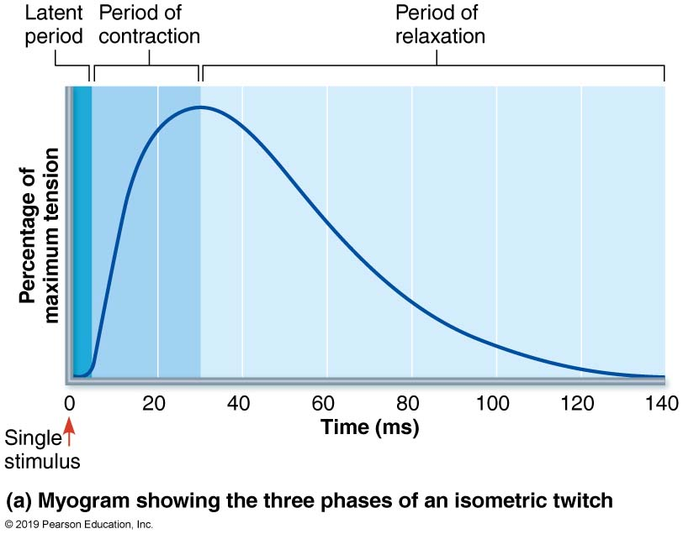
  The Muscle Twitch (3 of 5)
Figure 9.11a The muscle twitch.

Slide 9
The Muscle Twitch (4 of 5)
Differences in strength and duration of twitches are due to variations in metabolic properties and enzymes between muscles
  Example: eye muscles contraction are rapid and brief, whereas larger, fleshy muscles (calf muscles) contract more slowly and hold it longer

Slide 10
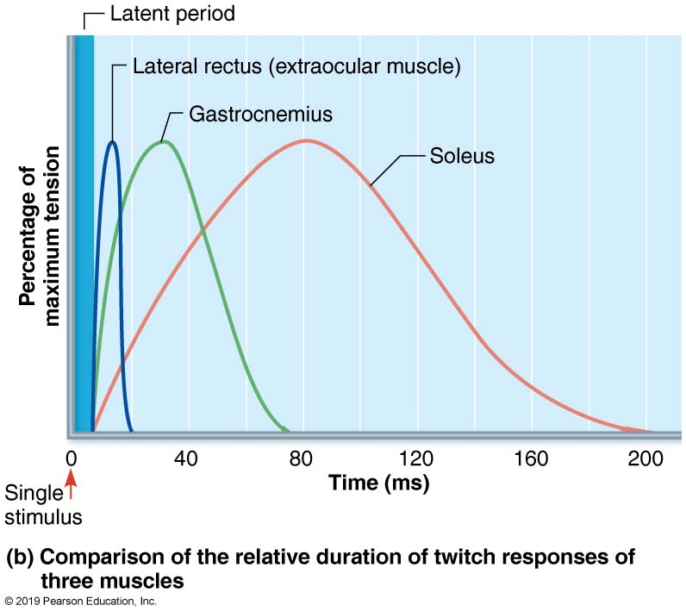
  The Muscle Twitch (5 of 5)
Figure 9.11b The muscle twitch.

Slide 11
Graded Muscle Responses (1 of 7)
Normal muscle contraction is relatively smooth, and strength varies with needs
  A muscle twitch is seen only in lab setting or with neuromuscular problems, but not in normal muscle
Graded muscle responses vary strength of contraction for different demands
  Required for proper control of skeletal movement
Responses are graded by:
  Changing frequency of stimulation
  Changing strength of stimulation

Slide 12
Graded Muscle Responses (2 of 7)
Muscle response to changes in stimulus frequency
  Single stimulus results in single contractile response (i.e., muscle twitch)

Slide 13
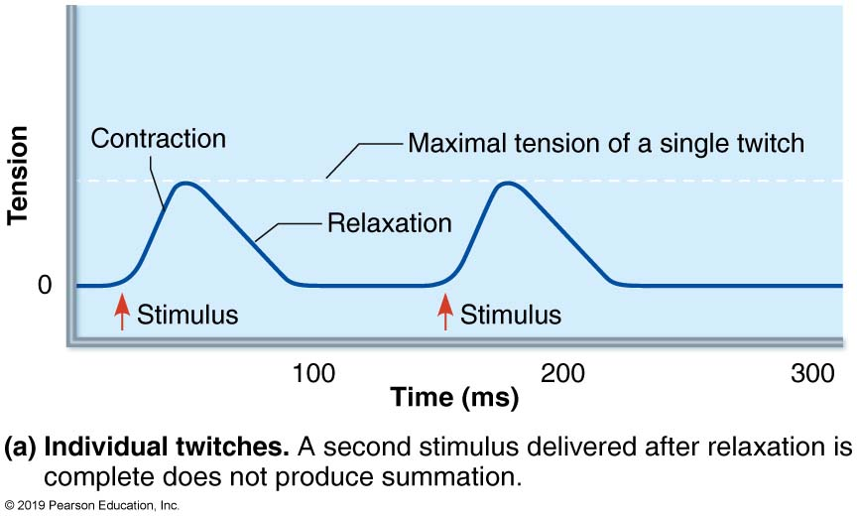
  Temporal Summation (1 of 4)
Figure 9.12a Temporal summation.

Slide 14
  Graded Muscle Responses (3 of 7)
Muscle response to changes in stimulus frequency (cont.)
  Wave (temporal) summation results if two stimuli are received by a muscle in rapid succession
    Muscle fibers do not have time to completely relax between stimuli, so twitches increase in force with each stimulus
    Additional Ca²⁺ that is released with second stimulus stimulates more shortening

Slide 15
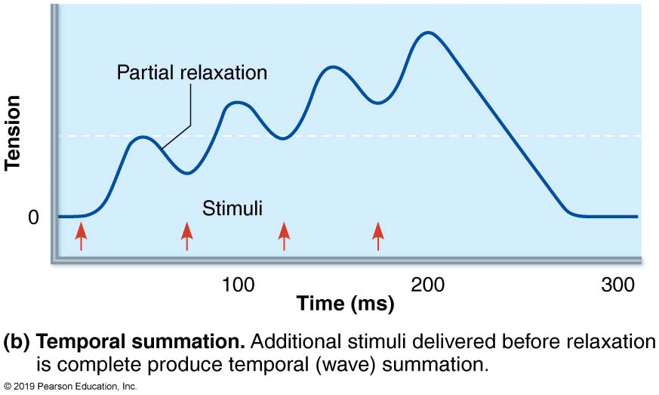
  Temporal Summation (2 of 4)
Figure 9.12b Temporal summation.

Slide 16
  Graded Muscle Responses (4 of 7)
Muscle response to changes in stimulus frequency (cont.)
  If stimuli frequency increases, muscle tension reaches near maximum
    Produces smooth, continuous contractions that add up (summation)
    Further increase in stimulus frequency causes muscle to progress to sustained, quivering contraction referred to as unfused (incomplete) tetanus

Slide 17
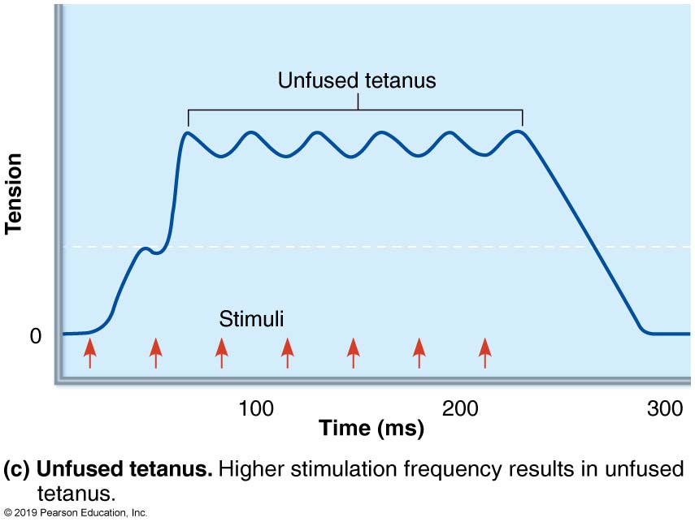
  Temporal Summation (3 of 4)
Figure 9.12c Temporal summation.

Slide 18
Graded Muscle Responses (5 of 7)
Muscle response to changes in stimulus frequency (cont.)
  If stimuli frequency further increase, muscle tension reaches maximum
    Referred to as fused (complete) tetanus because contractions “fuse” into one smooth sustained contraction plateau
    Prolonged muscle contractions lead to muscle fatigue

Slide 19
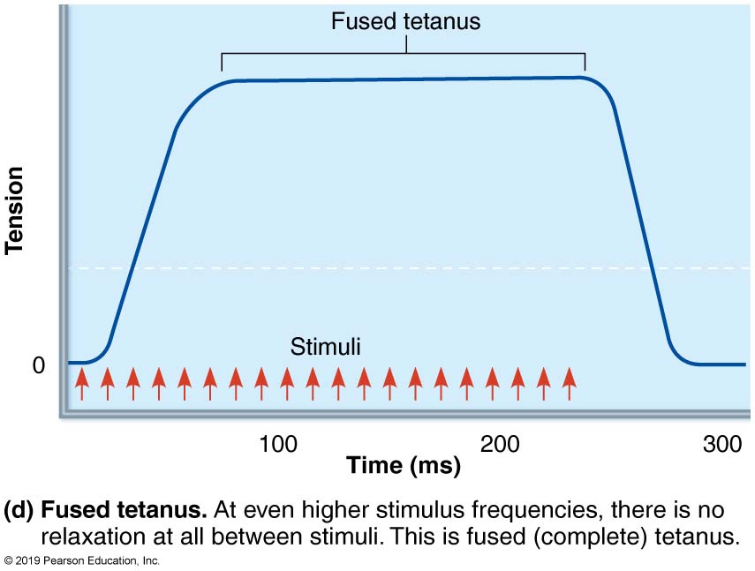
  Temporal Summation (4 of 4)
Figure 9.12d Temporal summation.

Slide 20
Graded Muscle Responses (6 of 7)
Muscle response to changes in stimulus strength
  Recruitment (or multiple motor unit summation): stimulus is sent to more muscle fibers, leading to more precise control
  Types of stimulus involved in recruitment:
    Subthreshold stimulus: stimulus not strong enough, so no contractions seen
    Threshold stimulus: stimulus is strong enough to cause first observable contraction
    Maximal stimulus: strongest stimulus that increases maximum contractile force
      All motor units have been recruited

Slide 21
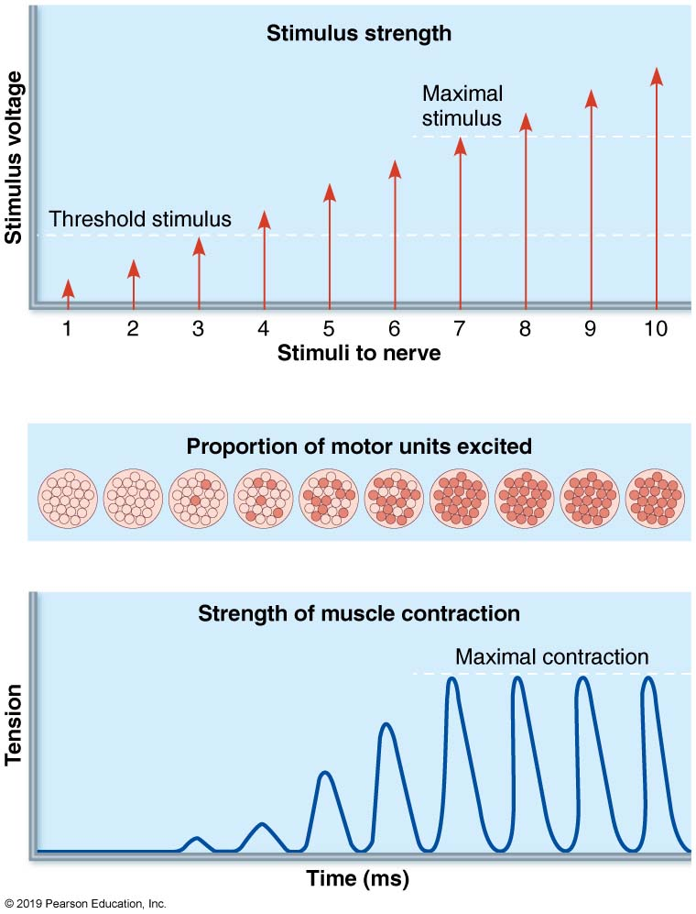
  Relationship Between Stimulus Intensity (Graph at Top) and Muscle Tension (Tracing Below)
Figure 9.13 Recruitment.

Slide 22
Graded Muscle Responses (7 of 7)
Muscle response to changes in stimulus strength (cont.)
  Recruitment works on size principle
    Motor units with smallest muscle fibers are recruited first
    Motor units with larger and larger fibers are recruited as stimulus intensity increases
    Largest motor units are activated only for most powerful contractions
    Motor units in muscle usually contract asynchronously
      Some fibers contract while others rest
      Helps prevent fatigue

Slide 23
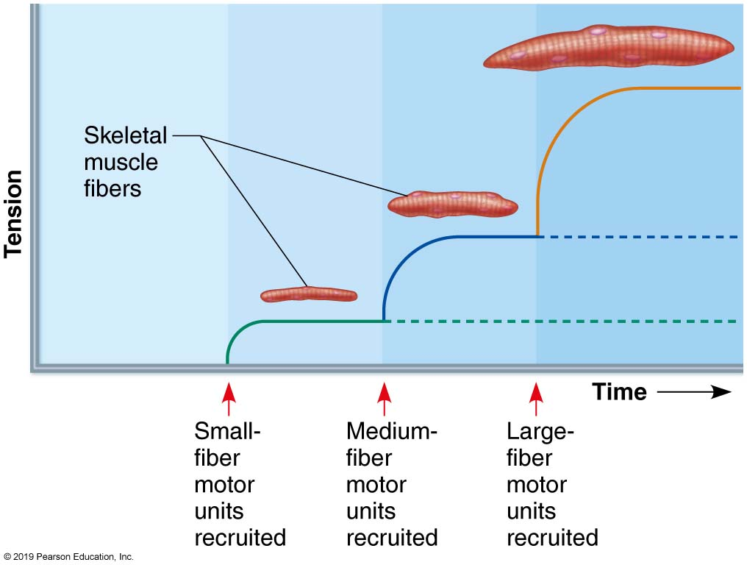
  The Size Principle of Recruitment
Figure 9.14 The size principle of recruitment.

Slide 24
Muscle Tone
Constant, slightly contracted state of all muscles
Due to spinal reflexes
  Groups of motor units are alternately activated in response to input from stretch receptors in muscles
Keeps muscles firm, healthy, and ready to respond

Slide 25
Isotonic and Isometric Contractions (1 of 3)
Isotonic contractions: muscle changes in length and moves load
  Isotonic contractions can be either concentric or eccentric:
    Concentric contractions: muscle shortens and does work
      Example: biceps contract to pick up a book
    Eccentric contractions: muscle lengthens and generates force
      Example: laying a book down causes biceps to lengthen while generating a force

Slide 26
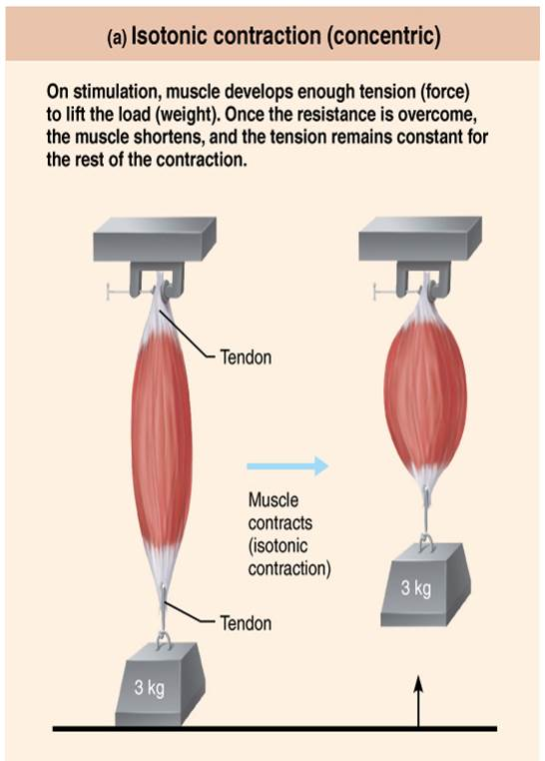
  Isotonic (concentric) and Isometric Contractions (1 of 4)
Figure 9.15 Isotonic (concentric) and isometric contractions.

Slide 27
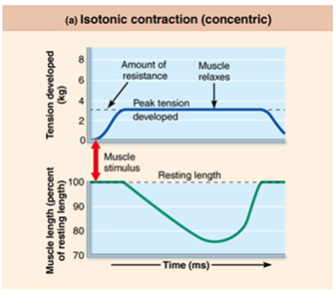
  Isotonic (concentric) and Isometric Contractions (2 of 4)
Figure 9.15 Isotonic (concentric) and isometric contractions.

Slide 28
Isotonic and Isometric Contractions (2 of 3)
Isometric contractions
  Load is greater than the maximum tension muscle can generate, so muscle neither shortens nor lengthens

Slide 29
Isotonic and Isometric Contractions (3 of 3)
Electrochemical and mechanical events are same in isotonic or isometric contractions, but results are different
  In isotonic contractions, actin filaments shorten and cause movement
  In isometric contractions, cross bridges generate force, but actin filaments do not shorten
    Myosin heads “spin their wheels” on same actin- binding site

Slide 30
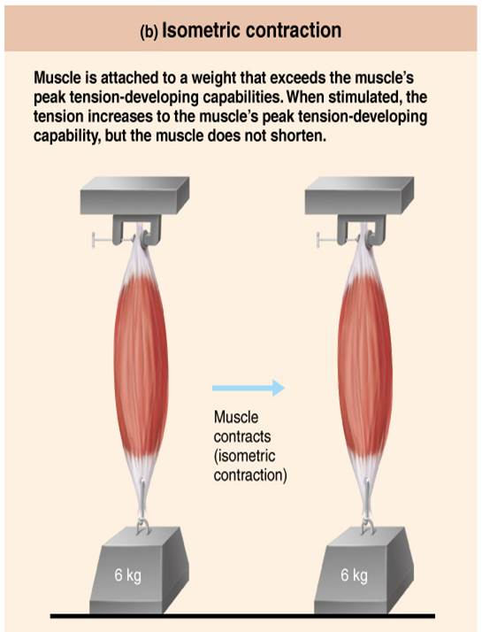
  Isotonic (Concentric) and Isometric Contractions (3 of 4)
Figure 9.15 Isotonic (concentric) and isometric contractions.

Slide 31
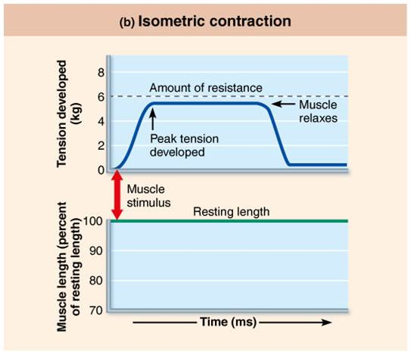
  Isotonic (Concentric) and Isometric Contractions (4 of 4)
Figure 9.15 Isotonic (concentric) and isometric contractions.

Slide 32
9.6 Energy for Contraction and ATP
Providing Energy for Contraction
ATP supplies the energy needed for the muscle fiber to:
  Move and detach cross bridges
  Pump calcium back into SR
  Pump Na⁺ out of and K⁺ back into cell after excitation-contraction coupling
Available stores of ATP depleted in 4–6 seconds
ATP is the only source of energy for contractile activities; therefore it must be regenerated quickly

Slide 33
Providing Energy for Contraction (1 of 7)
ATP is regenerated quickly by three mechanisms:
  Direct phosphorylation of ADP by creatine phosphate (CP)
  Anaerobic pathway: glycolysis and lactic acid formation
  Aerobic pathway

Slide 34
Providing Energy for Contraction (2 of 7)
Direct phosphorylation of ADP by creatine phosphate (CP)
  Creatine phosphate is a unique molecule located in muscle fibers that donates a phosphate to ADP to instantly form ATP
    Creatine kinase is enzyme that carries out transfer of phosphate
    Muscle fibers have enough ATP and CP reserves to power cell for about 15 seconds
Creatine phosphate + ADP → creatine + ATP

Slide 35
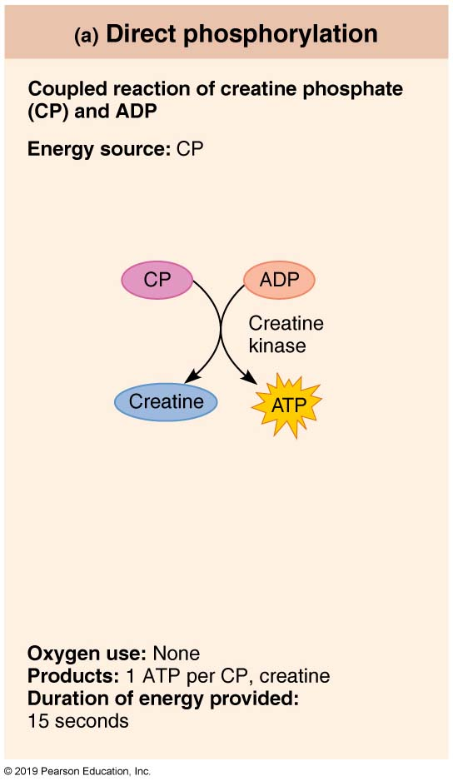
  Pathways for Regenerating ATP During Muscle Activity (1 of 3)
Figure 9.16a Pathways for regenerating ATP during muscle activity.

Slide 36
Providing Energy for Contraction (3 of 7)
Anaerobic pathway: glycolysis and lactic acid formation
  ATP can also be generated by breaking down and using energy stored in glucose
    Glycolysis: first step in glucose breakdown
  Does not require oxygen
  Glucose is broken into 2 pyruvic acid molecules
  2 ATPs are generated for each glucose broken down
    Low oxygen levels prevent pyruvic acid from entering aerobic respiration phase

Slide 37
Providing Energy for Contraction (4 of 7)
Anaerobic pathway: glycolysis and lactic acid formation (cont.)
  Normally, pyruvic acid enters mitochondria to start aerobic respiration phase; however, at high intensity activity, oxygen is not available
    Bulging muscles compress blood vessels, impairing oxygen delivery
  In the absence of oxygen, referred to as anaerobic glycolysis, pyruvic acid is converted to lactic acid

Slide 38
Providing Energy for Contraction (5 of 7)
Anaerobic pathway: glycolysis and lactic acid formation (cont.)
  Lactic acid
    Diffuses into bloodstream
    Used as fuel by liver, kidneys, and heart
    Converted back into pyruvic acid or glucose by liver
  Anaerobic respiration yields only 5% as much ATP as aerobic respiration, but produces ATP 2½ times faster

Slide 39
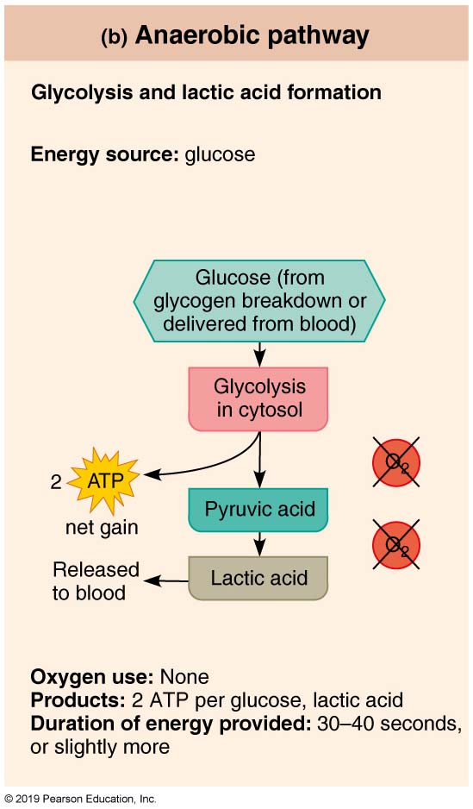
  Pathways for Regenerating ATP During Muscle Activity (2 of 3)
Figure 9.16b Pathways for regenerating ATP during muscle activity.

Slide 40
Providing Energy for Contraction (6 of 7)
Aerobic Respiration
  Produces 95% of ATP during rest and light-to-moderate exercise
    Slower than anaerobic pathway
  Consists of series of chemical reactions that occur in mitochondria and require oxygen
    Breaks glucose into CO₂, H₂O, and large amount ATP (32 can be produced)
  Fuels used include glucose from glycogen stored in muscle fiber, then bloodborne glucose, and free fatty acids
    Fatty acids are main fuel after 30 minutes of exercise

Slide 41
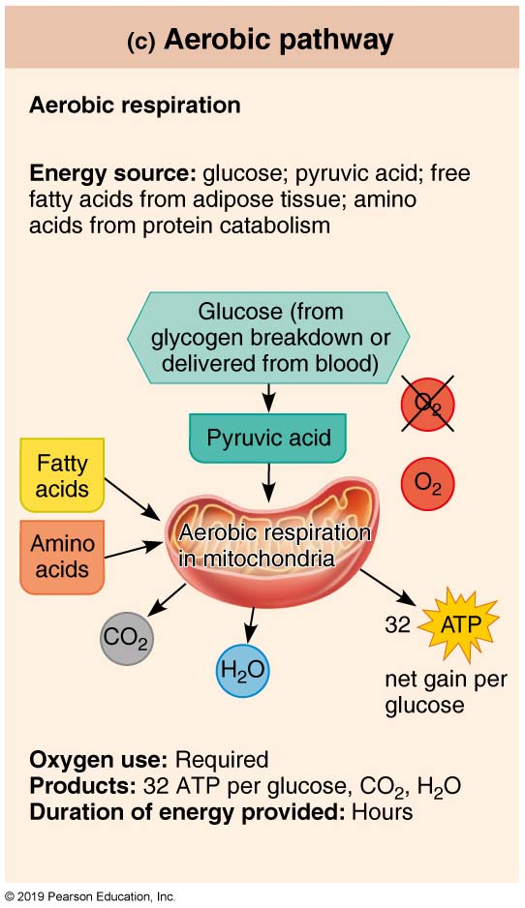
  Pathways for Regenerating ATP During Muscle Activity (3 of 3)
Figure 9.16c Pathways for regenerating ATP during muscle activity.

Slide 42
Providing Energy for Contraction (7 of 7)
Energy systems used during sports
  Aerobic endurance
    Length of time muscle contracts using aerobic pathways
      Light-to-moderate activity, which can continue for hours
  Anaerobic threshold
    Point at which muscle metabolism converts to anaerobic pathway

Slide 43
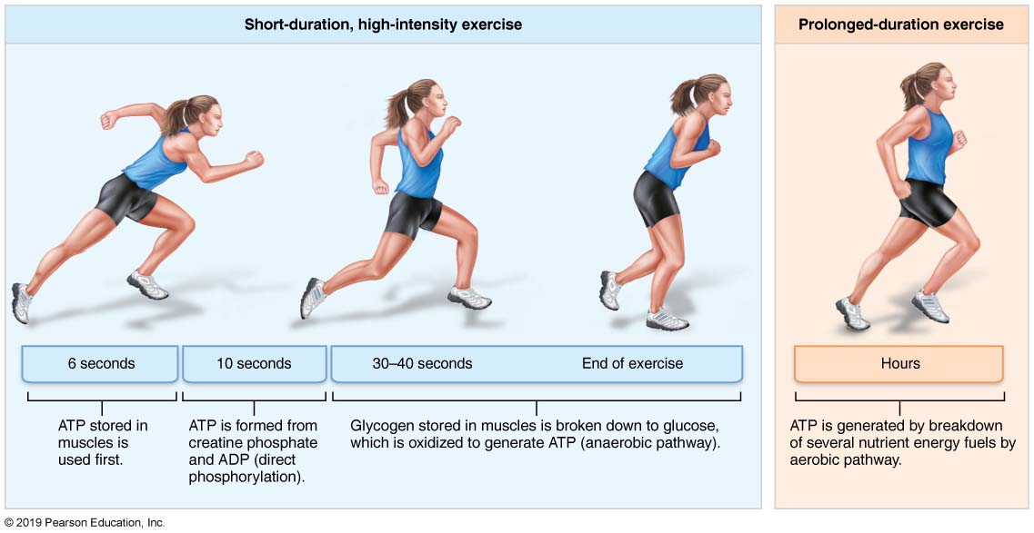
  Comparison of Energy Sources Used During Short-Duration Exercise and Prolonged-Duration Exercise
Figure 9.17 Comparison of energy sources used during short-duration exercise and prolonged-duration exercise.

Slide 44
Muscle Fatigue (1 of 2)
Fatigue is the physiological inability to contract despite continued stimulation
Possible causes include:
  Ionic imbalances can cause fatigue
    Levels of K⁺, Na⁺ and Ca²⁺ can change disrupting membrane potential of muscle cell
  Increased inorganic phosphage (P_{i}) from CP and ATP breakdown may interfere with calcium release from SR or hamper power

Slide 45
Muscle Fatigue (2 of 2)
  Decreased ATP and increased magnesium
    As ATP levels drop, magnesium levels increase and this can interfere with voltage sensitive T tubule proteins
  Decreased glycogen
Lack of ATP is rarely a reason for fatigue, except in severely stressed muscles

Slide 46
Excess Postexercise Oxygen Consumption
For a muscle to return to its pre-exercise state:
  Oxygen reserves are replenished
  Lactic acid is reconverted to pyruvic acid
  Glycogen stores are replaced
  ATP and creatine phosphate reserves are resynthesized
All replenishing steps require extra oxygen, so this is referred to as excess postexercise oxygen consumption (EPOC)
  Formerly referred to as “oxygen debt”

Slide 47

Copyright

