Slide 1

Human Anatomy and Physiology
Eleventh Edition
Chapter 10 Part A
The Muscular System
PowerPoint® Lectures Slides prepared by Karen Dunbar Kareiva, Ivy Tech Community College
Copyright © 2019, 2016, 2013 Pearson Education, Inc. All Rights Reserved

Slide 2
Why This Matters
Understanding the anatomy of skeletal muscles will improve your body mechanics and help avoid injury to yourself and your patient

Slide 3
Video: Why This Matters (Career Connection)
Click here to view ADA compliant video:
Why This Matters (Career Connection)
https://mediaplayer.pearsoncmg.com/assets/secs_wtm_ch_10_peter

Slide 4
10.1 Muscle Actions and Interactions
Muscle tissue consists of all contractile tissues
Skeletal, cardiac, smooth muscle
This chapter focuses on skeletal muscle and looks at:
How muscles interact to bring about movement
Criteria for naming muscles
Principles of leverage

Slide 5
Muscle Actions and Interactions (1 of 2)
Muscles can only pull; never push
What one muscle group “does,” another “undoes”
3 main functional groups:
Prime mover (agonist)
Major responsibility for producing specific movement
Antagonist
Opposes or reverses particular movement
Prime mover and antagonist are located on opposite sides of joint across which they act

Slide 6
Muscle Actions and Interactions (2 of 2)
Synergist helps prime movers
Adds extra force to same movement
Reduces undesirable or unnecessary movement
Fixators: type of synergist that immobilizes bone or muscle’s origin rather than enhancing movement of prime movers
Gives prime mover stable base on which to act

Slide 7
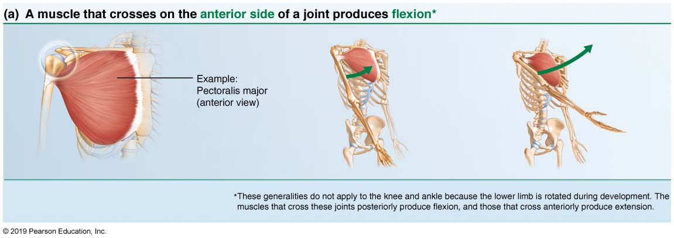
The Action of a Muscle can be Inferred by the Position of the Muscle Relative to the Joint it Crosses. (Examples Given Relate to the Shoulder Joint.) (1 of 4)
FOCUS FIGURE 10.1a Muscle Action.

Slide 8
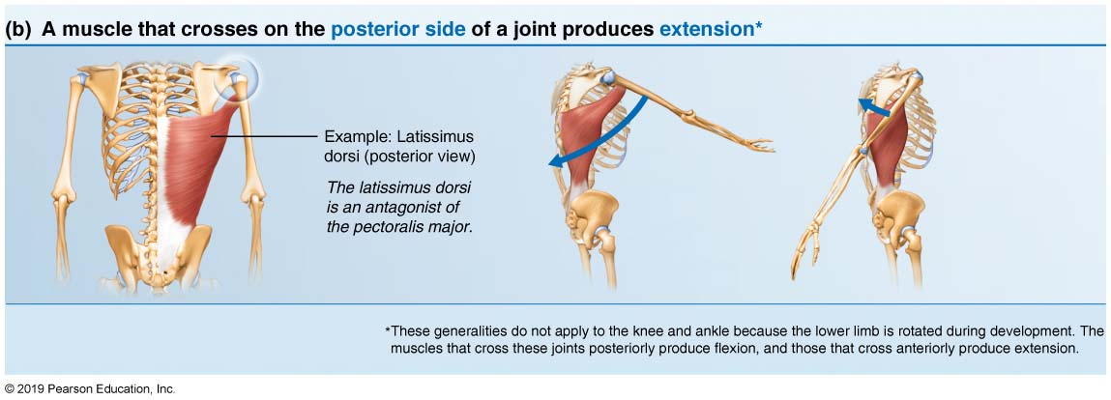
The Action of a Muscle can be Inferred by the Position of the Muscle Relative to the Joint it Crosses. (Examples Given Relate to the Shoulder Joint.) (2 of 4)
FOCUS FIGURE 10.1b Muscle Action.

Slide 9
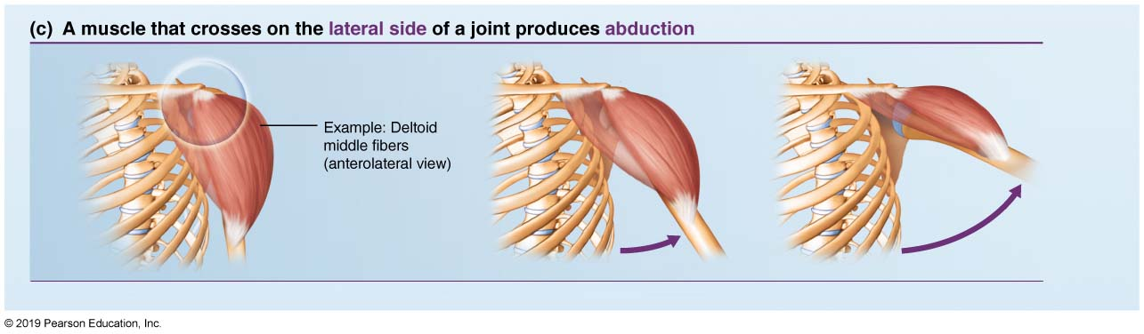
The Action of a Muscle can be Inferred by the Position of the Muscle Relative to the Joint it Crosses. (Examples Given Relate to the Shoulder Joint.) (3 of 4)
FOCUS FIGURE 10.1c Muscle Action.

Slide 10
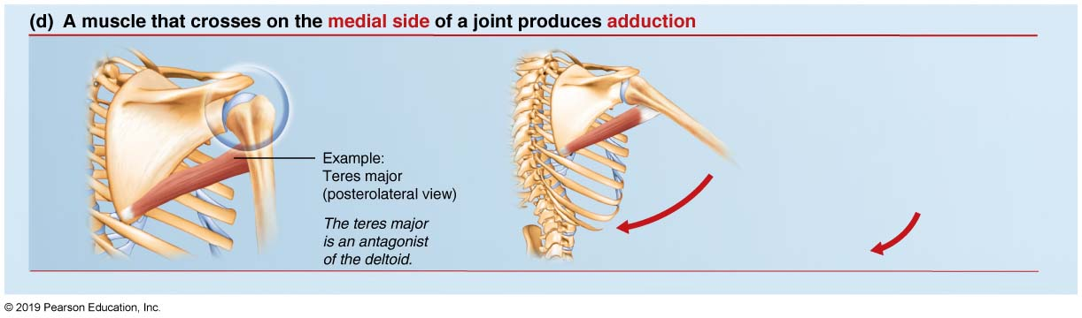
The Action of a Muscle can be Inferred by the Position of the Muscle Relative to the Joint it Crosses. (Examples Given Relate to the Shoulder Joint.) (4 of 4)
FOCUS FIGURE 10.1d Muscle Action.

Slide 11
Skeletal Muscles: Functional Groups
Same muscle may act as a:
Prime mover in one movement
Antagonist for a different movement
Synergist for a third movement

Slide 12
10.2 Naming Skeletal Muscles (1 of 3)
Muscle location: bone or body region with which muscle associated
Example: temporalis (over temporal bone)
Muscle shape: distinctive shapes
Example: deltoid muscle (deltoid = triangle)
Muscle size
Example: maximus (largest), minimus (smallest), longus (long)

Slide 13
10.2 Naming Skeletal Muscles (2 of 3)
Direction of muscle fibers or fascicles
Example: rectus (fibers run straight), transversus (fibers run at right angles), and oblique (fibers run at angles to imaginary defined axis)
Number of origins
Example: biceps (two origins) and triceps (three origins)

Slide 14
10.2 Naming Skeletal Muscles (3 of 3)
Location of attachments: named according to point of origin and insertion (origin named first)
Example: sternocleidomastoid attaches to sternum and clavicle, with insertion on mastoid process
Muscle action: named for action they produce
Example: flexor or extensor
Several criteria can be combined
Example: extensor (extends) carpi (wrist) radialis (radius) longus (length is long)

Slide 15
10.3 Fascicle Arrangements
All skeletal muscles consist of fascicles (bundles of fibers)
Fascicle arrangements vary, resulting in muscles with different shapes and functional capabilities
The most common patterns of arrangement
Circular
Convergent
Parallel
Pennate

Slide 16
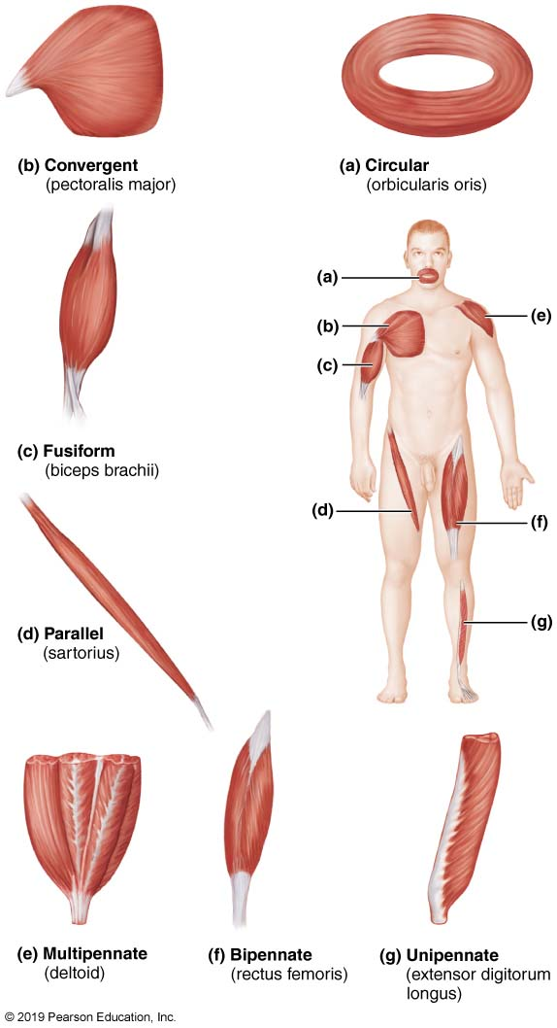
Patterns of Fascicle Arrangement in Muscles (1 of 8)
Figure 10.1 Patterns of fascicle arrangement in muscles.

Slide 17
Fascicle Arrangements (1 of 4)
Circular: fascicles arranged in concentric rings (example: orbicularis oris)
Convergent: broad origin; fascicles converge toward single tendon insertion (example: pectoralis major)

Slide 18
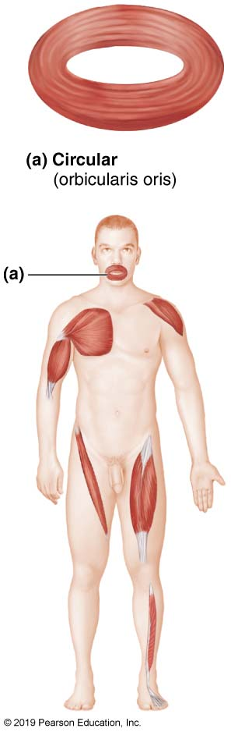
Patterns of Fascicle Arrangement in Muscles (2 of 8)
Figure 10.1a Patterns of fascicle arrangement in muscles.

Slide 19
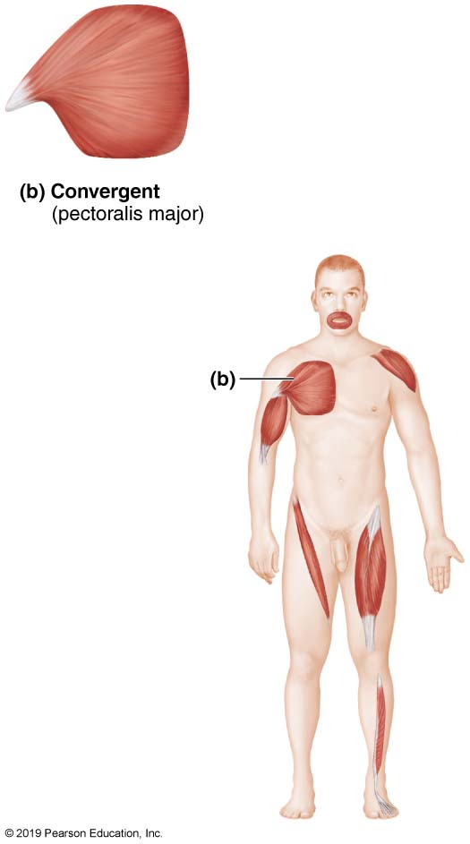
Patterns of Fascicle Arrangement in Muscles (3 of 8)
Figure 10.1b Patterns of fascicle arrangement in muscles.

Slide 20
Fascicle Arrangements (2 of 4)
Parallel: fascicles parallel to long axis of straplike muscle (example: sartorius)
Fusiform: spindle-shaped muscles with parallel fibers (example: biceps brachii)

Slide 21
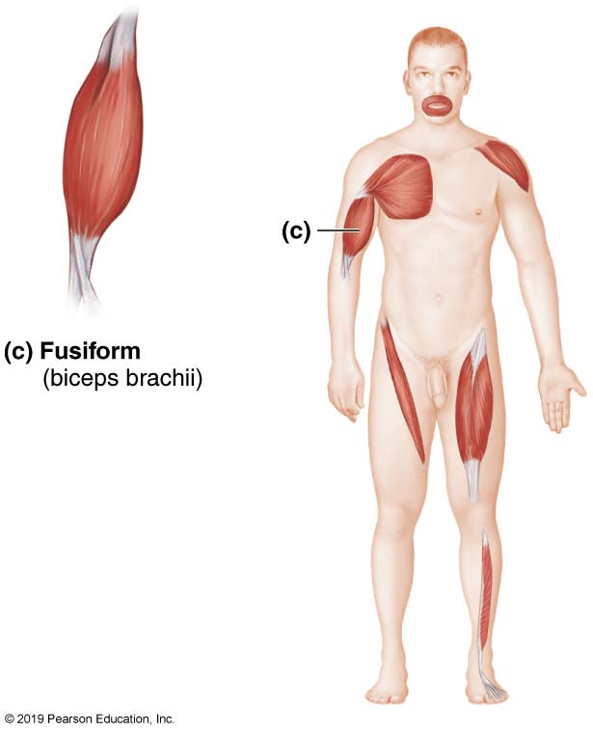
Patterns of Fascicle Arrangement in Muscles (4 of 8)
Figure 10.1c Patterns of fascicle arrangement in muscles.

Slide 22
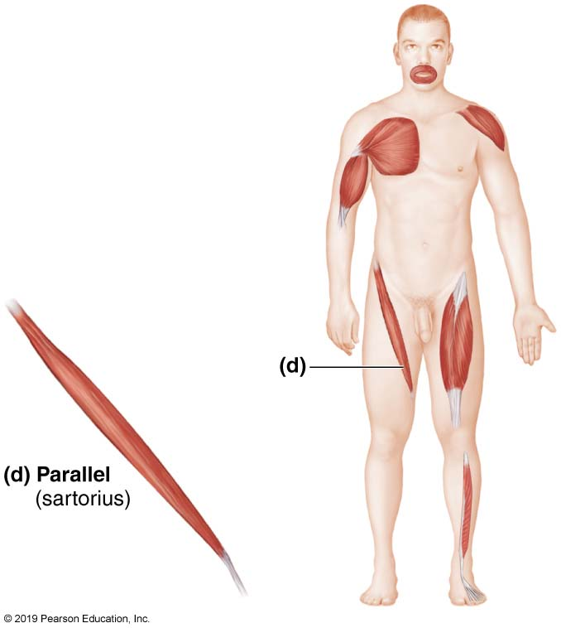
Patterns of Fascicle Arrangement in Muscles (5 of 8)
Figure 10.1d Patterns of fascicle arrangement in muscles.

Slide 23
Fascicle Arrangements (3 of 4)
Pennate: short fascicles attach obliquely to central tendon running length of muscle (example: rectus femoris)
Three forms
Unipennate: fascicles attach only to one side of tendon (example: extensor digitorum longus)
Bipennate: fascicles insert from opposite sides of tendon (example: rectus femoris)
Multipennate: appears as feathers inserting into one tendon (example: deltoid)

Slide 24
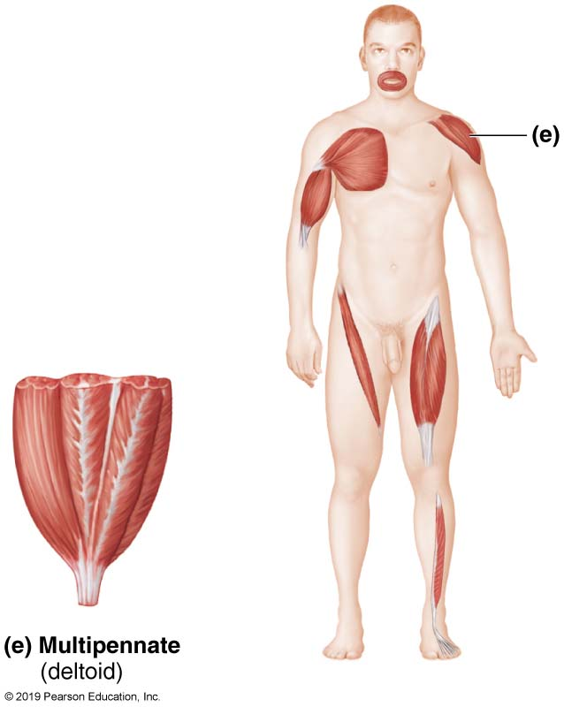
Patterns of Fascicle Arrangement in Muscles (6 of 8)
Figure 10.1e Patterns of fascicle arrangement in muscles.

Slide 25
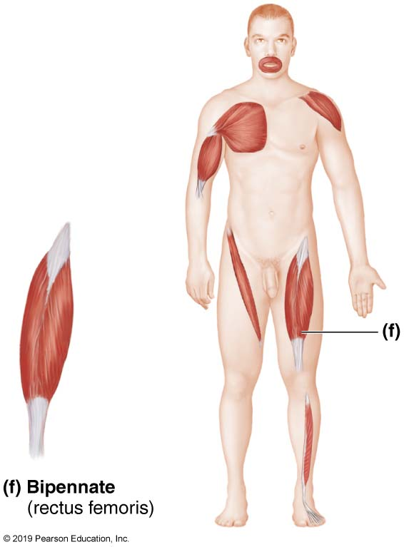
Patterns of Fascicle Arrangement in Muscles (7 of 8)
Figure 10.1f Patterns of fascicle arrangement in muscles.

Slide 26
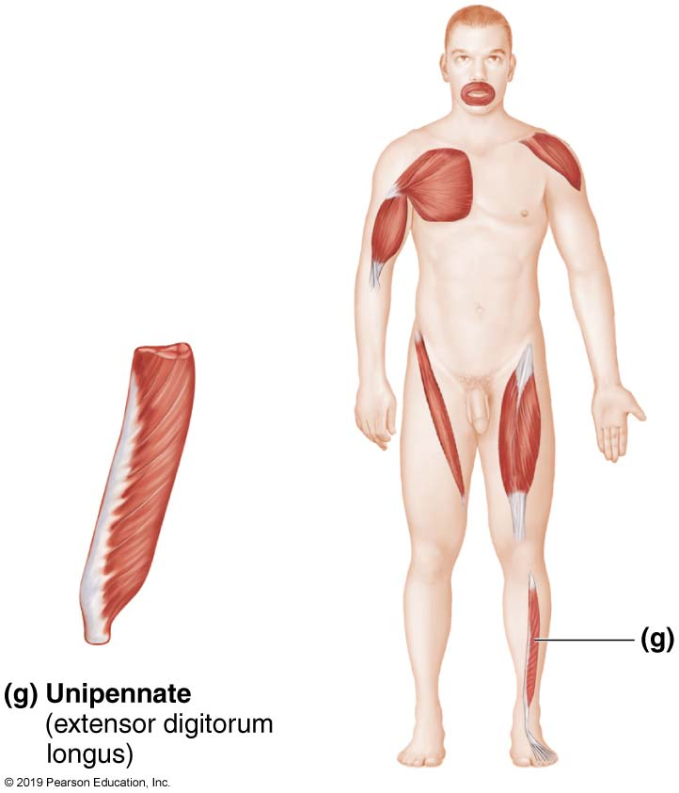
Patterns of Fascicle Arrangement in Muscles (8 of 8)
Figure 10.1g Patterns of fascicle arrangement in muscles.

Slide 27
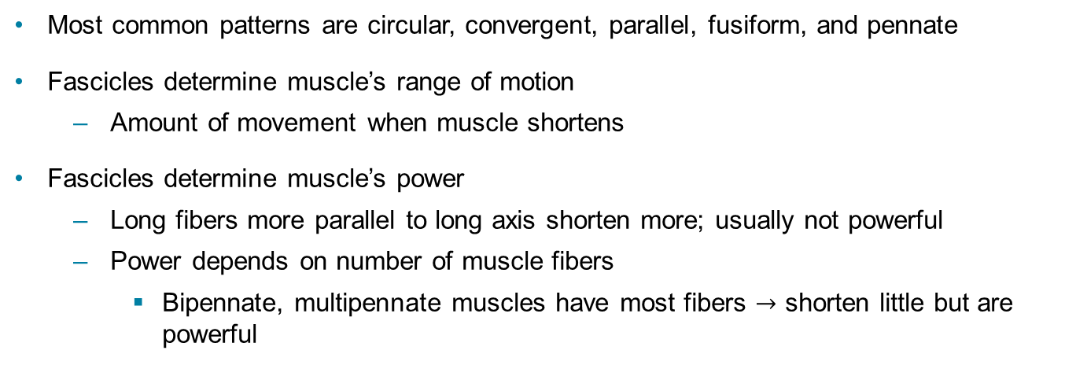
Fascicle Arrangements (4 of 4)
Most common patterns are circular, convergent, parallel, fusiform, and pennate
Fascicles determine muscle’s range of motion
Amount of movement when muscle shortens
Fascicles determine muscle’s power
Long fibers more parallel to long axis shorten more; usually not powerful
Power depends on number of muscle fibers
Bipennate, multipennate muscles have most fibers $→$ shorten little but are powerful

Slide 28
10.4 Lever Systems
Most skeletal muscles move using leverage
Components of lever system
Lever: rigid bar (bone) that moves on a fixed point called fulcrum (joint)
Effort: force (supplied by muscle contraction) applied to lever to move resistance (load)
Load: resistance (bone + tissues + any added weight) moved by the effort

Slide 29
Levers: Power Versus Speed (1 of 2)
Levers allow given effort to move heavier load or to move load farther or faster
Depends on fulcrum position relative to load and effort
Mechanical advantage (power lever): load is close to fulcrum, with effort far from fulcrum
Small effort can move large load
Mechanical disadvantage (speed lever): load is far from fulcrum, with effort close to fulcrum
Load moved rapidly over large distance; offers wider range of motion

Slide 30
Levers: Power Versus Speed (2 of 2)
Basic principle of levers
Effort farther than load from fulcrum = lever operates at mechanical advantage
Effort nearer than load to fulcrum = lever operates at mechanical disadvantage

Slide 31
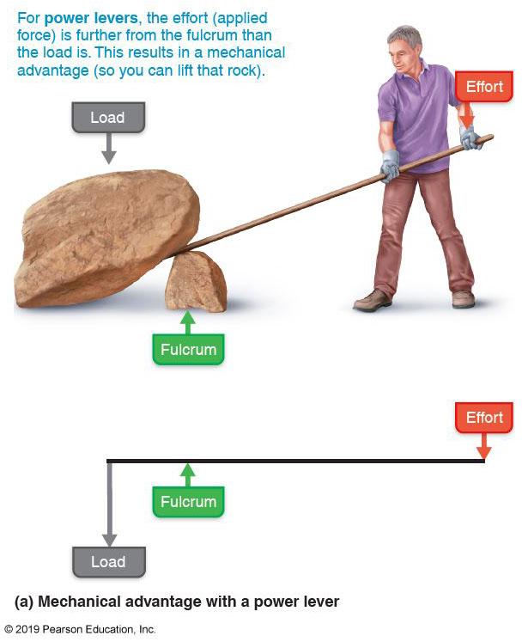
Lever Systems Operating at a Mechanical Advantage and a Mechanical Disadvantage (1 of 2)
Figure 10.2a Lever systems operating at a mechanical advantage and a
mechanical disadvantage.

Slide 32
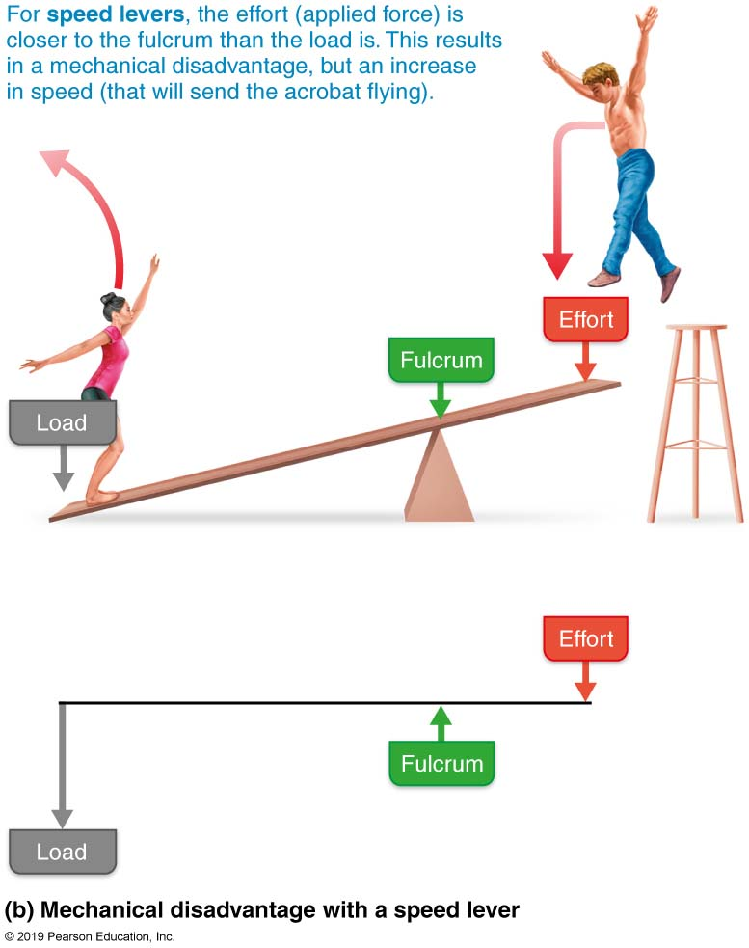
Lever Systems Operating at a Mechanical Advantage and a Mechanical Disadvantage (2 of 2)
Figure 10.2b (continued) Lever systems operating at a mechanical advantage and a mechanical disadvantage.

Slide 33
Classes of Lever Systems (1 of 4)
Three classes of levers are based on relative position of effort, fulcrum, load
First-class lever
Fulcrum is between load and effort
Example: seesaw, scissors

Slide 34
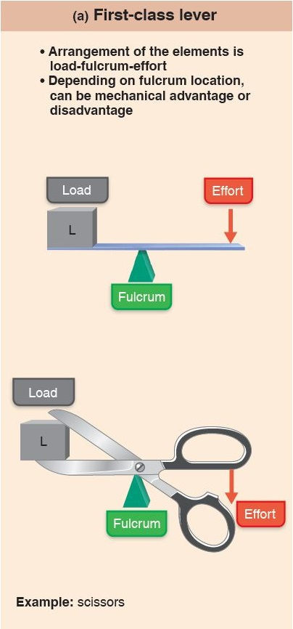
Lever Systems (1 of 6)
Figure 10.3a Lever systems.

Slide 35
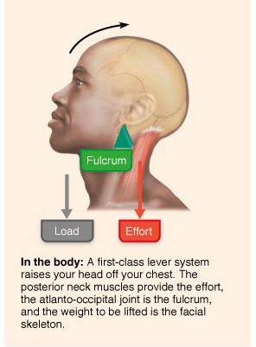
Lever Systems (2 of 6)
Figure 10.3a Lever systems.

Slide 36
Classes of Lever Systems (2 of 4)
Second-class lever
Load is between fulcrum and effort
Example: wheelbarrow, standing on toes

Slide 37
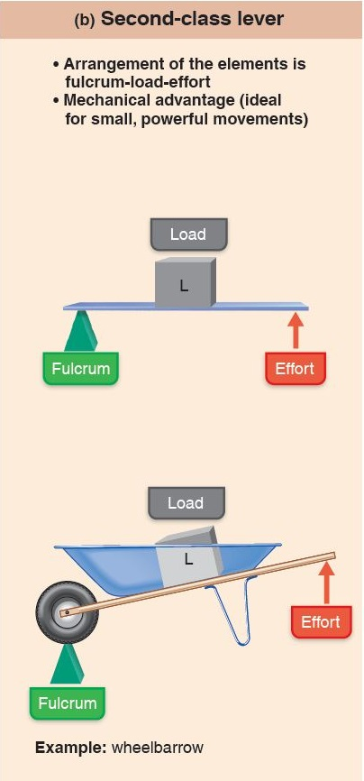
Lever Systems (3 of 6)
Figure 10.3b Lever systems.

Slide 38
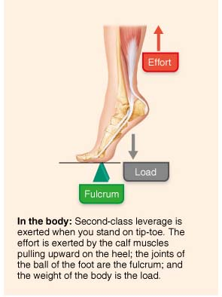
Lever Systems (4 of 6)
Figure 10.3b Lever systems.

Slide 39
Classes of Lever Systems (3 of 4)
Third-class lever
Effort is applied between fulcrum and load
Example: tweezers, forceps, most skeletal muscles

Slide 40
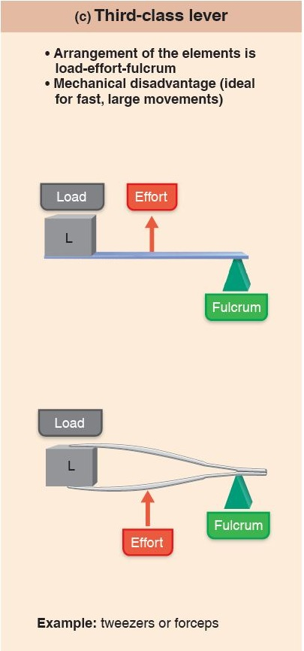
Lever Systems (5 of 6)
Figure 10.3c Lever systems.

Slide 41
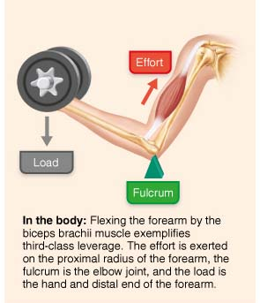
Lever Systems (6 of 6)
Figure 10.3c Lever systems.

Slide 42
Classes of Lever Systems (4 of 4)
Summary of lever systems:
In mechanical disadvantage (speed levers) force is lost, but speed and range of movement are gained
Systems operating under mechanical advantage (power levers) are slower, but more stable
Used where strength is a priority

Slide 43
10.5 Major Skeletal Muscles of the Body (1 of 2)
> 600 muscles; grouped by function and location
Muscle tables include following information:
Description, which includes location relative to other muscles
Origin and insertion: usually a joint between origin and insertion
Actions: movement that contraction causes
Innervation: name of major nerve that supplies muscle

Slide 44
10.5 Major Skeletal Muscles of the Body (2 of 2)
Tips for learning muscles:
Be aware of information learned from the muscle’s name
Read description in table, and identify muscle on figure
Helps to relate location and description
Relate muscle’s location and attachments to its actions
Act out movements on yourself
Feel for muscles contracting beneath skin

Slide 45
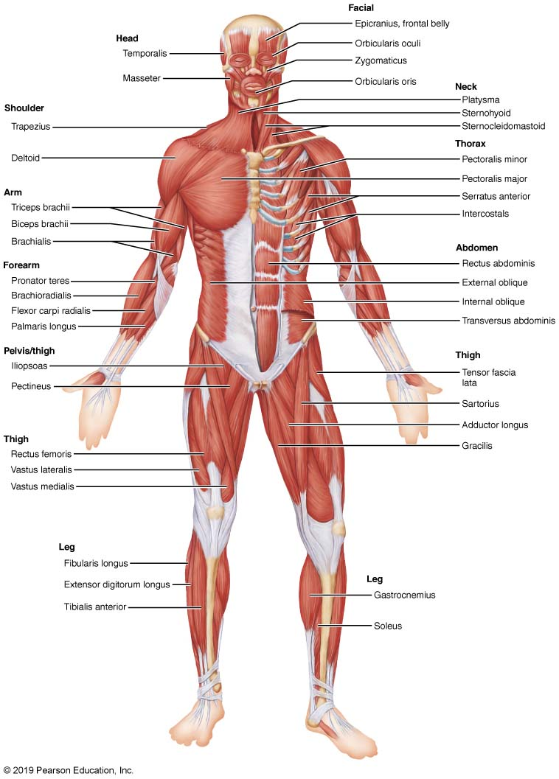
Superficial Muscles of the Body: Anterior View
Figure 10.4 Superficial muscles of the body: Anterior view.

Slide 46
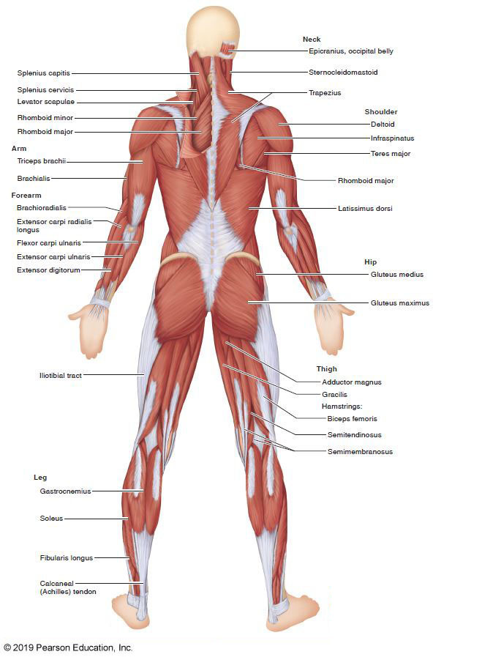
Superficial Muscles of the Body: Posterior View
Figure 10.5 Superficial muscles of the body: Posterior view.

Slide 47
Table 10.1: Muscles of the Head, Part 1: Facial Expression
Facial expression muscles are different because they insert into skin, not bone
Important in nonverbal communication
All innervated by cranial nerve VII (facial nerve)
Facial expression muscles consist of two groups:
Muscles of the scalp
Muscles of the face

Slide 48
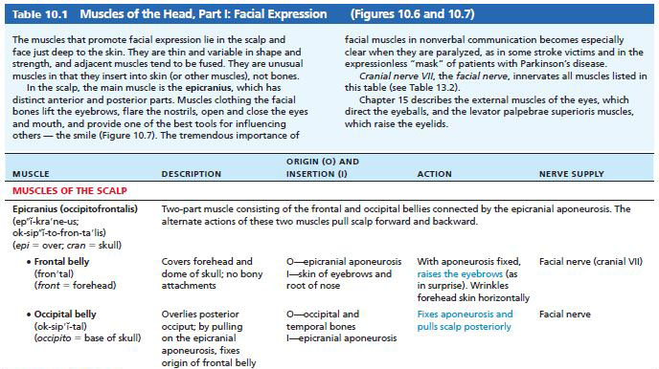
Table 10.1-1 Muscles of the Head, Part I: Facial Expression
Table 10.1-1 Muscles of the Head, Part I: Facial Expression

Slide 49
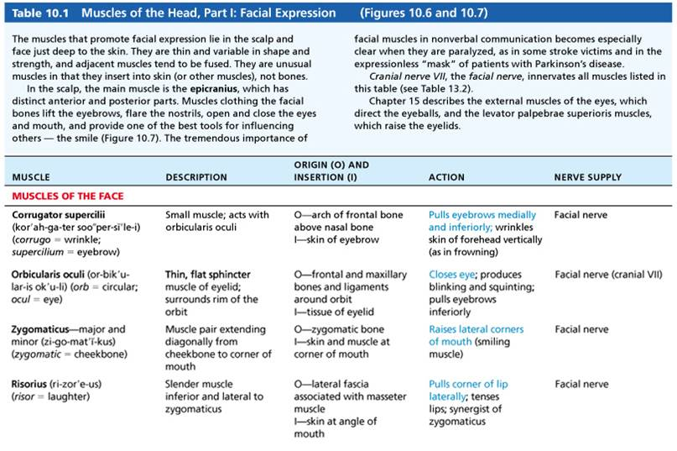
Table 10.1-2 Muscles of the Head, Part I: Facial Expression
Table 10.1-2 Muscles of the Head, Part I: Facial Expression (continued)

Slide 50
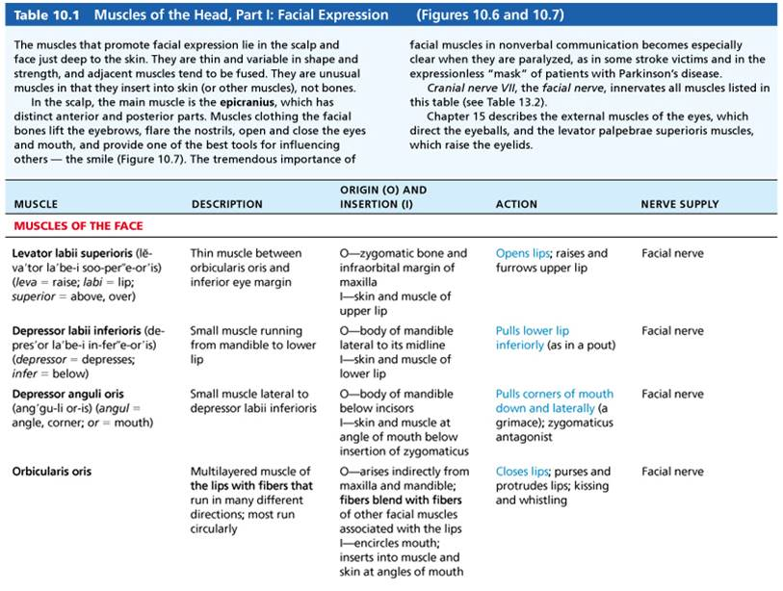
Table 10.1-3 Muscles of the Head, Part I: Facial Expression
Table 10.1-3 Muscles of the Head, Part I: Facial Expression (continued)

Slide 51
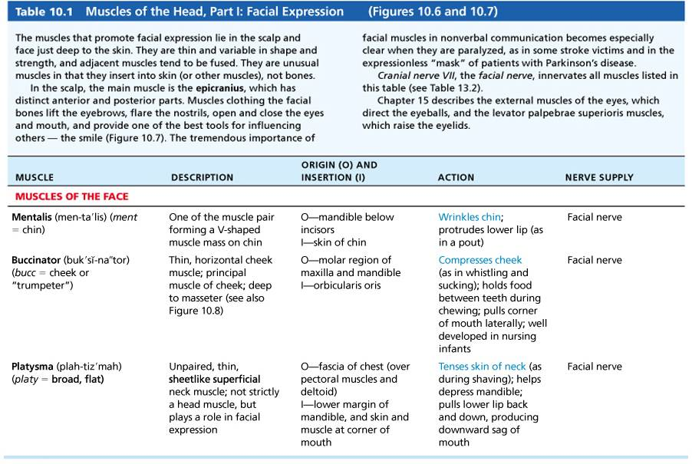
Table 10.1-4 Muscles of the Head, Part I: Facial Expression
Table 10.1-4 Muscles of the Head, Part I: Facial Expression (continued)

Slide 52
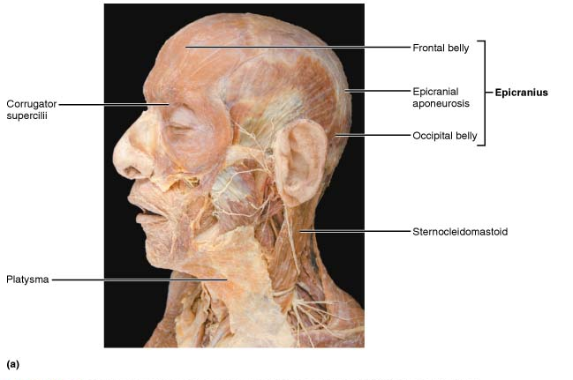
Lateral View of Muscles of the Scalp, Face, and Neck (1 of 2)
Figure 10.6a Lateral view of muscles of the scalp, face, and neck. (a) Cadaver dissection.

Slide 53
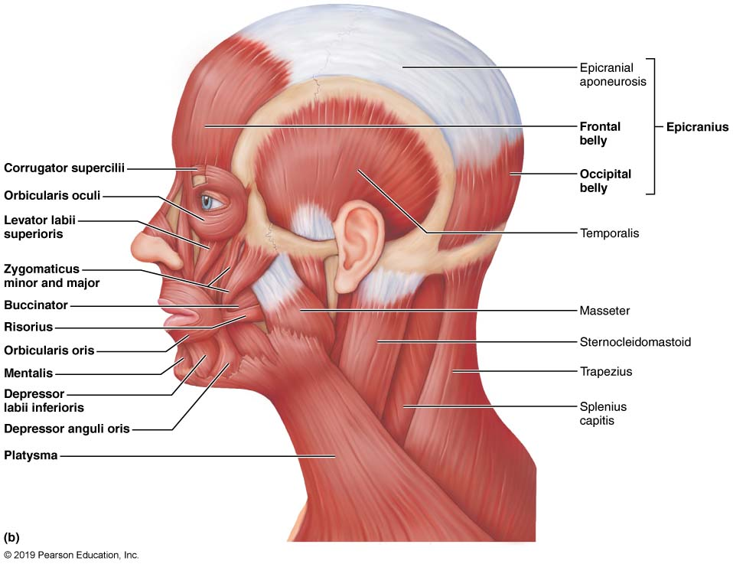
Lateral View of Muscles of the Scalp, Face, and Neck (2 of 2)
Figure 10.6b (continued) Lateral view of muscles of the scalp, face, and neck.

Slide 54
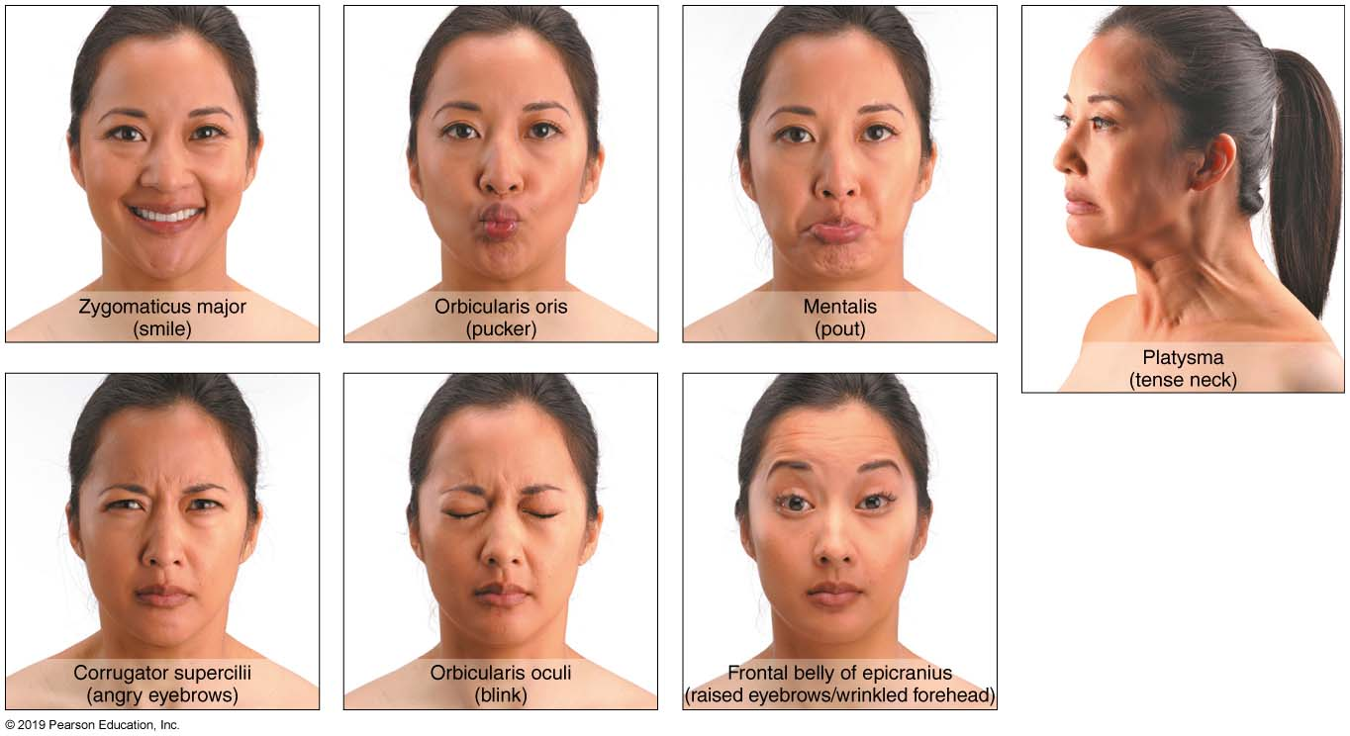
Muscles Used in Facial Expressions
Figure 10.7 Muscles used in facial expressions.

Slide 55
Table 10.2: Muscles of the Head, Part 2: Mastication and Tongue Movement
Muscles of mastication
Four pairs all innervated by cranial nerve V
Prime movers of jaw closure: temporalis and masseter
Grinding movements: pterygoids
Chewing role: buccinator
Muscles promoting tongue movements
Three extrinsic muscles anchor and move tongue
Genioglossus, hyoglossus, styloglossus

Slide 56
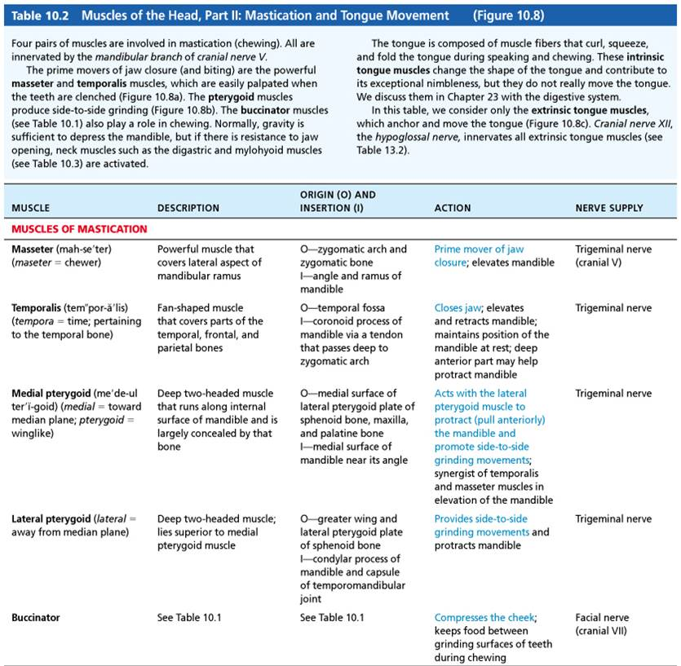
Table 10.2-1 Muscles of the Head, Part II: Mastication and Tongue Movement
Table 10.2-1 Muscles of the Head, Part II: Mastication and Tongue Movement

Slide 57
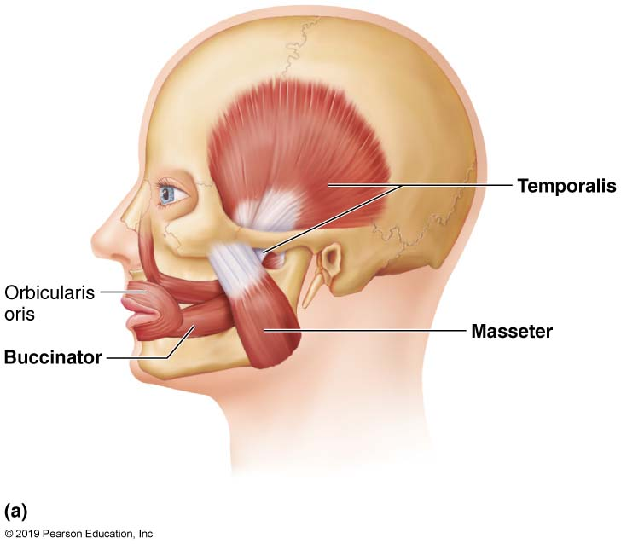
Muscles Promoting Mastication and Tongue Movements (1 of 3)
Figure 10.8a Muscles of mastication and tongue movement.

Slide 58
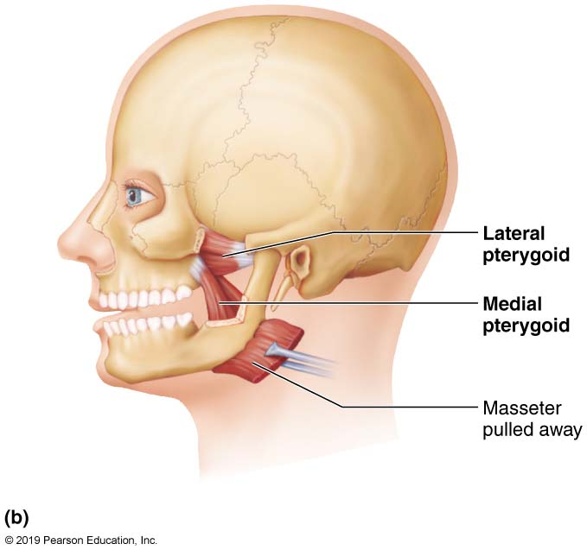
Muscles Promoting Mastication and Tongue Movements (2 of 3)
Figure 10.8b Muscles of mastication and tongue movement.

Slide 59
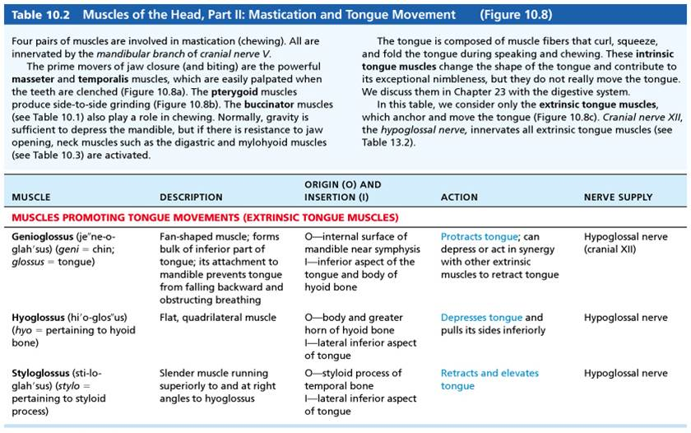
Table 10.2-2 Muscles of the Head, Part II: Mastication and Tongue Movement
Table 10.2-2 Muscles of the Head, Part II: Mastication and Tongue Movement (continued)

Slide 60
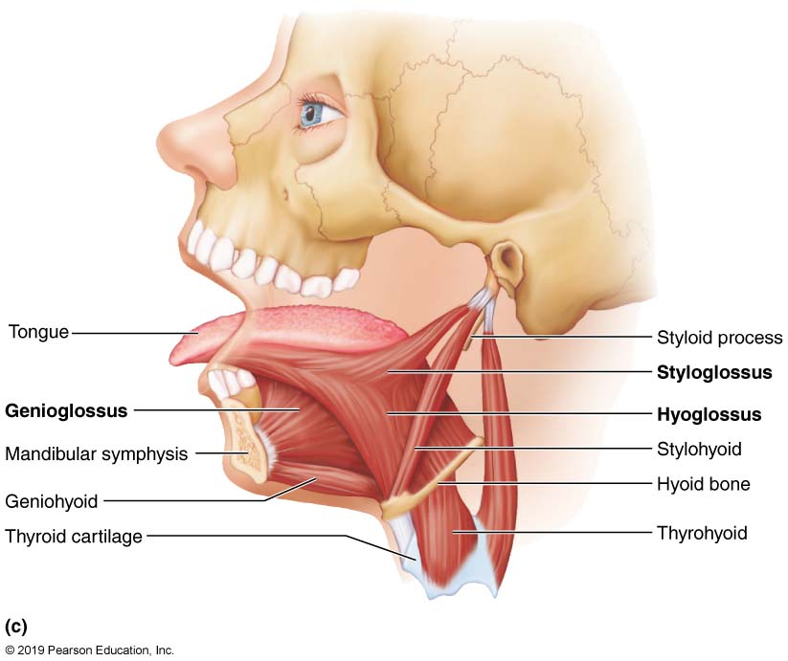
Muscles Promoting Mastication and Tongue Movements (3 of 3)
Figure 10.8c Muscles of mastication and tongue movement.

Slide 61
A&P Flix: Temporalis
Click here to view ADA compliant video:
A&P Flix: Temporalis
https://mediaplayer.pearsoncmg.com/assets/apf-temporalis

Slide 62
A&P Flix: Masseter
Click here to view ADA compliant video:
A&P Flix: Masseter
https://mediaplayer.pearsoncmg.com/assets/apf-masseter

Slide 63
A&P Flix: Buccinator
Click here to view ADA compliant video:
A&P Flix: Buccinator
https://mediaplayer.pearsoncmg.com/assets/apf-buccinator

Slide 64
Table 10.3: Muscles of the Anterior Neck and Throat: Swallowing (1 of 3)
Sternocleidomastoid muscle divides neck into two triangles (anterior and posterior)
Anterior muscles are divided based on location to the hyoid bone: suprahyoid and infrahyoid
Tongue and buccinator muscles push food back towards pharynx, where muscles in posterior mouth and pharynx complete swallowing process
Epiglottis closes over larynx while muscles in walls of pharynx propel food forward to stomach

Slide 65
Table 10.3: Muscles of the Anterior Neck and Throat: Swallowing (2 of 3)
Suprahyoid muscles
Four deep muscles involved in swallowing (move hyoid bone and larynx)
Form floor of oral cavity
Anchor tongue
Elevate hyoid bone
Move larynx during swallowing

Slide 66
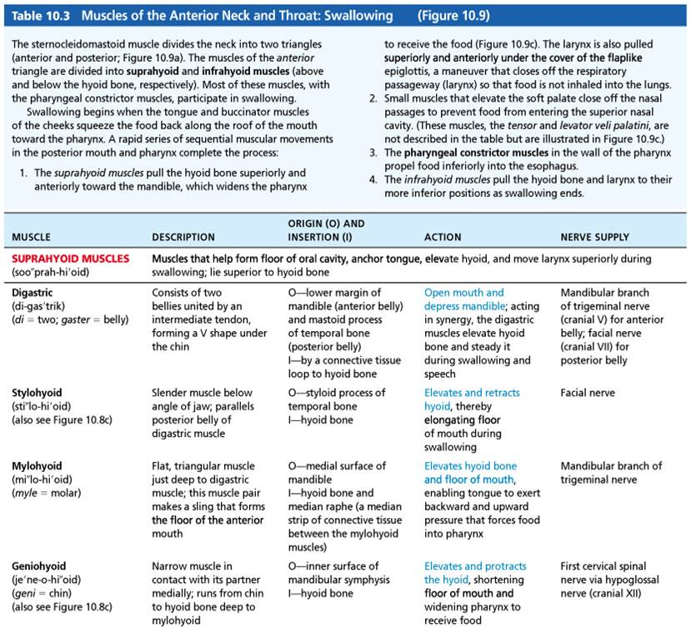
Table 10.3-1 Muscles of the Anterior Neck and Throat: Swallowing
Table 10.3-1 Muscles of the Anterior Neck and Throat: Swallowing

Slide 67
Table 10.3: Muscles of the Anterior Neck and Throat: Swallowing (3 of 3)
Infrahyoid muscles
Four straplike muscles
Depress hyoid bone and larynx during swallowing and speaking

Slide 68
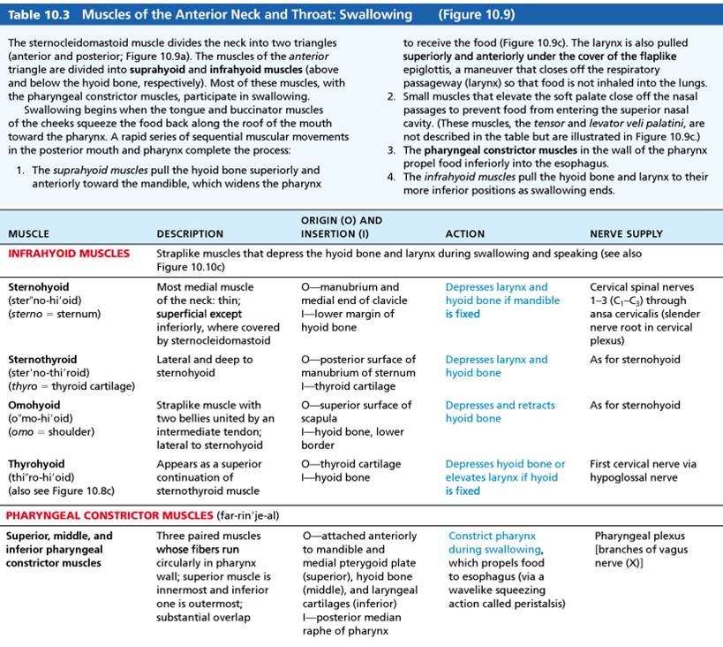
Table 10.3-2 Muscles of the Anterior Neck and Throat: Swallowing
Table 10.3-2 Muscles of the Anterior Neck and Throat: Swallowing (continued)

Slide 69
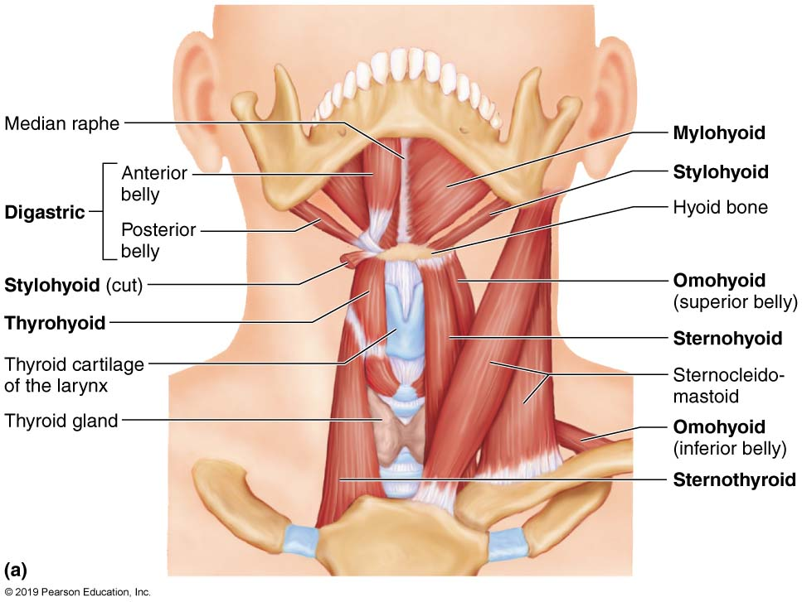
Muscles of the Anterior Neck and Throat Used in Swallowing (1 of 3)
Figure 10.9a Muscles of the anterior neck and throat used in swallowing.

Slide 70
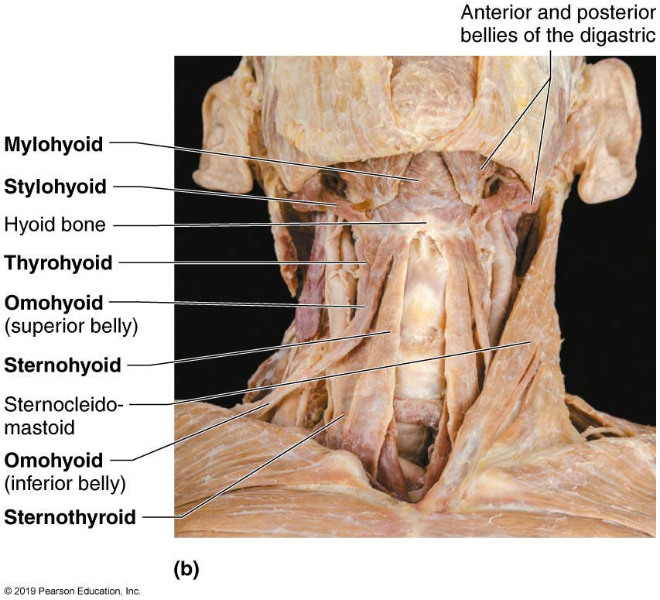
Muscles of the Anterior Neck and Throat Used in Swallowing (2 of 3)
Figure 10.9b Muscles of the anterior neck and throat used in swallowing.

Slide 71
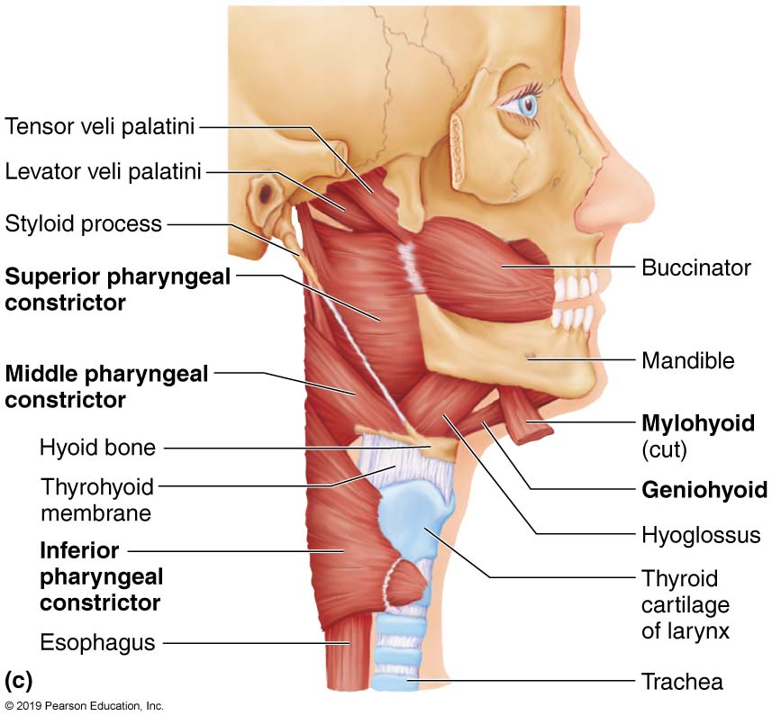
Muscles of the Anterior Neck and Throat Used in Swallowing (3 of 3)
Figure 10.9c Muscles of the anterior neck and throat used in swallowing.

Slide 72
Animation: Rotating Model: Head
Click here to view ADA compliant Animation:
Rotating Model: Head
https://mediaplayer.pearsoncmg.com/assets/rotating-model-head

Slide 73
Animation: Rotating Model: Face
Click here to view ADA compliant Animation:
Rotating Model: Face
https://mediaplayer.pearsoncmg.com/assets/rotating-model-face

Slide 74
Table 10.4: Muscles of the Neck and Vertebral Column: Head Movements and Trunk Extension
Two functional groups
Anterolateral neck muscles: move head
Intrinsic muscles of the back: extend trunk and maintain posture

Slide 75
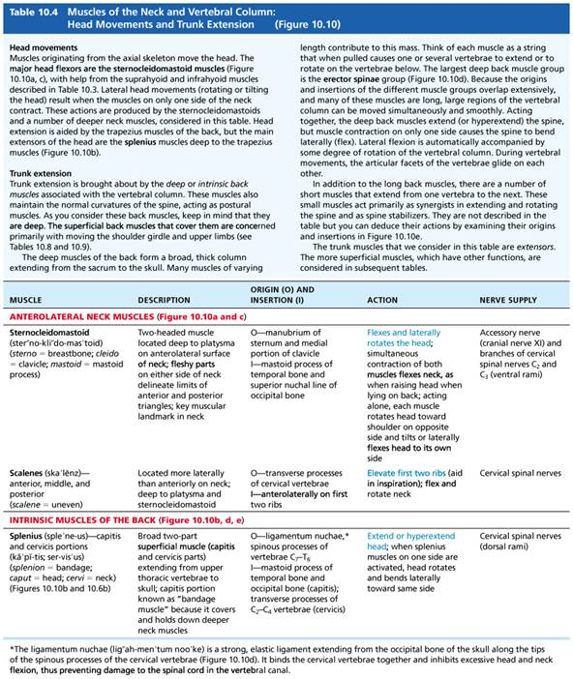
Table 10.4-1 Muscles of the Neck and Vertebral Column: Head Movements and Trunk Extension (1 of 2)
Table 10.4-1 Muscles of the Neck and Vertebral Column: Head Movements and Trunk Extension

Slide 76
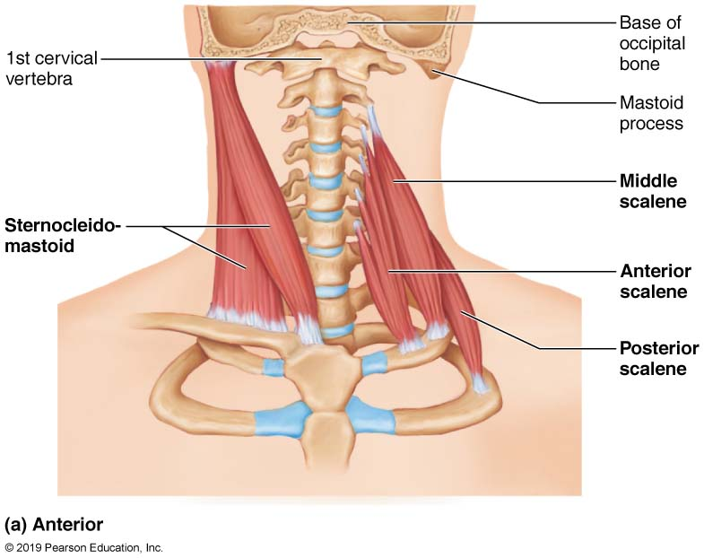
Muscles of the Neck and Vertebral Column That Move the Head and Trunk (1 of 5)
Figure 10.10a Muscles of the neck and vertebral column that move the head and trunk.

Slide 77
Table 10.4-1 Muscles of the Neck and Vertebral Column: Head Movements and Trunk Extension (2 of 2)
Table 10.4-1 Muscles of the Neck and Vertebral Column: Head Movements and Trunk Extension

Slide 78
A&P Flix: Splenius Capitas
Click here to view ADA compliant video:
A&P Flix: Splenius Capitas
https://mediaplayer.pearsoncmg.com/assets/apf-splenius-capitis

Slide 79
A&P Flix: Semispinalis Capitis
Click here to view ADA compliant video:
A&P Flix: Semispinalis Capitis
https://mediaplayer.pearsoncmg.com/assets/apf-semispinalis-capitis

Slide 80
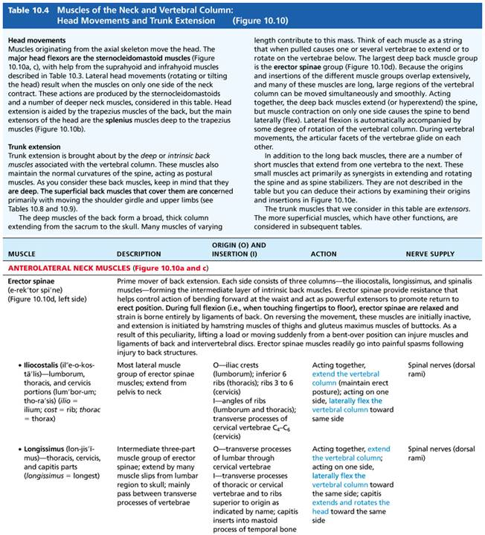
Table 10.4-2 Muscles of the Neck and Vertebral Column: Head Movements and Trunk Extension
Table 10.4-2 Muscles of the Neck and Vertebral Column: Head Movements and Trunk Extension (continued)

Slide 81
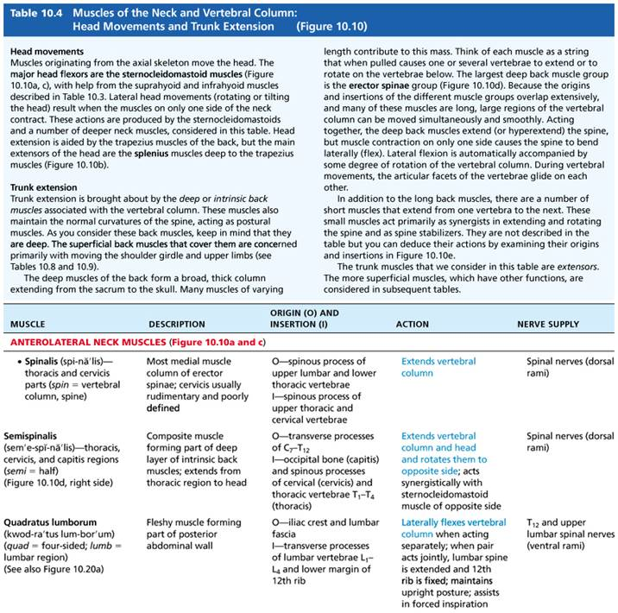
Table 10.4-3 Muscles of the Neck and Vertebral Column: Head Movements and Trunk Extension (1 of 2)
Table 10.4-3 Muscles of the Neck and Vertebral Column: Head Movements and Trunk Extension (continued)

Slide 82
A&P Flix: Iliocostalis
Click here to view ADA compliant video:
A&P Flix: Iliocostalis
https://mediaplayer.pearsoncmg.com/assets/apf-iliocostalis

Slide 83
A&P Flix: Longissimus
Click here to view ADA compliant video:
A&P Flix: Longissimus
https://mediaplayer.pearsoncmg.com/assets/apf-longissimus

Slide 84
A&P Flix: Spinalis
Click here to view ADA compliant video:
A&P Flix: Spinalis
https://mediaplayer.pearsoncmg.com/assets/apf-spinalis

Slide 85
Table 10.4-3 Muscles of the Neck and Vertebral Column: Head Movements and Trunk Extension (2 of 2)
Table 10.4-3 Muscles of the Neck and Vertebral Column: Head Movements and Trunk Extension (continued)

Slide 86
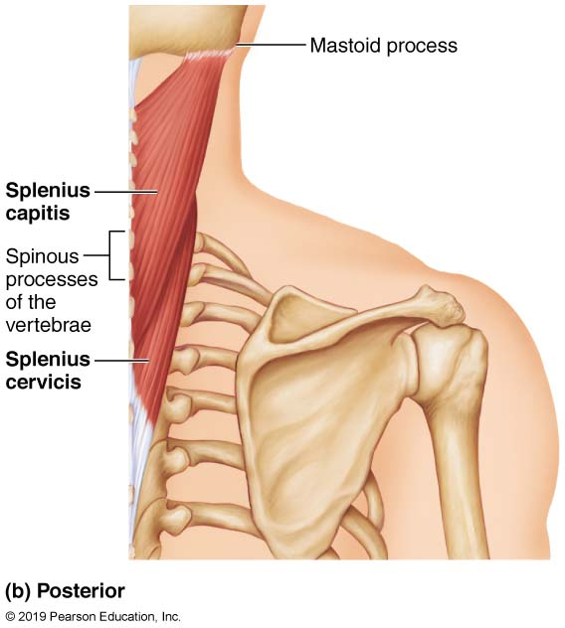
Muscles of the Neck and Vertebral Column That Move the Head and Trunk (2 of 5)
Figure 10.10b Muscles of the neck and vertebral column that move the head and trunk.

Slide 87
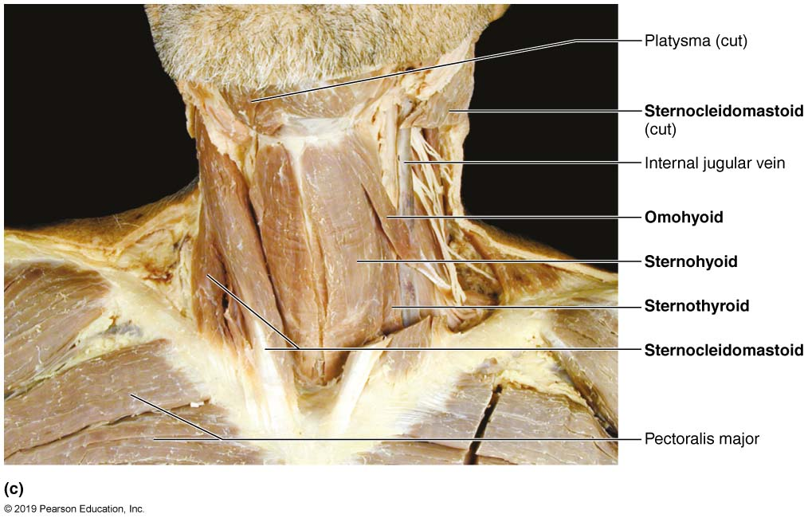
Muscles of the Neck and Vertebral Column That Move the Head and Trunk (3 of 5)
Figure 10.10c Muscles of the neck and vertebral column that move the head and trunk.

Slide 88
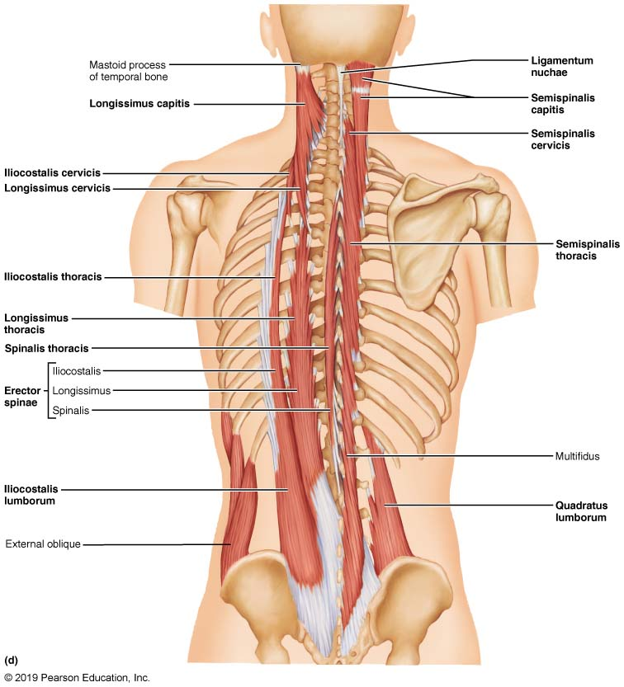
Muscles of the Neck and Vertebral Column That Move the Head and Trunk (4 of 5)
Figure 10.10d Muscles of the neck and vertebral column that move the head and trunk.

Slide 89
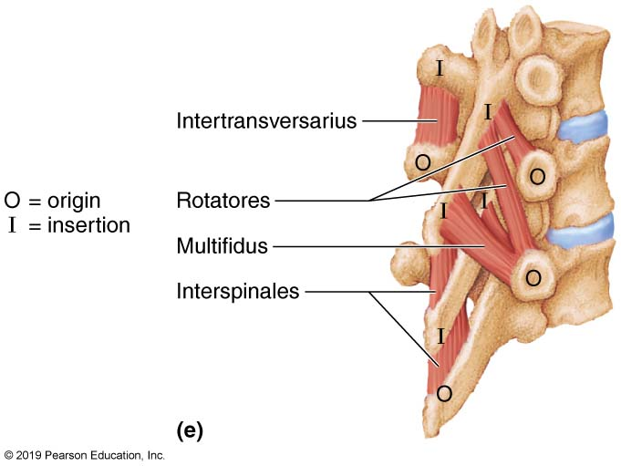
Muscles of the Neck and Vertebral Column That Move the Head and Trunk (5 of 5)
Figure 10.10e Muscles of the neck and vertebral column that move the head and trunk.

Slide 90
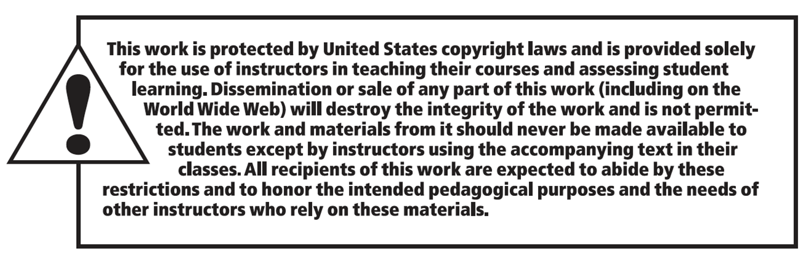
Copyright

