Slide 1
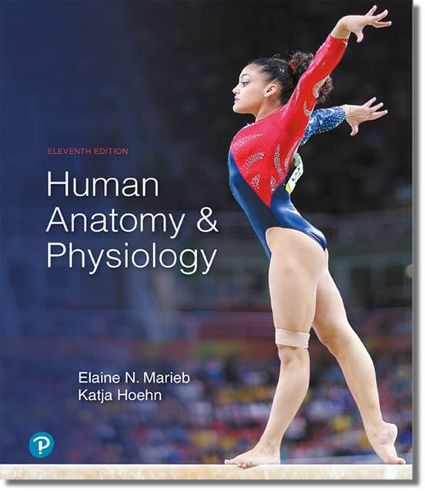
Human Anatomy and Physiology
Eleventh Edition
Chapter 22 Part A
The Respiratory System
PowerPoint® Lectures Slides prepared by Karen Dunbar Kareiva, Ivy Tech Community College
Copyright © 2019, 2016, 2013 Pearson Education, Inc. All Rights Reserved

Slide 2
Why This Matters
Understanding the anatomy and function of the respiratory system will help in assessing and treating patients with respiratory disorders.

Slide 3
Video: Why This Matters (Career Connection)
Click here to view ADA compliant video:
Why This Matters (Career Connection)
https://mediaplayer.pearsoncmg.com/assets/tOq_LE3XA6ceODwP0YGNxRJWOhzcXKhS

Slide 4
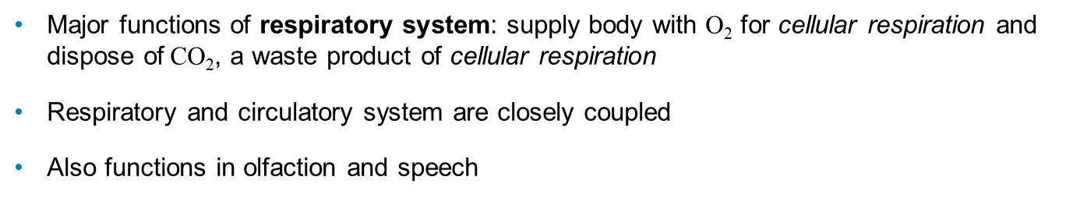
Respiratory System (1 of 3)
Major functions of respiratory system: supply body with O₂ for cellular respiration and dispose of CO₂, a waste product of cellular respiration
Respiratory and circulatory system are closely coupled
Also functions in olfaction and speech

Slide 5
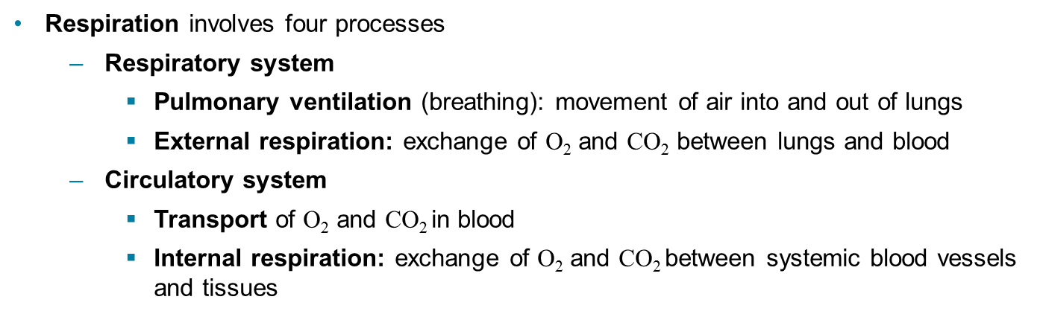
Respiratory System (2 of 3)
Respiration involves four processes
  Respiratory system
    Pulmonary ventilation (breathing): movement of air into and out of lungs
    External respiration: exchange of O₂ and CO₂ between lungs and blood
  Circulatory system
    Transport of O₂ and CO₂ in blood
    Internal respiration: exchange of O₂ and CO₂ between systemic blood vessels and tissues

Slide 6
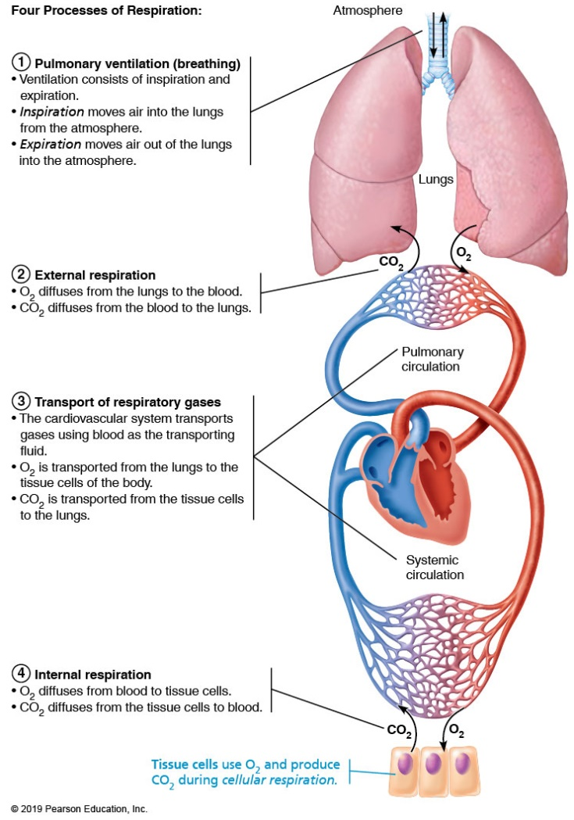
Respiratory System (3 of 3)
Figure 22.1 Respiration consists of four processes.

Slide 7
Part 1 Functional Anatomy
Major organs
  Upper respiratory
    Nose and nasal cavity
    Paranasal sinuses
    Pharynx
  Lower respiratory
    Larynx
    Trachea
    Bronchi and branches
    Lungs and alveoli

Slide 8
Animation: Rotating Face
Click here to view ADA compliant Animation:
Rotating Face
https://mediaplayer.pearsoncmg.com/assets/rotating-model-face

Slide 9
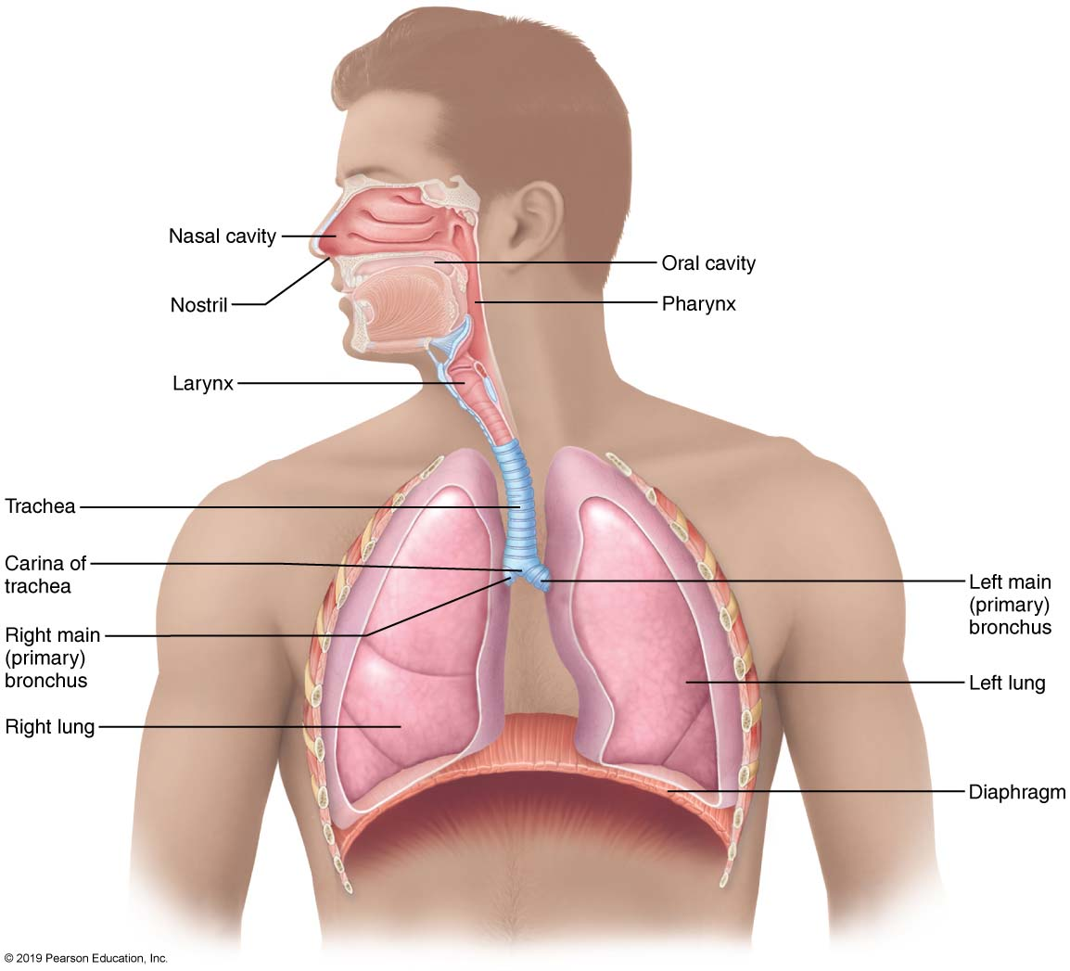
The Major Respiratory Organs in Relation to Surrounding Structures
Figure 22.2 The major respiratory organs in relation to surrounding structures.

Slide 10
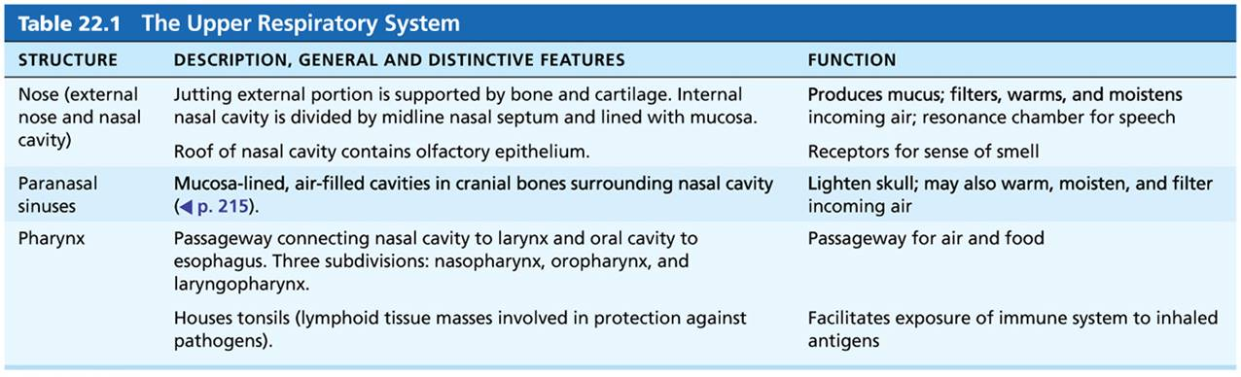
Table 22.1 The Upper Respiratory System
Table 22.1 The Upper Respiratory System

Slide 11
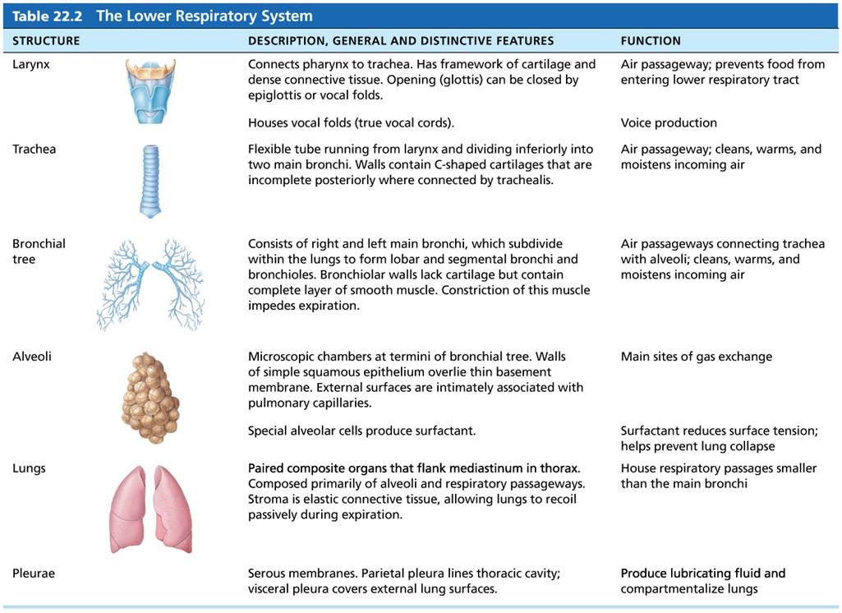
Table 22.2 The Lower Respiratory System
Table 22.2 The Lower Respiratory System

Slide 12
22.1 Upper Respiratory System

Slide 13
The Nose and Paranasal Sinuses (1 of 8)
Nose is only external portion of respiratory system
Functions of nose
  Provides an airway for respiration
  Moistens and warms entering air
  Filters and cleans inspired air
  Serves as resonating chamber for speech
  Houses olfactory receptors
Divided into two regions: external nose and nasal cavity

Slide 14
The Nose and Paranasal Sinuses (2 of 8)
External nose
  Areas include: root (area between eyebrows); bridge, dorsum nasi (anterior margin), and apex (tip of nose)
  Nostrils (nares): bounded laterally by alae
  External nose is formed by:
    Nasal and frontal bones superiorly—form bridge and root, respectively
    Maxillary bones laterally
    Plates of hyaline cartilage inferiorly

Slide 15
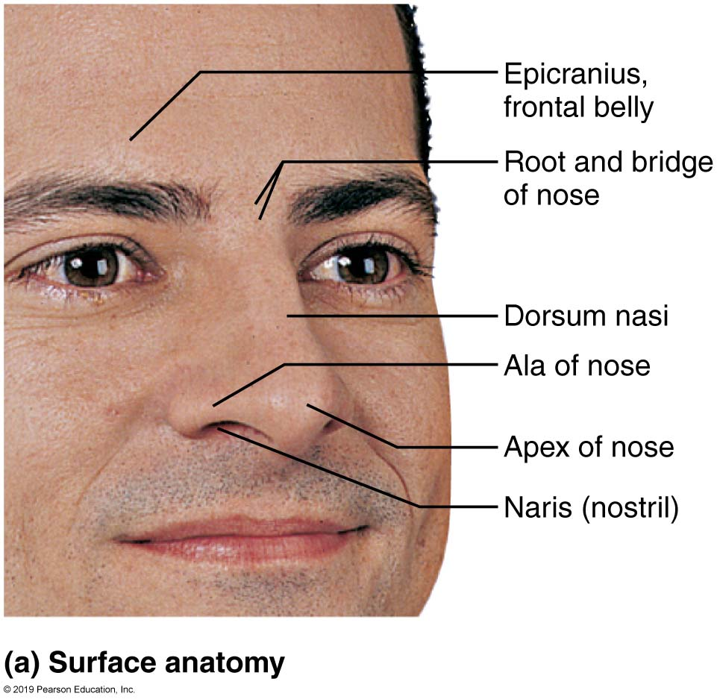
The External Nose (1 of 2)
Figure 22.3a The external nose.

Slide 16
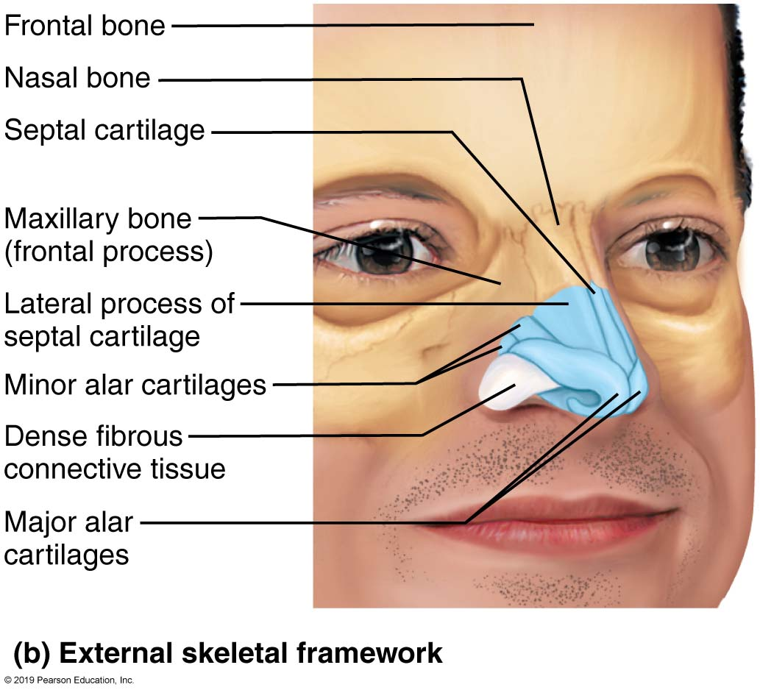
The External Nose (2 of 2)
Figure 22.3b The external nose.

Slide 17
The Nose and Paranasal Sinuses (3 of 8)
Nasal cavity
  Found within and posterior to external nose
  Divided by midline nasal septum
    Septum formed anteriorly by septal cartilage, and posteriorly by vomer bone and perpendicular plate of ethmoid bone
  Posterior nasal apertures (choanae): opening where nasal cavity turns into nasopharynx
  Roof: formed by ethmoid and sphenoid bones
  Floor: formed by hard palate (bone) and soft palate (muscle)

Slide 18
The Nose and Paranasal Sinuses (4 of 8)
Nasal cavity (cont.)
  Nasal vestibule: nasal cavity superior to nostrils
    Lined with vibrissae (hairs) that filter coarse particles from inspired air
    Rest of nasal cavity lined with mucous membranes
      Olfactory mucosa: lines superior region of nasal cavity and contains olfactory epithelium
      Respiratory mucosa: pseudostratified ciliated columnar epithelium that contains goblet cells and rests on lamina propria that contains many seromucous nasal glands

Slide 19
The Nose and Paranasal Sinuses (5 of 8)
Nasal cavity (cont.)
      Seromucous nasal glands contain mucus-secreting mucous cells and serous cells
      Serous cells secrete watery fluid containing enzymes
    Mucus and serous secretions also contain lysozyme and defensins
    Ciliated cells sweep contaminated mucus posteriorly towards throat
    Inspired air is warmed by plexuses of capillaries and veins in nasal cavity
    Nasal mucosa contains many sensory nerve endings that can cause sneezing to force particles out of cavity

Slide 20
The Nose and Paranasal Sinuses (6 of 8)
  Nasal conchae
    Scroll-like, mucosa-covered projections that protrude medially from each lateral wall of nasal cavity
    Three sections: superior, middle, and inferior conchae
    Nasal meatus: groove inferior to each concha
    Shape of conchae help to:
      Increase mucosal area
      Enhance air turbulence

Slide 21
The Nose and Paranasal Sinuses (7 of 8)
  Nasal conchae (cont.)
    Functions of conchae
      During inhalation, conchae and nasal mucosa:
        Filter, heat, and moisten air
      During exhalation these structures:
        Reclaim heat and moisture

Slide 22
The Nose and Paranasal Sinuses (8 of 8)
Paranasal sinuses
  Paranasal sinuses form ring around nasal cavities
  Located in frontal, sphenoid, ethmoid, and maxillary bones
  Functions
    Lighten skull
    Secrete mucus
    Help to warm and moisten air

Slide 23
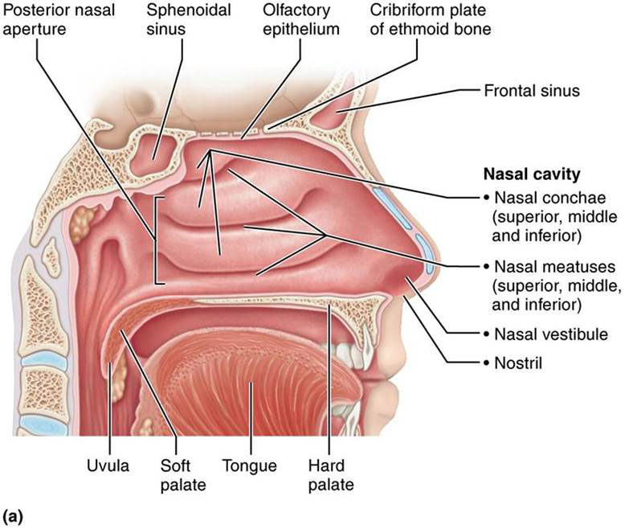
The Nasal Cavity (1 of 2)
Figure 22.4a The nasal cavity.

Slide 24
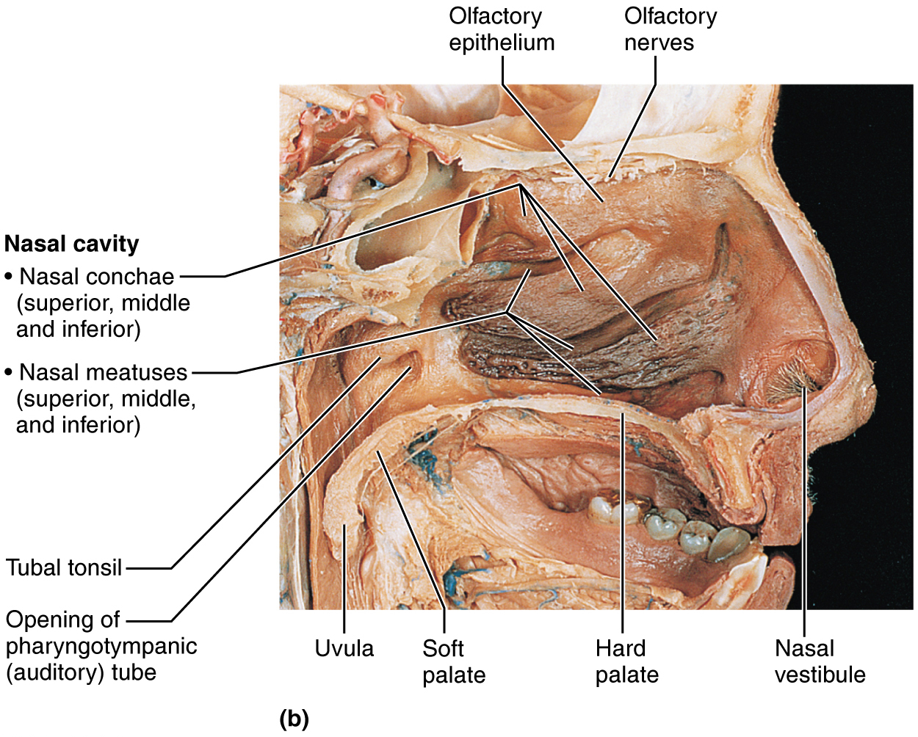
The Nasal Cavity (2 of 2)
Figure 22.4b The nasal cavity.

Slide 25
Clinical – Homeostatic Imbalance 22.1
Rhinitis
  Inflammation of nasal mucosa
  Nasal mucosa is continuous with mucosa of respiratory tract, so infections spread from nose to throat to chest
  Can also spread to tear ducts and paranasal sinuses, causing blockage of sinus passageways, resulting in sinusitis (inflamed sinuses)
    Can lead to absorption of air, producing a vacuum, resulting in sinus headache

Slide 26
The Pharynx (1 of 4)
Pharynx: funnel-shaped muscular tube that runs from base of skull to vertebra C₆
  Connects nasal cavity and mouth to larynx and esophagus
  Composed of skeletal muscle
Three regions
  Nasopharynx
  Oropharynx
  Laryngopharynx

Slide 27
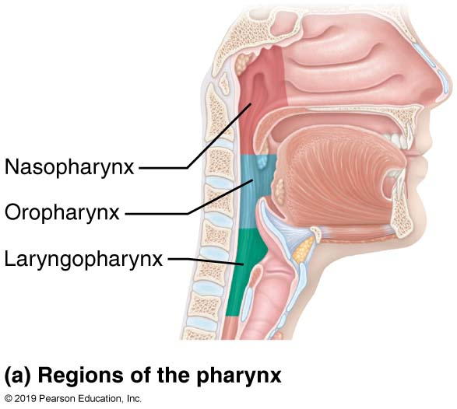
The Pharynx, Larynx, and Upper Trachea
(1 of 2)
Figure 22.5a The pharynx, larynx, and upper trachea.

Slide 28
The Pharynx (2 of 4)
Nasopharynx
  Air passageway posterior to nasal cavity
  Lining contains pseudostratified columnar epithelium
  Soft palate and uvula close nasopharynx during swallowing
  Pharyngeal tonsils (adenoids) located on posterior wall
  Pharyngotympanic tubes (auditory tubes) drain and equalize pressure in middle ear and open into lateral walls

Slide 29
The Pharynx (3 of 4)
Oropharynx
  Passageway for food and air from level of soft palate to epiglottis
  Lining consists of stratified squamous epithelium
  Isthmus of fauces: opening to oral cavity
  Palatine tonsils located in lateral walls of fauces
  Lingual tonsil located on posterior surface of tongue

Slide 30
The Pharynx (4 of 4)
Laryngopharynx
  Passageway for food and air
  Posterior to upright epiglottis
  Extends to larynx, where it is continuous with esophagus
  Lined with stratified squamous epithelium

Slide 31
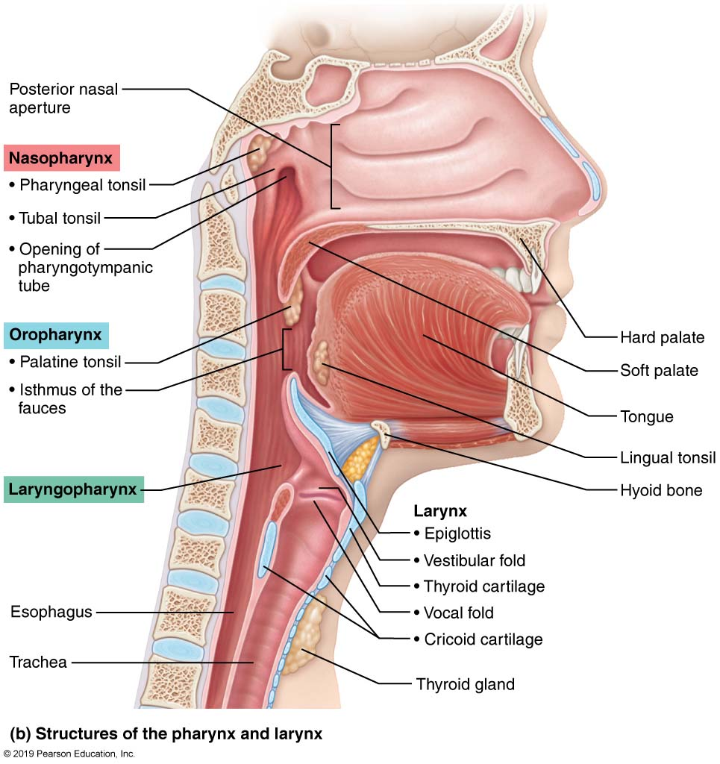
The Pharynx, Larynx, and Upper Trachea
(2 of 2)
Figure 22.5b The pharynx, larynx, and upper trachea.

Slide 32
Clinical – Homeostatic Imbalance 22.2
Infected and swollen adenoids can block air passage in nasopharynx, making it necessary to breathe through the mouth
As a result, air is not properly moistened, warmed, or filtered before reaching lungs
When adenoids are chronically enlarged, both speech and sleep may be disturbed

Slide 33
22.2 Lower Respiratory System
Lower respiratory system consists of:
  Larynx, trachea, bronchi, and lungs
Broken into two zones
  Respiratory zone: site of gas exchange
    Consists of microscopic structures such as respiratory bronchioles, alveolar ducts, and alveoli
  Conducting zone: conduits that tranport gas to and from gas exchange sites
    Includes all other respiratory structures
    Cleanses, warms, and humidifies air

Slide 34
The Larynx (2 of 13)
Basic anatomy
  Larynx (voice box) extends from 3rd to 6th cervical vertebra and attaches to hyoid bone
  Opens into laryngopharynx and is continuous with trachea
  Three functions of larynx:
    1. Provides patent airway
    2. Routes air and food into proper channels
    3. Voice production
      Houses vocal folds

Slide 35
The Larynx (3 of 13)
Framework of larynx consists of nine hyaline cartilages (except for epiglottis), connected by membranes and ligaments
  Thyroid cartilage: large, shield-shaped cartilage that resembles an upright open book; “spine” of book is the laryngeal prominence (Adam’s apple)
  1. Cricoid cartilage: ring-shaped
  2. & 4. Paired arytenoid cartilages
  5. & 6. Paired cuneiform cartilages
  7. & 8. Paired corniculate cartilages
  9. Epiglottis

Slide 36
The Larynx (4 of 13)
Epiglottis
  Consists of elastic cartilage (not hyaline)
  Covers laryngeal inlet during swallowing
  Covered in taste bud–containing mucosa

Slide 37
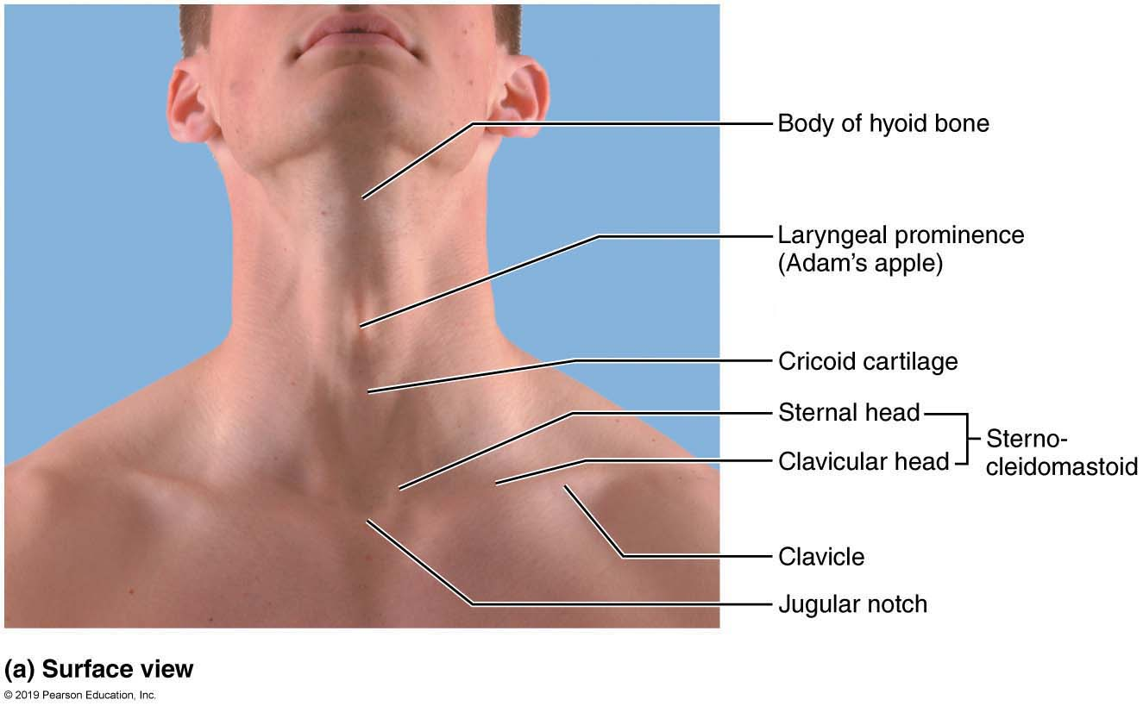
The Larynx (5 of 13)
Figure 22.6a The larynx.

Slide 38
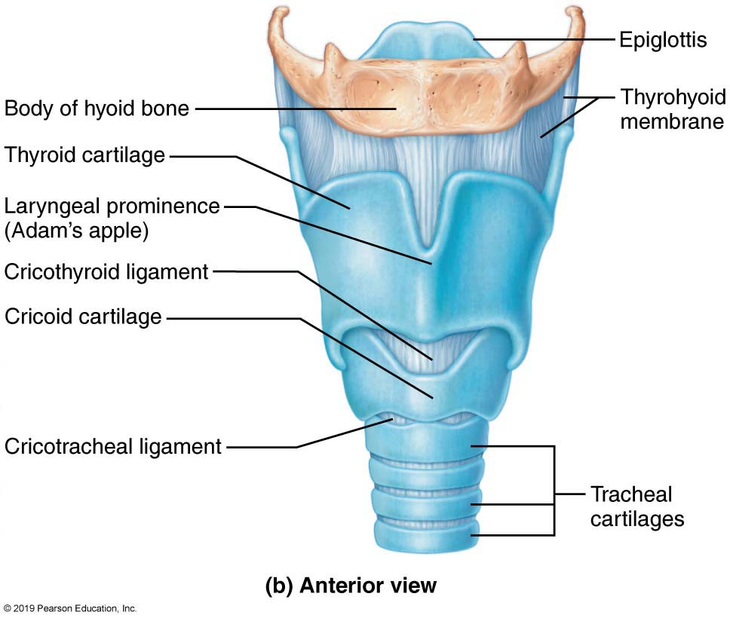
The Larynx (6 of 13)
Figure 22.6b The larynx.

Slide 39
The Larynx (7 of 13)
  Vocal folds
    Vocal ligaments: form core of vocal folds (true vocal cords)
    Ligaments lie deep to laryngeal mucosa and attach arytenoid cartilages to thyroid cartilage
    Contain elastic fibers that appear white because of lack of blood vessels
    Glottis: opening between vocal folds
    Folds vibrate to produce sound as air rushes up from lungs

Slide 40
The Larynx (8 of 13)
    Vestibular folds (false vocal cords)
      Superior to vocal folds
      No part in sound production
      Help to close glottis during swallowing

Slide 41
The Larynx (9 of 13)
  Epithelium of larynx
    Superior portion: stratified squamous epithelium
    Inferior to vocal fold: pseudostratified ciliated columnar epithelium

Slide 42
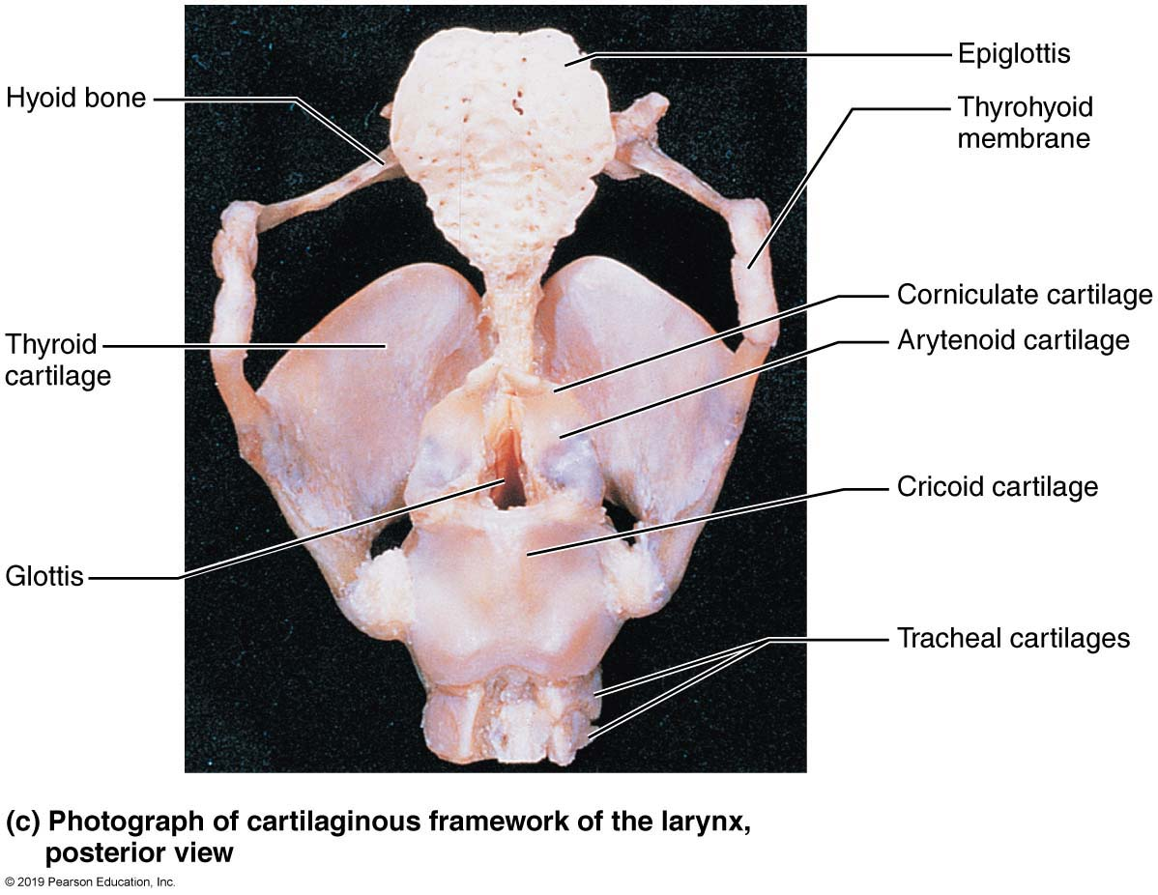
The Larynx (10 of 13)
Figure 22.6c The larynx.

Slide 43
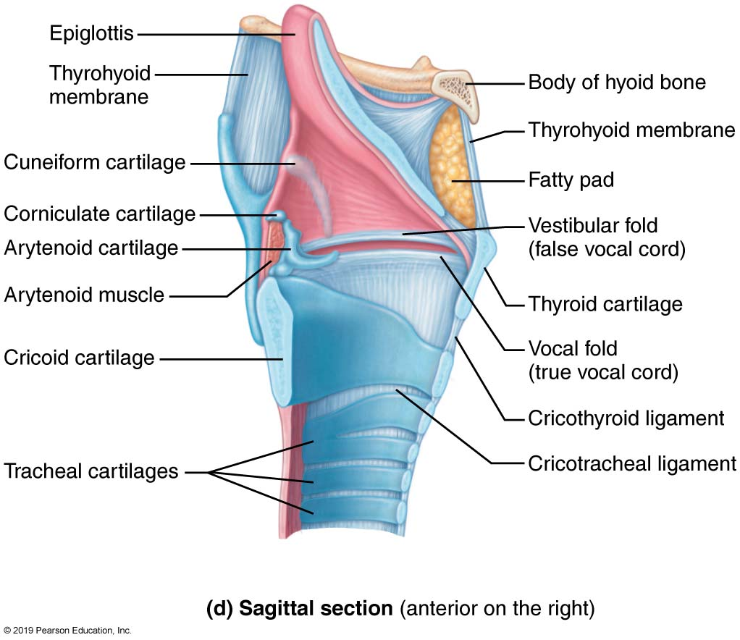
The Larynx (11 of 13)
Figure 22.6d The larynx.

Slide 44
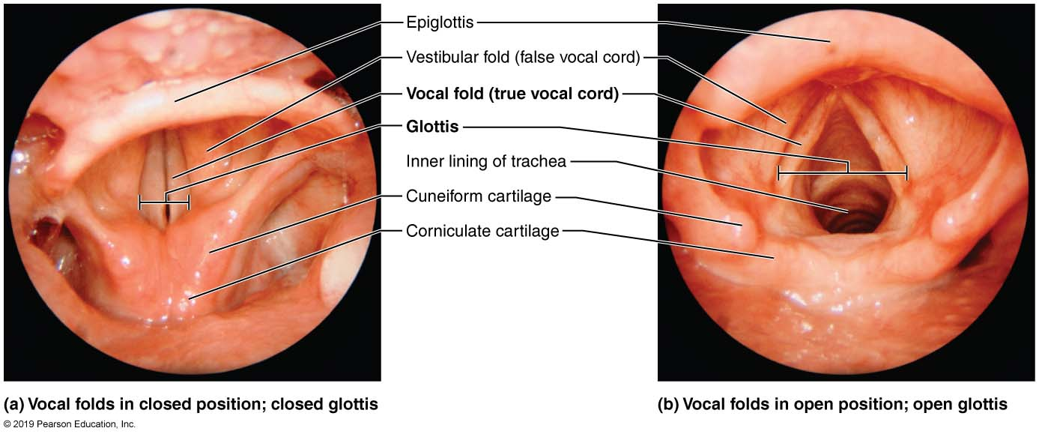
Movements of the Vocal Folds
Figure 22.7 Movements of the vocal folds.

Slide 45
The Larynx (12 of 13)
Voice production
  Speech: intermittent release of expired air during opening and closing of glottis
  Pitch is determined by length and tension of vocal cords
  Loudness depends upon force of air
  Chambers of pharynx and oral, nasal, and sinus cavities amplify and enhance sound quality
  Sound is “shaped” into language by muscles of pharynx, tongue, soft palate, and lips

Slide 46
The Larynx (13 of 13)
Sphincter functions of the larynx
  Vocal folds may act as sphincter to prevent air passage
  Example: Valsalva’s maneuver
    Glottis closes to prevent exhalation
    Abdominal muscles contract
    Intra-abdominal pressure rises
    Helps to empty rectum or stabilizes trunk during heavy lifting

Slide 47
Clinical – Homeostatic Imbalance 22.3
Laryngitis: inflammation of the vocal folds that causes the vocal folds to swell, interfering with vibrations
Results in changes to vocal tone, causing hoarseness; in severe cases, speaking is limited to a whisper
Laryngitis is most often caused by viral infections but may also be due to overuse of the voice, very dry air, bacterial infections, tumors on the vocal folds, or inhalation of irritating chemicals

Slide 48
The Trachea (1 of 3)
Trachea (windpipe) extends from larynx into mediastinum, where it divides into two main bronchi
  It is about 4 inches long, 3/4 inch in diameter, and very flexible

Slide 49
The Trachea (2 of 3)
Wall composed of three layers
  Mucosa: ciliated pseudostratified epithelium with goblet cells
  Submucosa: connective tissue with seromucous glands supported by 16–20 C-shaped cartilage rings that prevent collapse of trachea
  Adventitia: outermost layer made of connective tissue

Slide 50
The Trachea (3 of 3)
Trachealis
  Consists of smooth muscle fibers that connect posterior parts of cartilage rings
  Contracts during coughing to expel mucus
Carina
  Last tracheal cartilage that is expanded and found at point where trachea branches into two main bronchi
  Mucosa of carina highly sensitive
    Violent coughing will be triggered if any foreign object makes contact with it

Slide 51
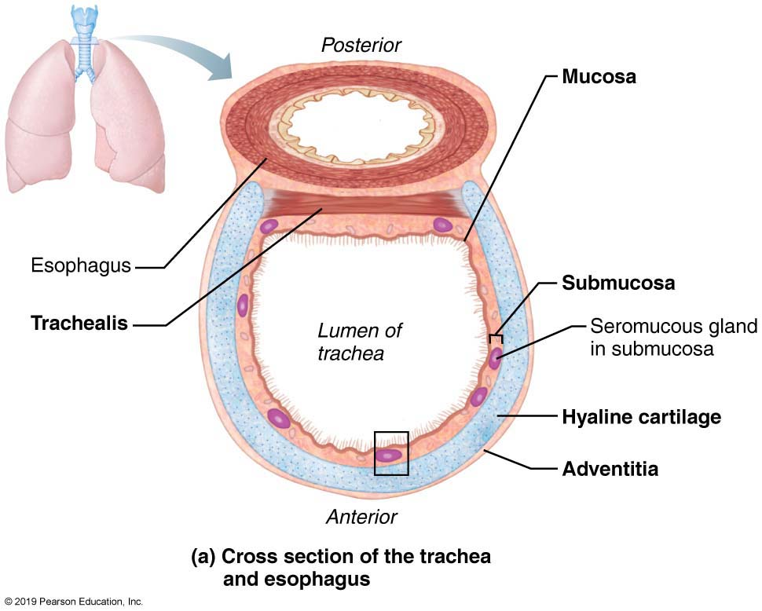
Tissue Composition of the Tracheal Wall
(1 of 3)
Figure 22.8a Tissue composition of the tracheal wall.

Slide 52
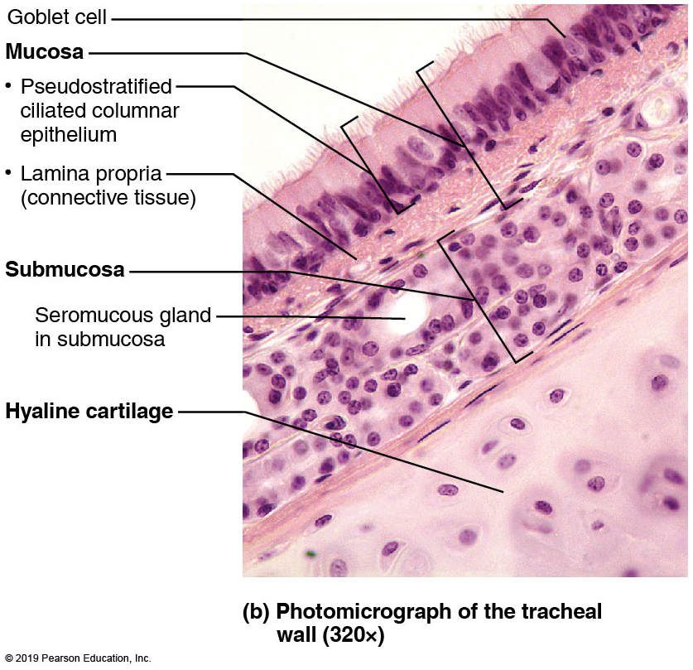
Tissue Composition of the Tracheal Wall
(2 of 3)
Figure 22.8b Tissue composition of the tracheal wall.

Slide 53
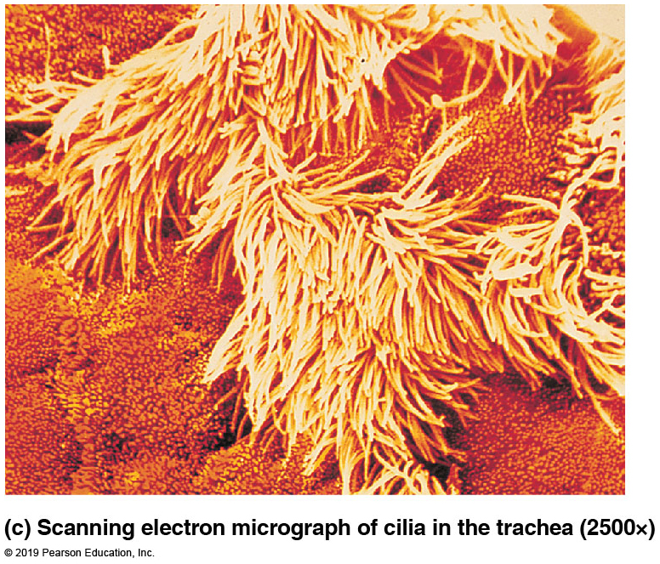
Tissue Composition of the Tracheal Wall
(3 of 3)
Figure 22.8c Tissue composition of the tracheal wall.

Slide 54
Clinical – Homeostatic Imbalance 22.4
Smoking inhibits and ultimately destroys cilia
Without ciliary activity, coughing is only way to prevent mucus from accumulating in lungs
When person stops smoking, ciliary function usually recovers within a few weeks
  Morning “smoker’s cough” will subside once ciliary function is restored

Slide 55
Clinical – Homeostatic Imbalance 22.5
Tracheal obstruction is life threatening: many people have suffocated after choking on a piece of food that suddenly closed off their trachea
Heimlich maneuver: procedure in which air in victim’s lungs is used to “pop out,” or expel, an obstructing piece of food
Maneuver is simple to learn and easy to do but is best learned by demonstration; when done incorrectly, may lead to cracked ribs

Slide 56
The Bronchi and Subdivisions (1 of 7)
Air passages undergo 23 orders of branching
  Branching referred to as bronchial tree
From tips of bronchial tree:
  Conducting zone structures give rise to respiratory zone structures

Slide 57
The Bronchi and Subdivisions (2 of 7)
Conducting zone structures
  Trachea divides to form right and left main (primary) bronchi
    Right main bronchus wider, shorter, more vertical than left
  Each main bronchus enters hilum of one lung
  Each main bronchus then branches into lobar (secondary) bronchi
    Three on right and two on left
    Each lobar bronchus supplies one lobe

Slide 58
The Bronchi and Subdivisions (3 of 7)
Conducting zone structures (cont.)
  Each lobar bronchus branches into segmental (tertiary) bronchi
    Segmental bronchi divide repeatedly
  Branches become smaller and smaller
    Bronchioles: less than 1 mm in diameter
    Terminal bronchioles: smallest of all branches
      Less than 0.5 mm in diameter

Slide 59
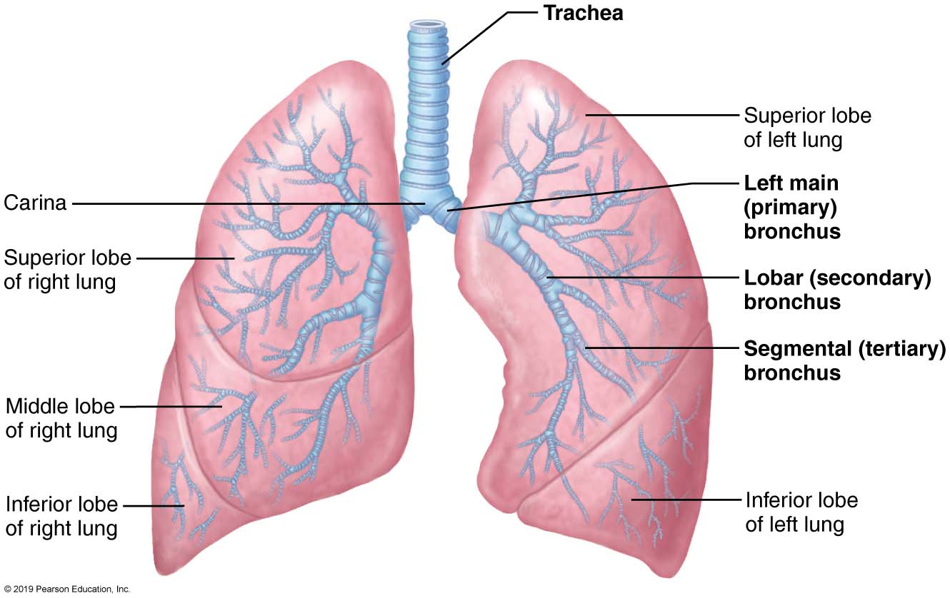
Conducting Zone Passages
Figure 22.9 Conducting zone passages.

Slide 60
The Bronchi and Subdivisions (4 of 7)
Conducting zone structures (cont.)
  In conducting zone, from bronchi to bronchioles, changes occur
    Support structures change
      Cartilage rings become irregular plates
      In bronchioles, elastic fibers replace cartilage altogether
    Epithelium type changes
      Pseudostratified columnar gives way to cuboidal
      Cilia and goblet cells become more sparse
    Amount of smooth muscle increases
      Allows bronchioles to provide substantial resistance to air passage

Slide 61
The Bronchi and Subdivisions (5 of 7)
Respiratory zone structures
  Respiratory zone begins where terminal bronchioles feed into respiratory bronchioles, which lead into alveolar ducts and finally into alveolar sacs (saccules)
    Alveolar sacs contain clusters of alveoli
      ~300 million alveoli make up most of lung volume
      Sites of actual gas exchange

Slide 62
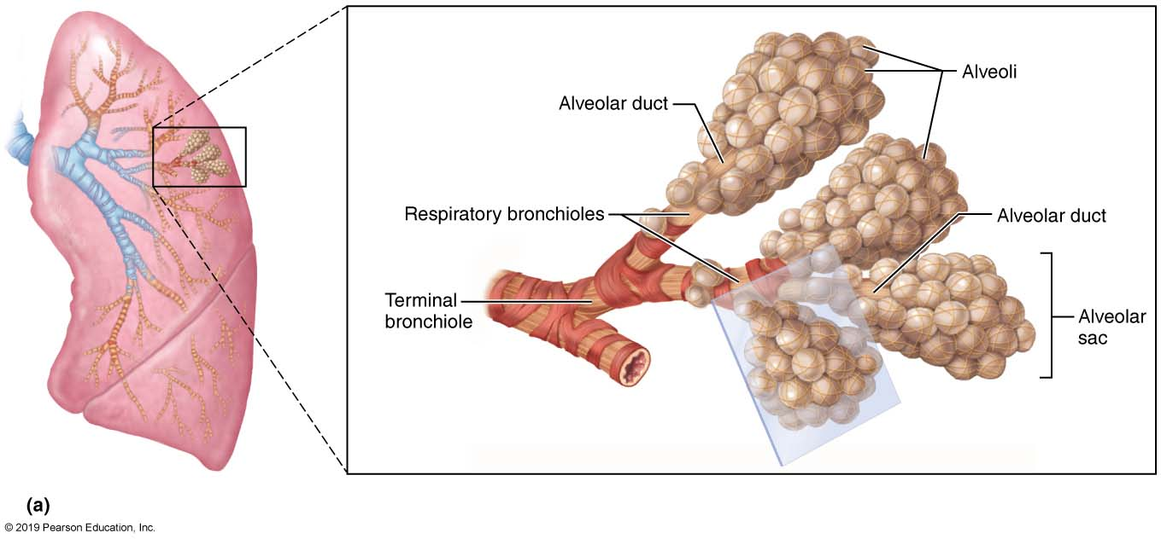
Respiratory Zone Structures (1 of 2)
Figure 22.10a Respiratory zone structures.

Slide 63
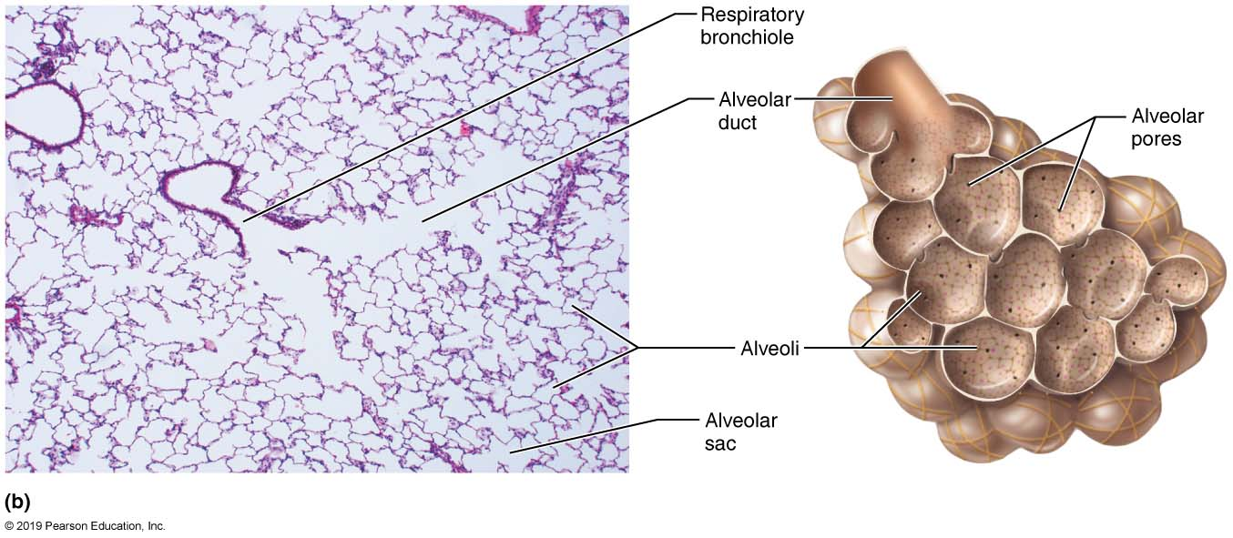
Respiratory Zone Structures (2 of 2)
Figure 22.10b Respiratory zone structures.

Slide 64
The Bronchi and Subdivisions (6 of 7)
  Respiratory membrane
    Blood air barrier that consists of alveolar and capillary walls along with their fused basement membranes
      Very thin (~0.5 μm); allows gas exchange across membrane by simple diffusion
    Alveolar walls consist of:
      Single layer of squamous epithelium (type I alveolar cells)
      Scattered cuboidal type II alveolar cells secrete surfactant and antimicrobial proteins

Slide 65
The Bronchi and Subdivisions (7 of 7)
  Respiratory membrane (cont.)
    Other significant features of alveoli:
      Surrounded by fine elastic fibers and pulmonary capillaries
      Alveolar pores connect adjacent alveoli
        Equalize air pressure throughout lung
        Provide alternate routes in case of blockages
      Alveolar macrophages keep alveolar surfaces sterile
        2 million dead macrophages/hour carried by cilia to throat and swallowed

Slide 66
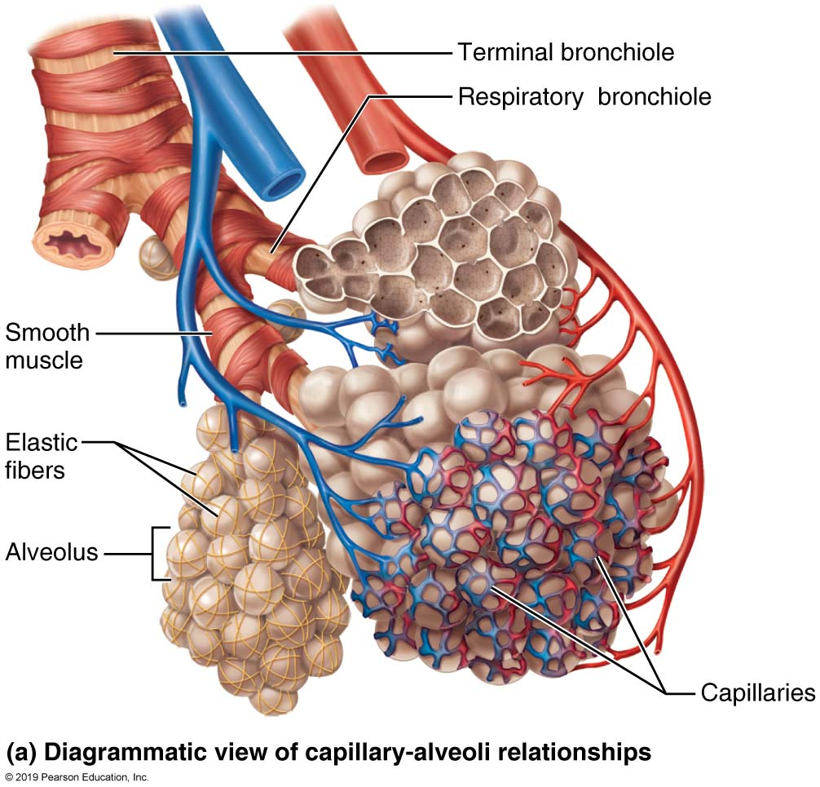
Alveoli and the Respiratory Membrane
(1 of 3)
Figure 22.11a Alveoli and the respiratory membrane.

Slide 67
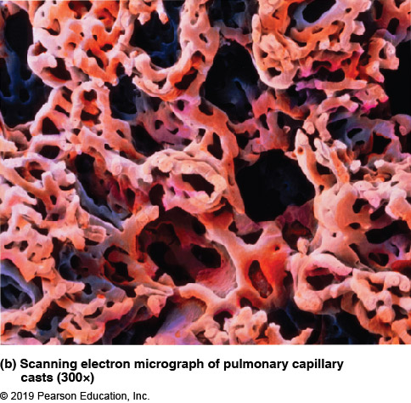
Alveoli and the Respiratory Membrane
(2 of 3)
Figure 22.11b Alveoli and the respiratory membrane.

Slide 68
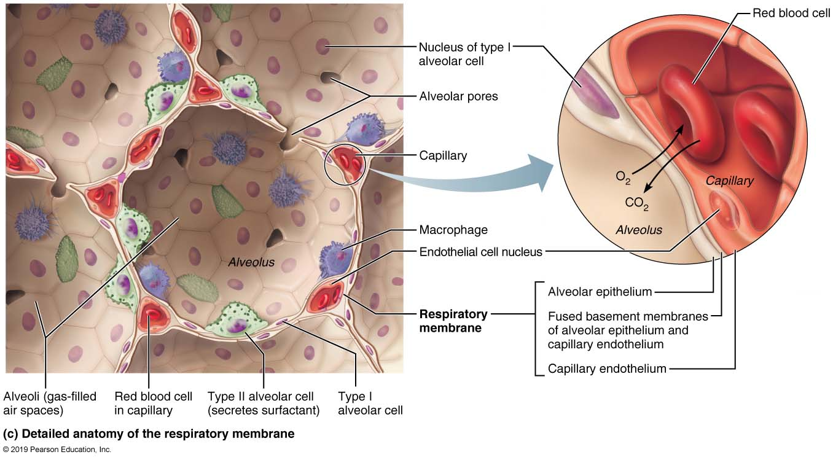
Alveoli and the Respiratory Membrane
(3 of 3)
Figure 22.11c Alveoli and the respiratory membrane.

Slide 69
IP Anatomy Review Animation: Respiratory
Click here to view ADA compliant Animation:
IP Anatomy Review Animation: Respiratory
https://mediaplayer.pearsoncmg.com/assets/secs-ipweb-respiratory-anat-rev

Slide 70
22.3 Lungs and Pleurae

Slide 71
Gross Anatomy of the Lungs (1 of 4)
Lungs occupy all of the thoracic cavity except for mediastinum
Root: site of vascular and bronchial attachment to mediastinum
Costal surface: anterior, lateral, and posterior surfaces
Apex: superior tip, deep to clavicle
Base: inferior surface that rests on diaphragm

Slide 72
Gross Anatomy of the Lungs (2 of 4)
Hilum: found on mediastinal surface, it is the site for entry/exit of blood vessels, bronchi, lymphatic vessels, and nerves
Left lung: separated into superior and inferior lobes by oblique fissure
  Smaller than right because of position of heart
    Cardiac notch: concavity for heart to fit into
Right lung: separated into superior, middle, and inferior lobes
    Superior and middle lobes separated by horizontal fissure
    Middle and inferior lobes separated by oblique fissure

Slide 73
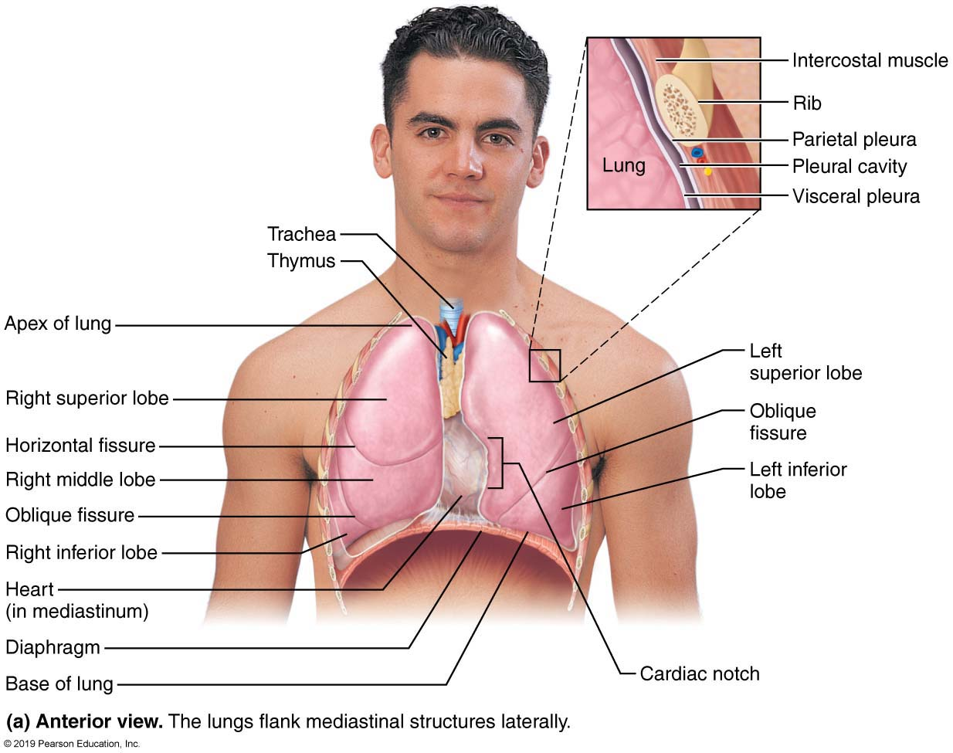
Anatomical Relationships of Organs in the Thoracic Cavity (1 of 3)
Figure 22.12a Anatomical relationships of organs in the thoracic cavity.

Slide 74
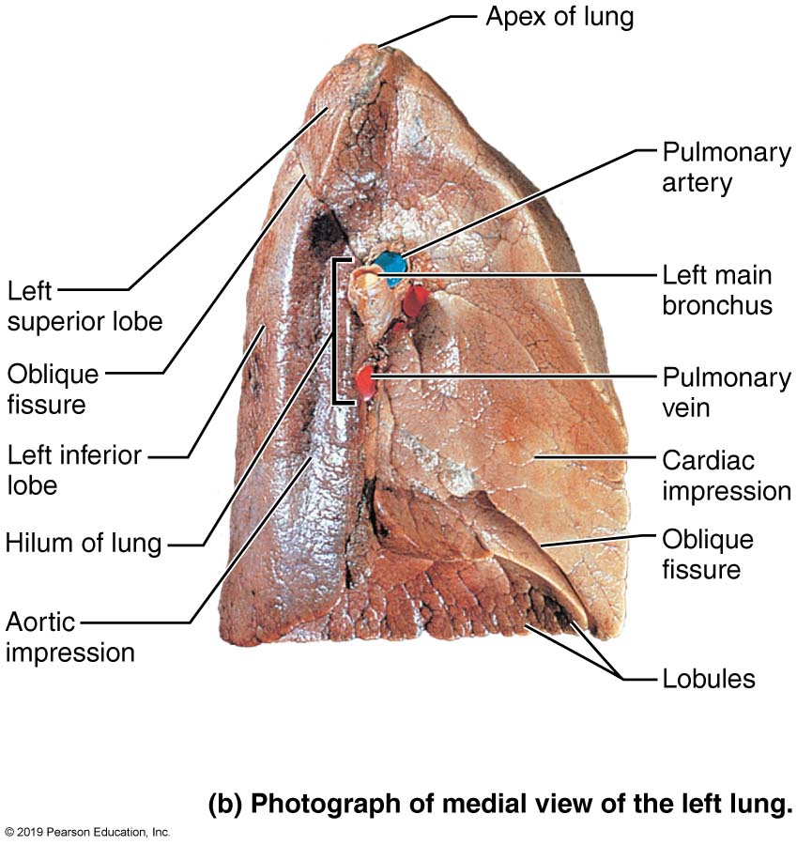
Anatomical Relationships of Organs in the Thoracic Cavity (2 of 3)
Figure 22.12b Anatomical relationships of organs in the thoracic cavity.

Slide 75
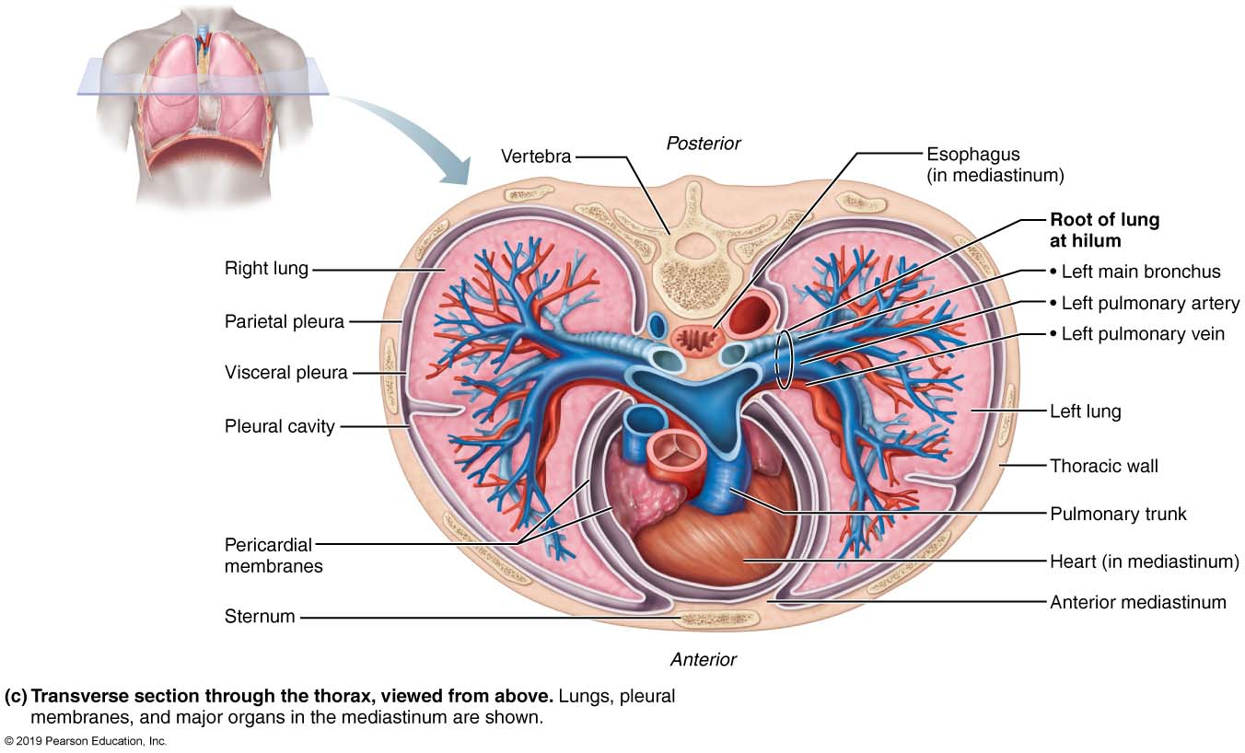
Anatomical Relationships of Organs in the Thoracic Cavity (3 of 3)
Figure 22.12c Anatomical relationships of organs in the thoracic cavity.

Slide 76
Gross Anatomy of the Lungs (3 of 4)
Each lobe further divided into bronchopulmonary segments
  10 on right and 8–10 on left
  Separated by connective tissue septa
  Each segment is served by its own artery, vein, and bronchus
    If one segment is diseased, it can be individually removed

Slide 77
Gross Anatomy of the Lungs (4 of 4)
Lobules: smallest subdivisions visible to naked eye; hexagonal segments served by bronchioles and their branches
Lungs are mostly composed of alveoli; the rest consists of stroma, elastic connective tissue
  Makes lungs very elastic and spongy

Slide 78
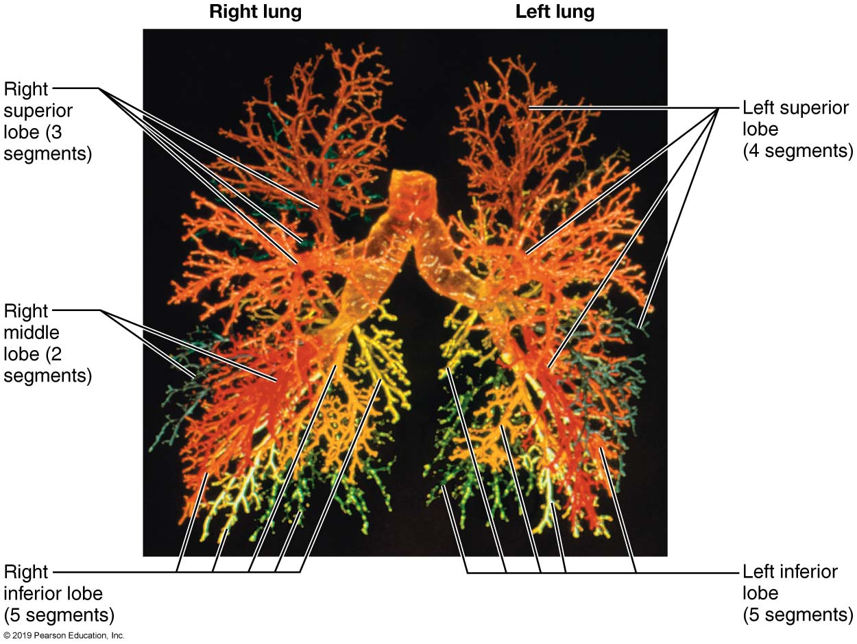
A Cast of the Bronchial Tree
Figure 22.13 A cast of the bronchial tree.

Slide 79
Blood Supply and Innervation of Lungs
(1 of 3)
Lungs are perfused by two circulations
  Pulmonary circulation
    Pulmonary arteries deliver systemic venous blood from heart to lungs for oxygenation
      Branch profusely to feed into pulmonary capillary networks
    Pulmonary veins carry oxygenated blood from respiratory zones back to heart
    Low-pressure, high-volume system
    Lung capillary endothelium contains many enzymes that act on different substances in blood
      Example: angiotensin-converting enzyme activates blood pressure hormone

Slide 80
Blood Supply and Innervation of Lungs
(2 of 3)
  Bronchial circulation
    Bronchial arteries provide oxygenated blood to lung tissue
      Arise from aorta and enter lungs at hilum
      Part of systemic circulation, so are high pressure, low volume
      Supply all lung tissue except alveoli
      Bronchial veins anastomose with pulmonary veins
        Pulmonary veins carry most venous blood back to heart

Slide 81
Blood Supply and Innervation of Lungs
(3 of 3)
Innervation of the lungs
  Lungs are innervated by parasympathetic and sympathetic motor fibers, as well as visceral sensory fibers
  Nerves enter through pulmonary plexus on lung root
    Run along bronchial tubes and blood vessels
  Parasympathetic fibers cause bronchoconstriction, whereas sympathetic fibers cause bronchodilation

Slide 82
The Pleurae (1 of 2)
Pleurae: thin, double-layered serosal membrane that divides thoracic cavity into two pleural compartments and mediastinum
Parietal pleura: membrane on thoracic wall, superior face of diaphragm, around heart, and between lungs
Visceral pleura: membrane on external lung surface

Slide 83
The Pleurae (2 of 2)
Pleural fluid fills slitlike pleural cavity between two pleurae
  Provides lubrication and surface tension that assists in expansion and recoil of lungs

Slide 84
Anatomical Relationships of Organs in the thoracic cavity
Figure 22.12 Anatomical relationships of organs in the thoracic cavity.

Slide 85
Clinical – Homeostatic Imbalance 22.6
(1 of 2)
Pleurisy: inflammation of pleurae that often results from pneumonia
Inflamed pleurae become rough, resulting in friction and stabbing pain with each breath
Pleurae may produce excessive amounts of fluid, which may exert pressure on lungs, hindering breathing

Slide 86
Clinical – Homeostatic Imbalance 22.6
(2 of 2)
Other fluids that may accumulate in pleural cavity
  Blood: leaked from damaged blood vessels
  Blood filtrate: watery fluid that oozes from lung capillaries when left-sided heart failure occurs
Pleural effusion: fluid accumulation in pleural cavity

Slide 87
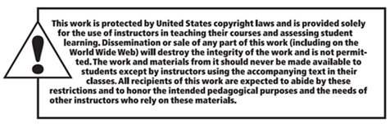
Copyright

