Slide 1

Human Anatomy and Physiology
Eleventh Edition
Chapter 22 Part B
The Respiratory System
PowerPoint® Lectures Slides prepared by Karen Dunbar Kareiva, Ivy Tech Community College
Copyright © 2019, 2016, 2013 Pearson Education, Inc. All Rights Reserved

Slide 2
Part 2 – Respiratory Physiology

Slide 3
22.4 Mechanics of Breathing
Pulmonary ventilation consists of two phases
Inspiration: gases flow into lungs
Expiration: gases exit lungs

Slide 4
Pressure Relationships in the Thoracic Cavity (1 of 6)
Atmospheric pressure (P_{atm})
Pressure exerted by air surrounding the body
760 mm Hg at sea level = 1 atmosphere
Respiratory pressures described relative to P_{atm}
Negative respiratory pressure: less than P_{atm}
Positive respiratory pressure: greater than P_{atm}
Zero respiratory pressure: equal to P_{atm}

Slide 5
Pressure Relationships in the Thoracic Cavity (2 of 6)
Intrapulmonary pressure (P_{pul})
Pressure in alveoli
Also called intra-alveolar pressure
Fluctuates with breathing
Always eventually equalizes with P_{atm}

Slide 6
Pressure Relationships in the Thoracic Cavity (3 of 6)
Intrapleural pressure (P_{ip})
Pressure in pleural cavity
Fluctuates with breathing
Always a negative pressure (<P_{atm} and <P_{pul})
Usually always 4 mm Hg less than P_{pul}
Fluid level must be kept at a minimum
Excess fluid pumped out by lymphatic system
If fluid accumulates, positive P_{ip} pressure develops
Lung collapses

Slide 7
Pressure Relationships in the Thoracic Cavity (4 of 6)
Intrapleural pressure (P_{ip}) (cont.)
Two inward forces promote lung collapse
Lungs’ natural tendency to recoil
Because of elasticity, lungs always try to assume smallest size
Surface tension of alveolar fluid
Surface tension pulls on alveoli to try to reduce alveolar size

Slide 8
Pressure Relationships in the Thoracic Cavity (5 of 6)
Intrapleural pressure (P_{ip}) (cont.)
One outward force tends to enlarge lungs
Elasticity of chest wall pulls thorax outward
Negative P_{ip} is affected by these opposing forces but is maintained by strong adhesive force between parietal and visceral pleurae

Slide 9
Pressure Relationships in the Thoracic Cavity (6 of 6)
Transpulmonary pressure
Transpulmonary pressure = (P_{pul} − P_{ip})
Pressure that keeps lung spaces open
Keeps lungs from collapsing
Greater transpulmonary pressure, the larger the lungs will be
Lungs will collapse if:
P_{ip} = P_{pul} or
P_{ip} = P_{atm}
Negative P_{ip} must be maintained to keep lungs inflated

Slide 10
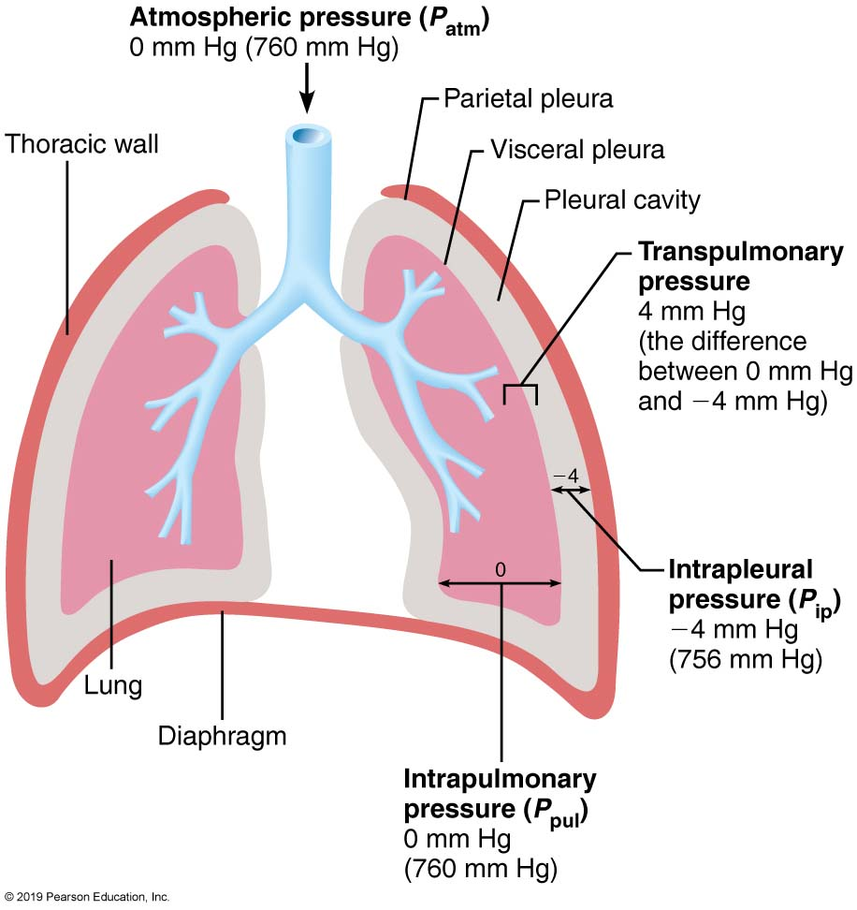
Intrapulmonary and Intrapleural Pressure Relationships
Figure 22.14 Intrapulmonary and intrapleural pressure relationships.

Slide 11
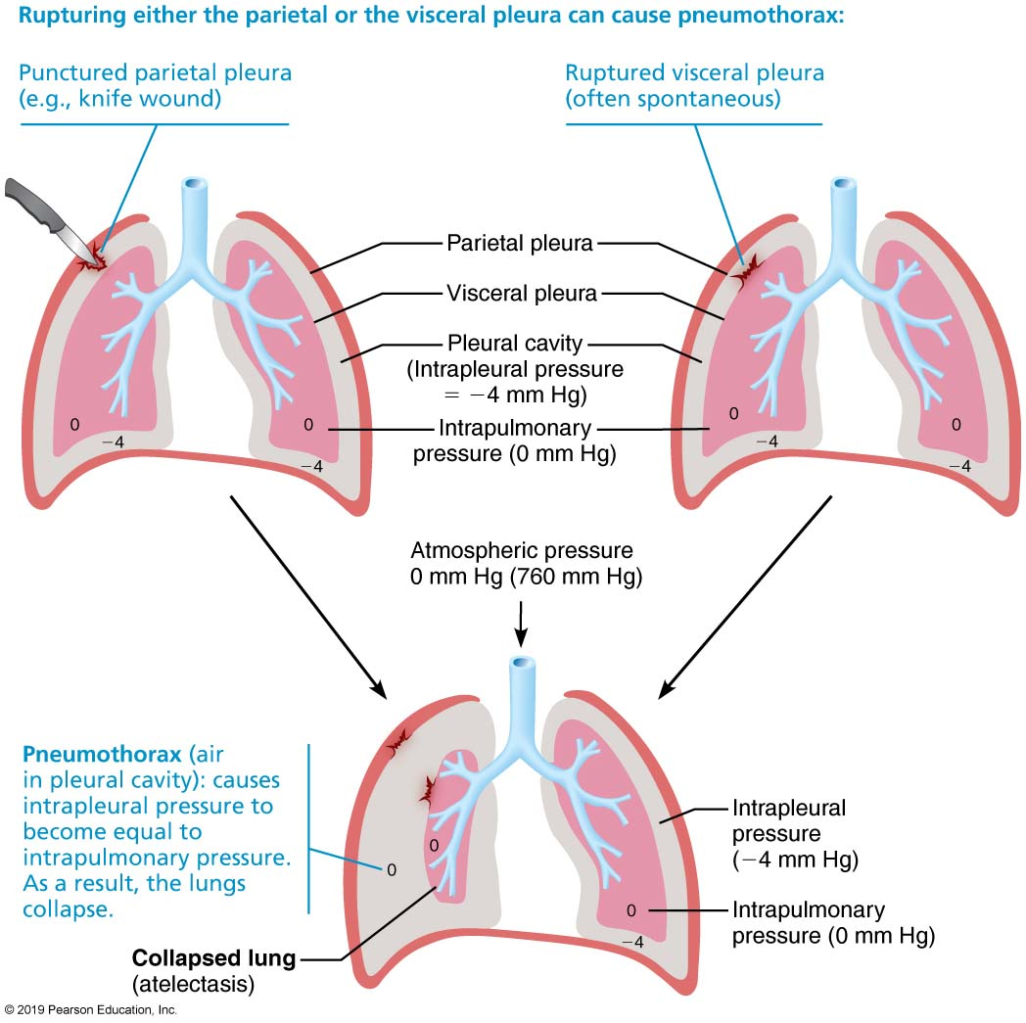
Pneumothorax
Figure 22.15 Pneumothorax.

Slide 12
Clinical – Homeostatic Imbalance 22.7
Atelectasis: lung collapse due to
Plugged bronchioles, which cause collapse of alveoli, or
Pneumothorax, air in pleural cavity
Can occur from either wound in parietal pleura or rupture of visceral pleura
Treated by removing air with chest tubes
When pleurae heal, lung reinflates

Slide 13
Pulmonary Ventilation (1 of 7)
Consists of inspiration and expiration
Mechanical process that depends on volume changes in thoracic cavity
Volume changes lead to pressure changes
Pressure changes lead to flow of gases to equalize pressure

Slide 14
Pulmonary Ventilation (2 of 7)
Boyle’s law: relationship between pressure and volume of a gas
Gases always fill the container they are in
If amount of gas is the same and container size is reduced, pressure will increase
So pressure (P) varies inversely with volume (V)
Mathematically:
P₁V₁ = P₂V₂

Slide 15
Pulmonary Ventilation (3 of 7)
Inspiration
Active process involving inspiratory muscles (diaphragm and external intercostals)
Action of the diaphragm: when dome-shaped diaphragm contracts, it moves inferiorly and flattens out
Results in increase in thoracic volume
Action of intercostal muscles: when external intercostals contract, rib cage is lifted up and out, much like when handle on a bucket is raised (outward as it moves upward)
Results in increase in thoracic volume

Slide 16
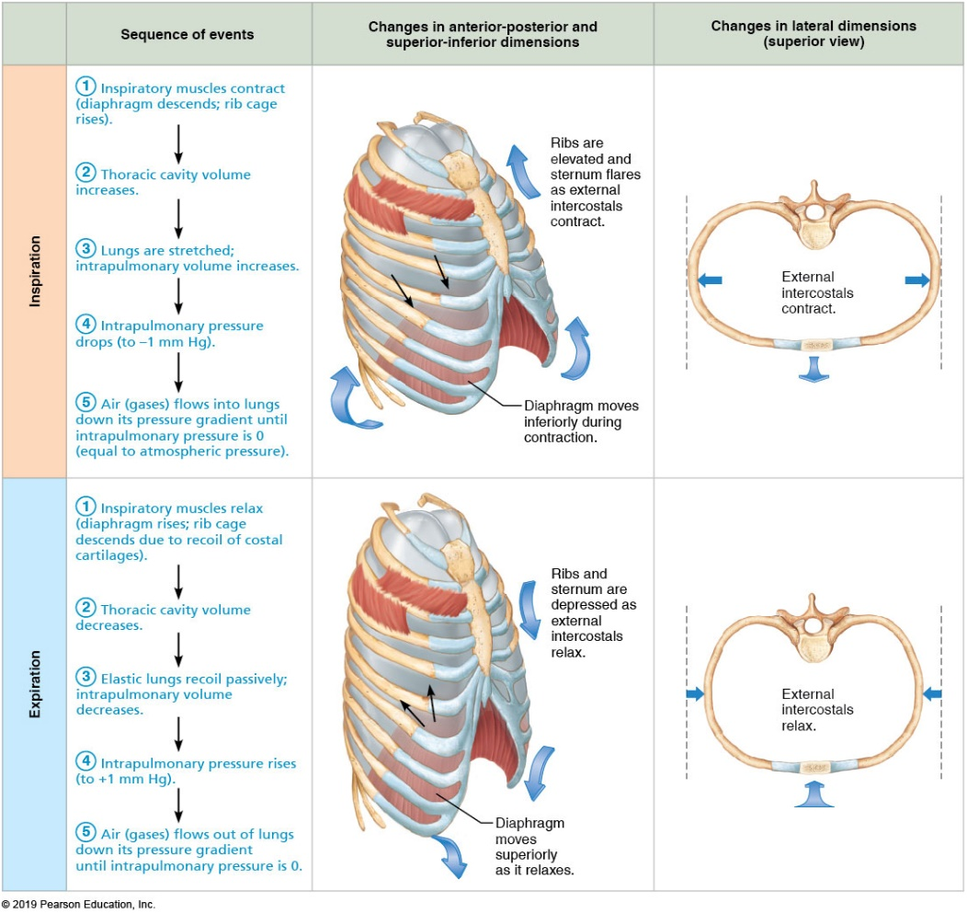
Changes in Thoracic Volume and Sequence of Events During Inspiration and Expiration
Figure 22.16 Changes in thoracic volume and sequence of events during inspiration and expiration.

Slide 17
Pulmonary Ventilation (4 of 7)
Inspiration (cont.)
As thoracic cavity volume increases, lungs are stretched as they are pulled out with thoracic cage
Causes intrapulmonary pressure to drop by 1 mm Hg P_{pul} < P_{atm}
Because of difference between atmospheric and intrapulmonary pressure, air flows into lungs, down its pressure gradient, until P_{pul} = P_{atm}
During same period, P_{ip} lowers to about 6 mm Hg less than P_{atm}

Slide 18
Pulmonary Ventilation (5 of 7)
Inspiration (cont.)
Forced (deep) inspirations can occur during vigorous exercise or in people with COPD
Accessory muscles are also activated
Scalenes, sternocleidomastoid, and pectoralis minor
Erector spinae muscles of back also help to straighten thoracic curvature
Act to further increase thoracic cage size, creating a larger pressure gradient so more air is drawn in

Slide 19
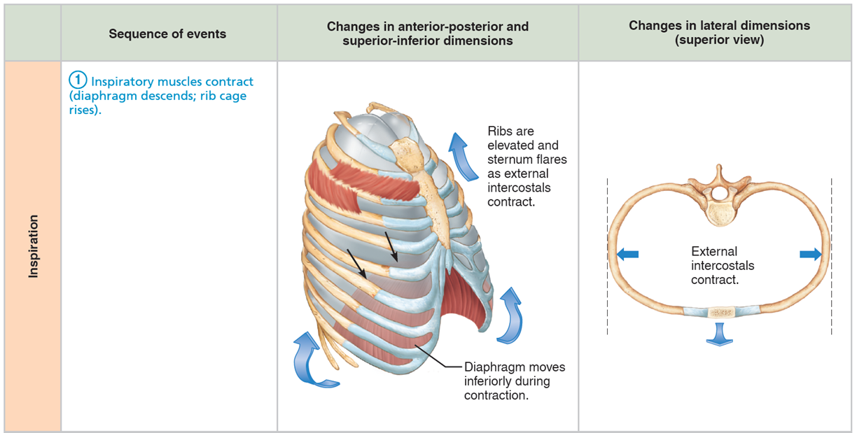
Changes in Thoracic Volume and Sequence of Events During Inspiration and Expiration (1 of 10)
Figure 22.16 Changes in thoracic volume and sequence of events during inspiration and expiration.

Slide 20
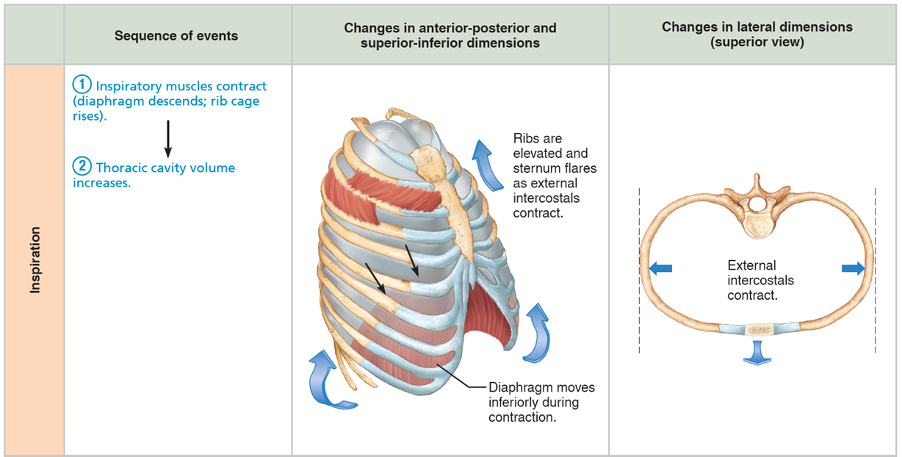
Changes in Thoracic Volume and Sequence of Events During Inspiration and Expiration (2 of 10)
Figure 22.16 Changes in thoracic volume and sequence of events during inspiration and expiration.

Slide 21
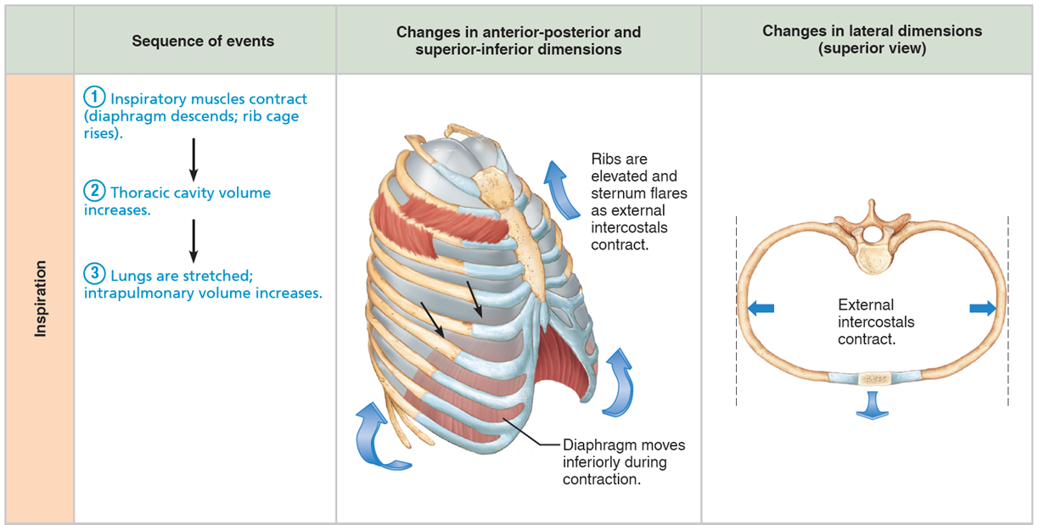
Changes in Thoracic Volume and Sequence of Events During Inspiration and Expiration (3 of 10)
Figure 22.16 Changes in thoracic volume and sequence of events during inspiration and expiration.

Slide 22
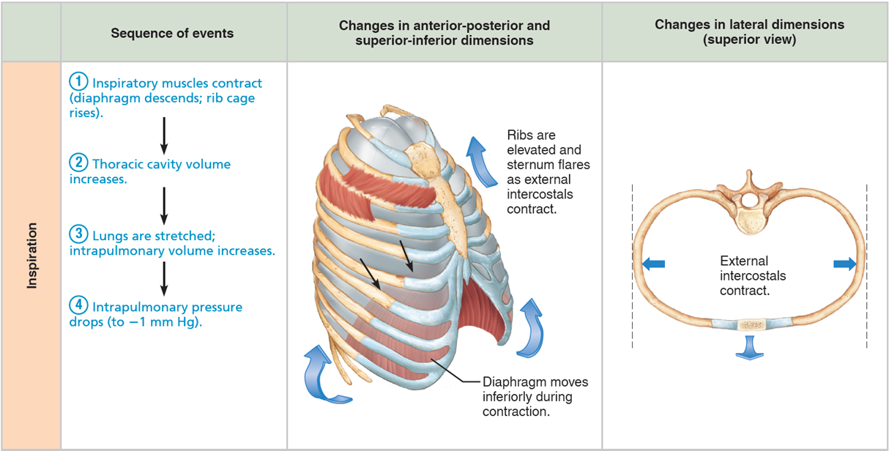
Changes in Thoracic Volume and Sequence of Events During Inspiration and Expiration (4 of 10)
Figure 22.16 Changes in thoracic volume and sequence of events during inspiration and expiration.

Slide 23

Changes in Thoracic Volume and Sequence of Events During Inspiration and Expiration (5 of 10)
Figure 22.16 Changes in thoracic volume and sequence of events during inspiration and expiration.

Slide 24
Pulmonary Ventilation (6 of 7)
Expiration
Quiet expiration normally is passive process
Inspiratory muscles relax, thoracic cavity volume decreases, and lungs recoil
Volume decrease causes intrapulmonary pressure (P_{pul}) to increase by +1 mm Hg
P_{pul} > Patm so air flows out of lungs down its pressure gradient until P_{pul} = P_{atm}
Forced expiration is an active process that uses oblique and transverse abdominal muscles, as well as internal intercostal muscles

Slide 25
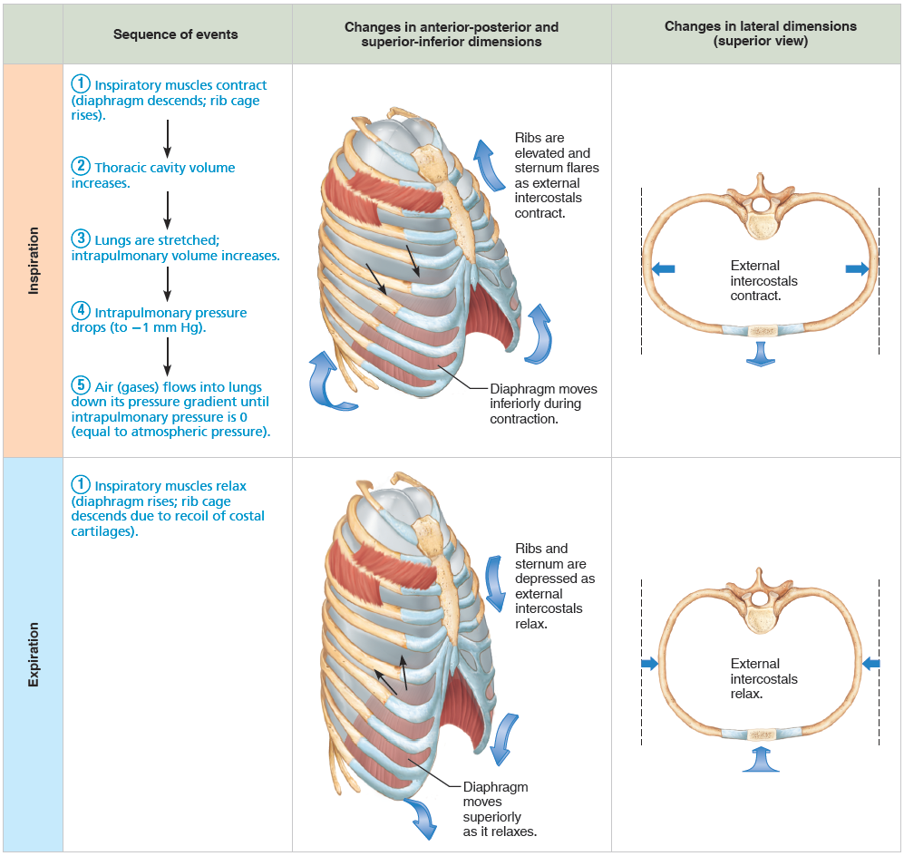
Changes in Thoracic Volume and Sequence of Events During Inspiration and Expiration (6 of 10)
Figure 22.16 Changes in thoracic volume and sequence of events during inspiration and expiration.

Slide 26

Changes in Thoracic Volume and Sequence of Events During Inspiration and Expiration (7 of 10)
Figure 22.16 Changes in thoracic volume and sequence of events during inspiration and expiration.

Slide 27
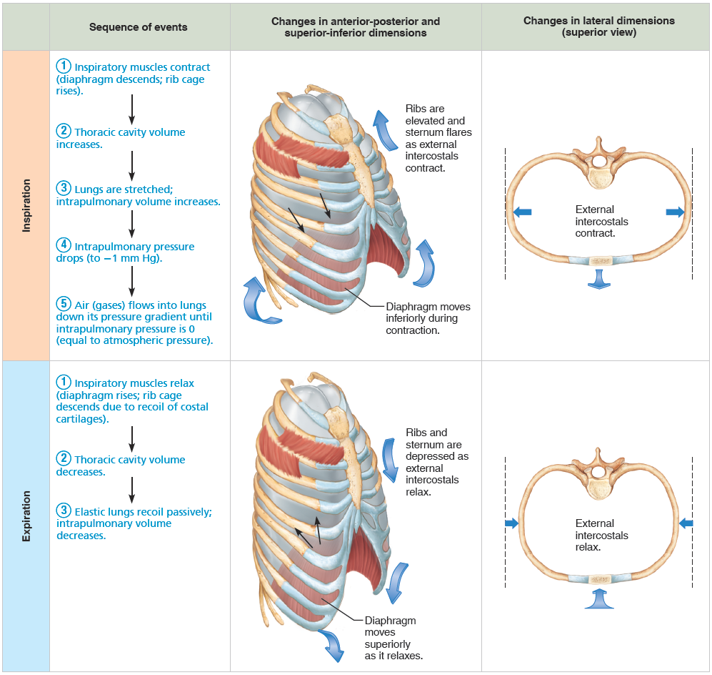
Changes in Thoracic Volume and Sequence of Events During Inspiration and Expiration (8 of 10)
Figure 22.16 Changes in thoracic volume and sequence of events during inspiration and expiration.

Slide 28
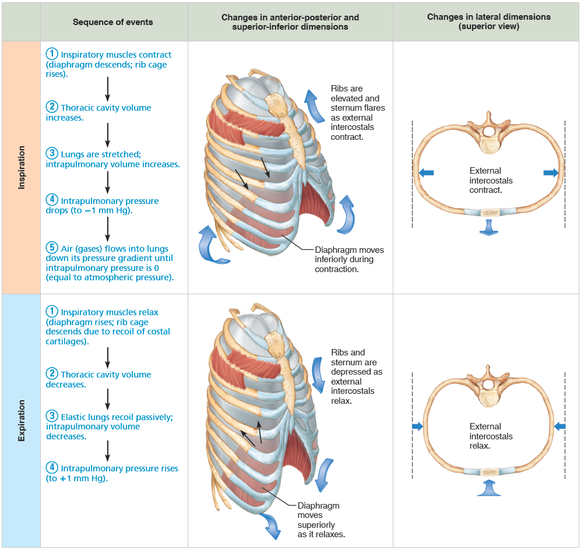
Changes in Thoracic Volume and Sequence of Events During Inspiration and Expiration (9 of 10)
Figure 22.16 Changes in thoracic volume and sequence of events during inspiration and expiration.

Slide 29

Changes in Thoracic Volume and Sequence of Events During Inspiration and Expiration (10 of 10)
Figure 22.16 Changes in thoracic volume and sequence of events during inspiration and expiration.

Slide 30
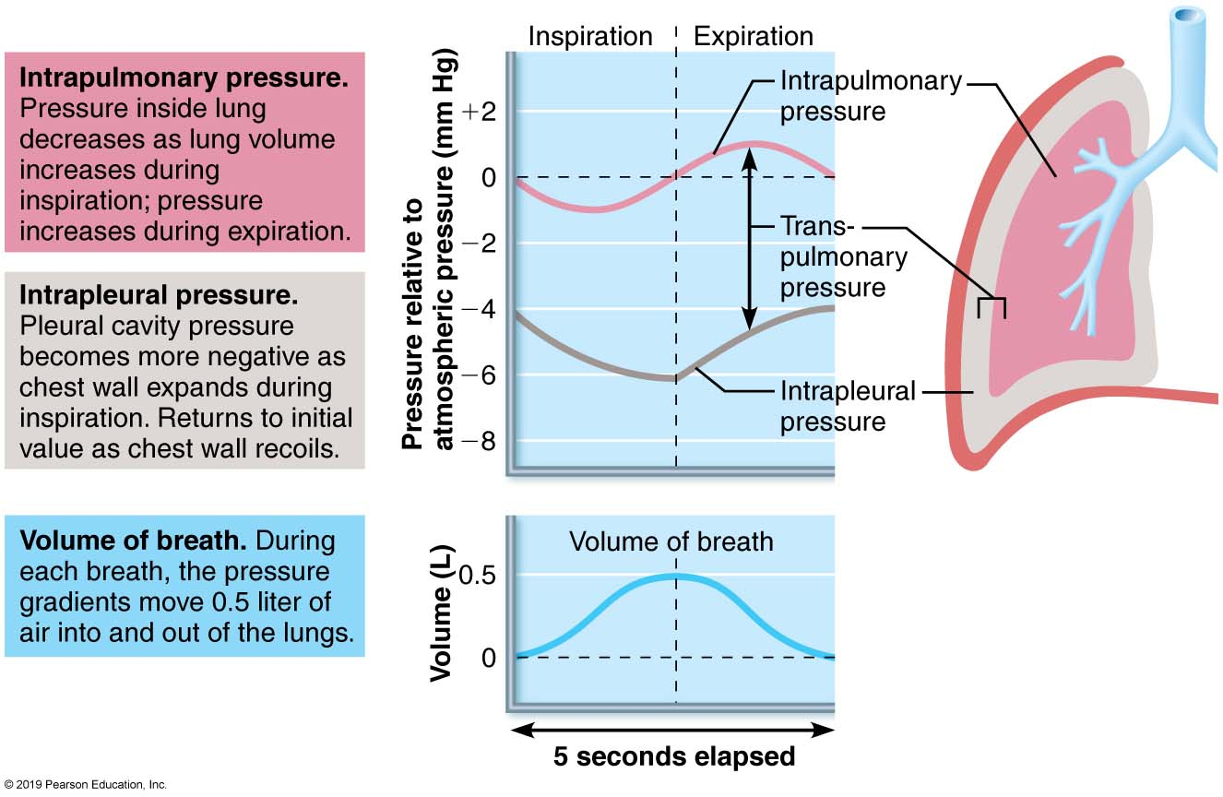
Changes in Intrapulmonary and Intrapleural Pressures During Inspiration and Expiration
Figure 22.17 Changes in intrapulmonary and intrapleural pressures during inspiration and expiration.

Slide 31
Pulmonary Ventilation (7 of 7)
Nonrespiratory air movements
Many processes can move air into or out of lungs besides breathing
May modify normal respiratory rhythm
Most result from reflex action, although some are voluntary
Examples: coughing, sneezing, crying, laughing, hiccups, and yawns

Slide 32
Physical Factors Influencing Pulmonary Ventilation (1 of 7)
Three physical factors influence the ease of air passage and the amount of energy required for ventilation
Airway resistance
Alveolar surface tension
Lung compliance

Slide 33
Physical Factors Influencing Pulmonary Ventilation (2 of 7)
Airway resistance
Friction: major nonelastic source of resistance to gas flow; occurs in airways
Relationship between flow (F), pressure (P), and resistance (R):
ΔP – pressure gradient between atmosphere and alveoli (2 mm Hg or less during normal quiet breathing)
2 mm Hg difference sufficient to move 500 ml of air
Gas flow changes inversely with resistance

Slide 34
Physical Factors Influencing Pulmonary Ventilation (3 of 7)
Airway resistance (cont.)
Resistance in respiratory tree is usually insignificant for two reasons:
Diameters of airways in first part of conducting zone are huge
Progressive branching of airways as they get smaller leads to an increase in total cross-sectional area
Any resistance usually occurs in medium-sized bronchi
Resistance disappears at terminal bronchioles, where diffusion is what drives gas movement

Slide 35
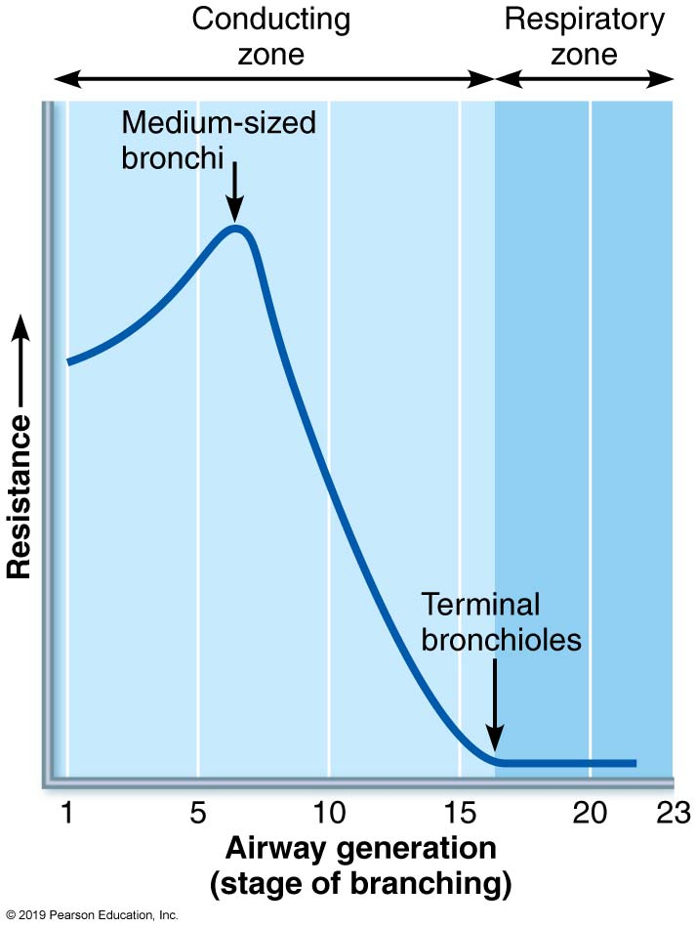
Resistance in Respiratory Passageways
Figure 22.18 Resistance in respiratory passageways.

Slide 36
Clinical – Homeostatic Imbalance 22.8
As airway resistance rises, breathing movements become more strenuous
Severe constriction or obstruction of bronchioles:
Can prevent life-sustaining ventilation
Can occur during acute asthma attacks and stop ventilation
Epinephrine dilates bronchioles, reduces air resistance

Slide 37
Physical Factors Influencing Pulmonary Ventilation (4 of 7)
Alveolar surface tension
Surface tension: the attraction of liquid molecules to one another at a gas-liquid interface
Tends to draw liquid molecules closer together and reduce contact with dissimilar gas molecules
Resists any force that tends to increase surface area of liquid
Water, which has very high surface tension, coats alveolar walls in a thin film
Tends to cause alveoli to shrink to smallest size—that is, collapse

Slide 38
Physical Factors Influencing Pulmonary Ventilation (5 of 7)
Alveolar surface tension (cont.)
Surfactant is body’s detergent-like lipid and protein complex that helps reduce surface tension of alveolar fluid
Prevents alveolar collapse
Produced by type II alveolar cells

Slide 39
Clinical – Homeostatic Imbalance 22.9 (1 of 2)
Insufficient quantity of surfactant in premature infants causes infant respiratory distress syndrome (IRDS)
Increased surface tension results in collapse of alveoli after each breath
Alveoli must be completely reinflated during each inspiration
Uses a tremendous amount of energy
Common in premature babies
Fetal lungs do produce adequate amounts of surfactant until last two months of development

Slide 40
Clinical – Homeostatic Imbalance 22.9 (2 of 2)
Treatment: spraying natural or synthetic surfactant into newborn’s air passages
Positive pressure devices also help to keep alveoli open between breaths
Severe cases may require mechanical ventilation
Survivors of mechanical ventilation may develop bronchopulmonary dysplasia, chronic childhood lung disease

Slide 41
Physical Factors Influencing Pulmonary Ventilation (6 of 7)
Lung compliance
Lung compliance: measure of change in lung volume that occurs with given change in transpulmonary pressure
Measure of how much “stretch” the lung has
Normally high because of
Distensibility of lung tissue
Surfactant, which decreases alveolar surface tension
Higher lung compliance means it is easier to expand lungs

Slide 42
Physical Factors Influencing Pulmonary Ventilation (7 of 7)
Lung compliance (cont.)
Can be written mathematically as:
Where C_{L} equals compliance, ΔV_{L} equals change in lung volume, and Δ(P_{pul} − P_{ip}) equals change in transpulmonary pressure
Compliance can be diminished by:
Nonelastic scar tissue replacing lung tissue (fibrosis)
Reduced production of surfactant
Decreased flexibility of thoracic cage

Slide 43
Clinical – Homeostatic Imbalance 22.10
Any decrease in the natural resilience of lungs diminishes lung compliance
Chronic inflammation, or infections such as tuberculosis, can cause nonelastic scar tissue to replace normal lung tissue (fibrosis)
Decreased production of surfactant can also impair lung compliance
The lower the lung compliance, the more energy is needed just to breathe

Slide 44
Clinical – Homeostatic Imbalance 22.11
Total compliance of the respiratory system is also influenced by compliance (distensibility) of the thoracic wall, which can be decreased by:
Deformities of thorax
Ossification of costal cartilage
Common in old age
Paralysis of intercostal muscles

Slide 45
22.5 Assessing Ventilation
Several respiratory volumes can be used to assess respiratory status
Respiratory volumes can be combined to calculate respiratory capacities, which can give information on a person’s respiratory status
Respiratory volumes and capacities are usually abnormal in people with pulmonary disorders
Spirometer: original, cumbersome clinical tool used to measure patient’s respiratory volumes
Electronic measuring devices used today

Slide 46
Respiratory Volumes (1 of 2)
Tidal volume (TV): amount of air moved into and out of lung with each breath
Averages ~500ml
Inspiratory reserve volume (IRV): amount of air that can be inspired forcibly beyond the tidal volume (2100–3200 ml)

Slide 47
Respiratory Volumes (2 of 2)
Expiratory reserve volume (ERV): amount of air that can be forcibly expelled from lungs (1000–1200 ml)
Residual volume (RV): amount of air that always remains in lungs
Needed to keep alveoli open

Slide 48
Respiratory Capacities
Combinations of two or more respiratory volumes
Inspiratory capacity (IC): sum of TV + IRV
Functional residual capacity (FRC): sum of RV + ERV
Vital capacity (VC): sum of TV + IRV + ERV
Total lung capacity (TLC): sum of all lung volumes (TV + IRV+ ERV + RV)

Slide 49
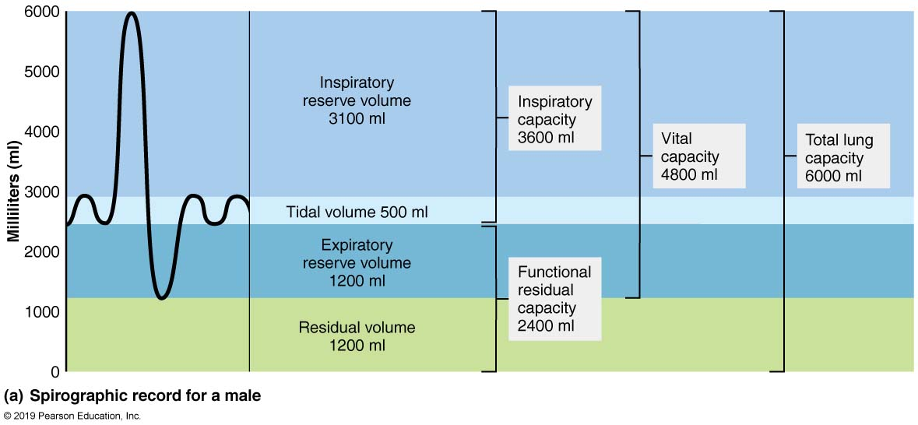
Respiratory Volumes and Capacities (1 of 2)
Figure 22.19a Respiratory volumes and capacities.

Slide 50
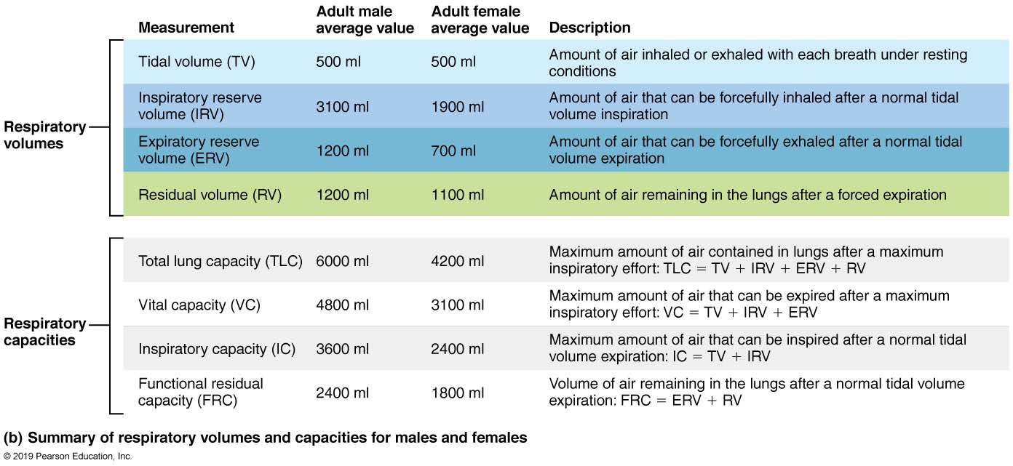
Respiratory Volumes and Capacities (2 of 2)
Figure 22.19b Respiratory volumes and capacities.

Slide 51
Dead Space
Anatomical dead space: does not contribute to gas exchange
Consists of air that remains in passageways
~150 ml out of 500 ml TV
Alveolar dead space: space occupied by nonfunctional alveoli
Can be due to collapse or obstruction
Total dead space: sum of anatomical and alveolar dead space

Slide 52
Pulmonary Function Tests (1 of 2)
Spirometry can distinguish between:
Obstructive pulmonary disease: increased airway resistance (example: bronchitis)
TLC, FRC, RV may increase because of hyperinflation of lungs
Restrictive disease: reduced TLC due to disease (example: tuberculosis) or exposure to environmental agents (example: fibrosis)
VC, TLC, FRC, RV decline because lung expansion is compromised

Slide 53
Pulmonary Function Tests (2 of 2)
Pulmonary functions tests can measure rate of gas movement
Forced vital capacity (FVC): amount of gas forcibly expelled after taking deep breath
Forced expiratory volume (FEV): amount of gas expelled during specific time interval of FVC
FEV₁: amount of air expelled in 1st second
Healthy individuals can expel 80% of FVC in 1st second
Patients with obstructive disease exhale less than 80% in 1st second, whereas those with restrictive disease exhale 80% or more even with reduced FVC

Slide 54
Alveolar Ventilation (1 of 2)
Minute ventilation: total amount of gas that flows into or out of respiratory tract in 1 minute
Normal at rest = ~ 6 L/min
Normal with exercise = up to 200 L/min
Only rough estimate of respiratory efficiency
Alveolar ventilation rate (AVR): flow of gases into and out of alveoli during a particular time
Better indicator of effective ventilation

Slide 55
Alveolar Ventilation (2 of 2)
AVR takes into account amount of dead space, TV, and rate of breathing
Can be calculated by following equation:
Because dead space in an individual is normally constant, AVR is affected by TV and frequency
Significant increases in AVR are brought about by increasing TV rather than frequency
Rapid, shallow breathing can actually decrease AVR

Slide 56
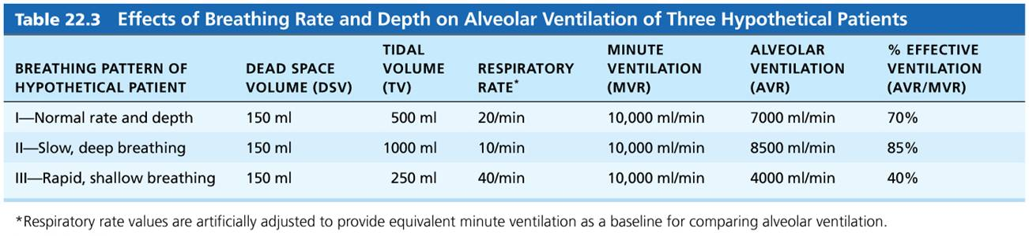
Effects of Breathing Rate and Depth on Alveolar Ventilation of Three Hypothetical Patients
Table 22.3 Effects of Breathing Rate and Depth on Alveolar Ventilation of Three Hypothetical Patients.

Slide 57
22.6 Gas Exchange
Gas exchange occurs between lungs and blood as well as blood and tissues
External respiration: diffusion of gases between blood and lungs
Internal respiration: diffusion of gases between blood and tissues
Both processes are subject to:
Basic properties of gases
Composition of alveolar gas

Slide 58
Basic Properties of Gases (1 of 4)
Dalton’s law of partial pressures
Total pressure exerted by mixture of gases is equal to sum of pressures exerted by each gas
Partial pressure
Pressure exerted by each gas in mixture
Directly proportional to its percentage in mixture

Slide 59
Basic Properties of Gases (2 of 4)
Total atmospheric pressure equals 760 mm Hg
Nitrogen makes up ~78.6% of air; therefore, partial pressure of nitrogen, P_{N2}, can be calculated:
0.786 × 760 mm Hg = 597 mm Hg due to N₂
Oxygen makes up 20.9% of air, so P_{O2} equals:
0.209 × 760 mm Hg = 159 mm Hg

Slide 60
Basic Properties of Gases (3 of 4)
Air also contains 0.04% CO₂, 0.5% water vapor, and insignificant amounts of other gases
At high altitudes, partial pressures declines, but at lower altitudes (under water), partial pressures increase significantly

Slide 61
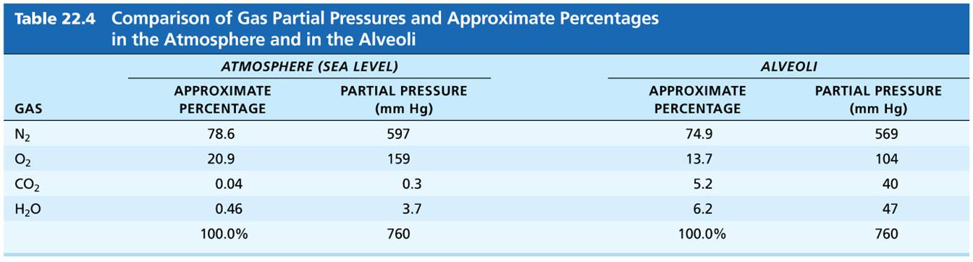
Comparison of Gas Partial Pressures and Approximate Percentages in the Atmosphere and in the Alveoli
Table 22.4 Comparison of Gas Partial Pressures and Approximate Percentages in the Atmosphere and in the Alveoli.

Slide 62
Basic Properties of Gases (4 of 4)
Henry’s law
For gas mixtures in contact with liquids:
Each gas will dissolve in the liquid in proportion to its partial pressure
At equilibrium, partial pressures in the two phases will be equal
Amount of each gas dissolved depends on:
Solubility: CO₂ is 20× more soluble in water than O₂, and little N₂ will dissolve
Temperature: as temperature of liquid rises, solubility decreases
Example of Henry’s law: hyperbaric chambers

Slide 63
Clinical – Homeostatic Imbalance 22.12
Breathing O₂ gas at 2 atm is not a problem for short periods; however, oxygen toxicity develops rapidly when P_{O2} is greater than 2.5–3 atm
Excessively high O₂ concentrations generate huge amounts of harmful free radicals
Results in CNS disturbances, coma, and even death

Slide 64
Composition of Alveolar Gas
Alveoli contain more CO₂ and water vapor than atmospheric air because of:
Gas exchanges in lungs (O₂ diffuses out of lung, and CO₂ diffuses into lung)
Humidification of air by conducting passages
Mixing of alveolar gas with each breath
Newly inspired air mixes with air that was left in passageways between breaths

Slide 65
External Respiration (1 of 8)
External respiration (pulmonary gas exchange) involves the exchange of O₂ and CO₂ across respiratory membranes
Exchange is influenced by:
Partial pressure gradients and gas solubilities
Thickness and surface area of respiratory membrane
Ventilation-perfusion coupling: matching of alveolar ventilation with pulmomary blood perfusion

Slide 66
External Respiration (2 of 8)
Partial pressure gradients and gas solubilities
Steep partial pressure gradient for O₂ exists between blood and lungs
Venous blood P_{O2} = 40 mm Hg
Alveolar P_{O2} = 104 mm Hg
Drives oxygen flow into blood
Equilibrium is reached across respiratory membrane in ~0.25 seconds, but it takes red blood cell ~0.75 seconds to travel from start to end of pulmonary capillary
Ensures adequate oxygenation even if blood flow increases 3×

Slide 67
External Respiration (3 of 8)
Partial pressure gradient for CO₂ is less steep
Venous blood P_{CO2} = 45 mm Hg
Alveolar P_{CO2} = 40 mm Hg
Though gradient is not as steep, CO₂ still diffuses in equal amounts with oxygen
Reason is that CO₂ is 20× more soluble in plasma and alveolar fluid than oxygen

Slide 68
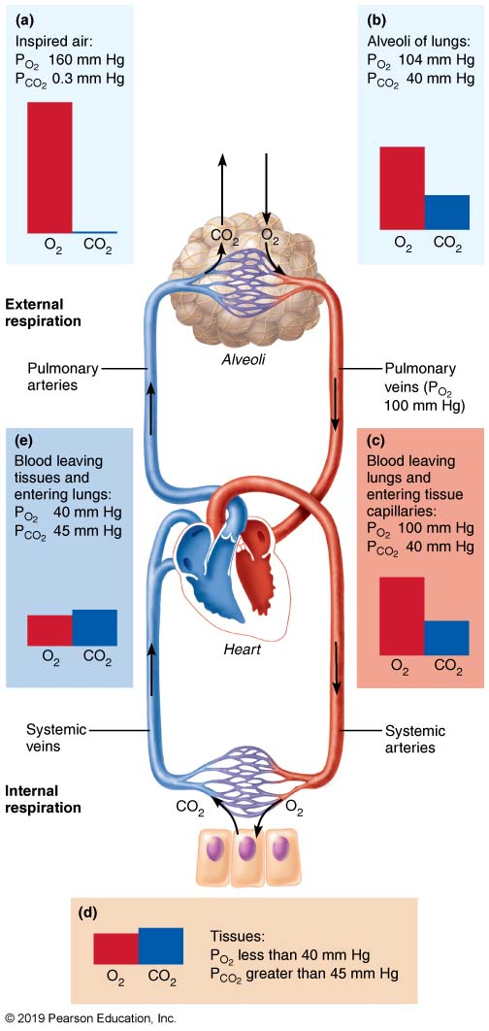
Partial Pressure Gradients Promoting Gas Movements in the Body (1 of 2)
Figure 22.20 Partial pressure gradients promoting gas movements in the body.

Slide 69
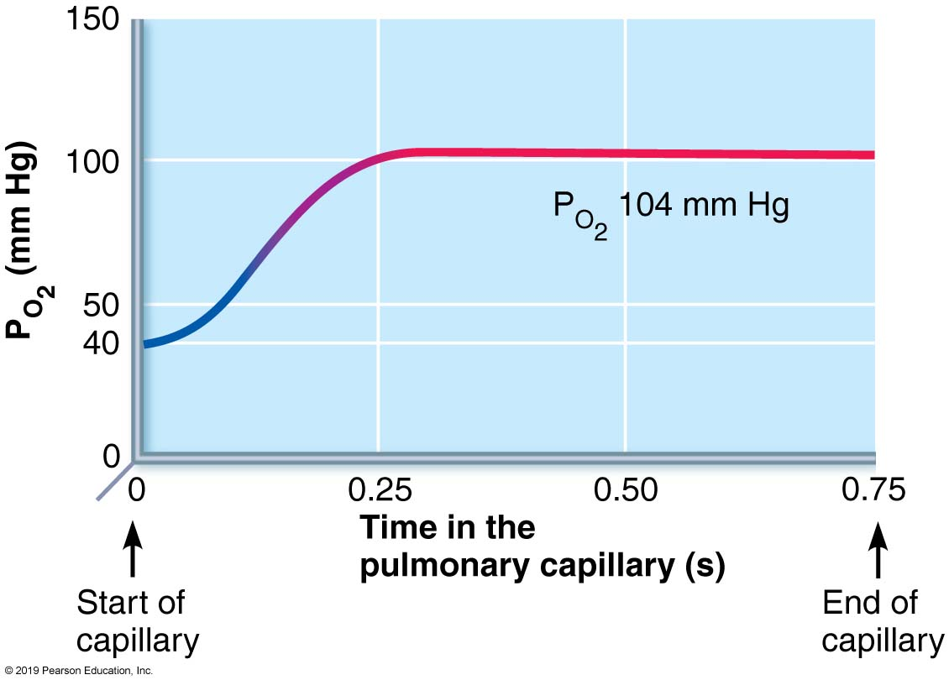
Oxygenation of Blood in The Pulmonary Capillaries at Rest
Figure 22.21 Oxygenation of blood in the pulmonary capillaries at rest.

Slide 70
External Respiration (4 of 8)
Thickness and surface area of the respiratory membrane
Respiratory membranes are very thin
0.5 to 1 µm thick
Large total surface area of the alveoli is 40× the surface area of the skin

Slide 71
Clinical – Homeostatic Imbalance 22.13
Effective thickness of respiratory membrane increases dramatically if the lungs become waterlogged and edematous
Seen in pneumonia or left heart failure
The 0.75 seconds that red blood cells spend in transit through pulmonary capillaries may not be enough for adequate gas exchange
Result: body tissues suffer from oxygen deprivation

Slide 72
Clinical – Homeostatic Imbalance 22.14
Certain pulmonary diseases drastically reduce alveolar surface area
Example: in emphysema, walls of adjacent alveoli break down, and alveolar chambers enlarge
Tumors, mucus, or inflammatory material also can reduce surface area by blocking gas flow into alveoli

Slide 73
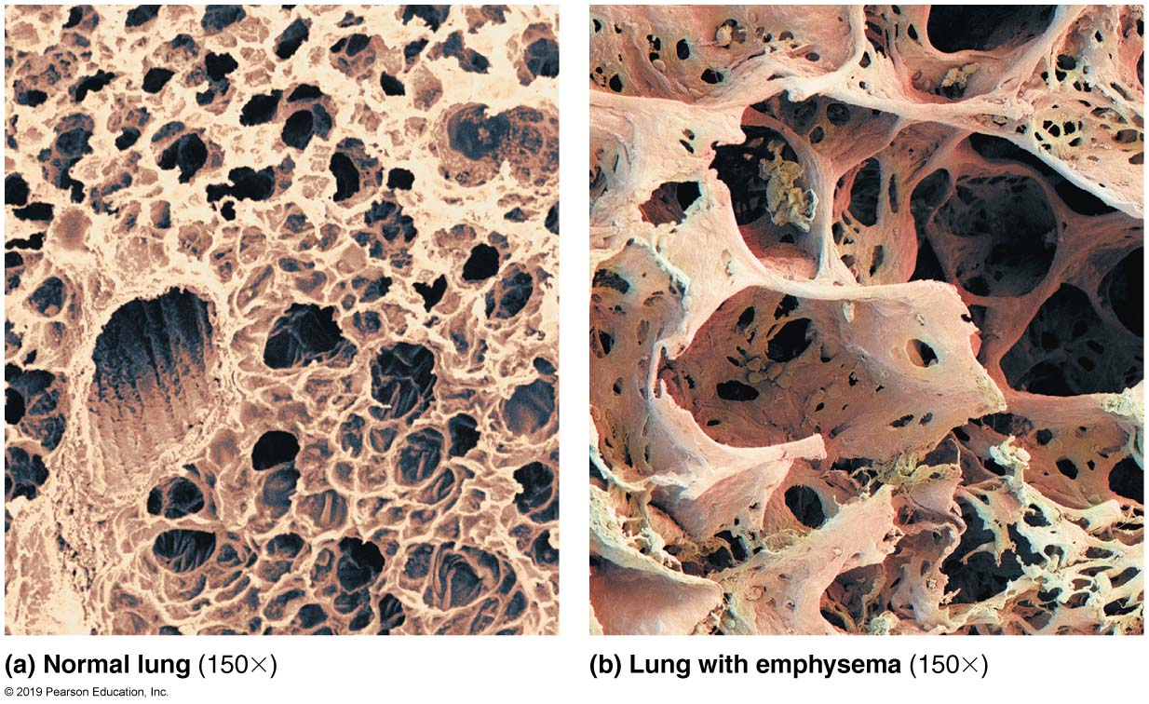
Tissue Changes in Emphysema
Figure 22.22 Tissue changes in emphysema.

Slide 74
External Respiration (5 of 8)
Ventilation-perfusion coupling
Perfusion: blood flow reaching alveoli
Ventilation: amount of gas reaching alveoli
Ventilation and perfusion rates must be matched for optimal, efficient gas exchange
Both are controlled by local autoregulatory mechanisms
P_{O2} controls perfusion by changing arteriolar diameter
P_{CO2} controls ventilation by changing bronchiolar diameter

Slide 75
External Respiration (6 of 8)
Influence of local P_{O2} on perfusion
Changes in P_{O2} in alveoli cause changes in diameters of arterioles
Where alveolar O₂ is high, arterioles dilate
Where alveolar O₂ is low, arterioles constrict
Directs blood to go to alveoli, where oxygen is high, so blood can pick up more oxygen
Opposite mechanism seen in systemic arterioles that dilate when oxygen is low and constrict when high

Slide 76
External Respiration (7 of 8)
Influence of local P_{CO2} on perfusion
Changes in P_{CO2} in alveoli cause changes in diameters of bronchioles
Where alveolar CO₂ is high, bronchioles dilate
Where alveolar CO₂ is low, bronchioles constrict
Allows elimination of CO₂ more rapidly

Slide 77
External Respiration (8 of 8)
Balancing ventilation and perfusion
Changing diameters of local arterioles and bronchioles synchronizes ventilation-perfusion
Ventilation-perfusion is never balanced for all alveoli because:
Regional variations may be present, due to effect of gravity on blood and air flow
Occasionally, alveolar ducts plugged with mucus cause unventilated areas

Slide 78
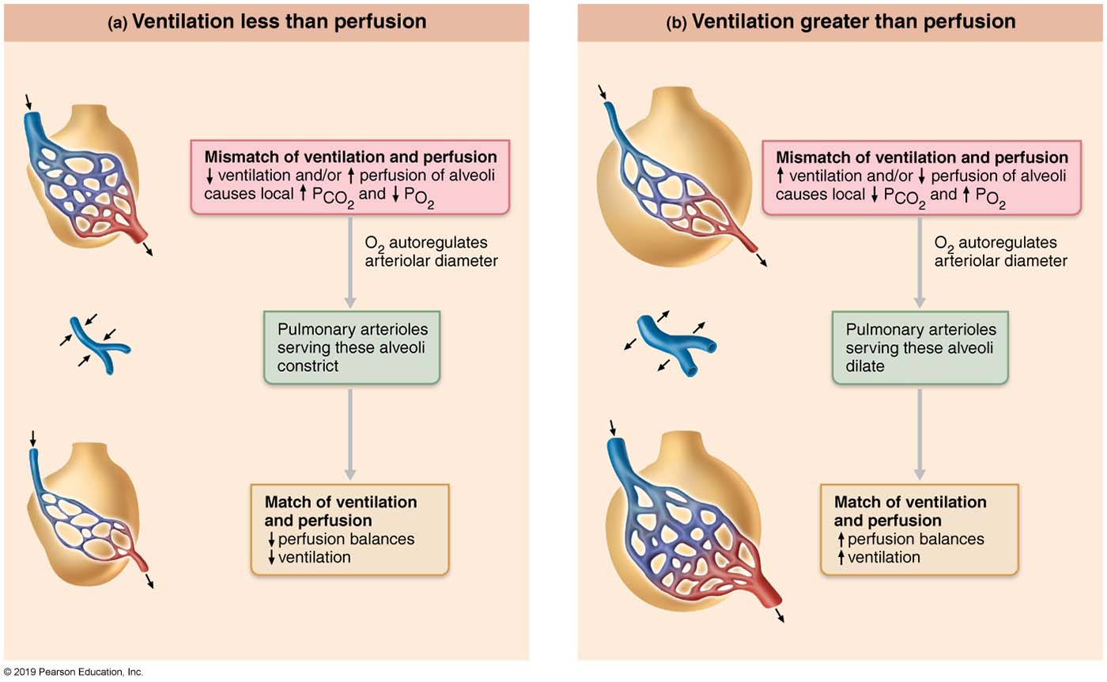
Ventilation-Perfusion Coupling
Figure 22.23 Ventilation-perfusion coupling.

Slide 79
Internal Respiration
Internal respiration involves capillary gas exchange in body tissues
Partial pressures and diffusion gradients are reversed compared to external respiration
Tissue P_{O2} is always lower than in arterial blood P_{O2} (40 vs. 100 mm Hg), so oxygen moves from blood to tissues
Tissue P_{CO2} is always higher than arterial blood P_{CO2} (45 vs. 40 mm Hg), so CO₂ moves from tissues into blood
Venous blood returning to heart has P_{O2} of 40 mm Hg and P_{CO2} of 45 mm Hg

Slide 80
Partial Pressure Gradients Promoting Gas Movements in the Body (2 of 2)
Figure 22.20 Partial pressure gradients promoting gas movements in the body.

Slide 81
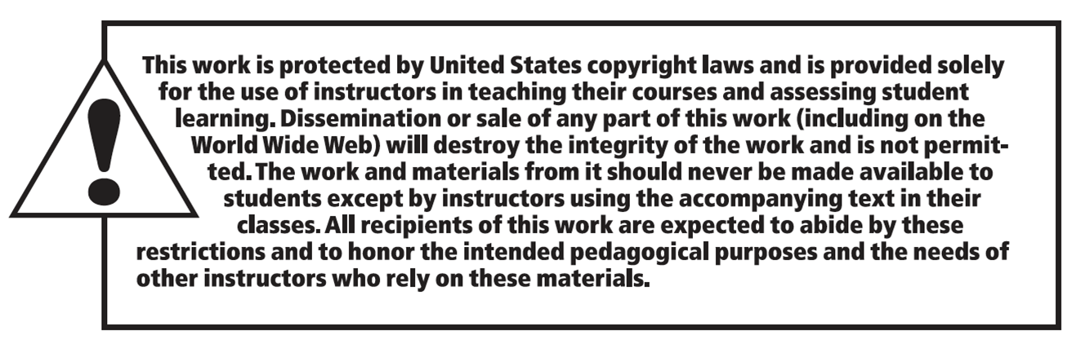
Copyright

