Slide 1

Human Anatomy and Physiology
Eleventh Edition
Chapter 22 Part C
The Respiratory System
PowerPoint® Lectures Slides prepared by Karen Dunbar Kareiva, Ivy Tech Community College
Copyright © 2019, 2016, 2013 Pearson Education, Inc. All Rights Reserved

Slide 2
22.7 Transport of Respiratory Gases by Blood

Slide 3
Oxygen Transport (1 of 8)
Molecular O₂ is carried in blood in two ways:
  1.5% is dissolved in plasma
  98.5% is loosely bound to each Fe of hemoglobin (Hb) in RBCs

Slide 4
Oxygen Transport (2 of 8)
Association of oxygen and hemoglobin
  Each Hb molecule is composed of four polypeptide chains, each with a iron-containing heme group
    So each Hb can transport four oxygen molecules
  Oxyhemoglobin (HbO₂): hemoglobin-O₂ combination
  Reduced hemoglobin (deoxyhemoglobin) (HHb): hemoglobin that has released O₂

Slide 5
Oxygen Transport (3 of 8)
Association of oxygen and hemoglobin (cont.)
  Loading and unloading of O₂ is facilitated by a change in shape of Hb
    As O₂ binds, Hb changes shape, increasing its affinity for O₂ increases
    As O₂ is released, Hb shape change causes a decrease in affinity for O₂
  Fully saturated (100%): all four heme groups carry O₂
  Partially saturated: when only one to three hemes carry O₂

Slide 6
Oxygen Transport (4 of 8)
Association of oxygen and hemoglobin (cont.)
  Rate of loading and unloading of O₂ is regulated to ensure adequate oxygen delivery to cells
  Factors that influence hemoglobin saturation:
    P_{O2}
    Other factors such as:
      Temperature
      Blood pH
      P_{CO2}
      Concentration of BPG

Slide 7
Oxygen Transport (5 of 8)
  Influence of P_{O2} on hemoglobin saturation
    P_{O2} heavily influences binding and release of O₂ with hemoglobin
    Percent of Hb saturation can be plotted against P_{O2} concentrations
      Resulting graph is not linear, but an S-shaped curve
      Referred to as an oxygen-hemoglobin dissociation curve

Slide 8
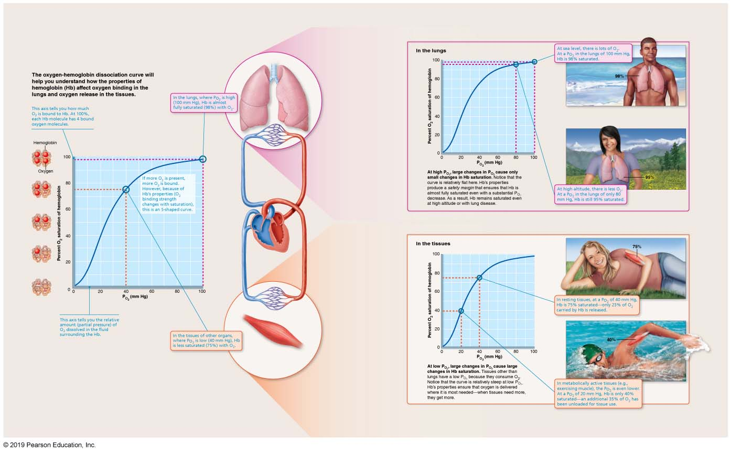
The Amount of Oxygen Carried by Hemoglobin Depends on the P_{O2} (the Amount of Oxygen) Available Locally. This Relationship Ensures Optimal Oxygen Pickup and Delivery (1 of 2)
Focus Figure 22.1 The Oxygen-Hemoglobin Dissociation Curve.

Slide 9
Oxygen Transport (6 of 8)
  Influence of P_{O2} on hemoglobin saturation
    In arterial blood:
      P_{O2} is 100 mm Hg and contains 20 ml of oxygen per 100 ml blood (20 volume %)
      Hb is 98% saturated
      Further increases in P_{O2} (as in deep breathing) produce minimal increases in O₂ binding
    In venous blood, P_{O2} is 40 mm Hg and contains 15 volume % oxygen
      Hb is still 75% saturated
      Venous reserve: oxygen remaining in venous blood that can still be used

Slide 10
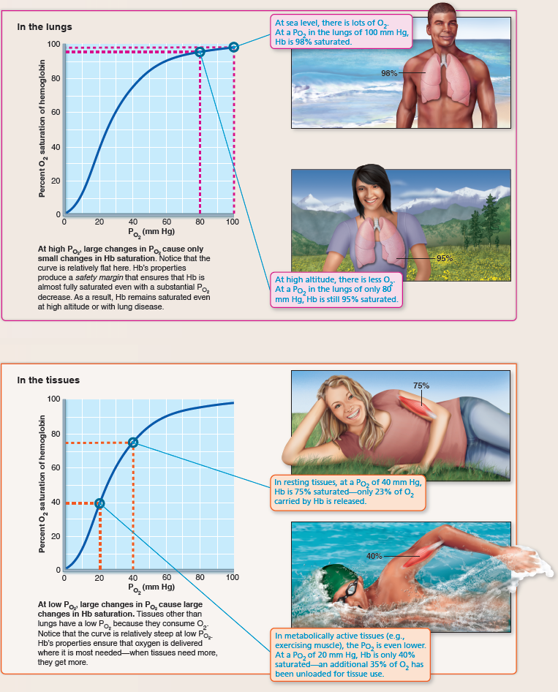
  The Amount of Oxygen Carried by Hemoglobin Depends on the P_{O2} (the Amount of Oxygen) Available Locally. This Relationship Ensures Optimal Oxygen Pickup and Delivery (2 of 2)
Focus Figure 22.1 The Oxygen-Hemoglobin Dissociation Curve.

Slide 11
Oxygen Transport (7 of 8)
  Influence of other factors on hemoglobin saturation
    Increases in temperature, H⁺, P_{CO2}, and BPG can modify structure of hemoglobin
      Results in a decrease for Hb’s affinity for O₂
      Occurs in systemic capillaries
      Enhances O₂ unloading, causing a shift in O₂-hemoglobin dissociation curve to right
    Decreases in these factors shift curve to left
      Decreases oxygen unloading from blood

Slide 12
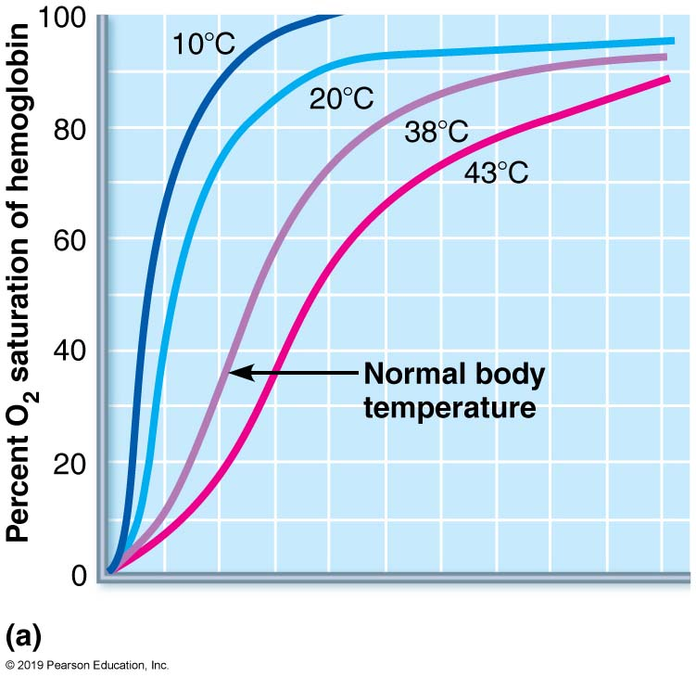
Effect of Temperature, P_{CO2}, and Blood pH on the Oxygen-Hemoglobin Dissociation Curve (1 of 2)
Figure 22.24a Effect of temperature, P_{CO2}, and blood pH on the oxygen-hemoglobin dissociation curve.

Slide 13
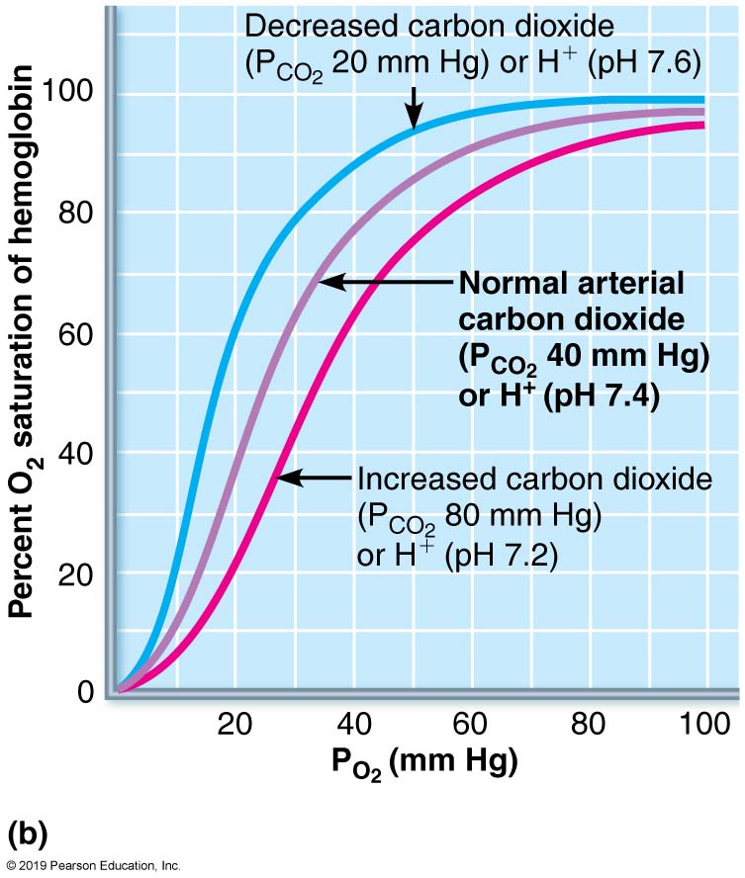
Effect of Temperature, P_{CO2}, and Blood pH on the Oxygen-Hemoglobin Dissociation Curve (2 of 2)
Figure 22.24b Effect of temperature, P_{CO2}, and blood pH on the oxygen-hemoglobin dissociation curve.

Slide 14
Oxygen Transport (8 of 8)
  Influence of other factors on hemoglobin saturation (cont.)
    BPG is produced by RBCs during glycolysis; BPG levels rise when oxygen levels are low
    As cells metabolize glucose, they use O₂, causing:
      Increases in P_{CO2} and H⁺ in capillary blood
      Declining blood pH (acidosis) and increasing P_{CO2} cause Hb-O₂ bond to weaken
        Referred to as Bohr effect
        O₂ unloading occurs where needed most
      Heat production in active tissue directly and indirectly decreases Hb affinity for O₂
        Allows increased O₂ unloading to active tissues

Slide 15
Carbon Dioxide Transport (1 of 7)
CO₂ is transported in blood in three forms:
  Dissolved in plasma (7 to 10%) as P_{CO2}
  Chemically bound to hemoglobin (just over 20%).
    CO₂ is bound to the globin part of hemoglobin
    Referred to as carbaminohemoglobin

Slide 16
Carbon Dioxide Transport (2 of 7)
  As bicarbonate ions in plasma (about 70%). (HCO₃–) in plasma
    Formation of bicarbonate involves CO₂ combining with water to form carbonic acid (H₂CO₃), which quickly dissociates into bicarbonate and H⁺

Slide 17
Carbon Dioxide Transport (3 of 7)
    Occurs primarily in RBCs, where enzyme carbonic anhydrase reversibly and rapidly catalyzes this reaction
    In systemic capillaries, after HCO₃– is created, it quickly diffuses from RBCs into plasma
      Outrush of HCO₃– from RBCs is balanced as Cl– moves into RBCs from plasma
        Referred to as chloride shift

Slide 18
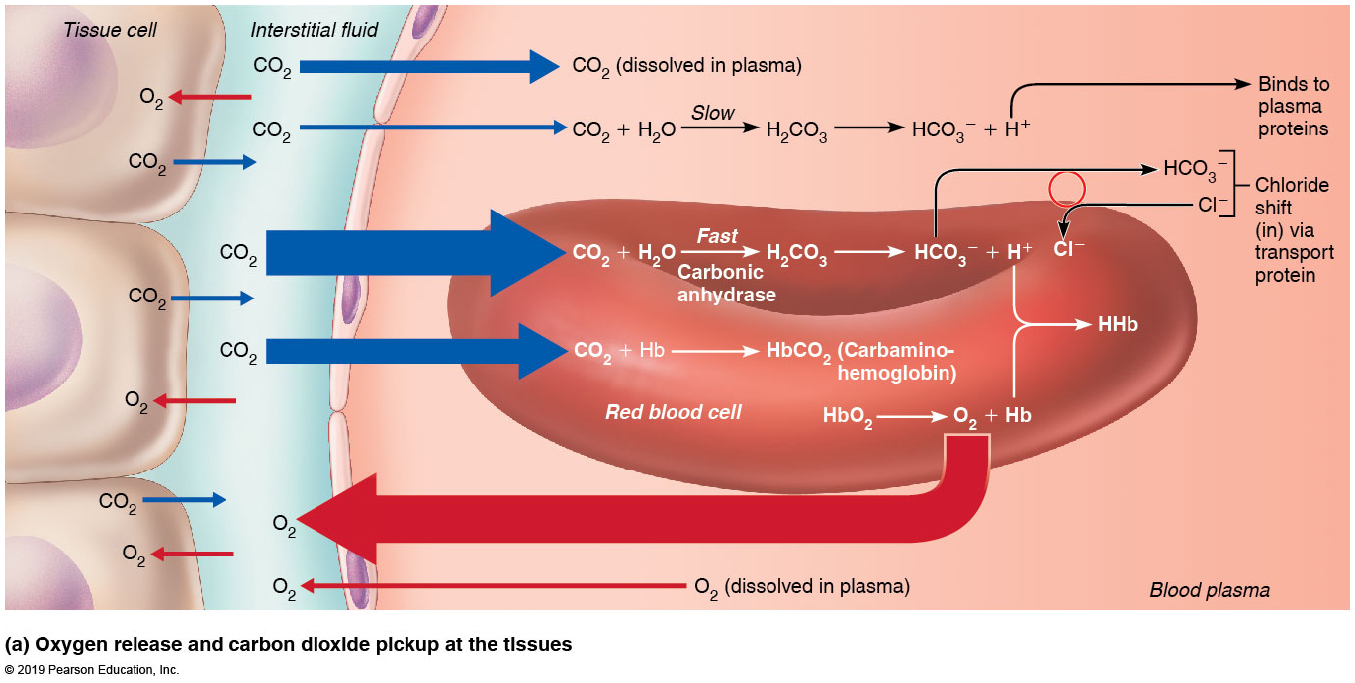
Transport and Exchange of CO₂ and O₂
(1 of 3)
Figure 22.25a Transport and exchange of CO₂ and O₂.

Slide 19
  Carbon Dioxide Transport (4 of 7)
    In pulmonary capillaries, the processes occur in reverse
      HCO₃– moves into RBCs while Cl⁻ moves out of RBCs back into plasma
      HCO₃– binds with H⁺ to form H₂CO₃
      H₂CO₃ is split by carbonic anhydrase into CO₂ and water
      CO₂ diffuses into alveoli

Slide 20
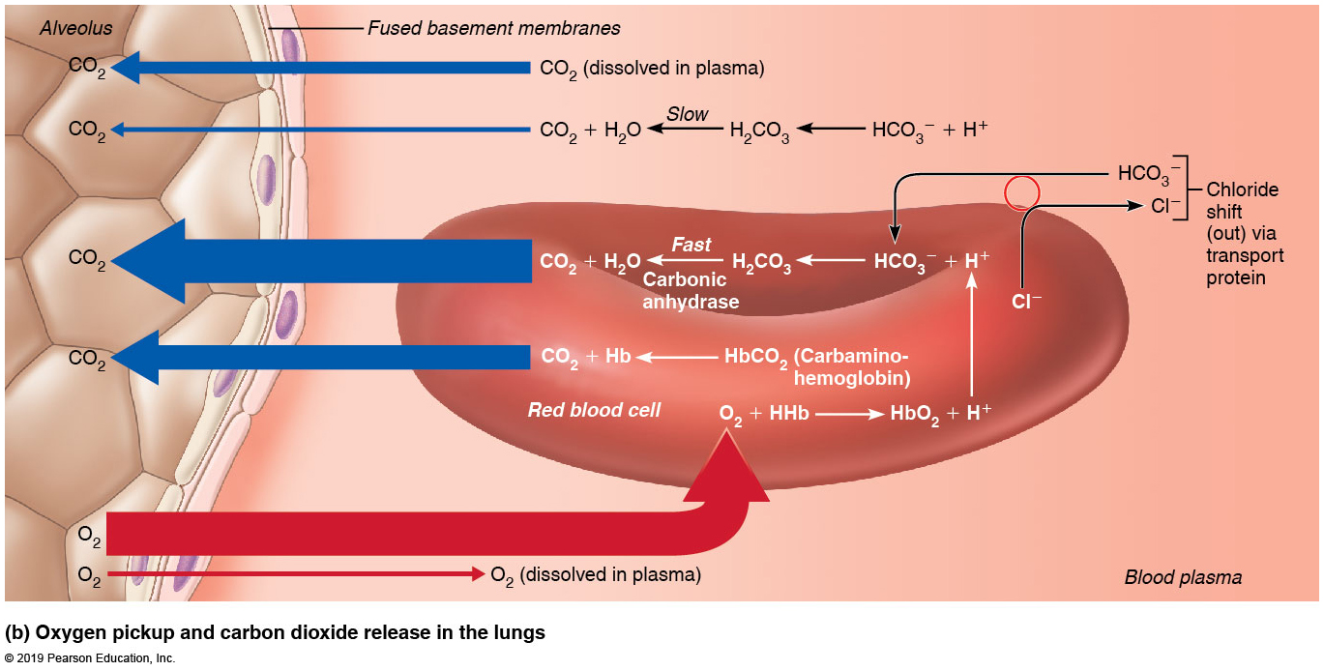
Transport and Exchange of CO₂ and O₂
(2 of 3)
Figure 22.25b Transport and exchange of CO₂ and O₂.

Slide 21
Carbon Dioxide Transport (5 of 7)
Haldane effect
  Amount of CO₂ transported is affected by P_{O2}
  The lower the P_{O2} and hemoglobin O₂ saturation, the more CO₂ can be carried in blood
  Reduced hemoglobin buffers H⁺ and forms carbaminohemoglobin more easily
  Process encourages CO₂ exchange at tissues and at lungs
    At tissues, as more CO₂ enters blood, more oxygen dissociates from hemoglobin (Bohr effect)
      As HbO₂ releases O₂, it more readily forms bonds with CO₂ to form carbaminohemoglobin

Slide 22
Transport and Exchange of CO₂ and O₂
(3 of 3)
Figure 22.25b Transport and exchange of CO₂ and O₂.

Slide 23
Carbon Dioxide Transport (6 of 7)
Influence of CO₂ on blood pH
  Carbonic acid–bicarbonate buffer system: helps blood resist changes in pH
    If H⁺ concentration in blood rises, excess H⁺ is removed by combining with HCO₃– to form H₂CO₃, which dissociates into CO₂ and H₂O
    If H⁺ concentration begins to drop, H₂CO₃ dissociates, releasing H⁺
    HCO₃– is considered the alkaline reserve of carbonic acid-bicarbonate buffer system

Slide 24
Carbon Dioxide Transport (7 of 7)
Changes in respiratory rate and depth affect blood pH
  Slow, shallow breathing causes an increase in CO₂ in blood, resulting in a drop in pH
  Rapid, deep breathing causes a decrease in CO₂ in blood, resulting in a rise in pH
Changes in ventilation can help adjust pH when disturbances are caused by metabolic factors
  Breathing plays a major role in acid-base balance of body

Slide 25
Hypoxia
Hypoxia: inadequate O₂ delivery to tissues; can result in cyanosis and is classified by cause:
  Anemic hypoxia: too few RBCs or abnormal or too little Hb
  Ischemic hypoxia: impaired or blocked blood circulation
  Histotoxic hypoxia: cells unable to use O₂, as in metabolic poisons (ex: cyanide)
  Hypoxemic hypoxia: abnormal ventilation; pulmonary disease, low levels of oxygen in air
  Carbon monoxide poisoning: especially from fire; Hb has a 200× greater affinity for carbon monoxide than oxygen
    Victims have headaches and can become flushed

Slide 26
BioFlix: Gas Exchange
Click here to view ADA compliant Animation:
BioFlix: Gas Exchange
https://mediaplayer.pearsoncmg.com/assets/secs-bioflix-gas-exchange-introduction

Slide 27
22.8 Control of Respiration
Respiratory rhythms are regulated by higher brain centers, chemoreceptors, and other reflexes

Slide 28
Neural Mechanisms (1 of 6)
Neural controls involve neurons in reticular formation of medulla and pons
Medullary respiratory centers
  Clustered neurons in two areas of medulla are most important:
    Ventral respiratory group
    Dorsal respiratory group

Slide 29
Neural Mechanisms (2 of 6)
  Ventral respiratory group (VRG)
    Rhythm-generating and integrative center
      Recent evidence suggests forced expiration may involve a separate group of neurons than passive respiration
    Consists of network of neurons in brain stem that extends from spinal cord to pons-medulla junction

Slide 30
Neural Mechanisms (3 of 6)
    Sets eupnea: normal respiratory rate and rhythm (12–15 breaths/minute)
    Its inspiratory neurons excite inspiratory muscles via phrenic (diaphragm) and intercostal nerves (external intercostals)
    Expiratory neurons inhibit inspiratory neurons

Slide 31
Neural Mechanisms (4 of 6)
  Dorsal respiratory group (DRG)
    Network of neurons located near root of cranial nerve IX
    Group integrates input from peripheral stretch and chemoreceptors, then sends information to VRG neurons
    Much is not known about this group of neurons

Slide 32
Neural Mechanisms (5 of 6)
Pontine respiratory centers
  Neurons in this center influence and modify activity of VRG
  Act to smooth out transition between inspiration and expiration and vice versa
  Transmit impulses to VRG that modify and fine-tune breathing rhythms during vocalization, sleep, exercise
  Lesions in this area of brain lead to apneustic breathing, where patient takes prolonged inspirations

Slide 33
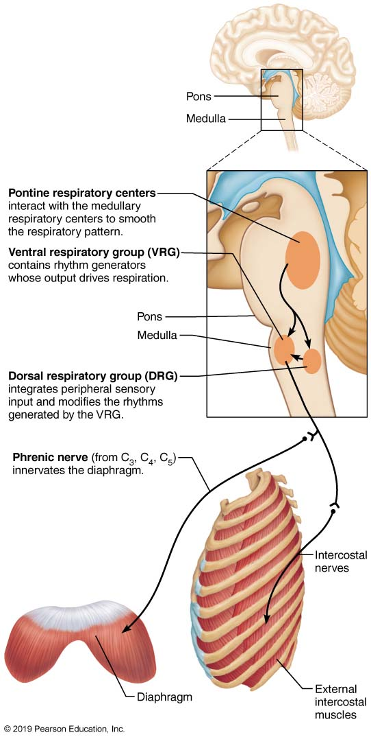
Respiratory Centers in the Brain Stem
Figure 22.26 Respiratory centers in the brain stem.

Slide 34
Neural Mechanisms (6 of 6)
Generation of the respiratory rhythm
  Origin of breathing rhythm is not yet fully understood
  One hypothesis: pacemaker neurons in VRG control intrinsic rhythmicity
  Most widely accepted hypothesis: reciprocal inhibition of two sets of interconnected pacemaker neurons in medulla generates rhythm
    Each neuron set controls the other to ensure rhythm

Slide 35
Factors Influencing Breathing Rate and Depth (1 of 11)
Depth is determined by how actively respiratory center stimulates respiratory muscles
  The greater the stimulation, the greater the number of motor units excited, increasing depth of inspiration
Rate is determined by how long center is active
Both are modified by changing body demands

Slide 36
Factors Influencing Breathing Rate and Depth (2 of 11)
Respiratory centers are affected by:
  Chemical factors
  Influence of higher brain centers
  Pulmonary irritant reflexes
  Inflation reflex

Slide 37
Factors Influencing Breathing Rate and Depth (3 of 11)
Chemical factors
  Most important of all factors affecting depth and rate of inspiration
  Changing levels of P_{CO2}, P_{O2}, and pH are most important
  Levels of these chemicals are sensed by:
    Central chemoreceptors: located throughout brain stem
    Peripheral chemoreceptors: found in aortic arch and carotid arteries

Slide 38
Factors Influencing Breathing Rate and Depth (4 of 11)
  Influence of P_{CO2}
    Most potent and most closely controlled
    If blood P_{CO2} levels rise (hypercapnia), CO₂ accumulates in brain and joins with water to become carbonic acid
      Carbonic acid dissociates, releasing H⁺, causing a drop in pH (increased acidity)
      Increased H⁺ stimulates central chemoreceptors of brain stem, which synapse with respiratory regulatory centers
      Respiratory centers increase depth and rate of breathing, which act to lower blood P_{CO2}, and pH rises to normal levels

Slide 39
Factors Influencing Breathing Rate and Depth (5 of 11)
  Influence of P_{CO2} (cont.)
    If blood P_{CO2} levels decrease, respiration becomes slow and shallow
      Apnea: breathing cessation that may occur when P_{CO2} levels drop abnormally low
      Swimmers sometimes voluntarily hyperventilate to enable them to hold their breath longer
        Causes a drop in P_{CO2}, which causes a delay in respiration, as P_{CO2} levels need to build back up
        Can cause dangerous drops in P_{O2} levels

Slide 40
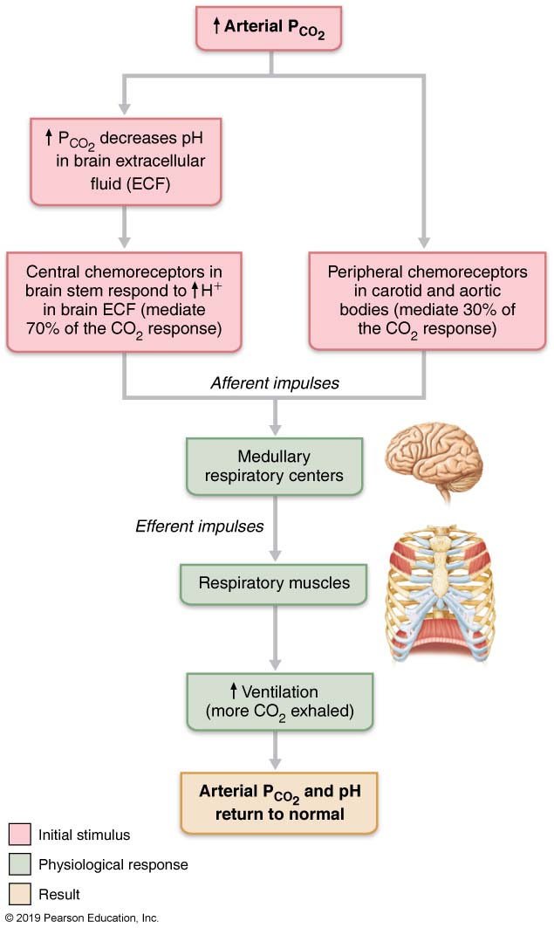
  Changes in P_{CO2} Regulate Ventilation by a Negative Feedback Mechanism
Figure 22.28 Changes in P_{CO2} regulate ventilation by a negative feedback mechanism.

Slide 41
Clinical – Homeostatic Imbalance 22.15
Hyperventilation: increased depth and rate of breathing that exceeds body’s need to remove CO₂
  May be caused by anxiety attacks
  Leads to decreased blood CO₂ levels (hypocapnia)
    Causes cerebral vasoconstriction and cerebral ischemia, resulting in dizziness, fainting
    Early symptoms include tingling and involuntary muscle spasms in hands and face
  Treatment: breathing into paper bag increases CO₂ levels being inspired

Slide 42
Factors Influencing Breathing Rate and Depth (6 of 11)
Chemical factors (cont.)
  Influence of P_{O2}
    Peripheral chemoreceptors in aortic and carotid bodies sense arterial O₂ levels
    Declining P_{O2} normally has only slight effect on ventilation because of huge O₂ reservoir bound to Hb
      Requires substantial drop in arterial P_{O2} (below 60 mm Hg) to stimulate increased ventilation
      When excited, chemoreceptors cause respiratory centers to increase ventilation

Slide 43
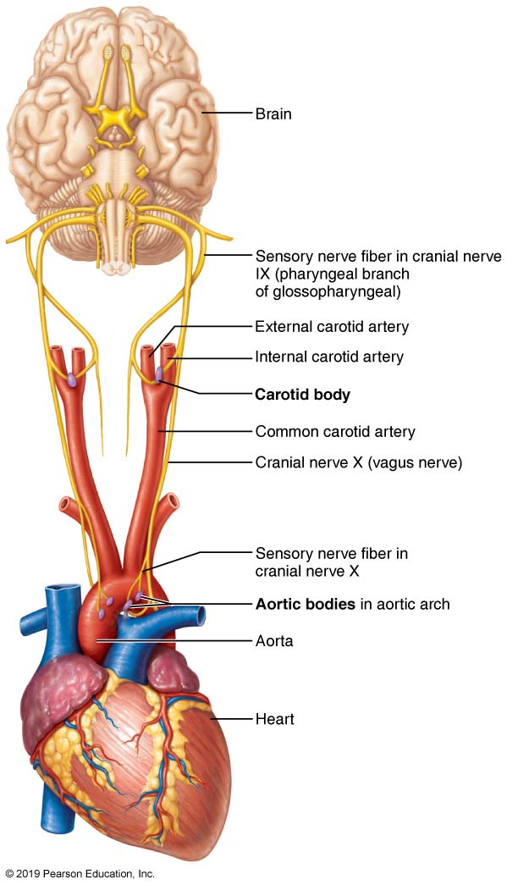
  Location and Innervation of the Peripheral Chemoreceptors in the Carotid and Aortic Bodies
Figure 22.29 Location and innervation of the peripheral chemoreceptors in the carotid and aortic bodies.

Slide 44
Factors Influencing Breathing Rate and Depth (7 of 11)
  Influence of arterial pH
    pH can modify respiratory rate and rhythm even if CO₂ and O₂ levels are normal
    Mediated by peripheral chemoreceptors
    Decreased pH may reflect CO₂ retention, accumulation of lactic acid, or excess ketone bodies
    Respiratory system controls attempt to raise pH by increasing respiratory rate and depth

Slide 45
Factors Influencing Breathing Rate and Depth (8 of 11)
  Summary of chemical factors
    Rising CO₂ levels are most powerful respiratory stimulant
    Normally, blood P_{O2} affects breathing only indirectly by influencing peripheral chemoreceptor sensitivity to changes in P_{CO2}
    When arterial P_{O2} falls below 60 mm Hg, it becomes major stimulus for respiration (via peripheral chemoreceptors)
    Changes in arterial pH resulting from CO₂ retention or metabolic factors act indirectly through peripheral chemoreceptors

Slide 46
Factors Influencing Breathing Rate and Depth (9 of 11)
Influence of higher brain centers
  Hypothalamic controls: act through limbic system to modify rate and depth of respiration
    Example: breath holding that occurs in anger or gasping with pain
    Change in body temperature changes rate
  Cortical controls: direct signals from cerebral motor cortex that bypass medullary controls
    Example: voluntary breath holding at least until brain stem reinstates breathing when blood CO₂ becomes critical

Slide 47
Factors Influencing Breathing Rate and Depth (10 of 11)
Pulmonary irritant reflexes
  Receptors in bronchioles respond to irritants such as dust, accumulated mucus, or noxious fumes
    Receptors communicate with respiratory centers via vagal nerve afferents
  Promote reflexive constriction of air passages
  Same irritant triggers a cough in trachea or bronchi or a sneeze in nasal cavity

Slide 48
Factors Influencing Breathing Rate and Depth (11 of 11)
Inflation reflex
  Hering-Breuer reflex (inflation reflex)
    Stretch receptors in pleurae and airways are stimulated by lung inflation
      Send inhibitory signals to medullary respiratory centers to end inhalation and allow expiration
      May act as protective response more than as a normal regulatory mechanism

Slide 49
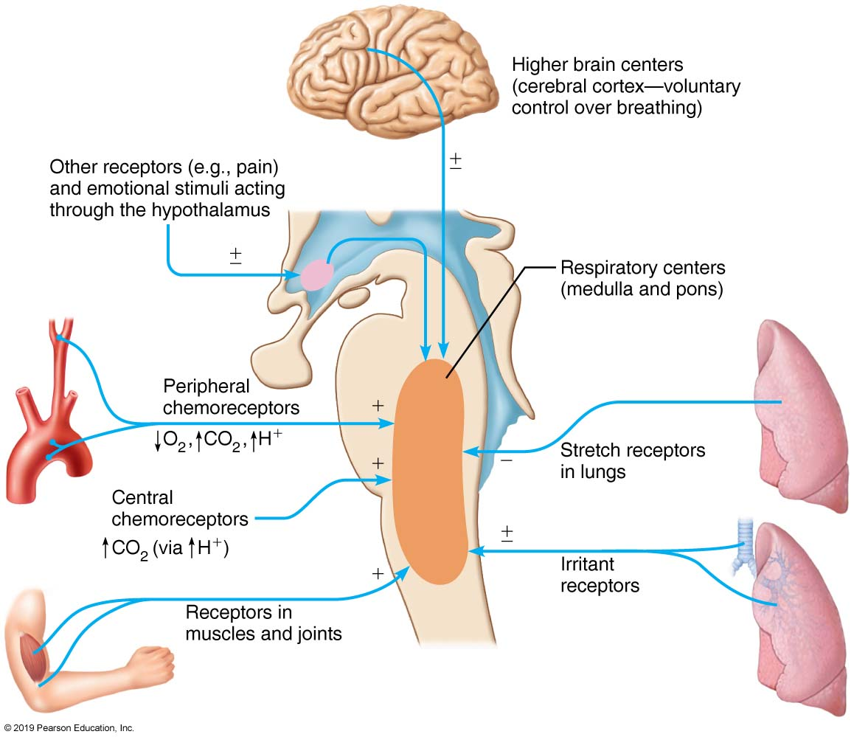
Neural and Chemical Influences on Brain Stem Respiratory Centers
Figure 22.27 Neural and chemical influences on brain stem respiratory centers.

Slide 50
22.9 Respiratory Adjustments

Slide 51
Exercise (1 of 3)
During exercise, adjustments geared to both intensity and duration must be made
Hyperpnea: increased ventilation in response to metabolic needs
  Ventilation can increase 10 to 20 fold
Ventilation increases abruptly, increases gradually, then reaches steady state; when exercise stops, there is a small, abrupt decline in ventilation, followed by a gradual decrease
P_{CO2}, P_{O2}, and pH remain surprisingly constant during exercise

Slide 52
Exercise (2 of 3)
Abrupt increase in ventilation that occurs as exercise begins involves three neural factors:
  Psychological stimuli: anticipation of exercise
  Simultaneous cortical motor activation of skeletal muscles and respiratory centers
  Excitatory impulses to respiratory centers from proprioceptors in moving muscles, tendons, joints
  Gradual increase and plateau of respiration reflect is caused by increased rate of CO₂ delivery to the lungs

Slide 53
Exercise (3 of 3)
Ventilation declines suddenly as exercise ends is because the three neural factors are shut off
  Gradual decline to baseline is due to decline in CO₂ flow after exercise ends
Exercise leads to anaerobic respiration and the formation of lactic acid
  Lack of oxygen in muscles is not from poor respiratory function, but rather from insufficient cardiac output or skeletal muscle inability to increase oxygen uptake

Slide 54
High Altitude (1 of 3)
Quick travel to altitudes above 2400 meters (8000 feet) may trigger symptoms of acute mountain sickness (AMS)
  Atmospheric pressure and P_{O2} levels are lower at high elevations
  Symptoms: headaches, shortness of breath, nausea, and dizziness
  In severe cases, lethal cerebral and pulmonary edema may occur

Slide 55
High Altitude (2 of 3)
Acclimatization: respiratory and hematopoietic adjustments are made with long-term moves to high altitude
  Chemoreceptors become more responsive to P_{CO2} when P_{O2} declines
  Substantial decline in P_{O2} directly stimulates peripheral chemoreceptors
  Results in increases in minute ventilation that stabilize in few days to 2–3 L/min higher than at sea level

Slide 56
High Altitude (3 of 3)
High altitude conditions always result in lower-than-normal Hb saturation levels
  Due to availability of less O₂
Decline in blood O₂ stimulates kidneys to accelerate production of EPO
RBC numbers increase slowly to provide long-term compensation

Slide 57
22.10 Lung Diseases

Slide 58
Chronic Obstructive Pulmonary Disease (COPD) (1 of 5)
Exemplified by chronic emphysema and chronic bronchitis
Key feature is irreversible decrease in ability to force air out of lungs

Slide 59
Chronic Obstructive Pulmonary Disease (COPD) (2 of 5)
Other common features:
  History of smoking in 80% of patients
  Dyspnea: labored breathing (“air hunger”)
  Coughing and frequent pulmonary infections
  Most patients develop hypoventilation accompanied by respiratory acidosis, hypoxemia

Slide 60
Chronic Obstructive Pulmonary Disease (COPD) (3 of 5)
Emphysema: Permanent enlargement of alveoli and destruction of alveolar walls result in decreased lung elasticity, with three consequences:
    Accessory muscles are necessary for breathing, leading to exhaustion from using 10–15% more energy to breathe than normal
    Trapped air causes hyperinflation, which flattens diaphragm and causes expanded barrel chest, both of which reduces ventilation efficiency
    Damaged pulmonary capillaries lead to enlarged right ventricle
  Hereditary factors for disease include alpha-1 antitrypsin deficiency

Slide 61
Chronic Obstructive Pulmonary Disease (COPD) (4 of 5)
Chronic bronchitis
  Inhaled irritants cause chronic excessive mucus
  Mucosae of lower respiratory passageways become inflamed and fibrosed
  Results in obstructed airways that impair lung ventilation and gas exchange
  Symptoms include frequent pulmonary infections
  Risk factors include smoking and environmental pollutants

Slide 62
Chronic Obstructive Pulmonary Disease (COPD) (5 of 5)
COPD symptoms and treatment
  Strength of patient’s innate respiratory drive is reason behind different symptoms seen
    “Pink puffers”: patient usually thin because they burn large amount of energy breathing; near-normal blood gases are maintained, so skin color is normal
    “Blue bloaters”: patient usually stocky; cyanosis is due to hypoxia, so skin color takes on bluish hue
  Treatment: bronchodilators, corticosteroids, oxygen, sometimes lung volume reduction surgery; oxygen must be administered carefully

Slide 63
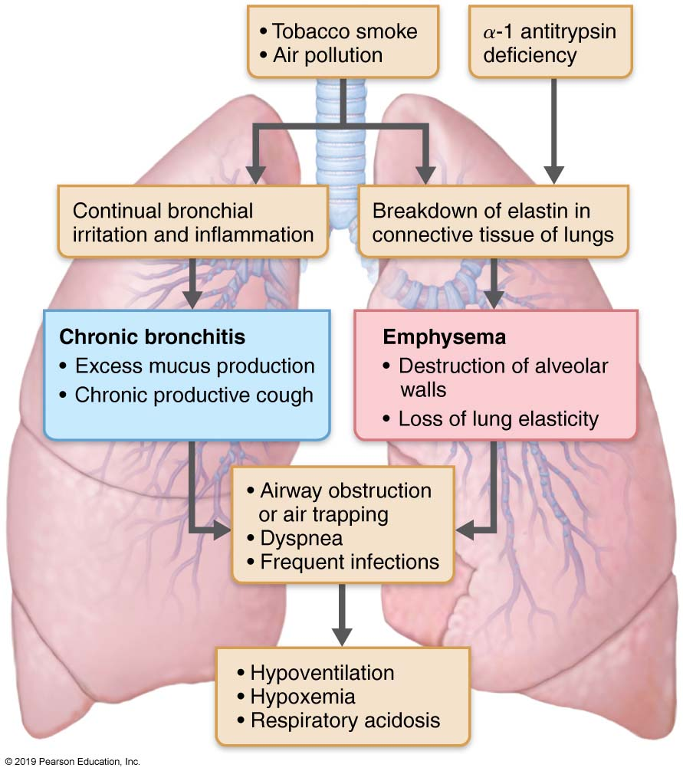
  The Pathogenesis of COPD
Figure 22.30 The pathogenesis of COPD.

Slide 64
Asthma
Sometimes classified as COPD, but episodes are acute, not chronic, with symptom-free periods
Characterized by coughing, dyspnea, wheezing, and chest tightness
Active inflammation of airways precedes bronchospasms
Airway inflammation is an immune response caused by release of interleukins, production of IgE, and recruitment of inflammatory cells
Airways thickened with inflammatory exudate magnify effect of bronchospasms

Slide 65
Tuberculosis (TB)
Infectious disease caused by bacterium Mycobacterium tuberculosis
Symptoms: fever, night sweats, weight loss, racking cough, coughing up blood
Treatment: 12-month course of antibiotics
  Antibiotic-resistant strains have been seen, including multidrug-resistant strains

Slide 66
Lung Cancer (1 of 3)
Leading cause of cancer deaths in North America
90% of all cases are result of smoking

Slide 67
Lung Cancer (2 of 3)
Three most common types:
  Adenocarcinoma (~40% of cases) originates in peripheral lung areas; develops from bronchial glands and alveolar cells
  Squamous cell carcinoma (~20 of cases) arises in bronchial epithelium
  Small cell carcinoma (~15% of cases) contains lymphocyte-like cells that originate in primary bronchi and subsequently metastasize

Slide 68
Lung Cancer (3 of 3)
Treatment for lung cancer
  Early detection is key to survival
  If metastasis has not occurred: surgery to remove diseased lung tissue
  If metastasis has occurred: radiation and chemotherapy
  Several new therapies are on horizon

Slide 69
Sleep Apnea (1 of 2)
Sleep apnea - common disorder characterized by temporary cessation of breathing during sleep
  Person usually not aware of problem
  Leads to excessive daytime sleepiness due to waking up several times each night (can be up to 30 per hour)
  Obstructive sleep apnea – most common type caused by collapse of upper airway
    Pharynx muscles relax during sleep and sag causing obstruction

Slide 70
Sleep Apnea (2 of 2)
Central sleep apnea – caused by reduced drive from respiratory centers of brain stem
Consequences of disrupted sleep:
  Susceptibility to accidents
  Increase in chronic illnesses such as hypertension, heart disease, stroke, diabetes
Obstructive sleep apnea can be treated by using CPAP (continuous positive airway pressure) device
  Pressure from CPAP holds airway open, preventing collapse

Slide 71
Developmental Aspects of Respiratory System (1 of 2)
Upper respiratory structures develop first
Olfactory placodes invaginate into olfactory pits (form nasal cavities) present by week 4
Laryngotracheal bud is present by week 5
Mucosae of bronchi and lung alveoli are present by eighth week
By week 28, premature baby can breathe on its own
During fetal life, lungs are filled with fluid, and blood bypasses the lungs
Gas exchange takes place via placenta

Slide 72
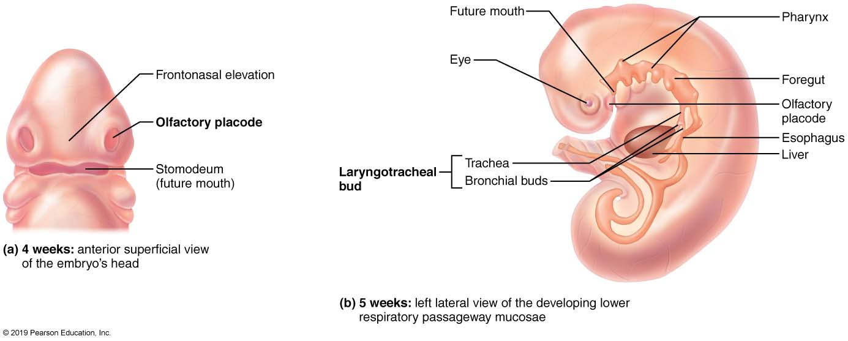
  Embryonic Development of the Respiratory System
Figure 22.31 Embryonic development of the respiratory system.

Slide 73
Developmental Aspects of Respiratory System (2 of 2)
At birth, respiratory centers are activated, alveoli inflate, and lungs begin to function
Takes 2 weeks after birth before lungs are fully inflated
Respiratory rate is highest in newborns (40–80 breaths/min) and slows until adulthood (12–16 breaths/min)
Lungs continue to mature, and more alveoli are formed until young adulthood
Respiratory efficiency decreases in old age

Slide 74
Clinical – Homeostatic Imbalance 22.16
(1 of 2)
Cystic fibrosis
  Most common lethal genetic disease in North America
  Abnormal, viscous mucus clogs passageways, which can lead to bacterial infections
    Affects lungs, pancreatic ducts, and reproductive ducts

Slide 75
Clinical – Homeostatic Imbalance 22.16
(2 of 3)
Cystic fibrosis (cont.)
  Caused by an abnormal gene for Cl⁻ membrane channel protein, cystic fibrosis transmembrane conductance regulator (CFTR)
    Abnormal CFTR protein gets stuck in endoplasmic reticulum (ER), so never reaches cell membrane to carry out Cl⁻ transport function

Slide 76
Clinical – Homeostatic Imbalance 22.16
(3 of 3)
Treatments for cystic fibrosis
  Mucus-dissolving drugs, manipulation to loosen mucus and antibiotics
  Inhalation hypertonic saline to thin mucus
  Ongoing research involves:
    Introducing normal CFTR genes into respiratory tract mucosa cells
    Prodding different protein to take over Cl⁻ channel protein duties
    Freeing patient’s abnormal CFTR protein from ER

Slide 77
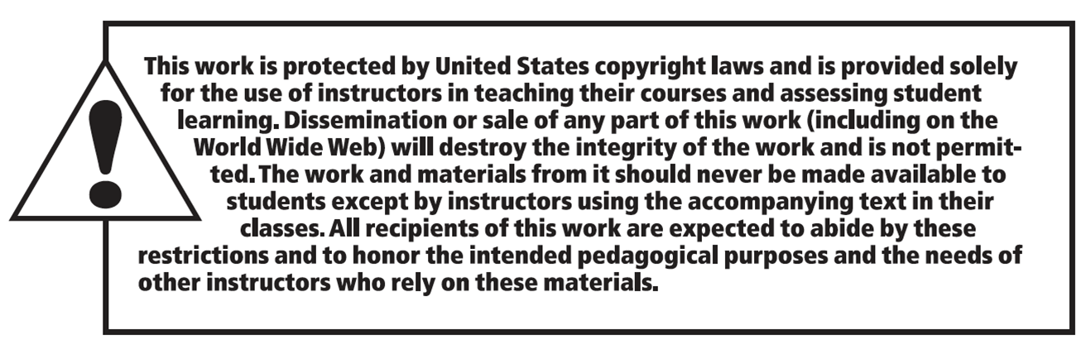
Copyright

