Slide 1

Human Anatomy and Physiology
Eleventh Edition
Chapter 23 Part A
The Digestive System
PowerPoint® Lectures Slides prepared by Karen Dunbar Kareiva, Ivy Tech Community College
Copyright © 2019, 2016, 2013 Pearson Education, Inc. All Rights Reserved

Slide 2
Why This Matters
Understanding the process of digestion will help in properly assessing patients with digestive disorders such as acid reflux and heartburn.

Slide 3
Video: Why This Matters (Career Connection)
Click here to view ADA compliant video:
Why This Matters (Career Connection)
https://mediaplayer.pearsoncmg.com/assets/secs_wtm_ch_23_christian_v2

Slide 4
Function of Digestive System
Main functions of the digestive system
  Take in food
  Break it down into nutrient molecules
  Absorb molecules into the bloodstream
  Rid body of any indigestible remains

Slide 5
Part 1 – Overview of Digestive System
(1 of 2)
Organs of the digestive system fall into two groups:
  Alimentary canal (gastrointestinal or GI tract or gut)
    Continuous muscular tube that runs from the mouth to anus
    Digests food: breaks down into smaller fragments
    Absorbs fragments through lining into blood
    Organs: mouth, pharynx, esophagus, stomach, small intestine, large intestine, anus

Slide 6
Part 1 – Overview of Digestive System
(2 of 2)
  Accessory digestive organs
    Teeth
    Tongue
    Gallbladder
    Digestive glands: produce secretions that help break down foodstuffs
      Salivary glands
      Liver
      Pancreas

Slide 7
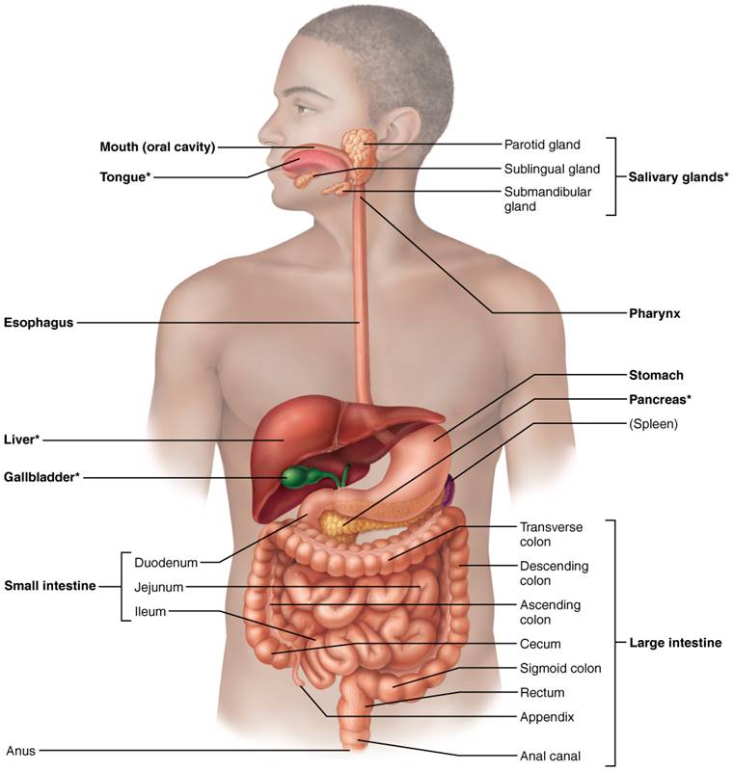
Alimentary Canal and Related Accessory Digestive Organs
Figure 23.1 Alimentary canal and related accessory digestive organs.

Slide 8
23.1 Digestive Processes (1 of 2)
Processing of food involves six essential activities:
  Ingestion: eating
  Propulsion: movement of food through the alimentary canal, which includes:
    Swallowing
    Peristalsis: major means of propulsion of food that involves alternating waves of contraction and relaxation

Slide 9
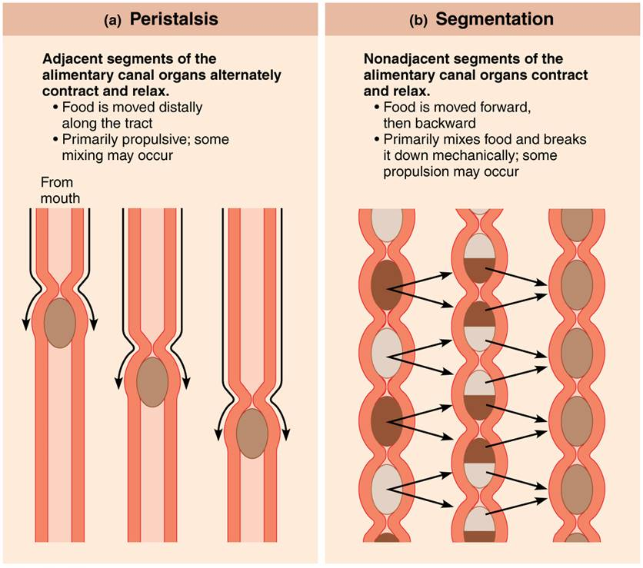
Peristalsis and Segmentation
Figure 23.3 Peristalsis and segmentation.

Slide 10
23.1 Digestive Processes (2 of 2)
  Mechanical breakdown: includes chewing, mixing food with saliva, churning food in
  stomach, and segmentation
    Segmentation: local constriction of intestine that mixes food with digestive juices
  Digestion: series of catabolic steps that involves enzymes that break down complex food molecules into chemical building blocks
  Absorption: passage of digested fragments from lumen of GI tract into blood or lymph
  Defecation: elimination of indigestible substances via anus in form of feces

Slide 11
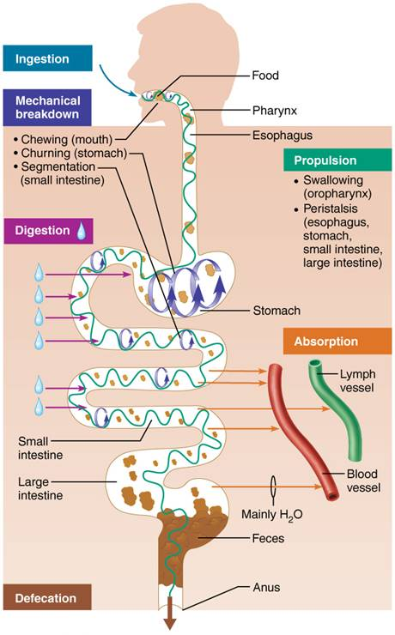
Gastrointestinal Tract Activities
Figure 23.2 Gastrointestinal tract activities.

Slide 12
23.2 Organization of Digestive System

Slide 13
Relationship of Digestive Organs to Peritoneum (1 of 3)
Peritoneum: serous membranes of abdominal cavity that consists of:
  Visceral peritoneum: membrane on external surface of most digestive organs
  Parietal peritoneum: membrane that lines body wall
Peritoneal cavity
  Fluid-filled space between two peritoneums
  Fluid lubricates mobile organs

Slide 14
Relationship of Digestive Organs to Peritoneum (2 of 3)
Mesentery: double layer of peritoneum; layers are fused back to back
  Extends from body wall to digestive organs
  Provides routes for blood vessels, lymphatics, and nerves
  Holds organs in place and also stores fat
Intraperitoneal (peritoneal) organs: organs that are located within the peritoneum

Slide 15
Relationship of Digestive Organs to Peritoneum (3 of 3)
Retroperitoneal organs: located outside, or posterior to, the peritoneum
  Includes most of pancreas, duodenum, and parts of large intestine

Slide 16
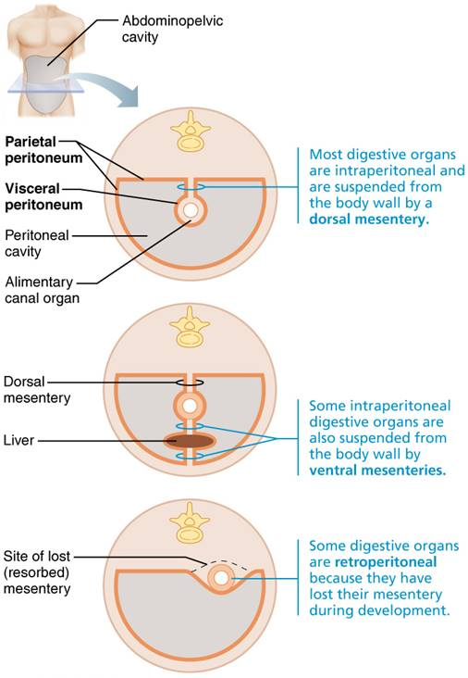
The Peritoneum and the Peritoneal Cavity
Figure 23.4 The peritoneum and mesenteries.

Slide 17
Clinical – Homeostatic Imbalance 23.1
Peritonitis
  Inflammation of peritoneum
  Can be caused by piercing abdominal wound, perforating ulcer, or ruptured appendix
  Peritoneal coverings stick together, which helps localize infection
  Dangerous and lethal if it becomes widespread
  Treatment: debris removal and megadoses of antibiotics

Slide 18
Histology of the Alimentary Canal (1 of 7)
All digestive organs have the same four basic layers, or tunics
  Mucosa
  Submucosa
  Muscularis externa
  Serosa

Slide 19
Histology of the Alimentary Canal (2 of 7)
Mucosa
  Tunic layer that lines lumen
  Functions: different layers perform one or all three
    Secretes mucus, digestive enzymes, and hormones
    Absorbs end products of digestion
    Protects against infectious disease
  Made up of three sublayers
    Epithelium
    Lamina propria
    Muscularis mucosae

Slide 20
Histology of the Alimentary Canal (3 of 7)
  Epithelium
    Simple columnar epithelium and mucus-secreting cells in most of tract
      Mouth, esophagus, and anus are made up of stratified squamous epithelium
    Secretes mucus
      Protects digestive organs from enzymes
      Eases food passage
    May secrete enzymes and hormones (e.g., in stomach and small intestine)

Slide 21
Histology of the Alimentary Canal (4 of 7)
  Lamina propria
    Made up of loose areolar connective tissue
    Rich supply of capillaries located here
      Needed for nourishment and absorption
    Also contains lymphoid follicles that help defend against microorganisms
      Follicles are part of MALT (mucosa-associated lymphoid tissue)
  Muscularis mucosae
    Smooth muscle that produces local movements of mucosa

Slide 22
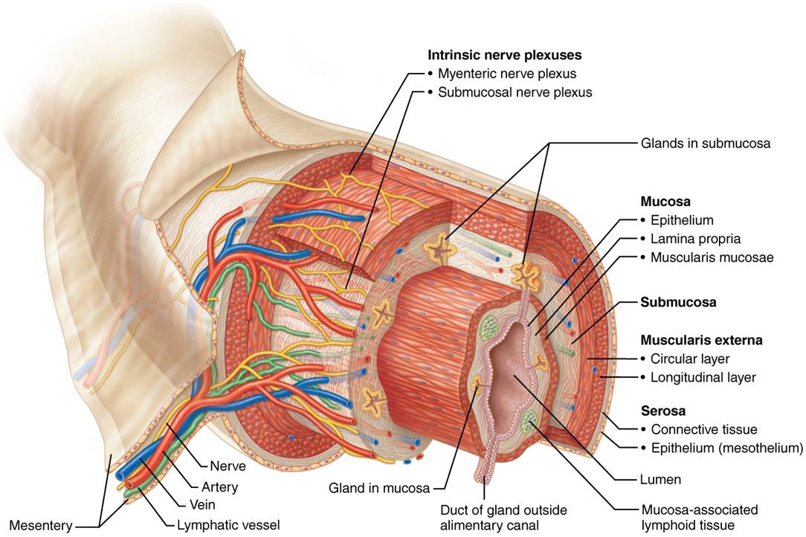
Basic Structure of the Alimentary Canal
(1 of 2)
Figure 23.5 Basic structure of the alimentary canal.

Slide 23
Histology of the Alimentary Canal (5 of 7)
Submucosa
  Consists of areolar connective tissue
  Contains blood and lymphatic vessels, lymphoid follicles, and submucosal nerve plexus that supply surrounding GI tract tissues
  Has abundant amount of elastic tissues that help organs to regain shape after storing large meal

Slide 24
Histology of the Alimentary Canal (6 of 7)
Muscularis externa
  Muscle layer responsible for segmentation and peristalsis
  Contains inner circular muscle layer and outer longitudinal layers
    Circular layer thickens in some areas to form sphincters

Slide 25
Histology of the Alimentary Canal (7 of 7)
Serosa
  Outermost layer, which is made up of the visceral peritoneum
    Formed from areolar connective tissue covered with mesothelium (single layer of squamous epithelium) in most organs
    Replaced by fibrous adventitia in esophagus
      Dense connective tissue that holds esophagus to surrounding structures
    Retroperitoneal organs have both an adventitia and a serosa

Slide 26
Basic Structure of the Alimentary Canal
(2 of 2)
Figure 23.5 Basic structure of the alimentary canal.

Slide 27
Blood Supply: Splanchnic Circulation
Splanchnic circulation includes:
  Arteries that branch off aorta to serve digestive organs
    Hepatic, splenic, and left gastric arteries
    Inferior and superior mesenteric arteries
  Hepatic portal circulation
    Drains nutrient-rich blood from digestive organs
    Delivers blood to liver for processing

Slide 28
23.3 Control of Digestive System

Slide 29
Enteric Nervous System (1 of 3)
GI tract has its own nervous system, referred to as enteric nervous system
  Also called the gut brain
  Contains more neurons than spinal cord
Gut brain is made up of enteric neurons that communicate extensively with each other
  Major nerve supply to GI tract wall that controls motility

Slide 30
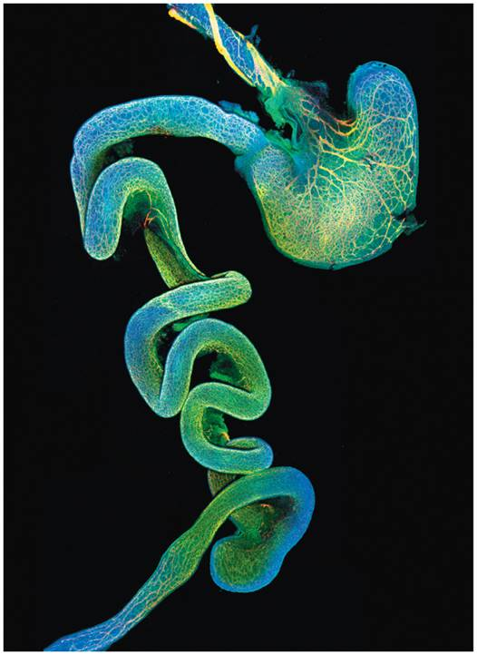
The Enteric Nervous System
Figure 23.6 The enteric nervous system.

Slide 31
Enteric Nervous System (2 of 3)
  Enteric neurons make up bulk of two main interconnecting intrinsic nerve plexuses:
  Submucosal nerve plexus
    Regulates glands and smooth muscle in mucosa
  Myenteric nerve plexus
    Controls GI tract motility

Slide 32
Enteric Nervous System (3 of 3)
Enteric nervous system participates in both short and long reflex arcs
  Short reflexes: mediated by enteric nerve plexuses (gut brain); respond to stimuli in GI tract
  Long reflexes: respond to stimuli arising inside or outside of gut, such as from autonomic nervous system
    Parasympathetic system enhances digestive process
    Sympathetic system inhibits digestion

Slide 33
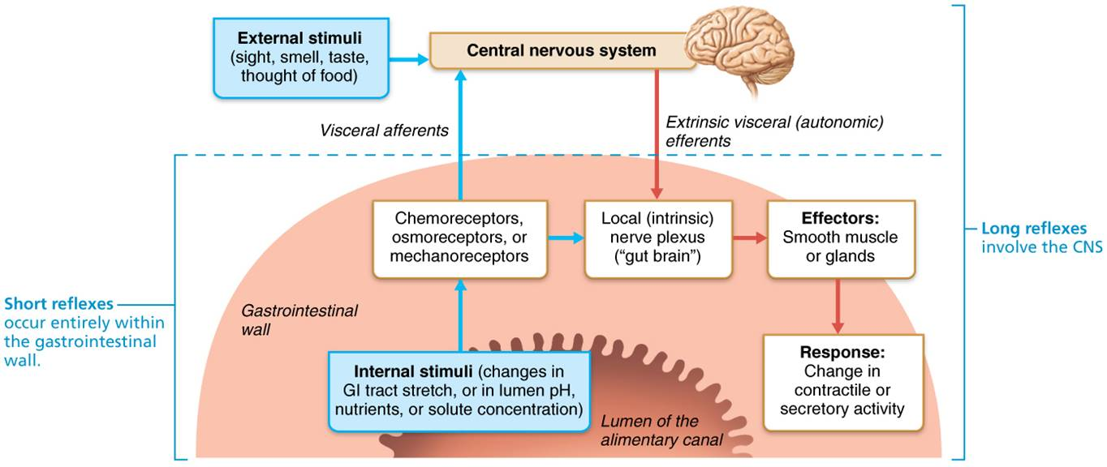
Neural Reflex Pathways Initiated by Stimuli Inside or Outside the Gastrointestinal Tract
Figure 23.7 Neural reflex pathways initiated by stimuli inside or outside the gastrointestinal tract.

Slide 34
Basic Concepts of Regulating Digestive Activity (1 of 3)
Three key concepts regulate GI activity
Digestive activity is provoked by a range of mechanical and chemical stimuli
  Receptors located in walls of GI tract organs
  Respond to stretch, changes in osmolarity and pH, and presence of substrate and end products of digestion

Slide 35
Basic Concepts of Regulating Digestive Activity (2 of 3)
Effectors of digestive activity are smooth muscle and glands
  When stimulated, receptors initiate reflexes that stimulate smooth muscle to mix and move lumen contents
  Reflexes can also activate or inhibit digestive glands that secrete digestive juices or hormones

Slide 36
Basic Concepts of Regulating Digestive Activity (3 of 3)
Neurons (intrinsic and extrinsic) and hormones control digestive activity
  Nervous system control
    Intrinsic controls: involve short reflexes (enteric nervous system)
    Extrinsic controls: involve long reflexes (autonomic nervous system)
  Hormonal controls
    Hormones from cells in stomach and small intestine stimulate target cells in same or different organs to secrete or contract

Slide 37
Part 2 – Functional Anatomy of the Digestive System

Slide 38
IP Anatomy Review Animation: Digestive
Click here to view ADA compliant Animation:
IP Anatomy Review Animation: Digestive
https://mediaplayer.pearsoncmg.com/assets/secs-ipweb-digestive-anat-rev

Slide 39
23.4 Mouth and Associated Organs
Mouth is where food is chewed and mixed with enzyme-containing saliva that begins process of digestion, and swallowing process is initiated
Associated organs include:
  Mouth
  Tongue
  Salivary glands
  Teeth

Slide 40
Mouth (1 of 4)
Also called the oral (buccal) cavity
  Bounded by lips anteriorly, cheeks laterally, palate superiorly, and tongue inferiorly
  Oral orifice is the anterior opening
  Walls of mouth lined with stratified squamous epithelium
    Tough cells that resist abrasion
    Cells of gums, hard palate, and part of tongue are keratinized for extra protection

Slide 41
Mouth (2 of 4)
Lips and cheeks
  Lips (labia): composed of fleshy orbicularis oris muscle
  Cheeks: composed of buccinator muscles
  Oral vestibule: recess internal to lips and cheeks, external to teeth and gums
  Oral cavity proper: lies within teeth and gums
  Labial frenulum: median attachment of each lip to gum

Slide 42
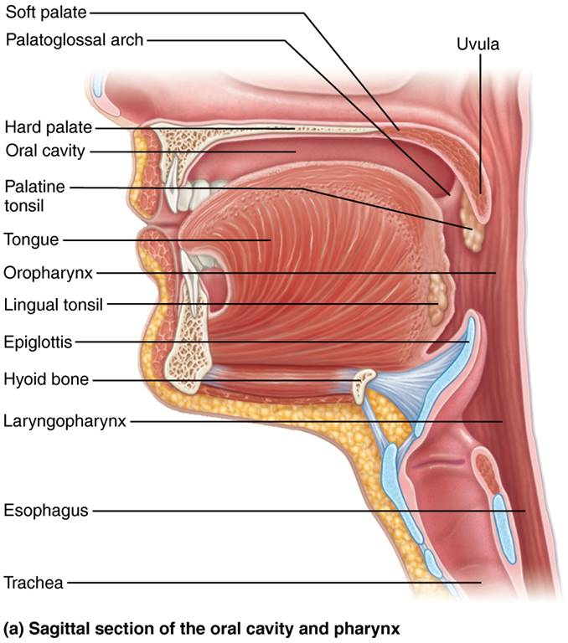
Anatomy of the Oral Cavity (Mouth) (1 of 2)
Figure 23.8a Anatomy of the oral cavity (mouth).

Slide 43
Mouth (3 of 4)
Palate
  Palate forms the roof of the mouth and has two distinct parts
    Hard palate: formed by palatine bones and palatine processes of maxillae with a midline ridge called raphe
      Mucosa is slightly corrugated to help create friction against tongue

Slide 44
Mouth (4 of 4)
Palate (cont.)
    Soft palate: fold formed mostly of skeletal muscle
      Closes off nasopharynx during swallowing
      Laterally, soft palate anchored to tongue by palatoglossal arches
      Also anchored to wall of oropharynx by palatopharyngeal arches
      Area in between two arches is called fauces
        Palatine tonsils are located in fauces
      Uvula: fingerlike projection that faces downward from free edge of soft palate

Slide 45
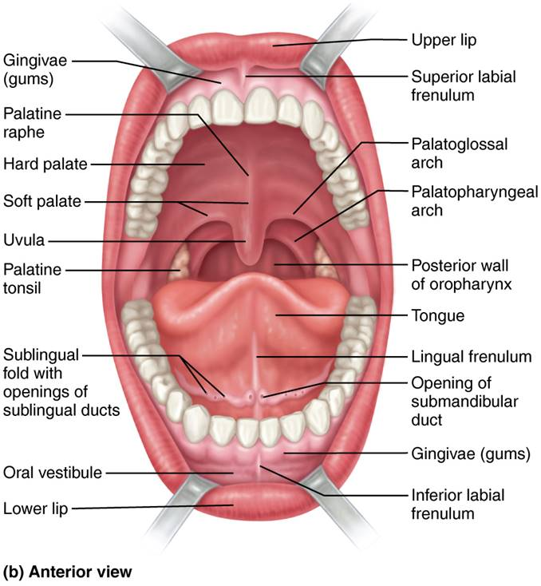
Anatomy of the Oral Cavity (Mouth) (2 of 2)
Figure 23.8b Anatomy of the oral cavity (mouth).

Slide 46
Tongue (1 of 3)
Tongue occupies floor of mouth
Composed of interlacing bundles of skeletal muscle
Functions include:
  Gripping, repositioning, and mixing of food during chewing
  Formation of bolus, mixture of food and saliva
  Initiation of swallowing, speech, and taste
Intrinsic muscles change shape of tongue
Extrinsic muscles alter tongue’s position
Lingual frenulum: attachment to floor of mouth

Slide 47
Tongue (2 of 3)
Superior surface bears papillae, peglike projections of underlying mucosa
  Filiform papillae: gives tongue roughness to provide friction; only one that does not contain taste buds; gives tongue a whitish appearance
  Fungiform papillae: mushroom shaped, scattered widely over tongue; vascular core causes reddish appearance of tongue
  Vallate (circumvallate) papillae: 8–12 form V-shaped row in back of tongue
  Foliate papillae: located on lateral aspects of posterior tongue

Slide 48
Tongue (3 of 3)
Terminal sulcus: groove located posterior to vallate papillae
  Marks division between:
    Body: portion of tongue that resides in oral cavity
    Root: posterior third residing in oropharynx
  Does not contain papillae, but still bumpy because of lingual tonsil, which lies deep to its mucosa

Slide 49
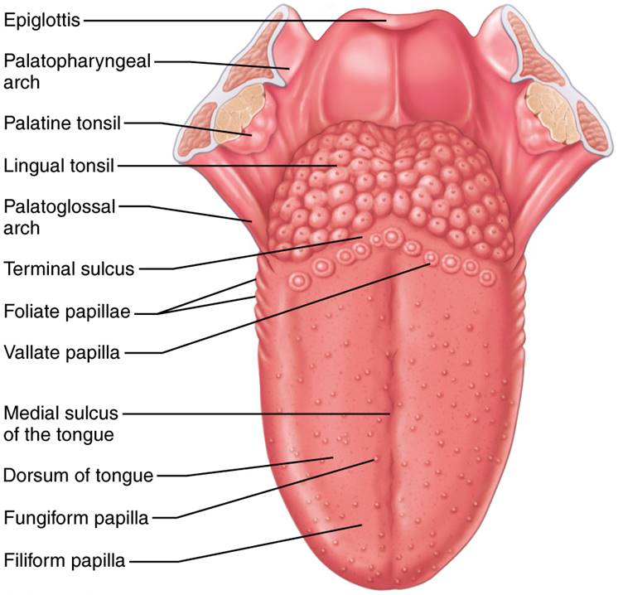
Dorsal Surface of the Tongue, and the Tonsils
Figure 23.9 Dorsal surface of the tongue, and the tonsils.

Slide 50
Clinical – Homeostatic Imbalance 23.2
Ankyloglossia: congenital condition in which children are born with an extremely short lingual frenulum
  Often referred to as “tongue-tied” or “fused tongue”
  Restricted tongue movement distorts speech
  Treatment: surgical snipping of frenulum

Slide 51
Salivary Glands (1 of 5)
Functions of saliva
  Cleanses mouth
  Dissolves food chemicals for taste
  Moistens food; compacts into bolus
  Begins breakdown of starch with enzyme amylase
Most saliva produced by major (extrinsic) salivary glands located outside oral cavity
Minor salivary glands are scattered throughout oral cavity; augment slightly

Slide 52
Salivary Glands (2 of 5)
Major salivary glands include:
  Parotid: anterior to ear and external to masseter muscle
    Parotid duct opens into oral vestibule next to second upper molar
  Submandibular: medial to body of mandible
    Duct opens at base of lingual frenulum
  Sublingual: anterior to submandibular gland under tongue
    Opens via 10–12 ducts into floor of mouth

Slide 53
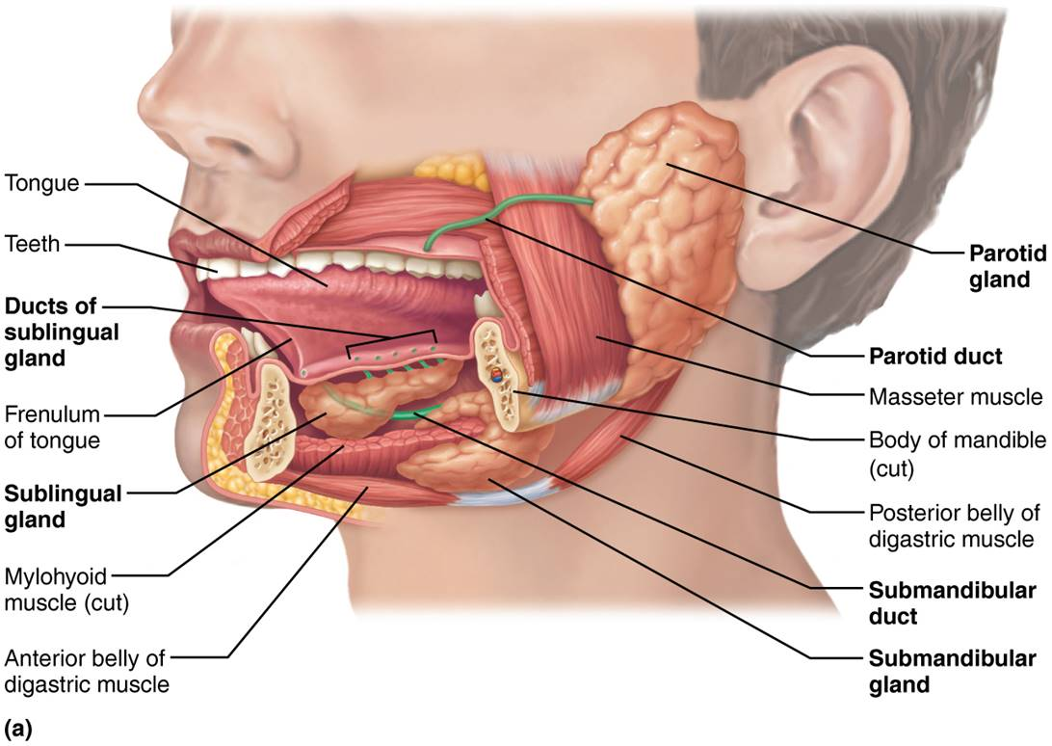
The Salivary Glands (1 of 2)
Figure 23.10a The salivary glands.

Slide 54
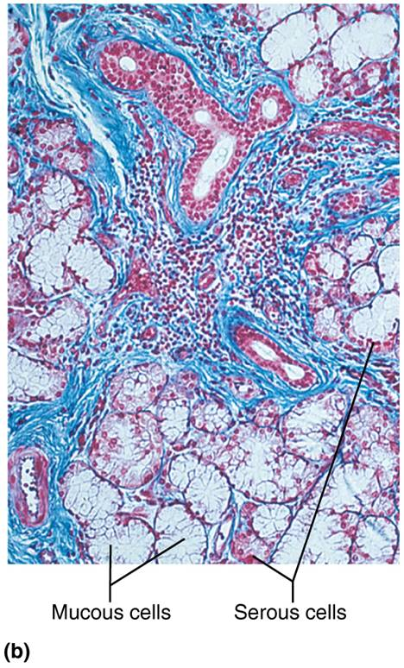
The Salivary Glands (2 of 2)
Figure 23.10b The salivary glands.

Slide 55
Salivary Glands (3 of 5)
Salivary glands are composed of two types of secretory cells
  Serous cells: produce watery secretion, enzymes, ions, bit of mucin
  Mucous cells: produce mucus
Parotid and submandibular glands contain mostly serous cells, but sublingual gland consists mostly of mucous cells

Slide 56
Clinical – Homeostatic Imbalance 23.3
Xerostomia – dry mouth, uncomfortable condition caused by too little saliva being made
  Normal salivary gland function is vital for oral health
Lack of moisture may lead to difficulty with chewing and swallowing, as well as oral infections
Can be caused by medications, diabetes, HIV/AIDS, and Sjögren’s syndrome (autoimmune disease affecting moisture-producing glands throughout body)

Slide 57
Salivary Glands (4 of 5)
Composition of saliva
  Mostly water (97–99.5%), so hypo-osmotic
  Slightly acidic (pH 6.75 to 7.00)
  Electrolytes: Na⁺, K⁺, Cl⁻, PO₄²⁻, HCO₃⁻
  Salivary amylase and lingual lipase
  Proteins: mucin, lysozyme, and IgA
  Metabolic wastes: urea and uric acid
  Lysozyme, IgA, defensins, and nitric oxide from nitrates in food protect against microorganisms

Slide 58
Animation: Rotating Head
Click here to view ADA compliant Animation:
Rotating Head
https://mediaplayer.pearsoncmg.com/assets/rotating-model-head

Slide 59
Salivary Glands (5 of 5)
Control of salivation
  1500 ml/day can be produced
  Minor glands continuously keep mouth moist
  Major salivary glands are activated by parasympathetic nervous system when:
    Ingested food stimulates chemoreceptors and mechanoreceptors in mouth, sending signals to:
    Salivatory nuclei in brain stem that stimulate parasympathetic impulses along fibers in cranial nerves VII and IX to glands
  Strong sympathetic stimulation inhibits salivation and results in dry mouth (xerostomia)
  Smell/sight of food or upset GI can act as stimuli

Slide 60
Clinical – Homeostatic Imbalance 23.4
Decaying primary teeth can be painful and may lead to serious infection
  Primary teeth deserve as much attention as permanent teeth
Primary teeth serve as important “place holders” for developing permanent teeth
Primary teeth can be kept healthy by brushing and limiting exposure to sugary liquids, especially from prolonged bottle feeding.

Slide 61
The Teeth (1 of 8)
Teeth lie in sockets in gum-covered margins of mandible and maxilla
Mastication: process of chewing that tears and grinds food into smaller fragments
Dentition and the dental formula
  Primary dentition consists of 20 deciduous teeth, or milk or baby teeth, that erupt between 6 and 24 months of age
  32 deep-lying permanent teeth enlarge and develop while roots of milk teeth are resorbed from below, causing them to loosen and fall out
    Occurs around 6–12 years of age

Slide 62
The Teeth (2 of 8)
Dentition and the dental formula (cont.)
  All but 3rd molars (wisdom teeth) are in by end of adolescence
    Third molars may or may not emerge around 17–25 years of age
Teeth are classified according to shape:
  Incisors: chisel shaped for cutting
  Canines: fanglike teeth that tear or pierce
  Premolars (bicuspids): broad crowns with rounded cusps used to grind or crush

Slide 63
The Teeth (3 of 8)
Dentition and the dental formula (cont.)
  Molars: broad crowns, rounded cusps: best grinders
    During chewing, upper and lower molars lock together, creating tremendous crushing force

Slide 64
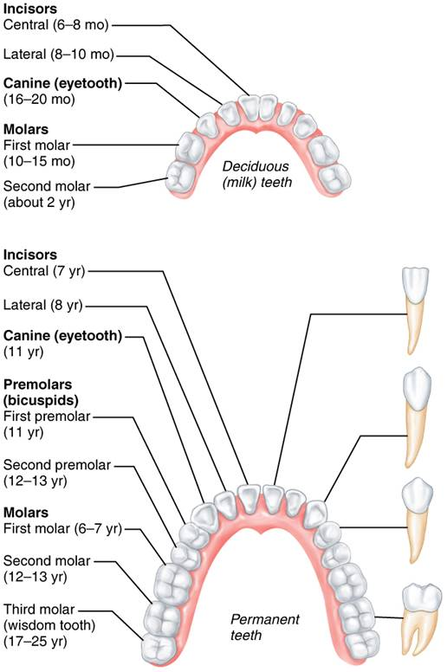
Human Dentition
Figure 23.11 Human dentition.

Slide 65
The Teeth (4 of 8)
Dental formula: shorthand indicator of number and position of teeth
  Shows ratio of upper to lower teeth for only half of mouth; other side is mirror image
  Primary
  Permanent

Slide 66
The Teeth (5 of 8)
Tooth structure
  Each tooth has two major regions:
    Crown: exposed part above gingiva (gum)
      Covered by enamel, the hardest substance in body
        Heavily mineralized with calcium salts and hydroxyapatite crystals
        Enamel-producing cells degenerate when tooth erupts, so no healing if tooth decays or cracks; needs artificial repair by filling
    Root: portion embedded in jawbone
      Connected to crown by neck

Slide 67
The Teeth (6 of 8)
Tooth structure (cont.)
  Canines, incisors, and premolars have only one root
    First upper premolar often has two
  First two upper molars have three roots
  First two lower molars have two roots
  Third molar roots vary; often single fused root

Slide 68
The Teeth (7 of 8)
Cement: calcified connective tissue
  Covers root; attaches it to periodontal ligament
Periodontal ligament
  Forms fibrous joint called gomphosis
  Anchors tooth in bony socket (alveolus)
Gingival sulcus: groove where gingiva borders tooth
Dentin: bonelike material under enamel
  Maintained by odontoblasts of pulp cavity

Slide 69
The Teeth (8 of 8)
Pulp cavity: surrounded by dentin
Pulp: connective tissue, blood vessels, and nerves
Root canal: as pulp cavity extends to root
Apical foramen at proximal end of root
  Entry for blood vessels, nerves, etc.

Slide 70
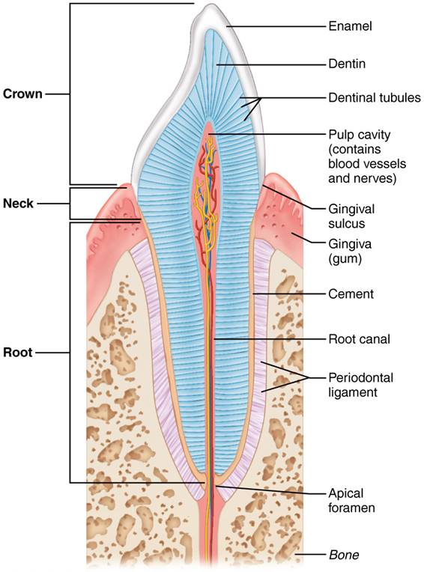
Longitudinal Section of a Canine Tooth Within its Bony Socket (Alveolus)
Figure 23.12 Longitudinal section of a canine tooth within its bony socket (alveolus).

Slide 71
Clinical – Homeostatic Imbalance 23.5
Impacted tooth: a tooth that remains trapped in the jawbone
Can cause a good deal of pressure and pain
Wisdom teeth are most commonly involved.
Treatment: surgical removal

Slide 72
Tooth and Gum Disease (1 of 3)
Dental caries (cavities): demineralization of enamel and dentin from bacterial action
  Dental plaque (film of sugar, bacteria, and debris) adheres to teeth
  Acid from bacteria dissolves calcium salts
  Proteolytic enzymes digest organic matter
  Prevention: daily flossing and brushing

Slide 73
Tooth and Gum Disease (2 of 3)
Gingivitis
  Plaque calcifies to form calculus (tartar)
  Calculus disrupts seal between gingivae and teeth
  Anaerobic bacteria infect gums
  Infection is reversible if calculus removed

Slide 74
Tooth and Gum Disease (3 of 3)
Periodontitis (periodontal disease)
  Neglected gingivitis can escalate to disease
  Immune cells attack not only bacterial intruders, but also body tissues
    Can destroy periodontal ligament
    Can activate osteoclasts, which leads to dissolving of bone and possible tooth loss
  May increase heart disease and stroke two ways:
    Promotes atherosclerotic plaque formation
    Bacteria entering blood can cause clot formation in coronary and cerebral arteries
  Risk factors: smoking, diabetes mellitus, oral piercings

Slide 75
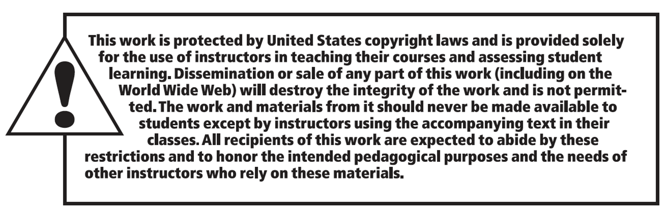
Copyright

