Slide 1
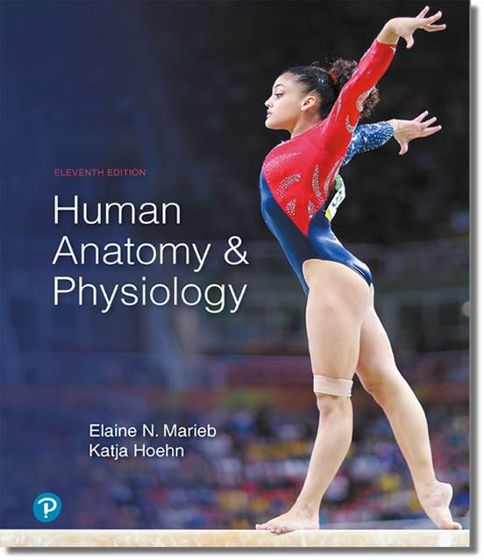
Human Anatomy and Physiology
Eleventh Edition
Chapter 23 Part B
The Digestive System
PowerPoint® Lectures Slides prepared by Karen Dunbar Kareiva, Ivy Tech Community College
Copyright © 2019, 2016, 2013 Pearson Education, Inc. All Rights Reserved

Slide 2
23.5 Pharynx and Esophagus

Slide 3
The Pharynx
Food passes from mouth into oropharynx and then into laryngopharynx
Allows passage of food, fluids, and air
Stratified squamous epithelium lining with mucus-producing glands
External muscle layers consists of two skeletal muscle layers
Inner layer of muscles runs longitudinally
Outer pharyngeal constrictors encircle wall of pharynx

Slide 4
The Esophagus (1 of 2)
Flat muscular tube that runs from laryngopharynx to stomach
Is collapsed when not involved in food propulsion
Pierces diaphragm at esophageal hiatus
Joins stomach at cardial orifice
Gastroesophageal (cardiac) sphincter surrounds cardial orifice
Keeps orifice closed when food is not being swallowed
Mucus cells on both sides of sphincter help protect esophagus from acid reflux

Slide 5
The Esophagus (2 of 2)
Esophagus has all four alimentary canal layers
Esophageal mucosa contains stratified squamous epithelium
Changes to simple columnar at stomach
Esophageal glands in submucosa secrete mucus to aid in bolus movement
Muscularis externa: skeletal muscle superiorly; mixed in middle; smooth muscle inferiorly
Has adventitia instead of serosa

Slide 6
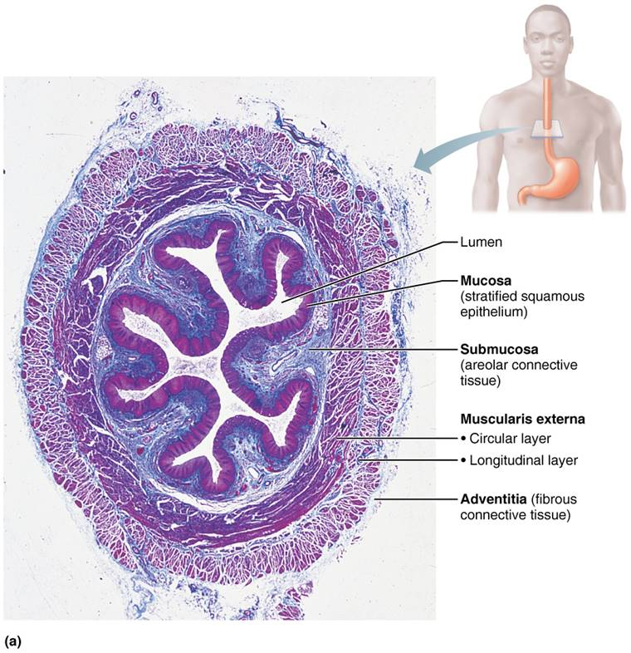
Microscopic Structure of the Esophagus (1 of 2)
Figure 23.13a Microscopic structure of the esophagus.

Slide 7
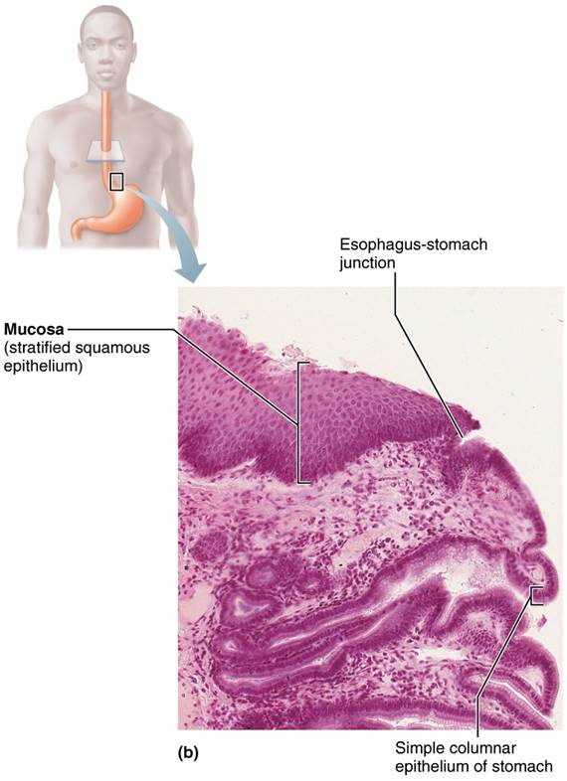
Microscopic Structure of the Esophagus (2 of 2)
Figure 23.13b Microscopic structure of the esophagus.

Slide 8
Clinical – Homeostatic Imbalance 23.6
Heartburn
Caused by stomach acid regurgitating into esophagus
First symptom of gastroesophageal reflux disease (GERD)
Can be caused by excess food/drink, extreme obesity, pregnancy, running
Also can be caused by hiatal hernia: structural abnormality where part of stomach protrudes above diaphragm
Can lead to esophagitis, esophageal ulcers, or even esophageal cancer

Slide 9
Digestive Processes of the Mouth
Pharynx and esophagus are conduits to pass food from mouth to stomach
Major function of both organs is propulsion that starts with deglutition (swallowing)
Deglutition involves coordination of 22 muscle groups and two phases:
Buccal phase: voluntary contraction of tongue
Pharyngeal-esophageal phase: involuntary phase that primarily involves vagus nerve
Controlled by swallowing center in medulla and lower pons

Slide 10
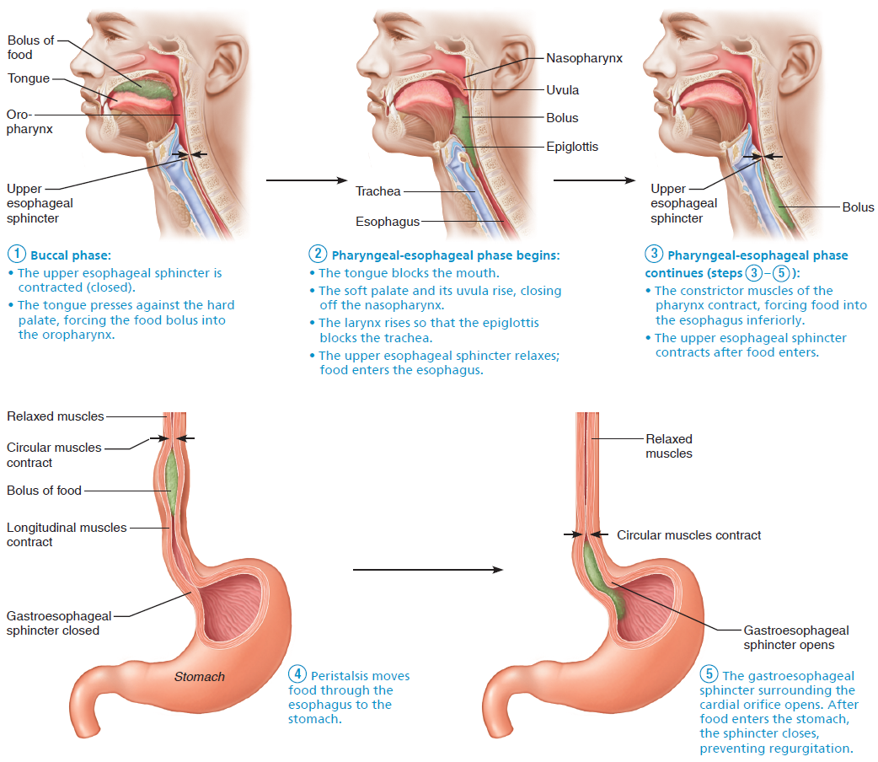
Deglutition (Swallowing) (1 of 6)
Figure 23.14 Deglutition (swallowing).

Slide 11
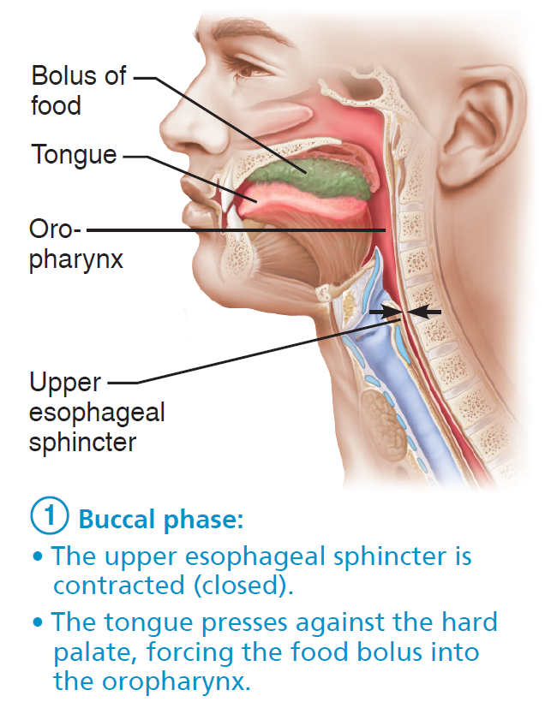
Deglutition (Swallowing) (2 of 6)
Figure 23.14 Deglutition (swallowing).

Slide 12
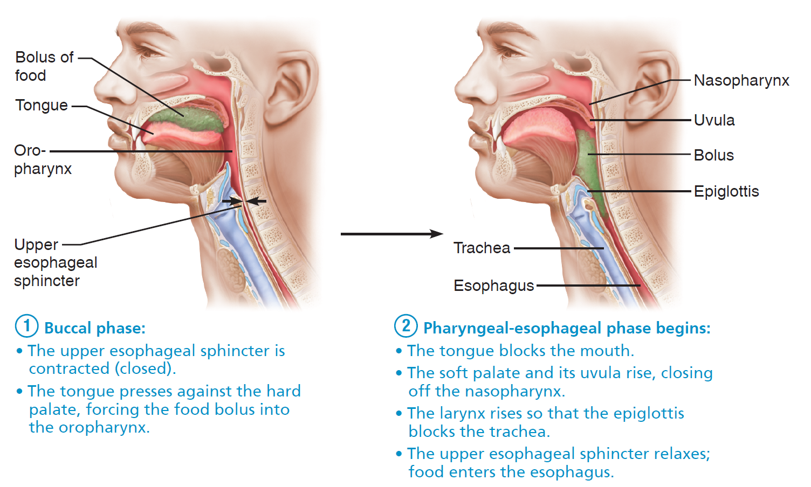
Deglutition (Swallowing) (3 of 6)
Figure 23.14 Deglutition (swallowing).

Slide 13
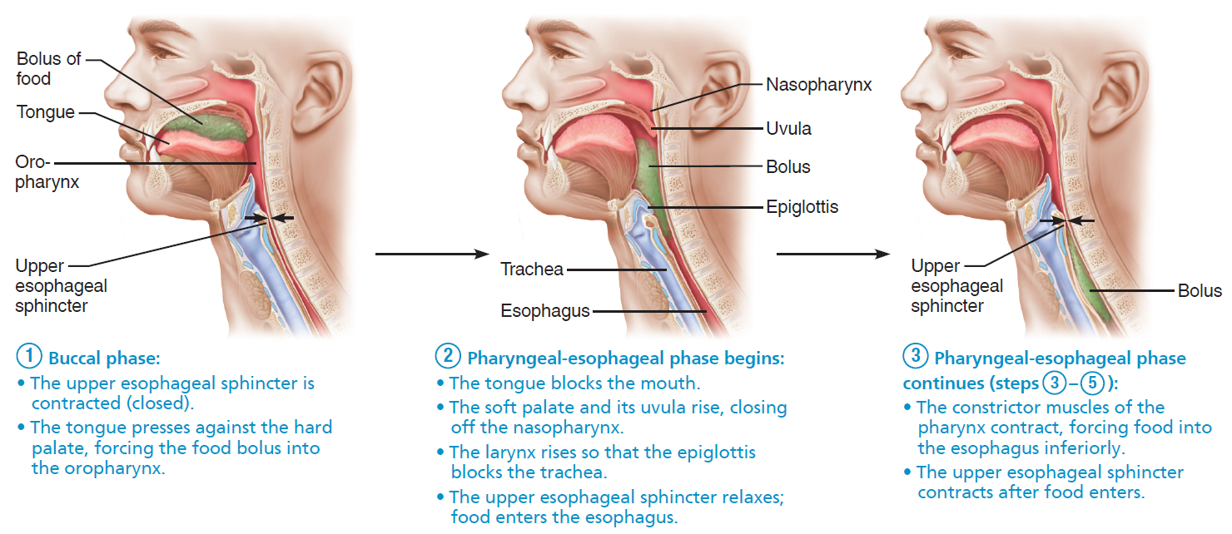
Deglutition (Swallowing) (4 of 6)
Figure 23.14 Deglutition (swallowing).

Slide 14
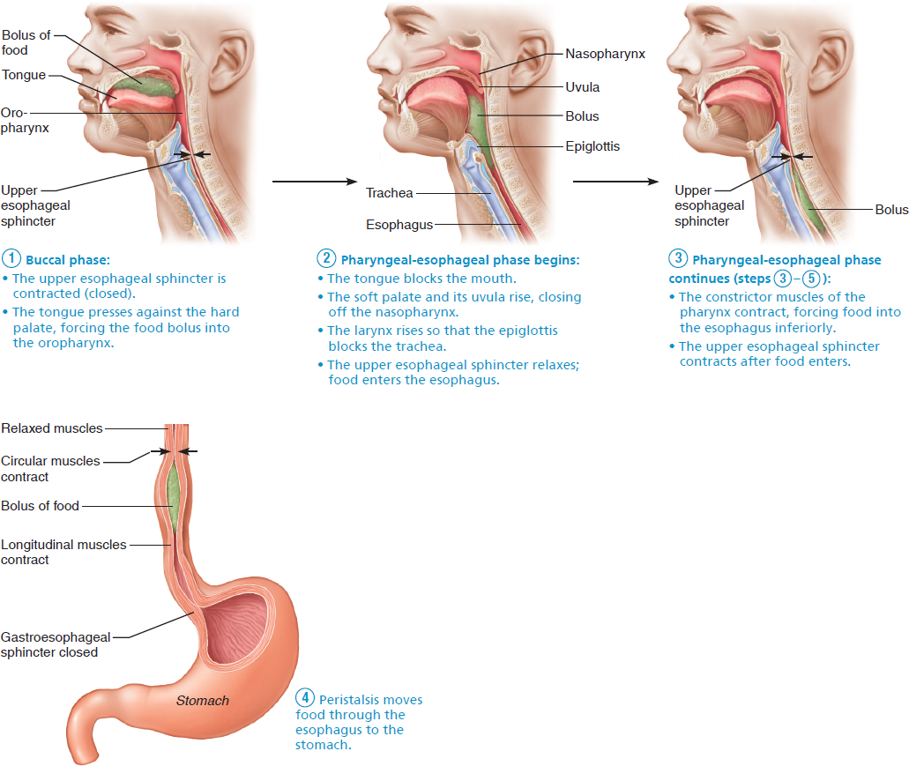
Deglutition (Swallowing) (5 of 6)
Figure 23.14 Deglutition (swallowing).

Slide 15

Deglutition (Swallowing) (6 of 6)
Figure 23.14 Deglutition (swallowing).

Slide 16
23.6 The Stomach

Slide 17
Gross Anatomy of the Stomach (1 of 5)
Stomach is a temporary storage tank that starts chemical breakdown of protein digestion
Converts bolus of food to paste-like chyme
Empty stomach has ~50 ml volume but can expand to 4 L
When empty, stomach mucosa forms many folds called rugae

Slide 18
Gross Anatomy of the Stomach (2 of 5)
Major regions of the stomach
Cardial part (cardia): surrounds cardial orifice
Fundus: dome-shaped region beneath diaphragm
Body: midportion
Pyloric part: wider and more superior portion of pyloric region, antrum, narrows into pyloric canal that terminates in pylorus
Pylorus is continuous with duodenum through pyloric valve (sphincter controlling stomach emptying)

Slide 19
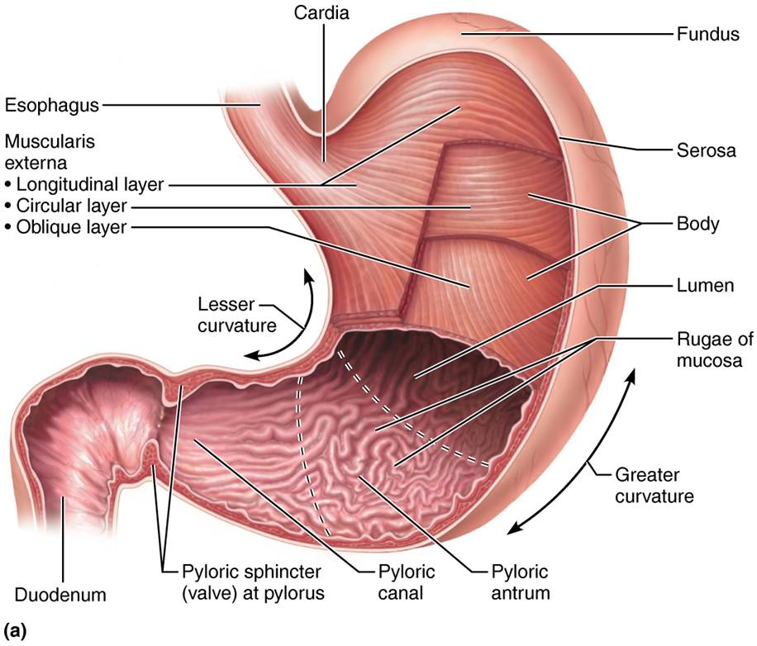
Anatomy of the Stomach (1 of 2)
Figure 23.15a Anatomy of the stomach.

Slide 20
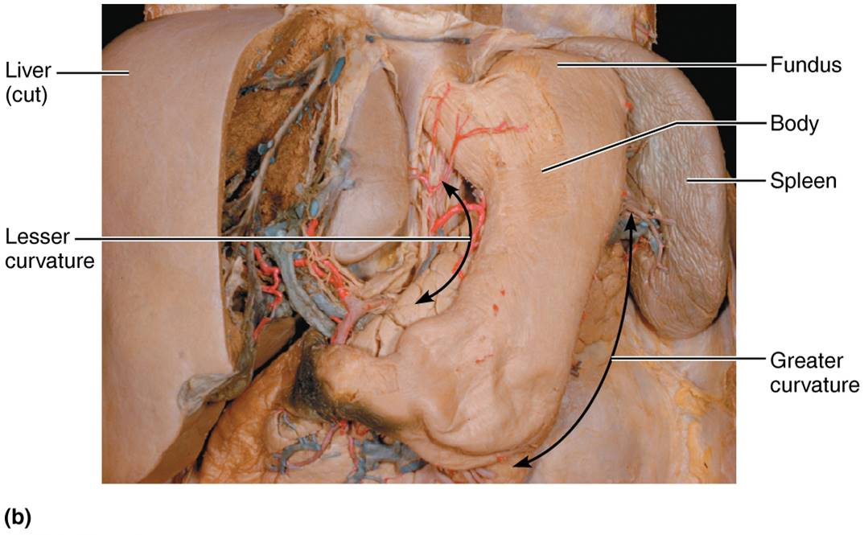
Anatomy of the Stomach (2 of 2)
Figure 23.15b Anatomy of the stomach.

Slide 21
Gross Anatomy of the Stomach (3 of 5)
Greater curvature: convex lateral surface of stomach
Lesser curvature: concave medial surface of stomach
Mesenteries extend from curvatures and tether stomach to other digestive organs
Lesser omentum
Runs from lesser curvature to liver

Slide 22
Gross Anatomy of the Stomach (4 of 5)
Greater omentum: drapes inferiorly from greater curvature over intestine, spleen, and transverse colon
Blends with mesocolon, mesentery that anchors large intestine to abdominal wall
Contains fat deposits and lymph nodes

Slide 23
Gross Anatomy of the Stomach (5 of 5)
Autonomic nervous system supplies stomach
Sympathetic fibers from thoracic splanchnic nerves are relayed through celiac plexus
Parasympathetic fibers are supplied by vagus nerve
Blood supply
Celiac trunk (gastric and splenic branches)
Veins of hepatic portal system

Slide 24
Microscopic Anatomy of the Stomach (1 of 10)
Stomach wall contains regular four tunics; however, muscularis and mucosa are modified
Muscularis externa has circular and longitudinal smooth muscle layers, as well as extra third layer, the oblique (diagonal) layer
Together, smooth muscles allow stomach not only to churn, mix, and move chyme, but also to pummel it, which increases physical breakdown and ram it into small intestine

Slide 25
Microscopic Anatomy of the Stomach (2 of 10)
Mucosa layer is also modified
Consists of simple columnar epithelium entirely composed of mucous cells
Secrete two-layer coat of alkaline mucus
Surface layer traps bicarbonate-rich fluid layer that is beneath it
Dotted with gastric pits, which lead into gastric glands
Gastric glands produce gastric juice

Slide 26
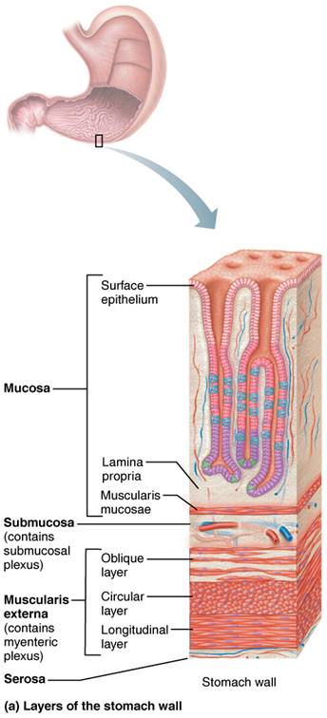
Microscopic Anatomy of the Stomach (3 of 10)
Figure 23.16a Microscopic anatomy of the stomach.

Slide 27
Microscopic Anatomy of the Stomach (4 of 10)
Types of gland cells
Glands in fundus and body produce most gastric juice
Glands include secretory cells
Mucous neck cells
Parietal cells
Chief cells
Enteroendocrine cells

Slide 28
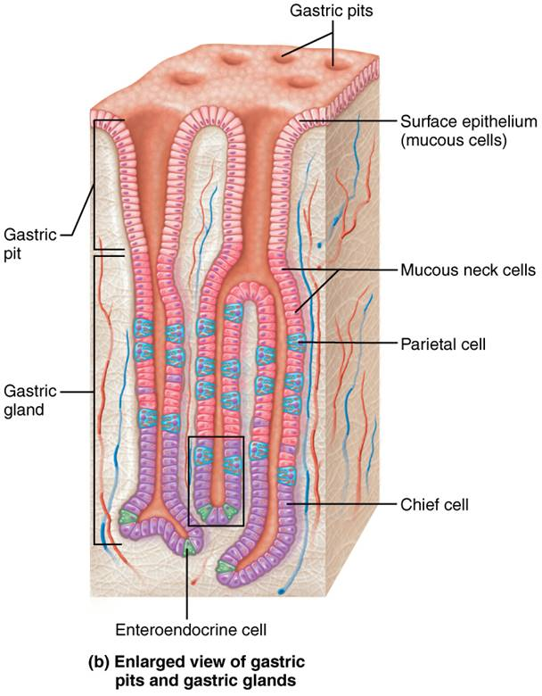
Microscopic Anatomy of the Stomach (5 of 10)
Figure 23.16b Microscopic anatomy of the stomach.

Slide 29
Microscopic Anatomy of the Stomach (6 of 10)
Mucous neck cells
Secrete thin, acidic mucus of unknown function
Parietal cells
Secretions include:
Hydrochloric acid (HCl)
pH 1.5–3.5; denatures protein, activates pepsin, breaks down plant cell walls, and kills many bacteria
Intrinsic factor
Glycoprotein required for absorption of vitamin B₁₂ in small intestine

Slide 30
Microscopic Anatomy of the Stomach (7 of 10)
Chief cells
Secretions include:
Pepsinogen: inactive enzyme that is activated to pepsin by HCl and by pepsin itself (a positive feedback mechanism)
Lipases
Digests ~15% of lipids

Slide 31
Microscopic Anatomy of the Stomach (8 of 10)
Enteroendocrine cells
Secrete chemical messengers into lamina propria
Act as paracrines
Serotonin and histamine
Hormones
Somatostatin (also acts as paracrine) and gastrin

Slide 32
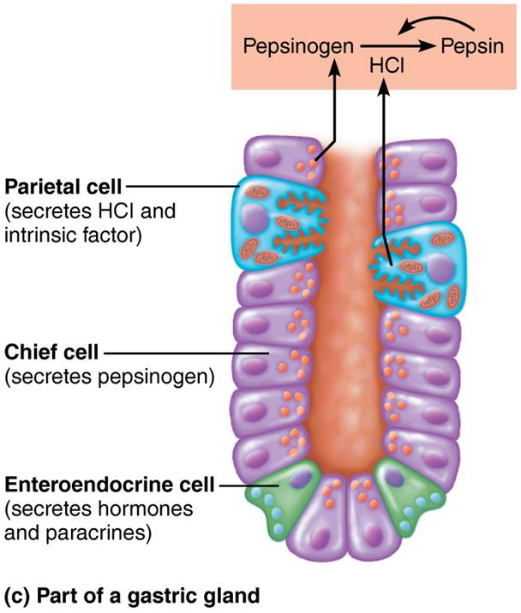
Microscopic Anatomy of the Stomach (9 of 10)
Figure 23.16c Microscopic anatomy of the stomach.

Slide 33
Microscopic Anatomy of the Stomach (10 of 10)
Mucosal barrier
Harsh digestive conditions require stomach to be protected
Mucosal barrier protects stomach and is created by three factors
Thick layer of bicarbonate-rich mucus
Tight junctions between epithelial cells
Prevent juice seeping underneath tissue
Damaged epithelial cells are quickly replaced by division of stem cells
Surface cells replaced every 3–6 days

Slide 34
Clinical – Homeostatic Imbalance 23.7
Gastritis
Inflammation caused by anything that breaches stomach’s mucosal barrier
Peptic or gastric ulcers
Can cause erosions in stomach wall
If erosions perforate wall, can lead to peritonitis and hemorrhage
Most ulcers caused by bacterum Helicobacter pylori
Can also be caused by non-steroidal anti-inflammatory drugs (NSAIDs), such as aspirin

Slide 35
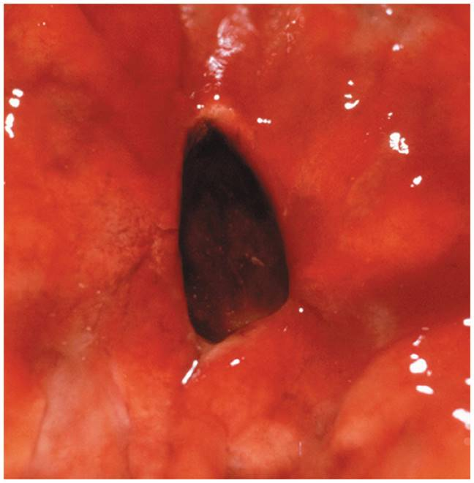
A Gastric Ulcer
Figure 23.17 A gastric ulcer.

Slide 36
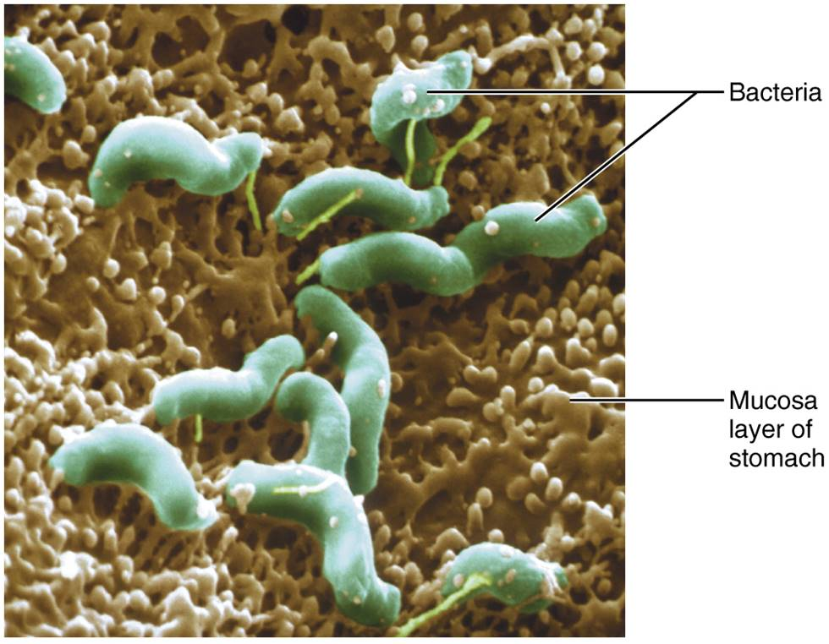
Photomicrograph of H. pylori, the Bacteria that Most Commonly Cause Gastric Ulcers
Figure 23.18 Photomicrograph of H. pylori, the bacteria that most commonly cause gastric ulcers.

Slide 37
Digestive Processes in the Stomach (1 of 2)
Processes carried out by stomach
Carries out breakdown of food
Serves as holding area for food
Delivers chyme to small intestine
Denatures proteins by HCl
Pepsin carries out enzymatic digestion of proteins
Milk protein (casein) is broken down by rennin in infants
Results in curdy substance

Slide 38
Digestive Processes in the Stomach (2 of 2)
Lipid-soluble alcohol and aspirin are absorbed into blood
Only stomach function essential to life is secretion of intrinsic factor for vitamin B₁₂ absorption
B₁₂ needed for red blood cells to mature
Lack of intrinsic factor causes pernicious anemia
Treated with B₁₂ injections

Slide 39
Regulation of Gastric Secretion (1 of 8)
Gastric mucosa secretes >3 L of gastric juice/day and are regulated by:
Neural mechanisms
Vagus nerve stimulation increases secretion
Sympathetic stimulation decreases secretion
Hormonal mechanisms
Gastrin stimulates HCl secretion by stomach and gastrin antagonist hormones by small intestine

Slide 40
Regulation of Gastric Secretion (2 of 8)
Gastric secretions are broken down into three phases
Cephalic (reflex) phase
Gastric phase
Intestinal phase

Slide 41
Regulation of Gastric Secretion (3 of 8)
Cephalic (reflex) phase
Conditioned reflex triggered by aroma, taste, sight, thought
Gastric phase
Lasts 3–4 hours and provides two-thirds of gastric juice released
Stimulation of gastric phase
Distension activates stretch receptors, initiating both long and short reflexes
Chemical stimuli, such as partially digested proteins, caffeine, and low acidity, activate enteroendocrine G cells to secrete gastrin

Slide 42
Regulation of Gastric Secretion (4 of 8)
Stimulation of gastric phase (cont.)
Release of gastrin then initiates HCl release from parietal cells and activates enzyme secretion
Prods parietal cells to secrete HCl by:
Binding to receptors on parietal cells
Stimulating enteroendocrine cells to release histamine
Buffering action of ingested proteins causes pH to rise, which activates more gastrin secretion

Slide 43
Regulation of Gastric Secretion (5 of 8)
Inhibition of gastric phase
Low pH inhibits gastrin secretion
Occurs between meals
Occurs during digestion as negative feedback mechanism
The more protein, the more HCl acid is secreted, causing decline in pH, which inhibits gastrin secretion

Slide 44
Regulation of Gastric Secretion (6 of 8)
Intestinal phase
Begins with a brief stimulatory component followed by inhibition
Stimulation of intestinal phase
Partially digested food enters small intestine, causing a brief release of intestinal (enteric) gastrin
Encourages gastric glands of stomach to continue secretory activities
Stimulatory effect is brief and overridden by inhibitory stimuli as intestine fills

Slide 45
Regulation of Gastric Secretion (7 of 8)
Inhibition of intestinal phase
Four main factors in duodenum cause inhibition of gastric secretions:
Distension of duodenum due to entry of chyme
Presence of acidic chyme
Presence of fatty chyme
Presence of hypertonic chyme
Inhibitory effects protect intestine from being overwhelmed by too much chyme or acidity
Inhibition is achieved in two ways: enterogastric reflex and enterogastrones

Slide 46
Regulation of Gastric Secretion (8 of 8)
Enterogastric reflex
Duodenum inhibits acid secretion in stomach by:
Enteric nervous system short reflexes
Sympathetic nervous system and vagus nerve long reflexes
Enterogastrones
Duodenal enteroendocrine cells release two important hormones that inhibit gastric secretion
Secretin
Cholecystokinin (CCK)

Slide 47
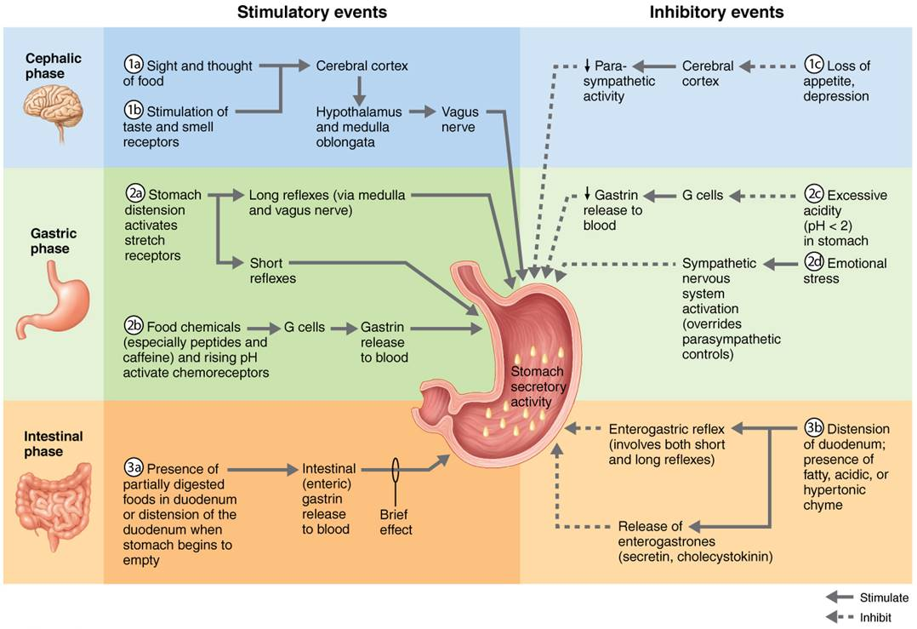
Neural and Hormonal Mechanisms that Regulate Release of Gastric Juice
Figure 23.19 Neural and hormonal mechanisms that regulate release of gastric juice.

Slide 48
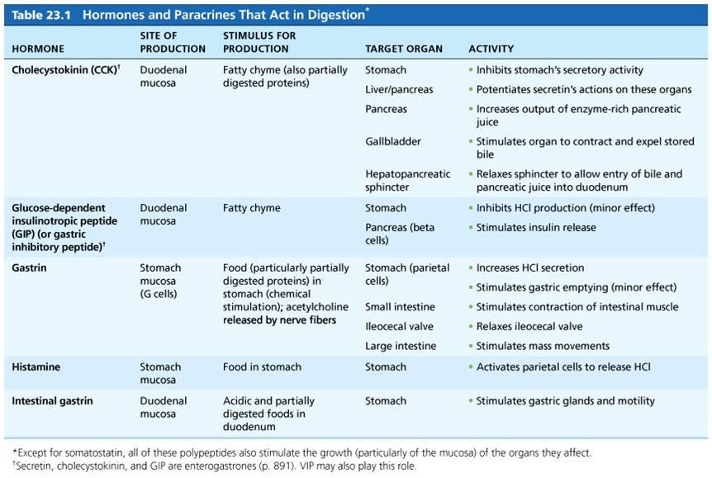
Table 23.1-1 Hormones and Paracrines That Act in Digestion (1 of 2)
Table 23.1-1 Hormones and Paracrines That Act in Digestion.

Slide 49
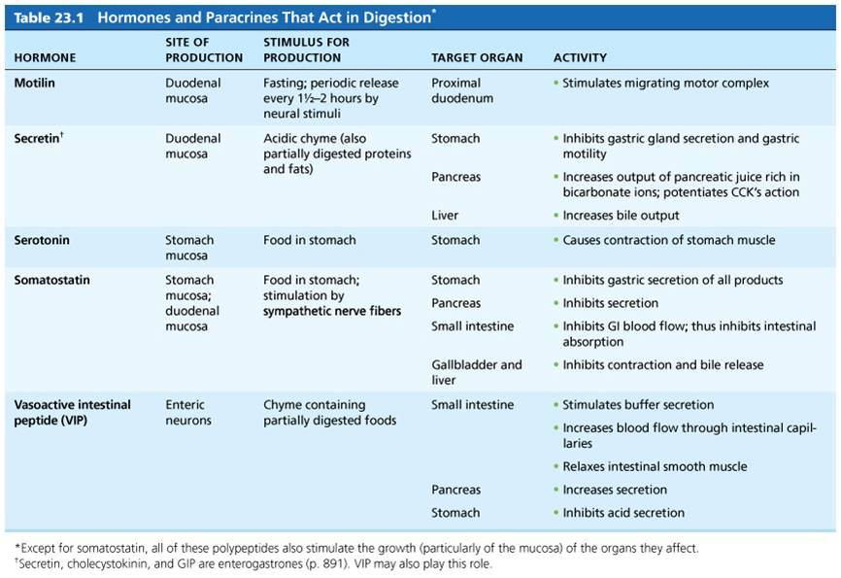
Table 23.1-1 Hormones and Paracrines That Act in Digestion (2 of 2)
Table 23.1-1 Hormones and Paracrines That Act in Digestion.

Slide 50
Mechanism of HCl Formation
Parietal cells pump H⁺ (from carbonic acid breakdown) into stomach lumen via H⁺/K⁺ ATPase (proton pumps)
As H⁺ is pumped into stomach lumen, HCO₃⁻ is exported back to blood via Cl⁻ and HCO₃⁻ antiporter
Resulting increase of HCO₃⁻ in blood leaving stomach is referred to as alkaline tide
Cl⁻ is pumped out to lumen to join with H⁺, forming HCl

Slide 51
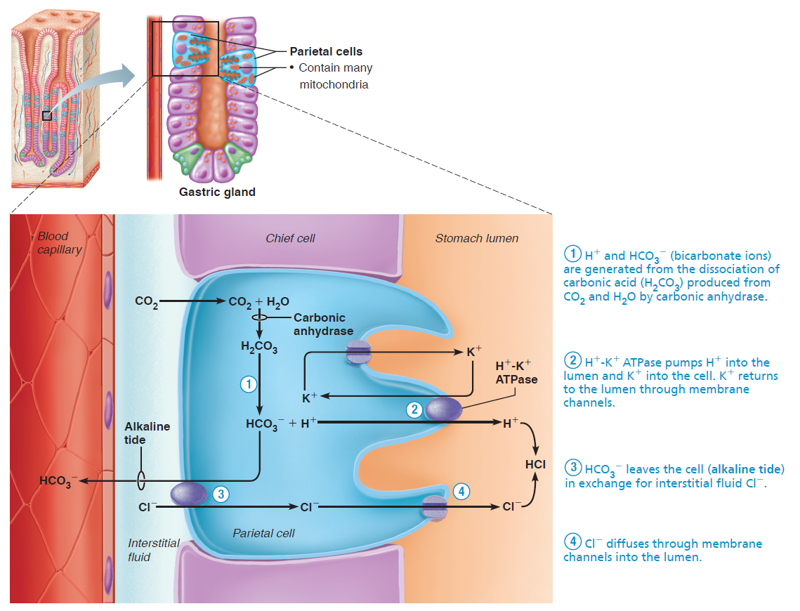
Mechanism of HCl Secretion by Parietal Cells (1 of 5)
Figure 23.20 Mechanism of HCl secretion by parietal cells.

Slide 52
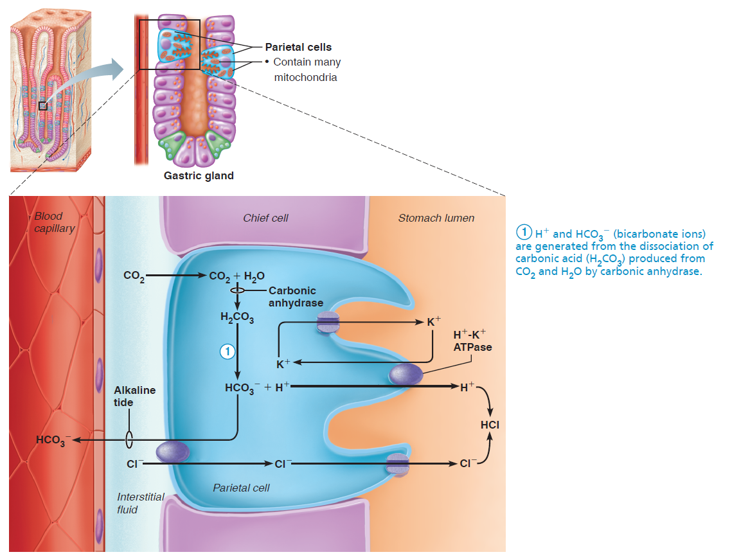
Mechanism of HCl Secretion by Parietal Cells (2 of 5)
Figure 23.20 Mechanism of HCl secretion by parietal cells.

Slide 53
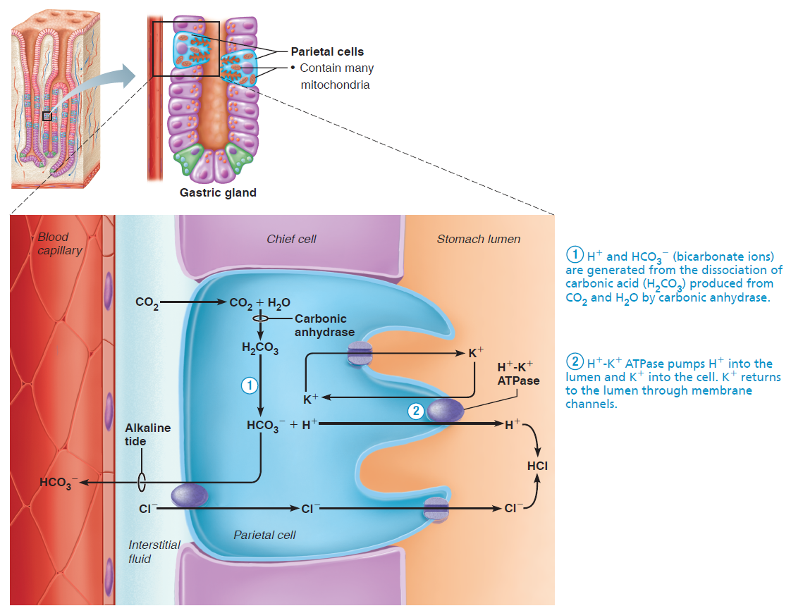
Mechanism of HCl Secretion by Parietal Cells (3 of 5)
Figure 23.20 Mechanism of HCl secretion by parietal cells.

Slide 54
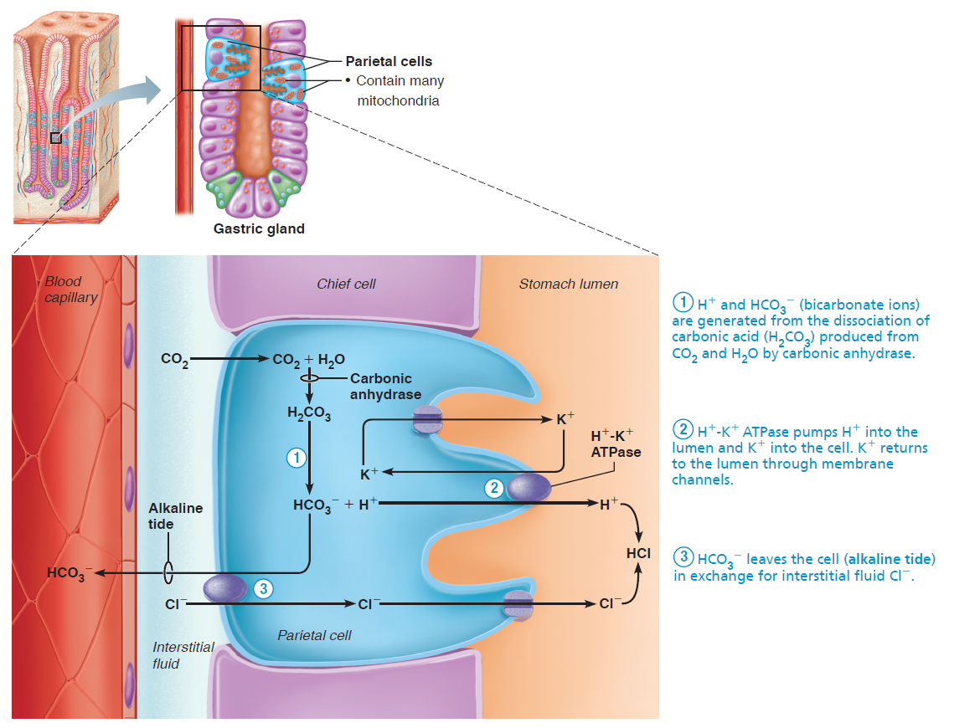
Mechanism of HCl Secretion by Parietal Cells (4 of 5)
Figure 23.20 Mechanism of HCl secretion by parietal cells.

Slide 55
Mechanism of HCl Secretion by Parietal Cells (5 of 5)
Figure 23.20 Mechanism of HCl secretion by parietal cells.

Slide 56
Regulation of Gastric Motility and Emptying (1 of 4)
Response of the stomach to filling
Stretches to accommodate incoming food
Two factors cause pressure to remain constant until 1.5 L of food is ingested
Receptive relaxation: reflex-mediated relaxation of smooth muscle coordinated by swallowing center of brain stem
Gastric accommodation: intrinsic ability of smooth muscle to exhibit stress-relaxation response, which enables hollow organs to stretch without increasing tension or contractions

Slide 57
Regulation of Gastric Motility and Emptying (2 of 4)
Gastric contractile activity
Peristaltic waves move toward pylorus at rate of three per minute
Basic electrical rhythm (BER) is set by enteric pacemaker cells (formerly interstitial cells of Cajal)
Pacemaker cells are linked by gap junctions so that entire muscularis contracts
Distension and gastrin increase force of contraction

Slide 58
Regulation of Gastric Motility and Emptying (3 of 4)
Gastric contractile activity (cont.)
Contractions are most vigorous and powerful near pylorus region
30 ml of chyme produced is either:
Delivered in ~3 ml spurts to duodenum, or
Rest of 27 ml forced backward into stomach
Only liquids and small particles are allowed to pass through pyloric valve

Slide 59
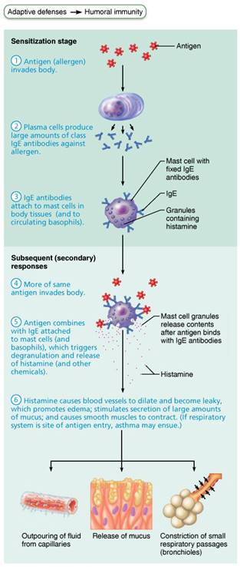
Mechanism of an Acute Allergic (Immediate Hypersensitivity) Response
Figure 21.21 Mechanism of an acute allergic (immediate hypersensitivity) response.

Slide 60
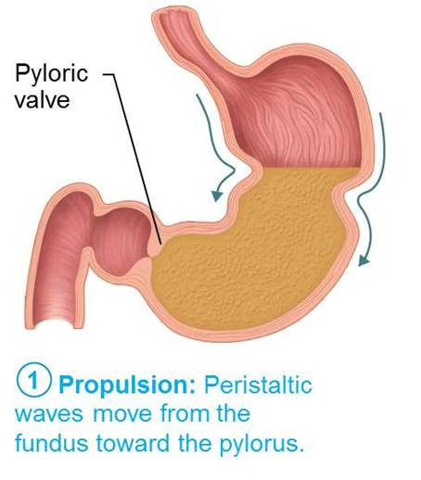
Peristaltic Waves in the Stomach (1 of 3)
Figure 23.21 Peristaltic waves in the stomach.

Slide 61
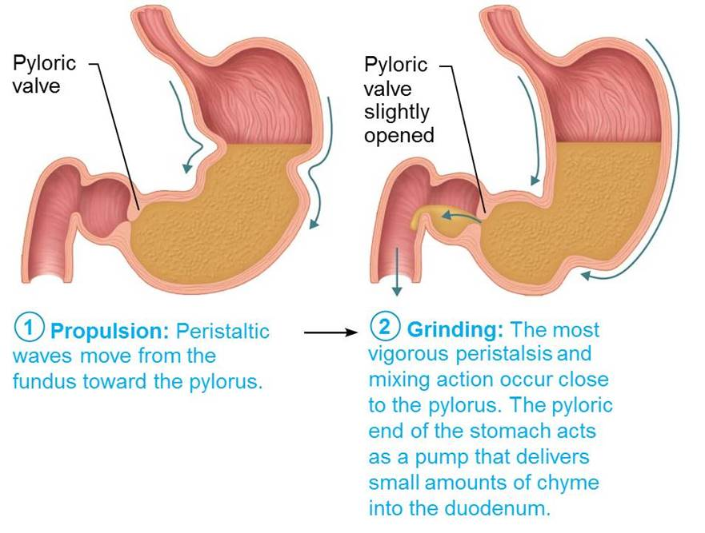
Peristaltic Waves in the Stomach (2 of 3)
Figure 23.21 Peristaltic waves in the stomach.

Slide 62
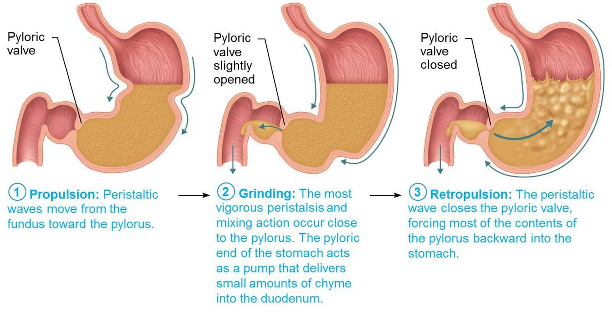
Peristaltic Waves in the Stomach (3 of 3)
Figure 23.21 Peristaltic waves in the stomach.

Slide 63
Regulation of Gastric Motility and Emptying (4 of 4)
Regulation of gastric emptying
Duodenum can prevent overfilling by controlling how much chyme enters
Duodenal receptors respond to stretch and chemical signals
Enterogastric reflex and enterogastrones inhibit gastric secretion and duodenal filling
Stomach empties in ~4 hours, but increase in fatty chyme entering duodenum can increase time to 6 hours or more
Carbohydrate-rich chyme moves quickly through duodenum

Slide 64
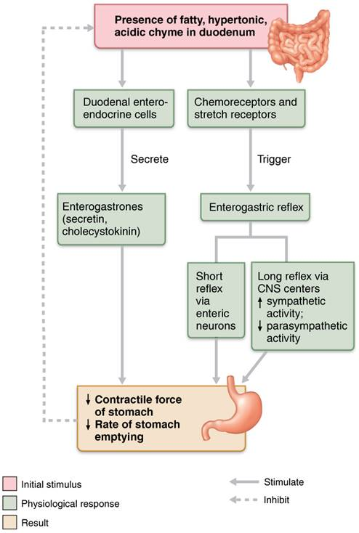
Neural and Hormonal Factors that Inhibit Gastric Emptying
Figure 23.22 Neural and hormonal factors that inhibit gastric emptying.

Slide 65
Clinical – Homeostatic Imbalance 23.8
Vomiting (emesis) is caused by:
Extreme stretching
Intestinal irritants, such as bacterial toxins, excessive alcohol, spicy food, certain drugs
Chemicals and sensory impulses stimulate emetic center of medulla
Excessive vomiting can lead to dehydration and electrolyte and acid-base imbalances (alkalosis)

Slide 66
23.7 Liver, Gallbladder and Pancreas
Liver, gallbladder, and pancreas are accessory organs associated with small intestine
Liver: digestive function is production of bile
Bile: fat emulsifier
Gallbladder: chief function is storage of bile
Pancreas: supplies most of enzymes needed to digest chyme, as well as bicarbonate to neutralize stomach acid

Slide 67
The Liver (1 of 8)
Gross anatomy of the liver
Largest gland in body; weighs ~3 lbs
Consists of four primary lobes: right, left, caudate, and quadrate
Falciform ligament
Separates larger right and smaller left lobes
Suspends liver from diaphragm and anterior abdominal wall
Round ligament (ligamentum teres)
Remnant of fetal umbilical vein along free edge of falciform ligament

Slide 68
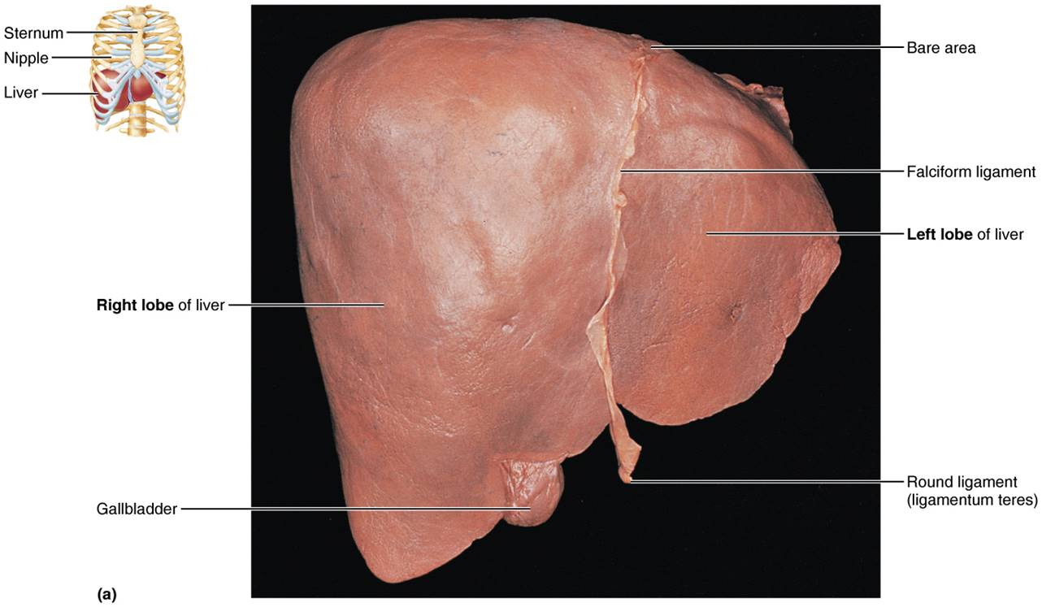
Gross Anatomy of the Human Liver (1 of 3)
Figure 23.23a Gross anatomy of the human liver.

Slide 69
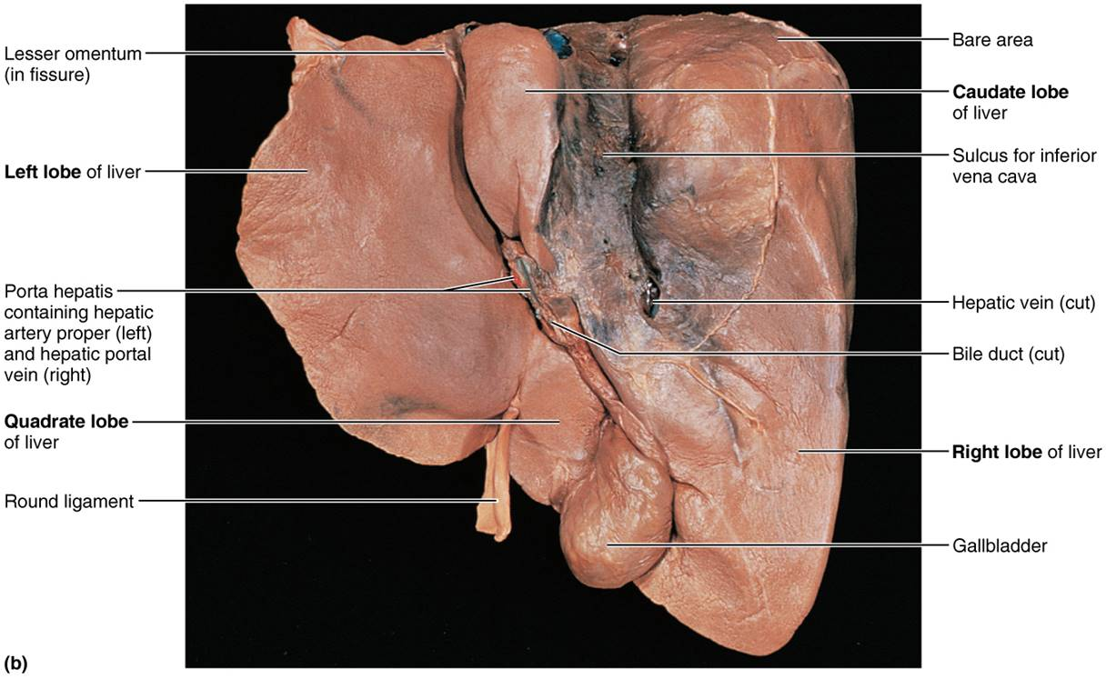
Gross Anatomy of the Human Liver (2 of 3)
Figure 23.23b Gross anatomy of the human liver.

Slide 70
The Liver (2 of 8)
Gross anatomy of the liver (cont.)
Lesser omentum anchors liver to stomach
Hepatic artery and vein enter liver at porta hepatis
Bile ducts
Common hepatic duct leaves liver
Cystic duct connects to gallbladder
Bile duct formed by union of common hepatic and cystic ducts

Slide 71
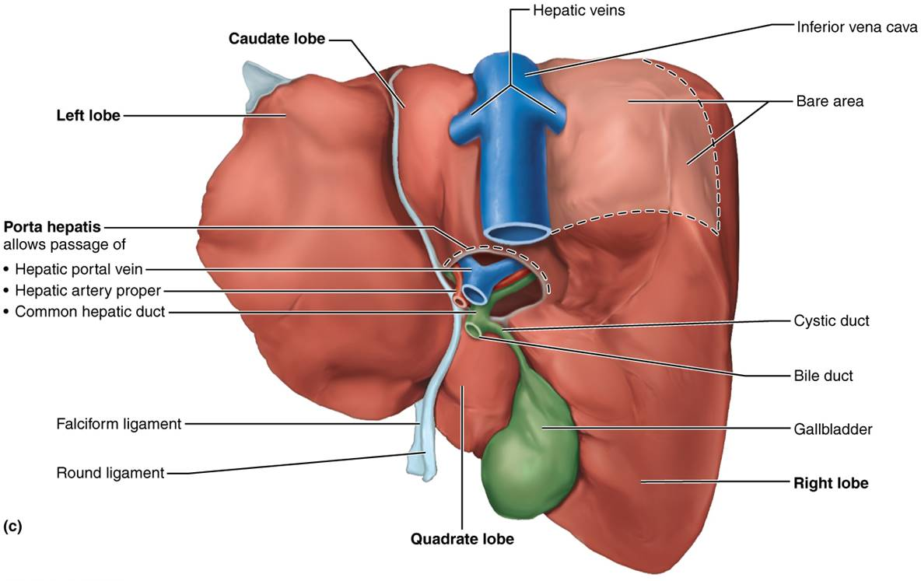
Gross Anatomy of the Human Liver (3 of 3)
Figure 23.23c Gross anatomy of the human liver.

Slide 72
The Liver (3 of 8)
Microscopic anatomy of the liver
Liver lobules
Hexagonal structural and functional units
Composed of plates of hepatocytes (liver cells) that filter and process nutrient-rich blood
Central vein located in longitudinal axis
Portal triad in each corner of lobule contains:
Branch of hepatic artery, which supplies oxygen
Branch of hepatic portal vein, which brings nutrient-rich blood from intestine
Bile duct, which receives bile from bile canaliculi

Slide 73
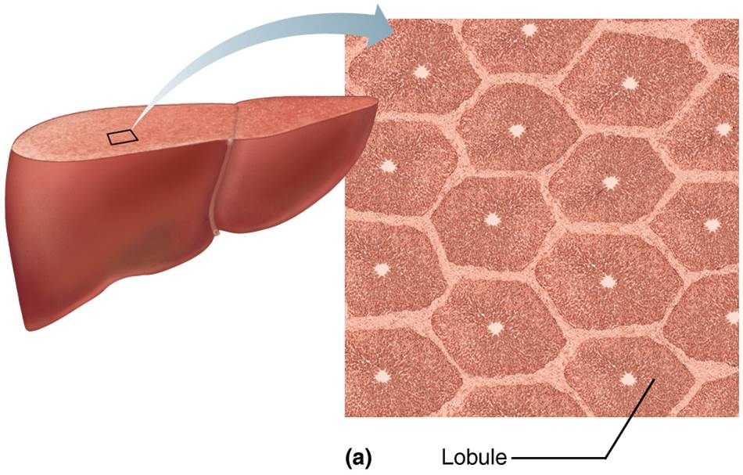
Microscopic Anatomy of the Liver (1 of 3)
Figure 23.24a Microscopic anatomy of the liver.

Slide 74
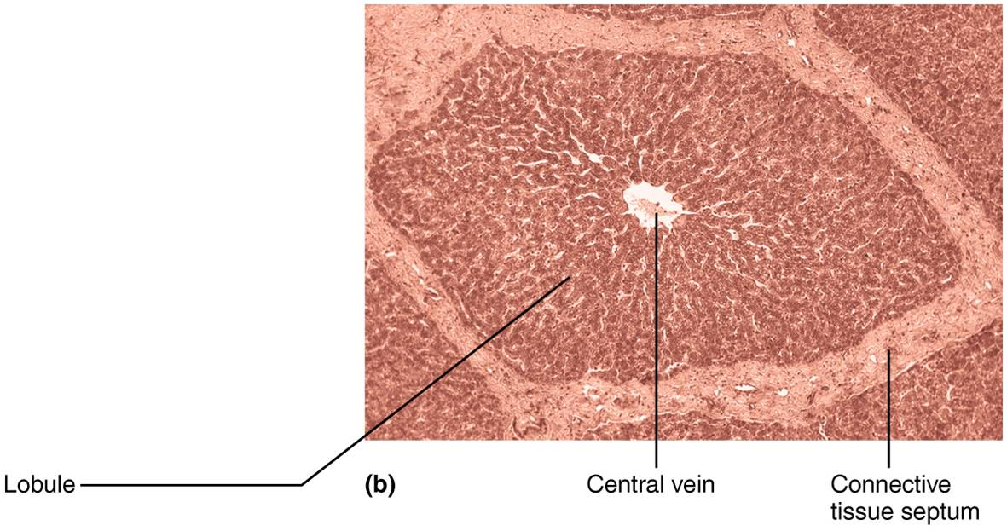
Microscopic Anatomy of the Liver (2 of 3)
Figure 23.24b Microscopic anatomy of the liver.

Slide 75
The Liver (4 of 8)
Microscopic anatomy of the liver (cont.)
Liver sinusoids: leaky capillaries located between hepatic plates
Blood from both hepatic portal vein and hepatic artery proper percolates from triad regions through sinusoids and empties into central vein
Stellate macrophages (hepatic macrophages) in liver sinusoids remove debris and old RBCs

Slide 76
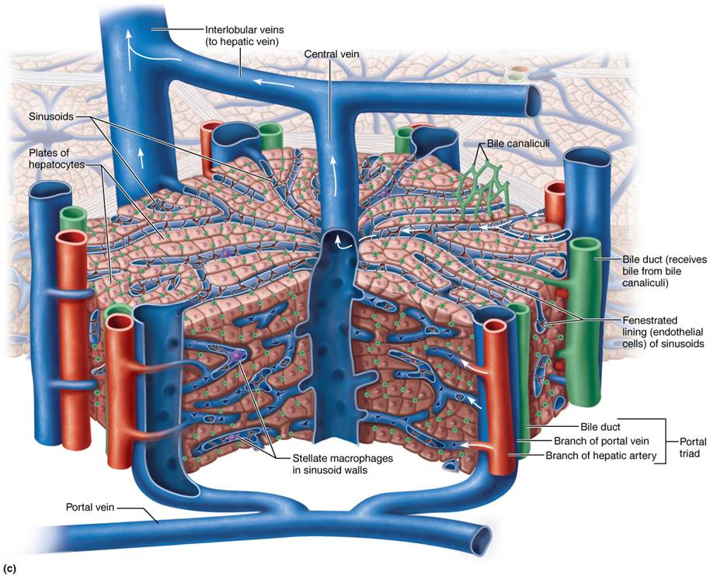
Microscopic Anatomy of the Liver (3 of 3)
Figure 23.24c Microscopic anatomy of the liver.

Slide 77
The Liver (5 of 8)
Microscopic anatomy of the liver (cont.)
Hepatocytes have increased rough and smooth ER, Golgi apparatus, peroxisomes, and mitochondria
Hepatocyte functions
Produce ~900 ml bile per day
Process bloodborne nutrients
Example: store glucose as glycogen and make plasma proteins
Store fat-soluble vitamins
Perform detoxification
Example: converting ammonia to urea

Slide 78
The Liver (6 of 8)
Bile: Composition and enterohepatic circulation
Yellow-green, alkaline solution containing:
Bile salts: cholesterol derivatives that function in fat emulsification and absorption
Bilirubin: pigment formed from heme
Bacteria break down in intestine to stercobilin that gives brown color of feces
Cholesterol, triglycerides, phospholipids, and electrolytes

Slide 79
The Liver (7 of 8)
Bile: Composition and enterohepatic circulation (cont.)
Enterohepatic circulation
Recycling mechanism that conserves bile salts
Bile salts are:
Reabsorbed into blood by ileum (the last part of small intestine)
Returned to liver via hepatic portal blood
Resecreted in newly formed bile
About 95% of secreted bile salts are recycled, so only 5% is newly synthesized each time

Slide 80
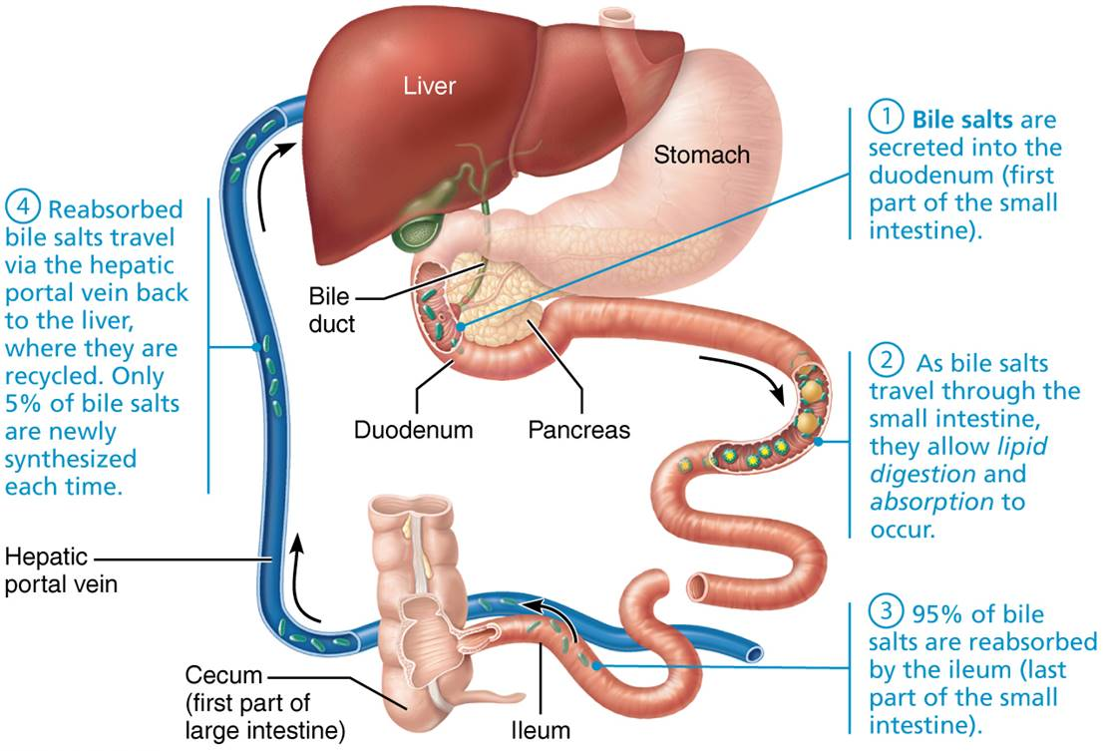
The Enterohepatic Circulation
Figure 23.25 The enterohepatic circulation.

Slide 81
The Liver (8 of 8)
Homeostatic imbalance of liver
Hepatitis
Usually viral infection, drug toxicity, wild mushroom poisoning
Cirrhosis
Progressive, chronic inflammation from chronic hepatitis or alcoholism
Liver → fatty, fibrous → portal hypertension
Liver transplants successful, but livers are scarce
Liver can regenerate to its full size in 6–12 months after 80% removal

Slide 82
The Gallbladder
Gallbladder is a thin-walled muscular sac on ventral surface of liver
Functions to store and concentrate bile by absorbing water and ions
Contains many honeycomb folds that allow it to expand as it fills
Muscular contractions release bile via cystic duct, which flows into bile duct

Slide 83
Clinical – Homeostatic Imbalance 23.9
Gallstones (biliary calculi): caused by too much cholesterol or too few bile salts
Can obstruct flow of bile from gallbladder
Painful when gallbladder contracts against sharp crystals
Obstructive jaundice: blockage can cause bile salts and pigments to build up in blood, resulting in jaundiced (yellow) skin
Jaundice can also be caused by liver failure
Gallstone treatment: crystal-dissolving drugs, ultrasound vibrations (lithotripsy), laser vaporization, or surgery

Slide 84
The Pancreas (1 of 3)
Location: mostly retroperitoneal, deep to greater curvature of stomach
Head is encircled by duodenum; tail abuts spleen
Exocrine function: produce pancreatic juice
Acini: clusters of secretory cells that produce zymogen granules containing proenzymes
Ducts: secrete to duodenum via main pancreatic duct; smaller duct cells produce water and bicarbonate
Endocrine function: secretion of insulin and glucagon by pancreatic islet cells

Slide 85
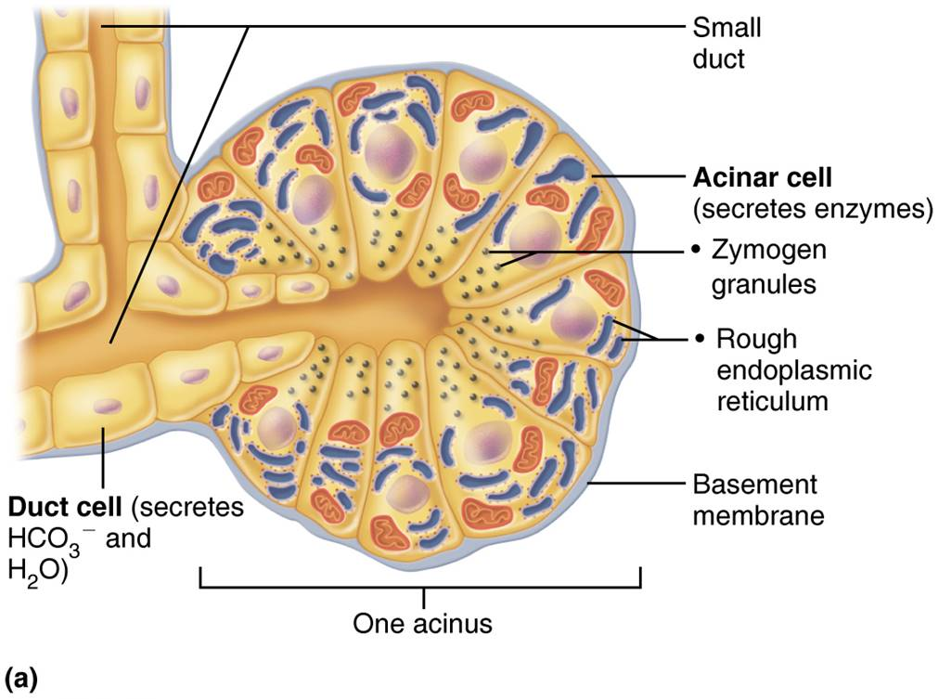
Structure of the Enzyme-Producing Tissue of the Pancreas (1 of 2)
Figure 23.26a Structure of the enzyme-producing tissue of the pancreas.

Slide 86
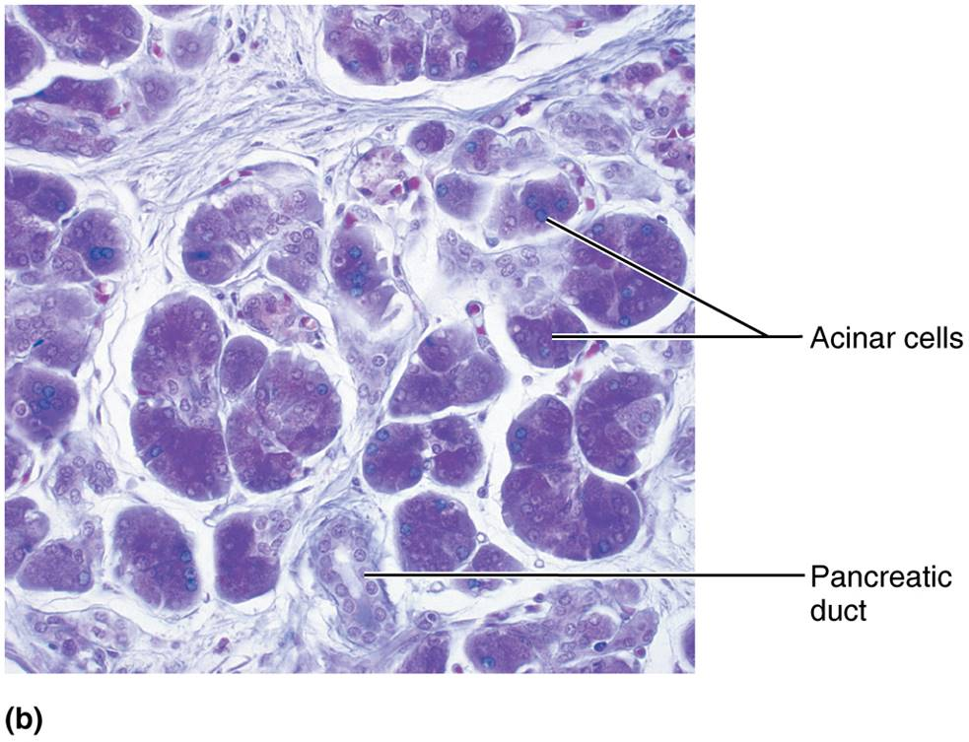
Structure of the Enzyme-Producing Tissue of the Pancreas (2 of 2)
Figure 23.26b Structure of the enzyme-producing tissue of the pancreas.

Slide 87
The Pancreas (2 of 3)
Composition of pancreatic juice
1200–1500 ml/day is produced containing:
Watery, alkaline solution (pH 8) to neutralize acidic chyme coming from stomach
Electrolytes, primarily HCO₃⁻ Digestive enzymes
Proteases (for proteins): secreted in inactive form to prevent self-digestion
Amylase (for carbohydrates)
Lipases (for lipids)
Nucleases (for nucleic acids)

Slide 88
The Pancreas (3 of 3)
Composition of pancreatic juice (cont.)
Proteases are secreted in an inactive form; they are activated after they reach duodenum
Enteropeptidase, enzyme bound to plasma membrane of duodenal epithelial cells, activates pancreatic protease trypsinogen to trypsin
Once trypsin is activated, it can then activate:
More trypsinogen
Procarboxypeptidase to active carboxypeptidase
Chymotrypsinogen to active chymotrypsin

Slide 89
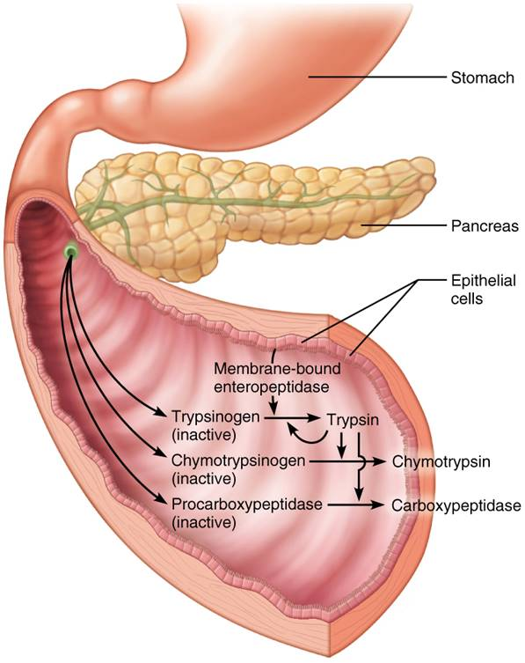
Activation of Pancreatic Proteases in the Small Intestine
Figure 23.27 Activation of pancreatic proteases in the small intestine.

Slide 90
Bile and Pancreatic Secretion into the Small Intestine (1 of 3)
Bile duct and pancreatic duct unite in wall of duodenum
Fuse together in bulblike structure called hepatopancreatic ampulla
Ampulla opens into duodenum via volcano-shaped major duodenal papilla
Hepatopancreatic sphincter controls entry of bile and pancreatic juice into duodenum
Accessory pancreatic duct: smaller duct that empties directly into duodenum

Slide 91
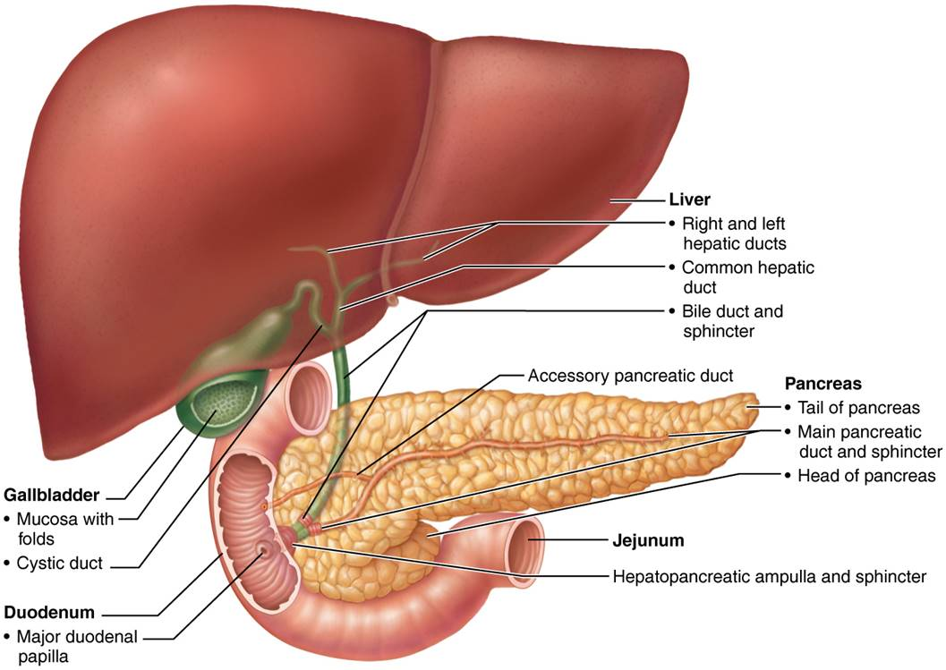
Relationship of the Liver, Gallbladder and Pancreas to the Duodenum
Figure 23.28 Relationship of the liver, gallbladder, and pancreas to the duodenum.

Slide 92
Bile and Pancreatic Secretion into the Small Intestine (2 of 3)
Regulation of bile and pancreatic secretions
Bile and pancreatic juice secretions are both stimulated by neural and hormonal controls
Hormonal controls include:
Cholecystokinin (CCK)
Secretin

Slide 93
Bile and Pancreatic Secretion into the Small Intestine (3 of 3)
Regulation of bile and pancreatic secretions (cont.)
Bile secretion is increased when:
Enterohepatic circulation returns large amounts of bile salts
Secretin, from intestinal cells exposed to HCl and fatty chyme, stimulates gallbladder to release bile
Hepatopancreatic sphincter is closed, unless digestion is active
Bile is stored in gallbladder and released to small intestine only with contraction

Slide 94
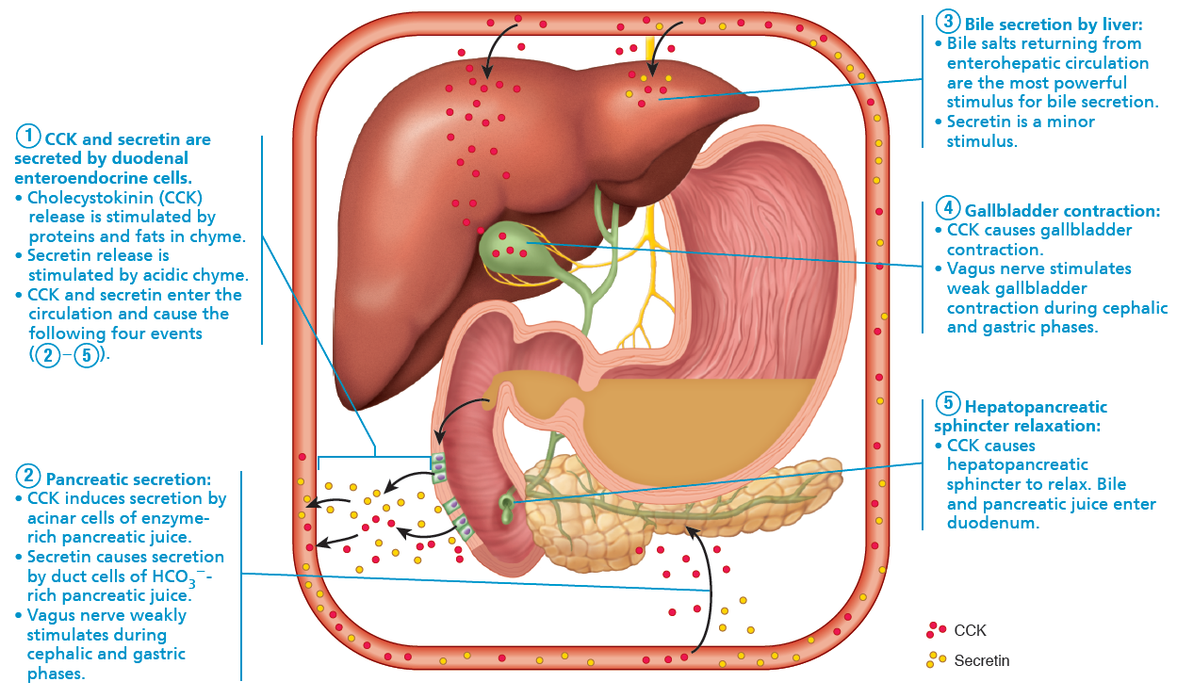
Mechanisms Promoting Secretion and Release of Bile and Pancreatic Juice (1 of 6)
Figure 23.29 Mechanisms promoting secretion and release of bile and pancreatic juice.

Slide 95
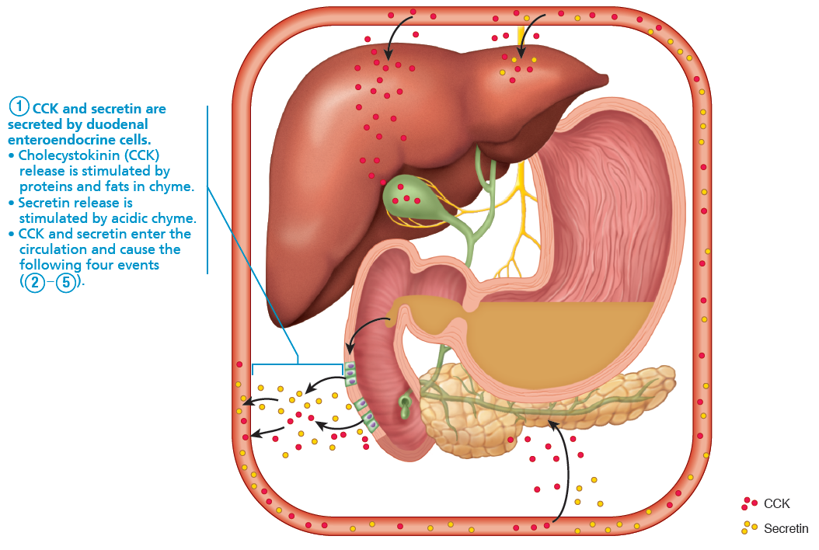
Mechanisms Promoting Secretion and Release of Bile and Pancreatic Juice (2 of 6)
Figure 23.29 Mechanisms promoting secretion and release of bile and pancreatic juice.

Slide 96
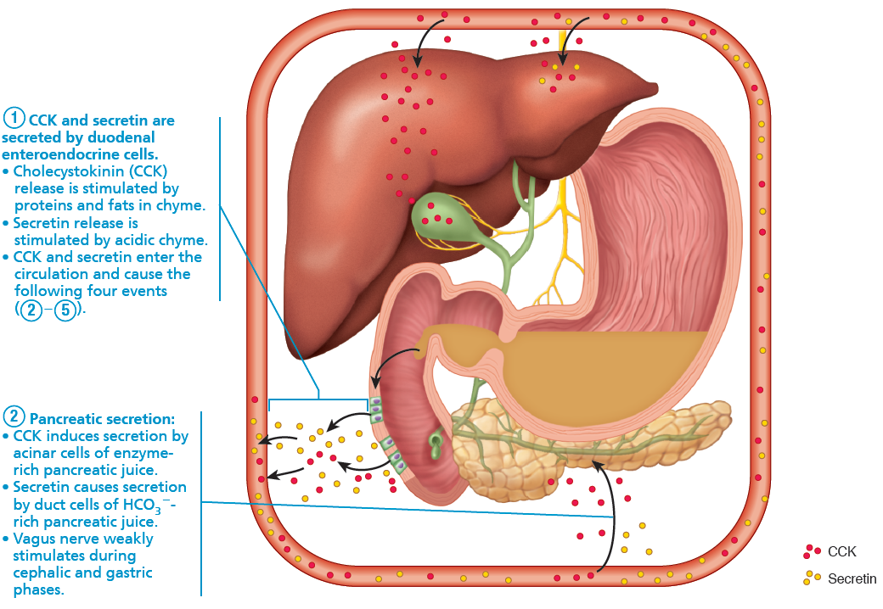
Mechanisms Promoting Secretion and Release of Bile and Pancreatic Juice (3 of 6)
Figure 23.29 Mechanisms promoting secretion and release of bile and pancreatic juice.

Slide 97
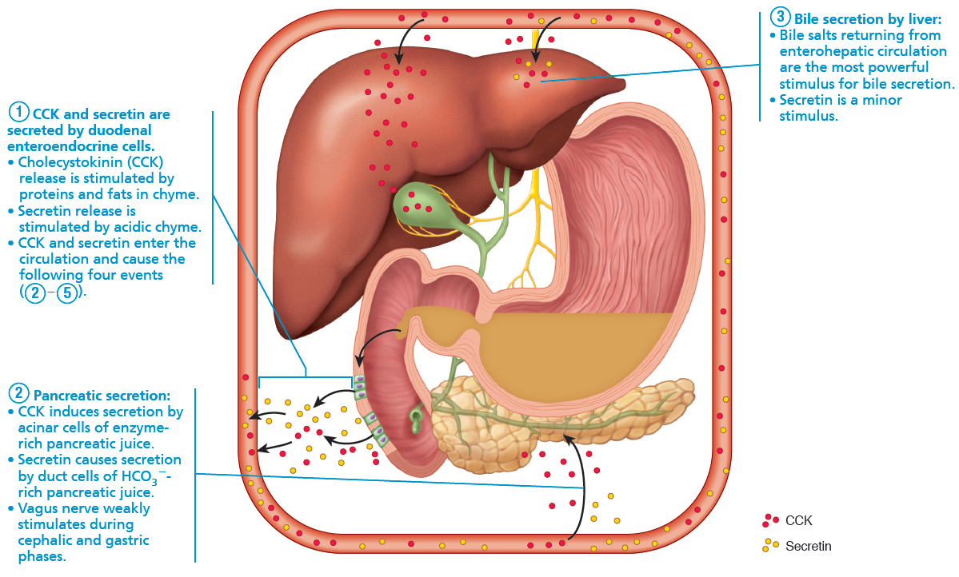
Mechanisms Promoting Secretion and Release of Bile and Pancreatic Juice (4 of 6)
Figure 23.29 Mechanisms promoting secretion and release of bile and pancreatic juice.

Slide 98
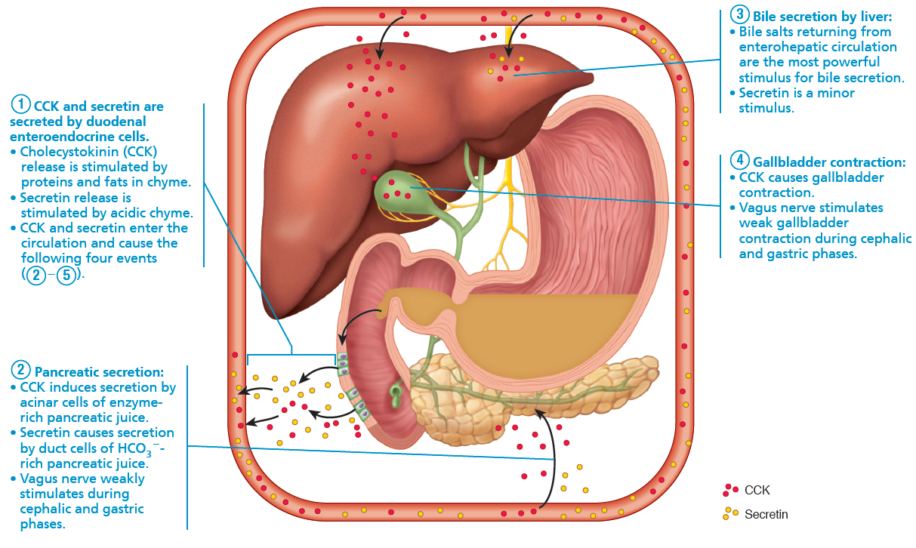
Mechanisms Promoting Secretion and Release of Bile and Pancreatic Juice (5 of 6)
Figure 23.29 Mechanisms promoting secretion and release of bile and pancreatic juice.

Slide 99
Mechanisms Promoting Secretion and Release of Bile and Pancreatic Juice (6 of 6)
Figure 23.29 Mechanisms promoting secretion and release of bile and pancreatic juice.

Slide 100
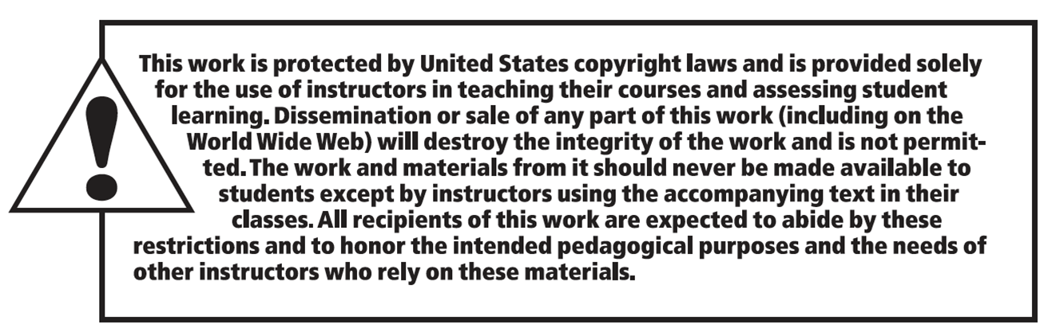
Copyright

