Slide 1
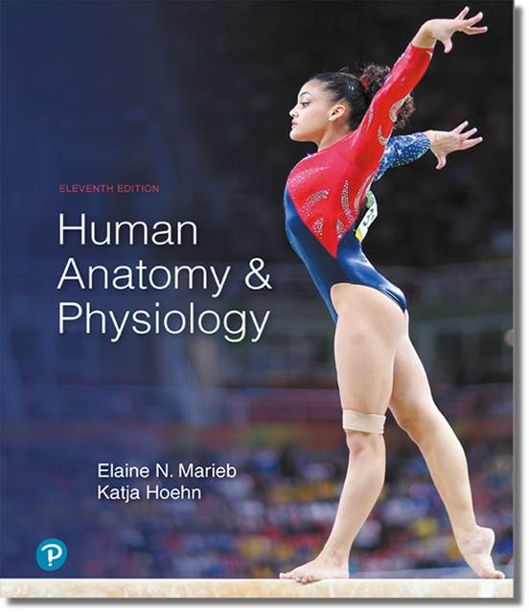
Human Anatomy and Physiology
Eleventh Edition
Chapter 23 Part C
The Digestive System
PowerPoint® Lectures Slides prepared by Karen Dunbar Kareiva, Ivy Tech Community College
Copyright © 2019, 2016, 2013 Pearson Education, Inc. All Rights Reserved

Slide 2
23.8 The Small Intestine

Slide 3
Gross Anatomy (1 of 3)
Small intestine is the major organ of digestion and absorption
2–4 m long (7–13 ft) from pyloric sphincter to ileocecal valve, point at which it joins large intestine
Small diameter of 2.5–4 cm (1.0–1.6 inches)

Slide 4
Gross Anatomy (2 of 3)
Subdivisions
  Duodenum: mostly retroperitoneal; ~25.0 cm (10.0 in) long; curves around head of pancreas
    Has most features
  Jejunum: ~2.5 m (8 ft) long; attached posteriorly by mesentery
  Ileum: ~3.6 m (12 ft) long; attached posteriorly by mesentery; joins large intestine at ileocecal valve

Slide 5
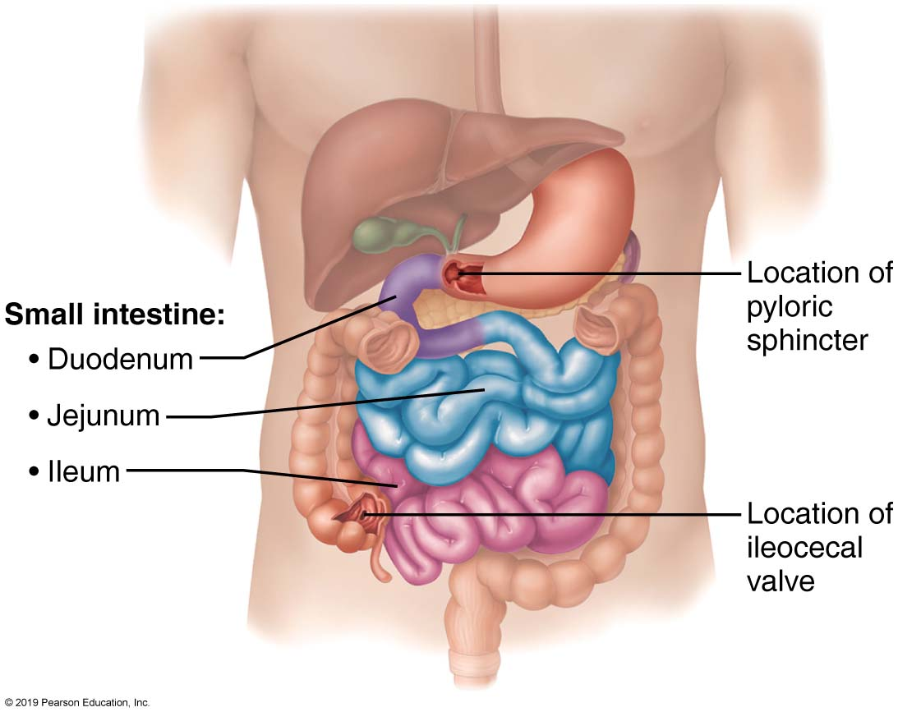
The Small Intestine
Figure 23.30 The small intestine.

Slide 6
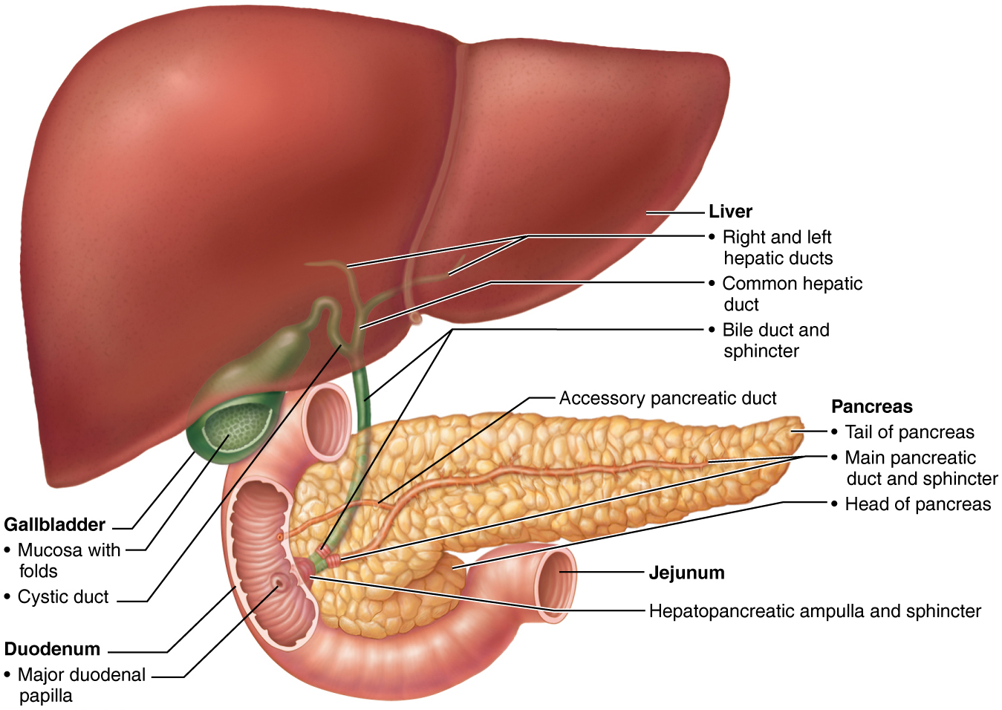
Relationship of the Liver, Gallbladder, and Pancreas to the Duodenum
Figure 23.28 Relationship of the liver, gallbladder, and pancreas to the duodenum.

Slide 7
Gross Anatomy (3 of 3)
Blood supply:
  Superior mesenteric artery brings blood supply
  Veins (carrying nutrient-rich blood) drain into superior mesenteric veins, then into hepatic portal vein, and finally into liver
Nerve supply
  Parasympathetic innervation via vagus nerve, and sympathetic innervation from thoracic splanchnic nerves

Slide 8
Microscopic Anatomy (1 of 5)
Modifications of small intestine for absorption
  Small intestine’s length and other structural modifications provide huge surface area for nutrient absorption
    Surface area is increased 600× to ~200 m² (size of a tennis court)
  Modifications include:
    Circular folds
    Villi
    Microvilli

Slide 9
Microscopic Anatomy (2 of 5)
  Circular folds
    Permanent folds (~1 cm deep) that force chyme to slowly spiral through lumen, allowing more time for nutrient absorption
  Villi
    Fingerlike projections of mucosa (~1 mm high) with a core that contains dense capillary bed and lymphatic capillary called a lacteal for absorption
  Microvilli
    Cytoplasmic extensions of mucosal cell that give fuzzy appearance called the brush border that contains membrane-bound enzymes brush border enzymes, used for final carbohydrate and protein digestion

Slide 10
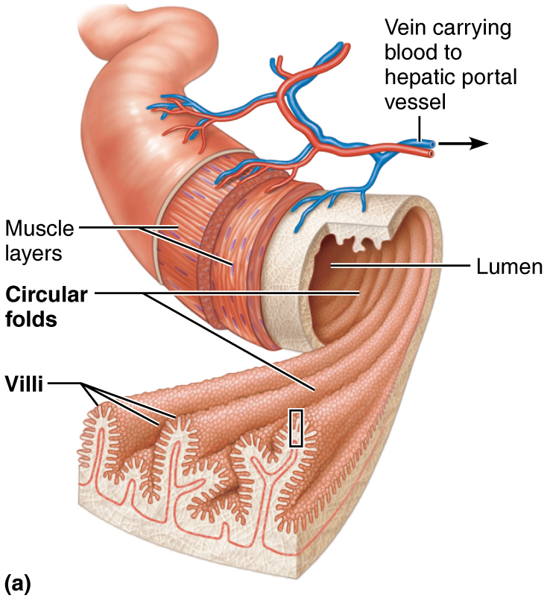
Structural Modifications of the Small Intestine that Increase its Surface Area for Digestion and Absorption (1 of 3)
Figure 23.31a Structural modifications of the small intestine that increase its surface area for digestion and absorption.

Slide 11
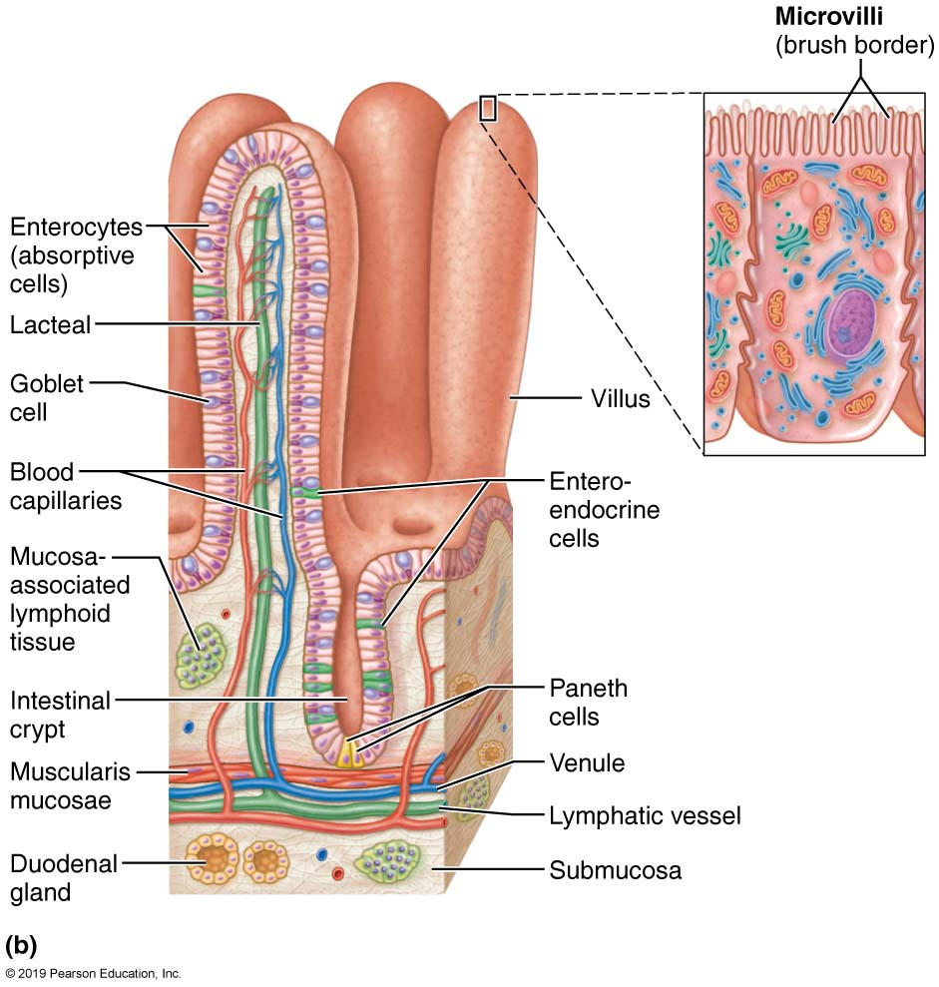
Structural Modifications of the Small Intestine that Increase its Surface Area for Digestion and Absorption (2 of 3)
Figure 23.31b Structural modifications of the small intestine that increase its surface area for digestion and absorption.

Slide 12
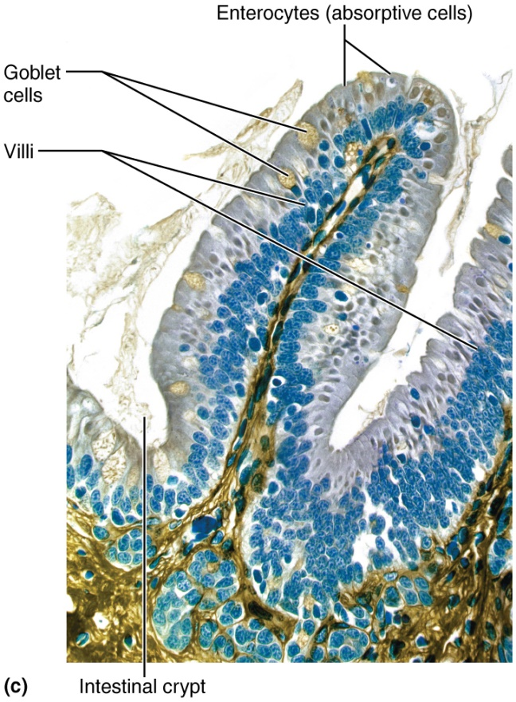
Structural Modifications of the Small Intestine that Increase its Surface Area for Digestion and Absorption (3 of 3)
Figure 23.31c Structural modifications of the small intestine that increase its surface area for digestion and absorption.

Slide 13
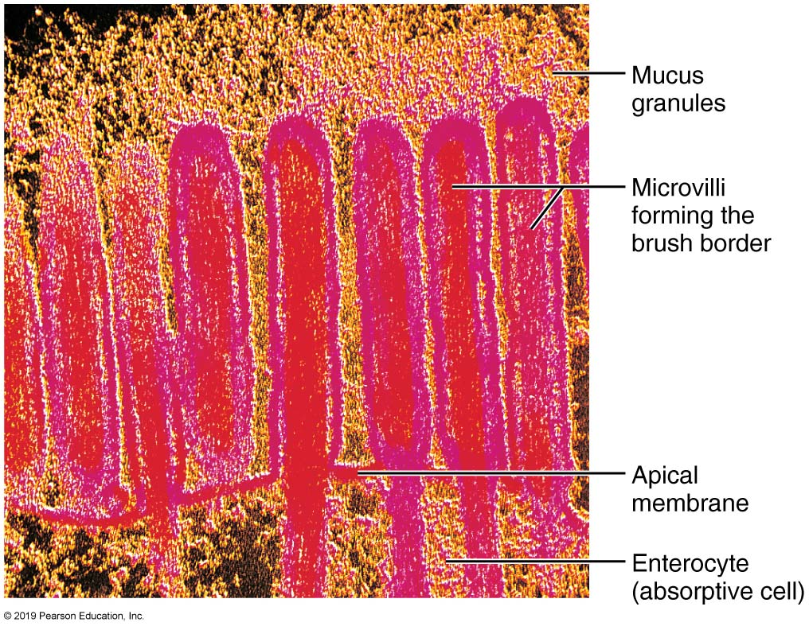
Microvilli of the Small Intestine
Figure 23.32 Microvilli of the small intestine.

Slide 14
Microscopic Anatomy (3 of 5)
Histology of the small intestine wall
  Modifications of mucosa and submucosa of small intestine reflect its function in digestion
  Intestinal crypts: tubular glands scattered between villi
  Five main types of cells found in villi and crypts
    Enterocytes: make up bulk of epithelium
      Simple columnar absorptive cells bound by tight junctions and contain many microvilli
      Function
        Villi: absorb nutrients and electrolytes
        Crypts: produce intestinal juice, watery mixture of mucus that acts as carrier fluid for chyme

Slide 15
Microscopic Anatomy (4 of 5)
Histology of the small intestine wall (cont.)
    Goblet cells: mucus-secreting cells found in epithelia of villi and crypts
    Enteroendocrine cells: source of enterogastrones (examples: CCK and secretin)
      Found scattered in villi but some in crypts
    Paneth cells: found deep in crypts, specialized secretory cells that fortify small intestine’s defenses
      Secrete antimicrobial agents (defensins and lysozyme) that can destroy bacteria
    Stem cells that continuously divide to produce other cell types
      Villus epithelium renewed every 2–4 days

Slide 16
Microscopic Anatomy (5 of 5)
Histology of the small intestine wall (cont.)
  Mucosa-associated lymphoid tissue protects intestine against microorganisms and includes:
    Individual lymphoid follicles
    Peyer’s patches (aggregated lymphoid nodules), located in lamina propria
      Found in great numbers in distal part of small intestine, where bacterial numbers increase
    Lamina propria also contains large numbers of plasma cells that secrete IgA
  Submucosa consists of areolar tissue
    Duodenal glands of duodenum secrete alkaline mucus to neutralize acidic chyme

Slide 17
Clinical – Homeostatic Imbalance 23.10
Chemotherapy targets rapidly dividing cells, such as cancer cells
Negative side effect is that it also targets rapidly dividing GI tract epithelium
Reason why many patients undergoing chemotherapy have symptoms of nausea, vomiting, and diarrhea

Slide 18
Intestinal Juice
1–2 L secreted daily in response to distension or irritation of mucosa
Major stimulus for production is hypertonic or acidic chyme
Slightly alkaline and isotonic with blood plasma
Consists largely of water but also contains mucus
  Mucus is secreted by duodenal glands and goblet cells of mucosa

Slide 19
Digestive Processes in the Small Intestine
(1 of 5)
Chyme from stomach contains partially digested carbohydrates and proteins and undigested fats
Takes 3–6 hours in small intestine to absorb all nutrients and most water
Sources of enzymes for digestion
  Substances such as bile, bicarbonate, digestive enzymes (not brush border enzymes) are imported from liver and pancreas
  Brush border enzymes bound to plasma membrane perform final digestion of chyme

Slide 20
Digestive Processes in the Small Intestine
(2 of 5)
Regulating chyme entry
  Chyme entering duodenum is usually hypertonic; therefore, chyme delivery has to be slow to prevent osmotic loss of water from blood
  Low pH of chyme has to be adjusted upward
  Chyme has to be mixed with bile and pancreatic juice to continue digestion
  Enterogastric reflex and enterogastrones control movement of food into duodenum to prevent it from being overwhelmed

Slide 21
Digestive Processes in the Small Intestine
(3 of 5)
Motility of the small intestine
  After a meal
    Segmentation is most common motion of small intestine
      Initiated by intrinsic pacemaker cells
      Mixes/moves contents toward ileocecal valve
      Intensity is altered by long and short reflexes and hormones
        Parasympathetic increases motility; sympathetic decreases it

Slide 22
Digestive Processes in the Small Intestine
(4 of 5)
  Between meals
    Peristalsis increases, initiated by rise in hormone motilin in late intestinal phase (every 90–120 minutes)
    Each wave starts distal to previous wave; referred to as migrating motor complex (MMC)
    Meal remnants, bacteria, and debris are moved toward large intestine
    Complete trip from duodenum to ileum takes ~2 hours

Slide 23
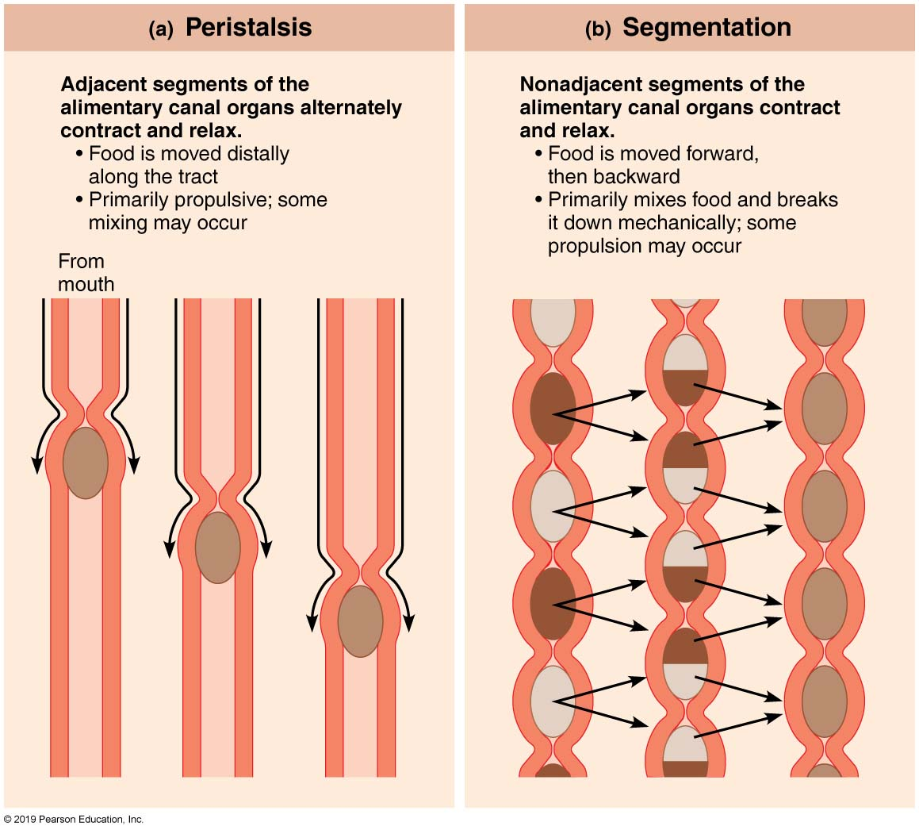
Peristalsis and Segmentation
Figure 23.3 Peristalsis and segmentation.

Slide 24
Digestive Processes in the Small Intestine
(5 of 5)
Ileocecal valve control
  Ileocecal sphincter relaxes and admits chyme into large intestine when:
    Gastroileal reflex enhances force of segmentation in ileum
    Gastrin increases motility of ileum
  Ileocecal valve flaps close when chyme exerts backward pressure
    Prevents regurgitation into ileum

Slide 25
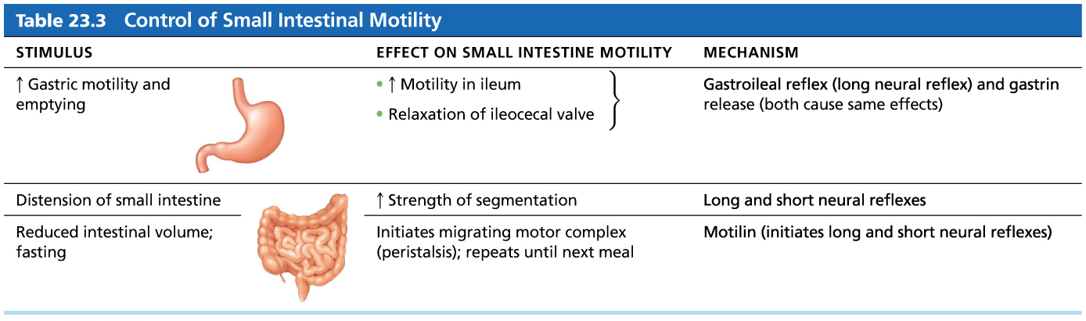
Table 23.3 Control of Small Intestinal Motility
Table 23.3 Control of Small Intestinal Motility.

Slide 26
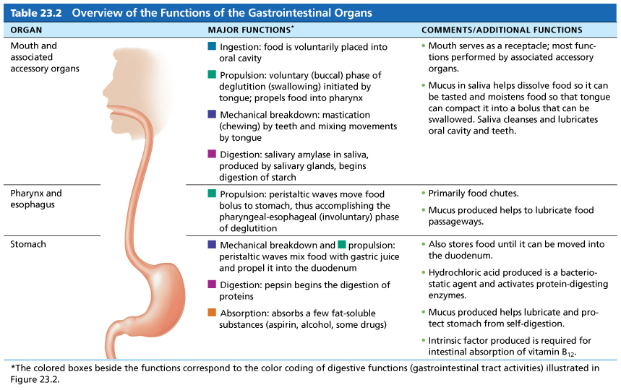
Table 23.2-1 Overview of the Functions of the Gastrointestinal Organs (1 of 2)
Table 23.2 Overview of the Functions of the Gastrointestinal Organs.

Slide 27
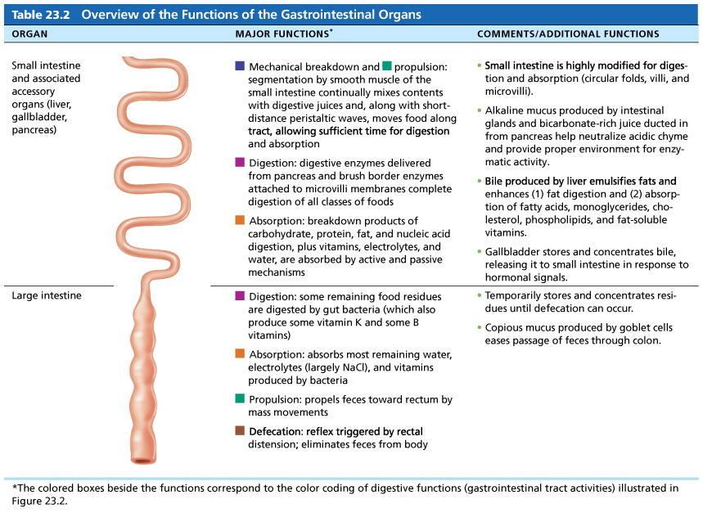
Table 23.2-1 Overview of the Functions of the Gastrointestinal Organs (2 of 2)
Table 23.2 Overview of the Functions of the Gastrointestinal Organs.

Slide 28
23.9 The Large Intestine

Slide 29
Gross Anatomy (1 of 6)
Large intestine has three unique features not seen elsewhere:
  Teniae coli: three bands of longitudinal smooth muscle in muscularis
  Haustra: pocketlike sacs caused by tone of teniae coli
  Epiploic appendages: fat-filled pouches of visceral peritoneum

Slide 30
Gross Anatomy (2 of 6)
Subdivisions of large intestine
  Cecum: first part of large intestine
  Appendix: masses of lymphoid tissue
    Part of MALT of immune system
    Bacterial storehouse capable of recolonizing gut when necessary
    Twisted shape of appendix makes it susceptible to blockages

Slide 31
Gross Anatomy (3 of 6)
Subdivisions of large intestine (cont.)
  Colon: has several regions, most which are retroperitoneal (except for transverse and sigmoid regions)
    Ascending colon: travels up right side of abdominal cavity to level of right kidney
      Ends in right-angle turn called right colic (hepatic) flexure
    Transverse colon: travels across abdominal cavity
      Ends in another right-angle turn, left colic (splenic) flexure

Slide 32
Gross Anatomy (4 of 6)
Subdivisions of large intestine (cont.)
  Colon (cont.) :
    Descending colon: travels down left side of abdominal cavity
    Sigmoid colon: S-shaped portion that travels through pelvis
  Rectum: three rectal valves stop feces from being passed with gas (flatus)

Slide 33
Gross Anatomy (5 of 6)
Subdivisions of large intestine (cont.)
  Anal canal: last segment of large intestine that opens to body exterior at anus
    Has two sphincters
      Internal anal sphincter: smooth muscle
      External anal sphincter: skeletal muscle

Slide 34
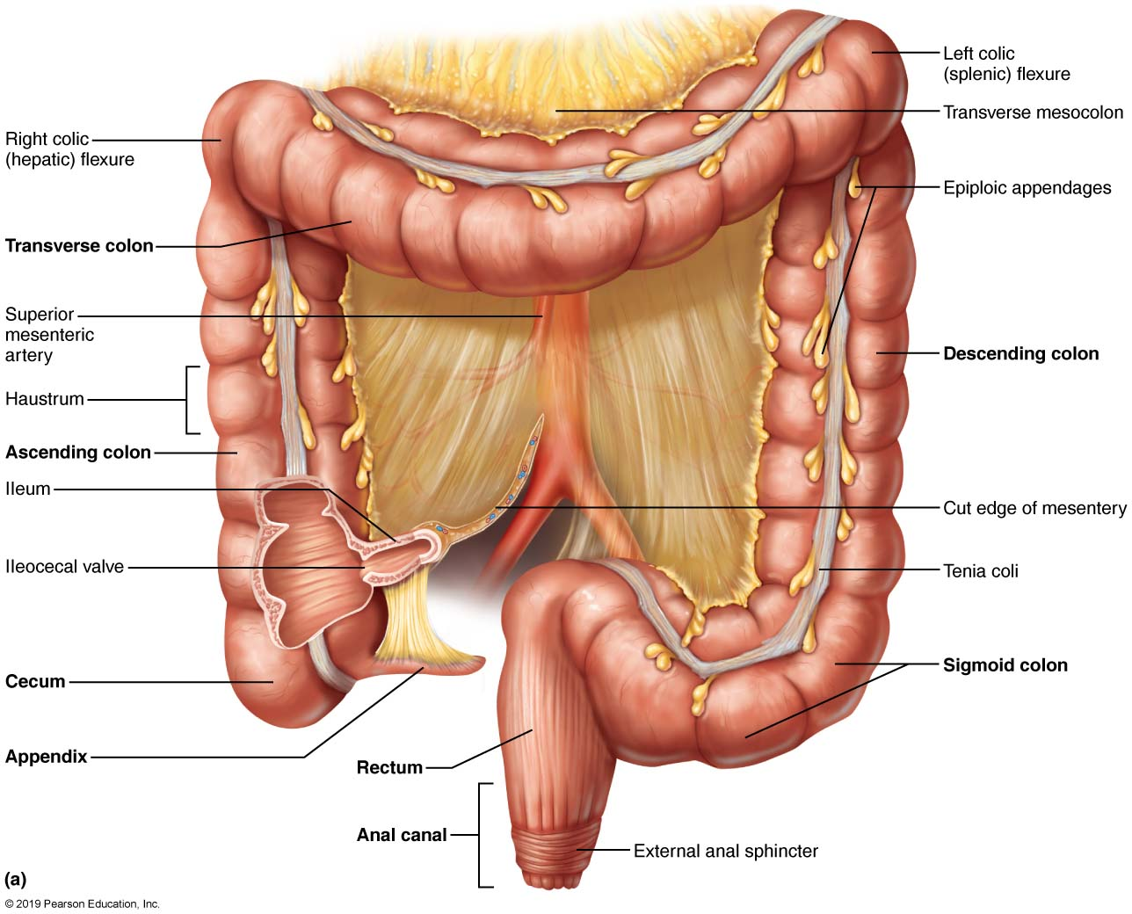
Gross Anatomy of the Large Intestine (1 of 3)
Figure 23.33a Gross anatomy of the large intestine.

Slide 35
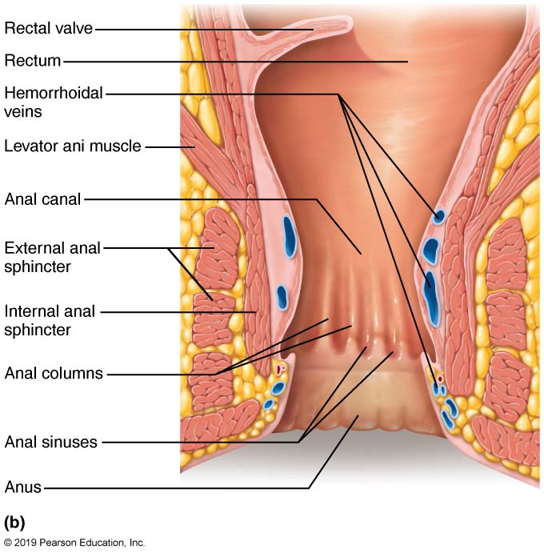
Gross Anatomy of the Large Intestine (2 of 3)
Figure 23.33b Gross anatomy of the large intestine.

Slide 36
Gross Anatomy (6 of 6)
Relationship of the large intestine to the peritoneum
  Cecum, appendix, and rectum are all retroperitoneal
  Colon is also retroperitoneal, except for its transverse and sigmoid parts
  Intraperitoneal regions are anchored to posterior abdominal wall by mesentery sheets called mesocolons

Slide 37
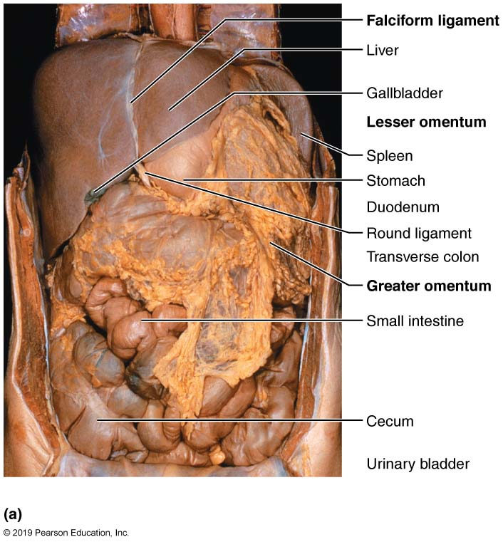
Mesenteries of the Abdominal Digestive Organs (1 of 4)
Figure 23.34a Mesenteries of the abdominal digestive organs.

Slide 38
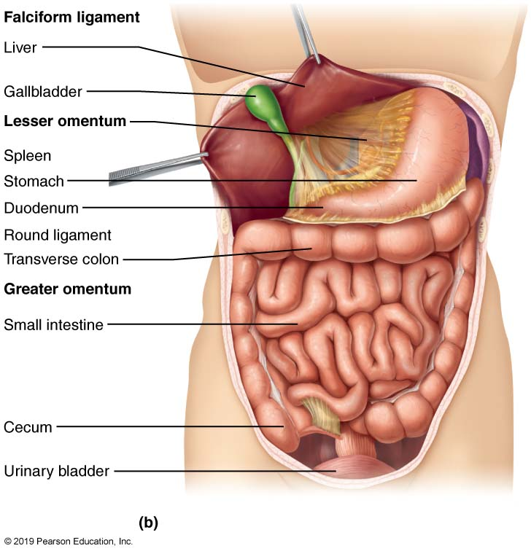
Mesenteries of the Abdominal Digestive Organs (2 of 4)
Figure 23.34b Mesenteries of the abdominal digestive organs.

Slide 39
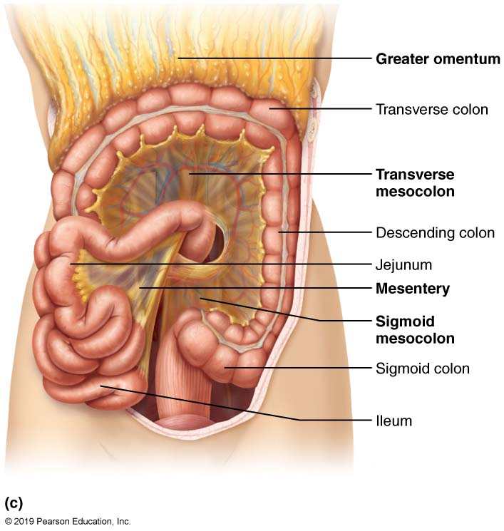
Mesenteries of the Abdominal Digestive Organs (3 of 4)
Figure 23.34c Mesenteries of the abdominal digestive organs.

Slide 40
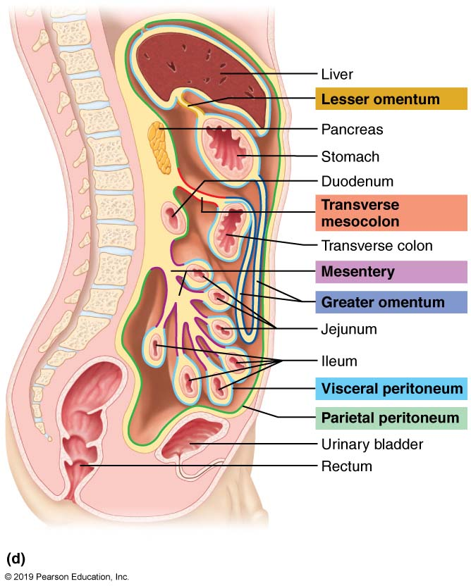
Mesenteries of the Abdominal Digestive Organs (4 of 4)
Figure 23.34d Mesenteries of the abdominal digestive organs.

Slide 41
Clinical – Homeostatic Imbalance 23.11
Appendicitis: acute inflammation of appendix; usually results from a blockage by feces that traps infectious bacteria
  Most common in adolescence when entrance to appendix is at widest
Venous drainage can be impaired, leading to ischemia and necrosis (tissue death)
Ruptured appendix can cause peritonitis
Symptoms: pain in umbilical region, moving to lower right abdominal quadrant
  loss of appetite, nausea, and vomiting are also seen
Treatment: surgical removal (appendectomy), or in some cases, with antibiotics.

Slide 42
Microscopic Anatomy (1 of 2)
Large intestine contains thicker mucosa made up of simple columnar epithelium
  Except in anal canal, where it becomes stratified squamous epithelium to withstand abrasion
Does not contain circular folds, villi, or digestive secretions
Contains abundant deep crypts with many mucus-producing goblet cells
Mucosa of anal canal hangs in long ridges or folds referred to as anal columns

Slide 43
Microscopic Anatomy (2 of 2)
Anal recesses: located between anal columns; secrete mucus to aid in emptying
Pectinate line: horizontal line that parallels anal sinuses
  Visceral sensory nerves innervate area superior to this line
    Region insensitive to pain
  Somatic nerves innervate inferior to this line
    Region sensitive to pain
Superficial venous plexuses of anal canal form hemorrhoids if inflamed

Slide 44
Gross Anatomy of the Large Intestine (3 of 3)
Figure 23.33b Gross anatomy of the large intestine.

Slide 45
Bacterial Flora (1 of 3)
Bacterial flora: consist of 1000+ different types of bacteria
  Outnumber our own cells 10 to 1
Enter from small intestine or anus to colonize colon
Metabolic functions
  Fermentation
    Ferment indigestible carbohydrates and mucin
    Release irritating acids and gases (~500 ml/day)

Slide 46
Bacterial Flora (2 of 3)
  Vitamin synthesis
    Synthesize B complex and some vitamin K needed by liver to produce clotting factors
Keeping pathogenic bacteria in check
  Beneficial bacteria outnumber and suppress pathogenic bacteria
  Immune system destroys any bacteria that try to breach mucosal barrier
    Epithelial cells recruit dendritic cells to mucosa to sample microbial antigens and present to T cells of MALT, triggering production of IgA that restricts microbes

Slide 47
Bacterial Flora (3 of 3)
Gut bacteria and health
  Mounting evidence supports findings that the kinds and proportions of gut bacteria can influence:
    Body weight
    Susceptibility to various diseases (including diabetes, atherosclerosis, fatty liver disease)
    Our moods
  Manipulating gut bacteria may become a routine health-care strategy in future

Slide 48
Clinical – Homeostatic Imbalance 23.12 (1 of 2)
Antibiotic-associated diarrhea: accounts for 14,000 deaths per year
Clostridium difficile, an anaerobic bacterium that many carry in intestine, is most common cause
When other bacteria are wiped out by antibiotics, C. difficile can flourish and cause pseudomembranous colitis (inflammation of colon)
  May lead to bowel perforation and sepsis

Slide 49
Clinical – Homeostatic Imbalance 23.12 (2 of 2)
C. difficile infections are resistant to many antibiotics and difficult to treat
  New treatments include fecal transplants to replace healthy bacteria to suppress C. difficile

Slide 50
Digestive Processes in the Large Intestine
(1 of 4)
Residue remains in large intestine 12–24 hours
No food breakdown occurs except what enteric bacteria digest
Vitamins (made by bacterial flora), water, and electrolytes (especially Na⁺ and Cl⁻) are reclaimed
Major functions of large intestine is propulsion of feces to anus and defecation

Slide 51
Clinical – Homeostatic Imbalance 23.13
Large intestine is important for our comfort, but it is not essential for life
If colon is removed, terminal ileum can be brought out through abdominal wall in a procedure called an ileostomy

Slide 52
Digestive Processes in the Large Intestine
(2 of 4)
Motility of the large intestine
  Haustral contractions: most contractions of colon, where haustra sequentially contract in response to distension
    Slow segmenting movements, mostly in ascending and transverse colon
  Gastrocolic reflex: initiated by presence of food in stomach
    Results in mass movements: slow, powerful peristaltic waves that are activated three to four times per day
  Descending colon and sigmoid colon act as storage reservoir

Slide 53
Clinical – Homeostatic Imbalance 23.14 (1 of 2)
Low-fiber diet can narrow colon and cause strong contractions that increase pressure on walls
  Can result in diverticula, herniations of mucosa
Diverticulosis: presence of diverticula
  Common in sigmoid colon
  Affects half of people > 70 years
Diverticulitis
  Inflamed diverticula that may rupture and leak into peritoneal cavity
    May be life threatening

Slide 54
Clinical – Homeostatic Imbalance 23.14 (2 of 2)
Irritable bowel syndrome
  Functional GI disorder
  Recurring abdominal pain, stool changes, bloating, flatulence, nausea, depression
  Stress is a common precipitating factor
    Stress management is important in treatment

Slide 55
Digestive Processes in the Large Intestine
(3 of 4)
Defecation
  Mass movements force feces toward rectum
  Distension initiates spinal defecation reflex
  Parasympathetic signals
    Stimulate contraction of sigmoid colon and rectum
    Relax internal anal sphincter
  Conscious control allows relaxation of external anal sphincter

Slide 56
Digestive Processes in the Large Intestine
(4 of 4)
Defecation (cont.)
  Muscles of rectum contract to expel feces
  Assisted by Valsalva’s maneuver
    Closing of glottis, contraction of diaphragm and abdominal wall muscles cause increased intra-abdominal pressure
    Levator ani muscle contracts, causing anal canal to be lifted superiorly and allowing feces to leave body

Slide 57
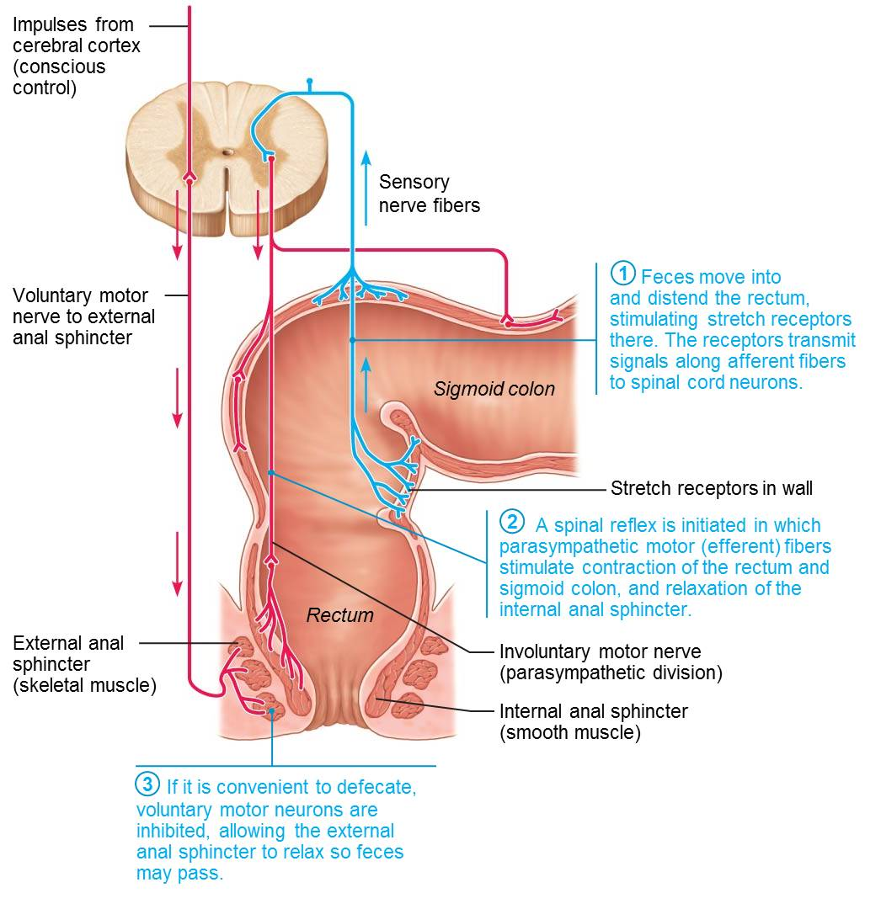
Defecation Reflex (1 of 4)
Figure 23.35 Defecation reflex.

Slide 58
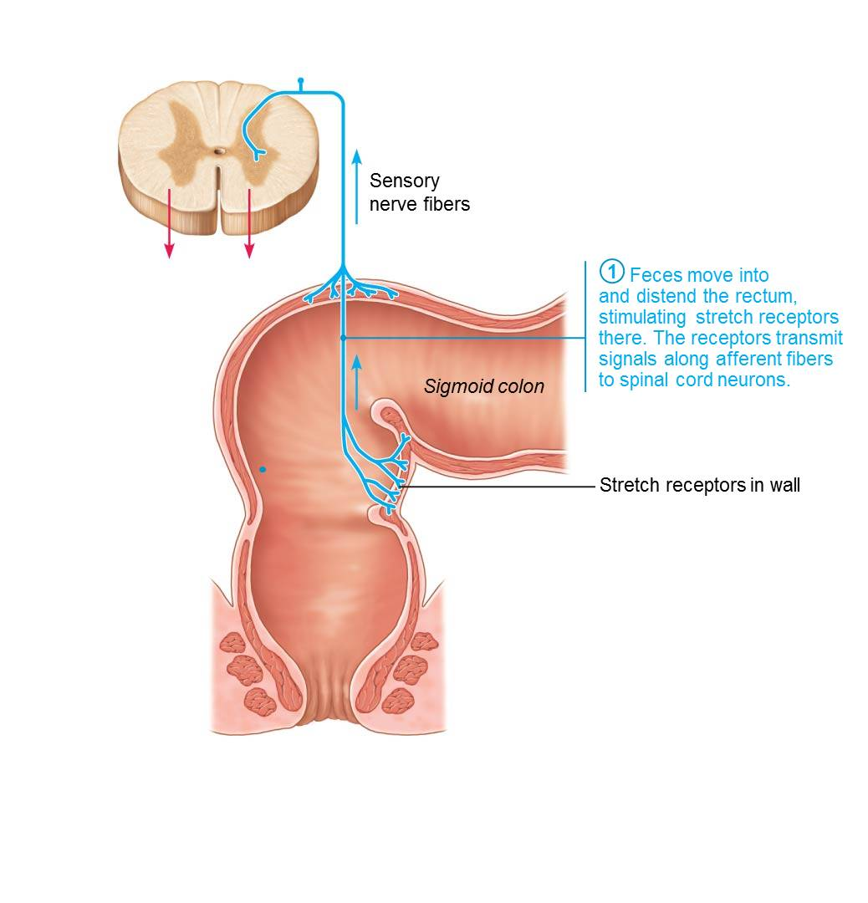
Defecation Reflex (2 of 4)
Figure 23.35 Defecation reflex.

Slide 59
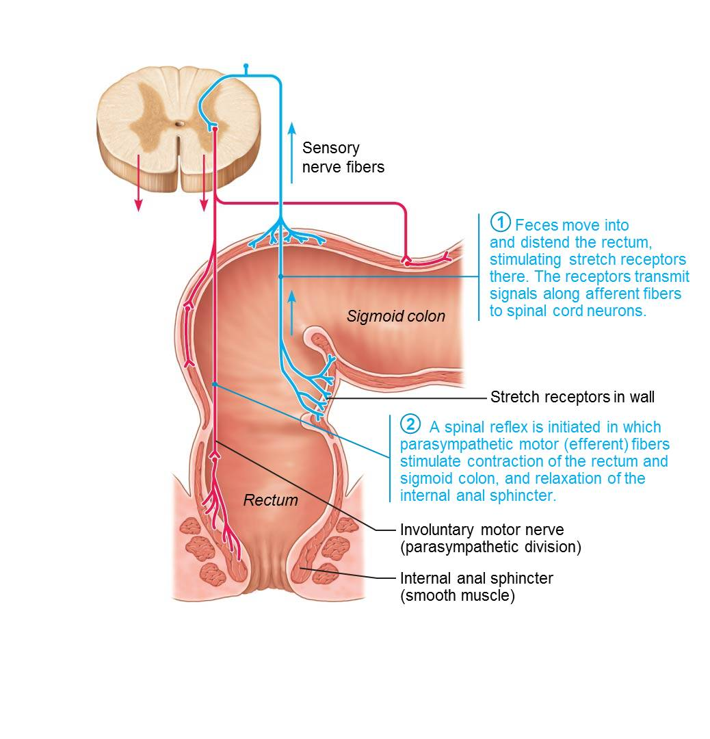
Defecation Reflex (3 of 4)
Figure 23.35 Defecation reflex.

Slide 60
Defecation Reflex (4 of 4)
Figure 23.35 Defecation reflex.

Slide 61
Clinical – Homeostatic Imbalance 23.15 (1 of 2)
Diarrhea, watery stools, results when large intestine does not have sufficient time to absorb remaining water
  Causes include irritation of colon by bacteria or jostling of digestive viscera (occurs in marathon runners)
  Prolonged diarrhea may result in dehydration and electrolyte imbalance (acidosis and loss of potassium)

Slide 62
Clinical – Homeostatic Imbalance 23.15 (2 of 2)
Constipation can occur when food remains in colon for extended periods of time and too much water is absorbed
  Stool becomes hard and difficult to pass
  May result from insufficient fiber or fluid in the diet, improper bowel habits, lack of exercise, or laxative abuse

Slide 63
Part 3 – Physiology of Digestion and Absorption

Slide 64
23.10 Mechanisms of Digestion and Absorption
Digestion breaks down ingested foods into their chemical building blocks
Only these molecules are small enough to be absorbed across wall of small intestine

Slide 65
Mechanism of Digestion: Enzymatic
Hydrolysis
Digestion: catabolic process that breaks macromolecules down into monomers small enough for absorption
  Intrinsic and accessory gland enzymes are involved in digestion
  Enzymes carry out hydrolysis, whereby water is added to break chemical bonds

Slide 66
Mechanisms of Absorption (1 of 2)
Absorption is process of moving substances from lumen of gut into body
Tight junctions ensure molecules must pass through epithelial cell rather than between them
  Materials enter cell through apical membrane (lumen side) and exit through basolateral membrane (blood side)
Lipid molecules can be absorbed passively through membrane, but other polar molecules are absorbed by active transport
Most nutrients are absorbed before chyme reaches ileum

Slide 67
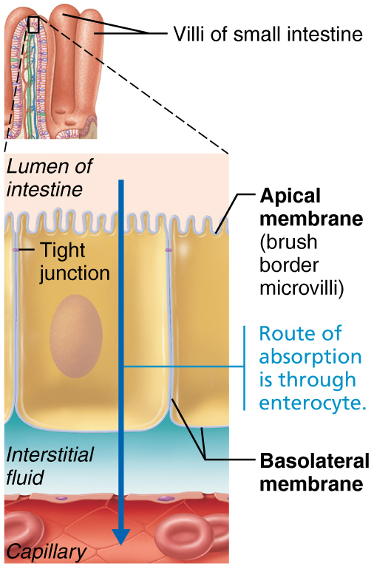
Mechanisms of Absorption (2 of 2)

Slide 68
23.11 Processing of Nutrients

Slide 69
Digestion of Carbohydrates (1 of 3)
Only monosaccharides can be absorbed
Starch and disaccharides are broken down to oligosaccharides and disaccharides
  Begins in mouth with salivary amylase
Further broken down into lactose, maltose, and sucrose
Final breakdown into monosaccarides (glucose, fructose, galactose)

Slide 70
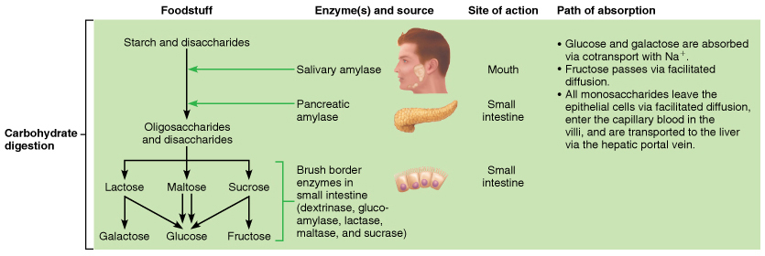
Flowchart of Digestion and Absorption of Foodstuffs (1 of 4)
Figure 23.36 Flowchart of digestion and absorption of foodstuffs.

Slide 71
Digestion of Carbohydrates (2 of 3)
Steps of starch digestion in intestine
  Pancreatic amylase breaks down starch or glycogen that escaped salivary mylase into oligosaccharides and disaccharides
  Brush border enzymes dextrinase, lactase, glucoamylase, maltase, and sucrase further break these into lactose, maltose, and sucrose; and then into monosaccharides (glucose, fructose, galactose)

Slide 72
Digestion of Carbohydrates (3 of 3)
Steps of starch digestion in intestine (cont.)
  Monosaccharides are cotransported across apical membrane of absorptive epithelial cell, mostly by secondary active transport with Na⁺
  Monosaccharides exit across the basolateral membrane by facilitated diffusion

Slide 73
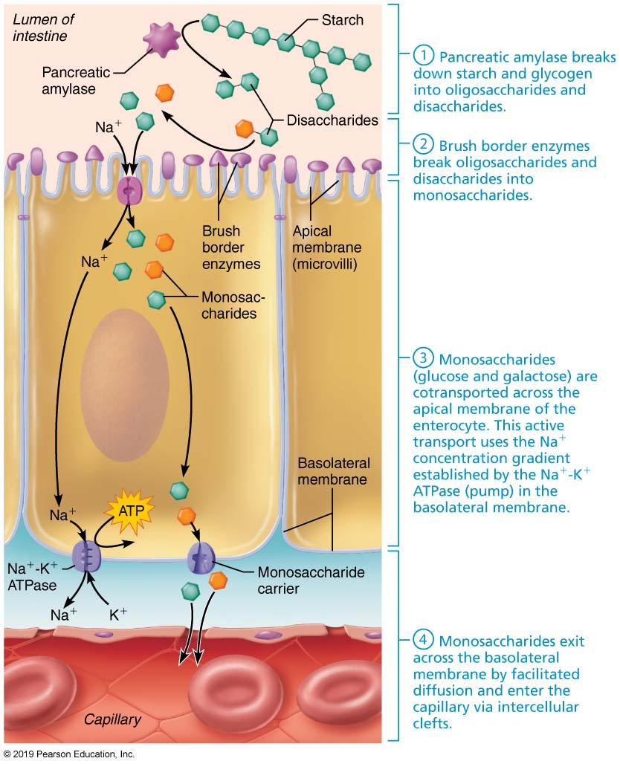
Carbohydrate Digestion and Absorption in the Small Intestine (1 of 5)
Figure 23.37 Carbohydrate digestion and absorption in the small intestine.

Slide 74
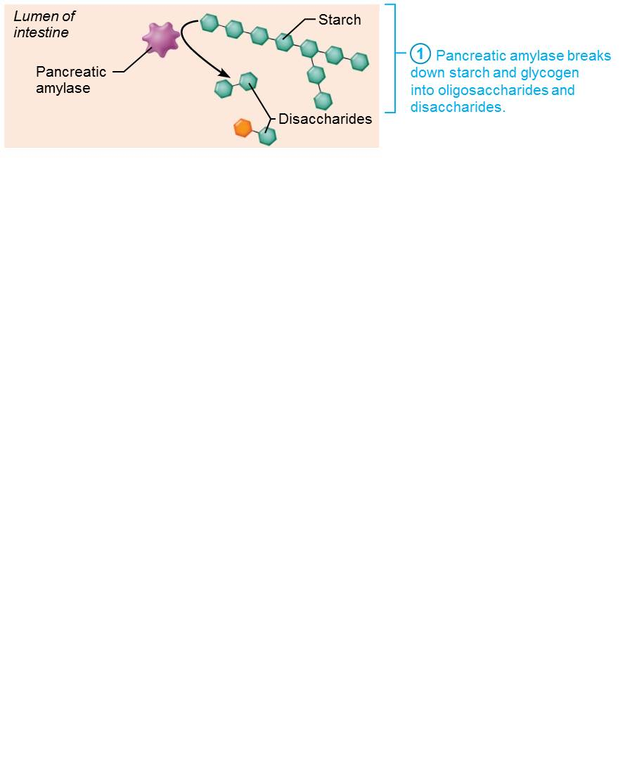
Carbohydrate Digestion and Absorption in the Small Intestine (2 of 5)
Figure 23.37 Carbohydrate digestion and absorption in the small intestine.

Slide 75
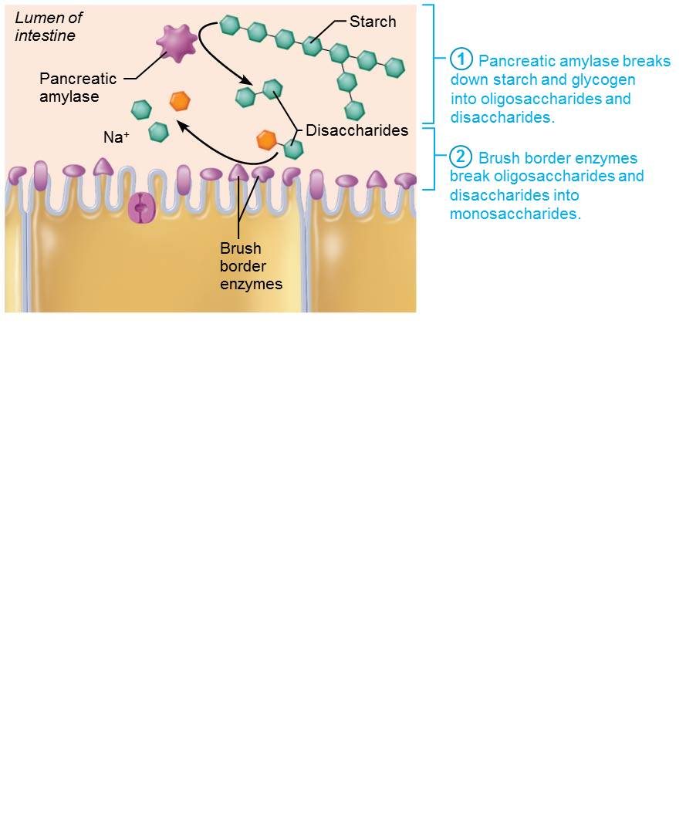
Carbohydrate Digestion and Absorption in the Small Intestine (3 of 5)
Figure 23.37 Protein digestion and absorption in the small intestine.

Slide 76
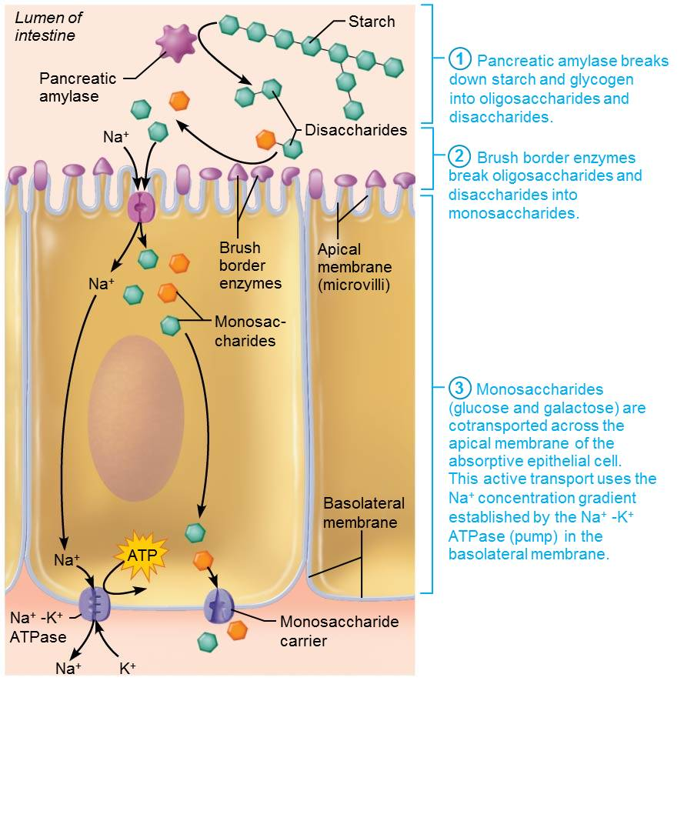
Carbohydrate Digestion and Absorption in the Small Intestine (4 of 5)
Figure 23.37 Protein digestion and absorption in the small intestine.

Slide 77
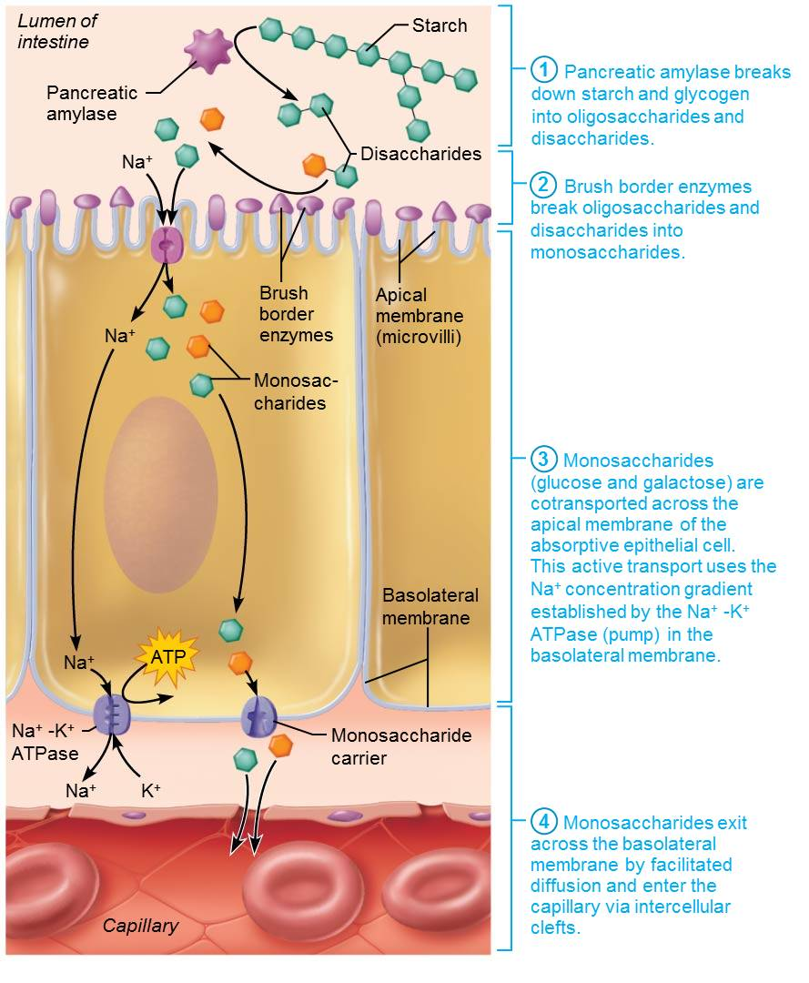
Carbohydrate Digestion and Absorption in the Small Intestine (5 of 5)
Figure 23.37 Protein digestion and absorption in the small intestine.

Slide 78
Clinical – Homeostatic Imbalance 23.16 (1 of 2)
People with lactose intolerance have deficient amounts of lactase and cannot consume lactose
Any lactose eaten remains undigested and creates an osmotic gradient in intestine that prevents water from being absorbed, resulting in diarrhea
  Can also can pull water from interstitial space into intestinal lumen

Slide 79
Clinical – Homeostatic Imbalance 23.16 (2 of 2)
Bacterial metabolism of undigested solutes produces large amounts of gas, resulting in bloating, flatulence, and cramping pain
Treatment: add lactase enzyme “drops” to milk or take a lactase tablet before consuming milk products

Slide 80
Digestion of Proteins (1 of 3)
Source of protein not only is dietary, but also includes digestive enzymes and proteins from breakdown of mucosal cells
Proteins are broken into:
  Large polypeptides
  Small polypeptides and small peptides
  Finally into amino acid monomers, with some dipeptides and tripeptides
Digestion begins in stomach when pepsinogen is converted to pepsin at pH 1.5–2.5
  Becomes inactive in high pH of duodenum

Slide 81
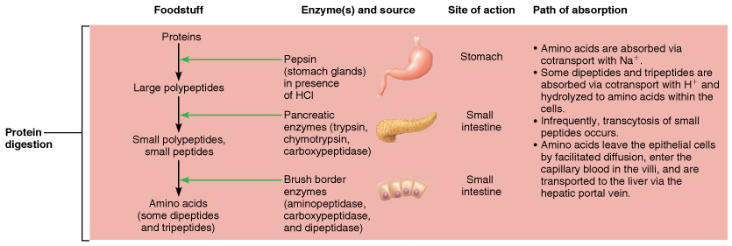
Flowchart of Digestion and Absorption of Foodstuffs (2 of 4)
Figure 23.36 Flowchart of digestion and absorption of foodstuffs.

Slide 82
Digestion of Proteins (2 of 3)
Steps of protein digestion in intestine
  Pancreatic proteases trypsin and chymotrypsin cleave protein into smaller peptides, while carboxypeptidase takes off one amino acid at a time from end
  Brush border enzymes aminopeptidases, carboxypeptidases, and dipeptidases break oligopeptides and dipeptides into amino acids

Slide 83
Digestion of Proteins (3 of 3)
Steps of protein digestion in intestine (cont.)
  Amino acids are cotransported across apical membrane of absorptive epithelial cell via secondary active transport carriers (Na⁺ or H⁺)
  Amino acids exit across basolateral membrane via facilitated diffusion

Slide 84
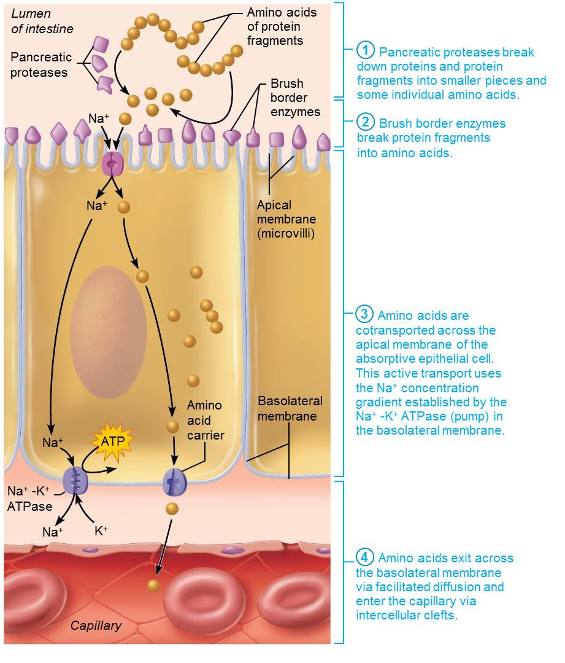
Protein Digestion and Absorption in the Small Intestine (1 of 5)
Figure 23.38 Protein digestion and absorption in the small intestine.

Slide 85
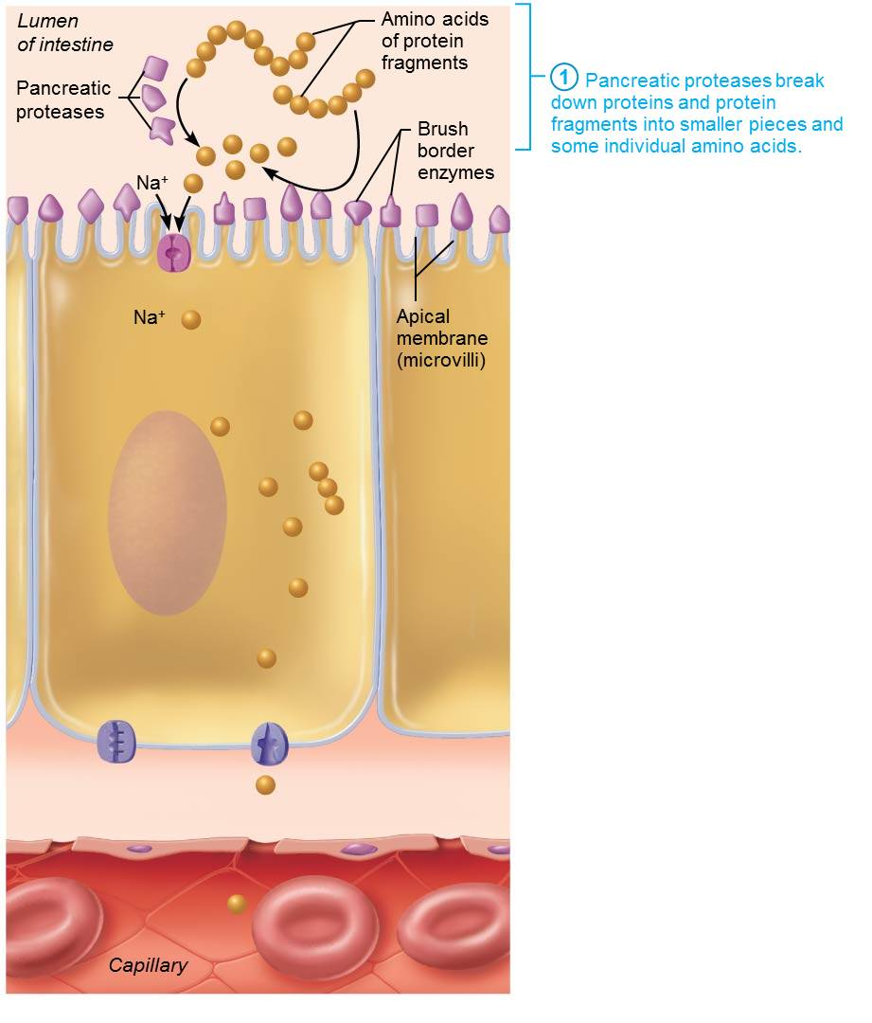
Protein Digestion and Absorption in the Small Intestine (2 of 5)
Figure 23.38 Protein digestion and absorption in the small intestine.

Slide 86
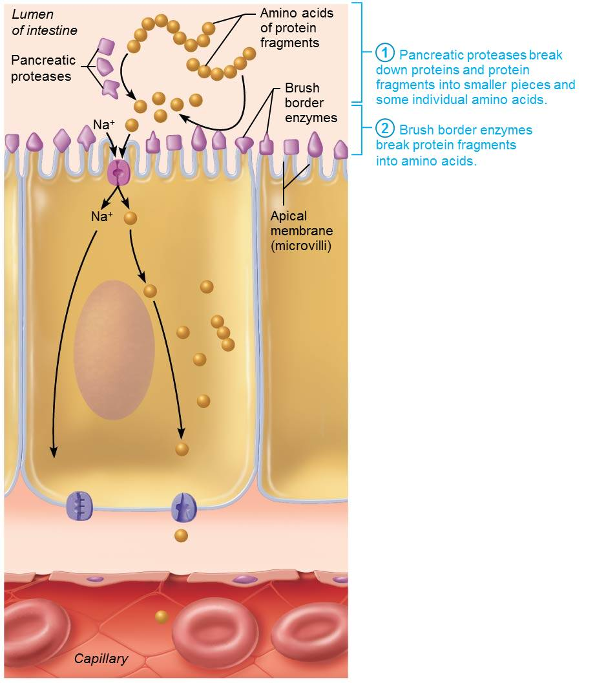
Protein Digestion and Absorption in the Small Intestine (3 of 5)
Figure 23.38 Protein digestion and absorption in the small intestine.

Slide 87
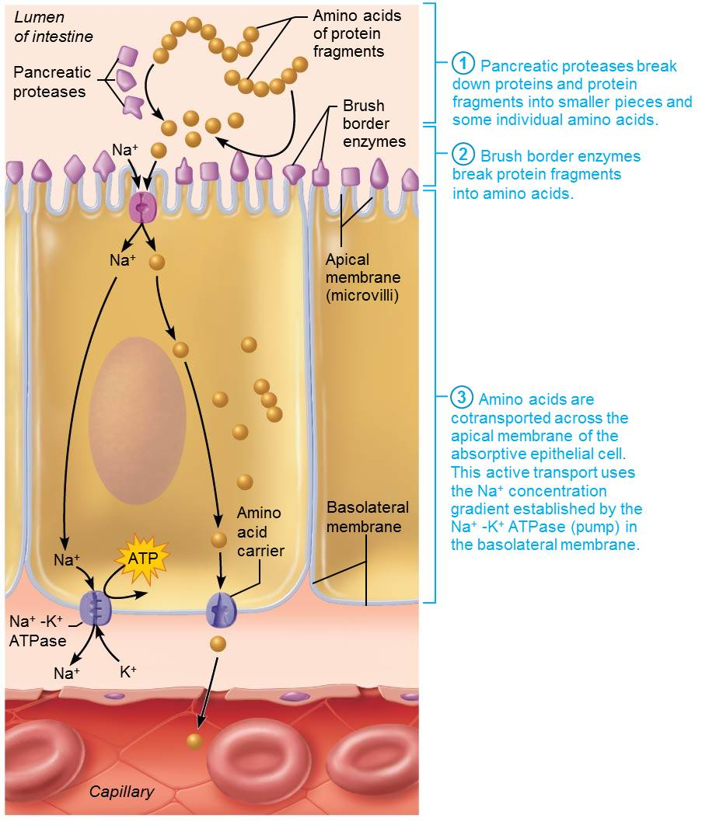
Protein Digestion and Absorption in the Small Intestine (4 of 5)
Figure 23.38 Protein digestion and absorption in the small intestine.

Slide 88
Protein Digestion and Absorption in the Small Intestine (5 of 5)
Figure 23.38 Protein digestion and absorption in the small intestine.

Slide 89
Digestion of Lipids (1 of 3)
Steps in lipid digestion in intestine
  Emulsification: triglycerides and their breakdown products are insoluble in water
    Need pre-treatment with bile salts that break large fat globules into smaller ones
  Digestion: pancreatic lipases break down fat into monoglyceride plus two free fatty acids
  Micelle formation: products from digestion become coated with bile salts and lecithin
  Diffusion: lipid products leave micelles and cross epithelial membrane via diffusion

Slide 90
Digestion of Lipids (2 of 3)
Steps in lipid digestion in intestine (cont.)
  Chylomicron formation: lipid products are converted back into triglycerides and packaged with lecithin and lipoproteins, forming chylomicron
  Chylomicron transport: chylomicrons are exocytosed from basolateral side and enter lymphatic lacteal
    Eventually emptied into venous blood at thoracic duct

Slide 91
Digestion of Lipids (3 of 3)
Once in blood, chylomicrons are broken into free fatty acids and glycerol by lipoprotein lipase so they can be used by cells
Short-chain fatty acids can diffuse directly into blood

Slide 92
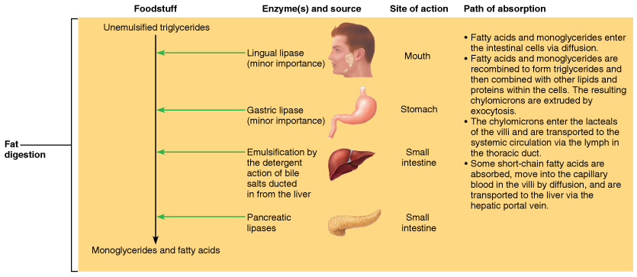
Flowchart of Digestion and Absorption of Foodstuffs (3 of 4)
Figure 23.36 Flowchart of digestion and absorption of foodstuffs.

Slide 93
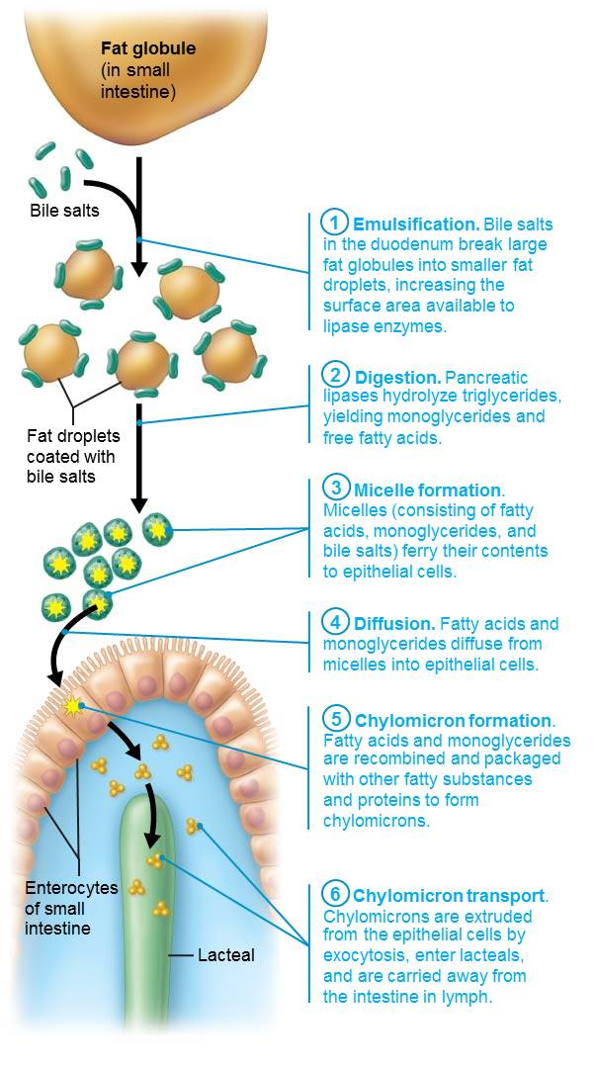
Emulsification, Digestion, and Absorption of Fats (1 of 7)
Figure 23.39 Emulsification, digestion, and absorption of fats.

Slide 94
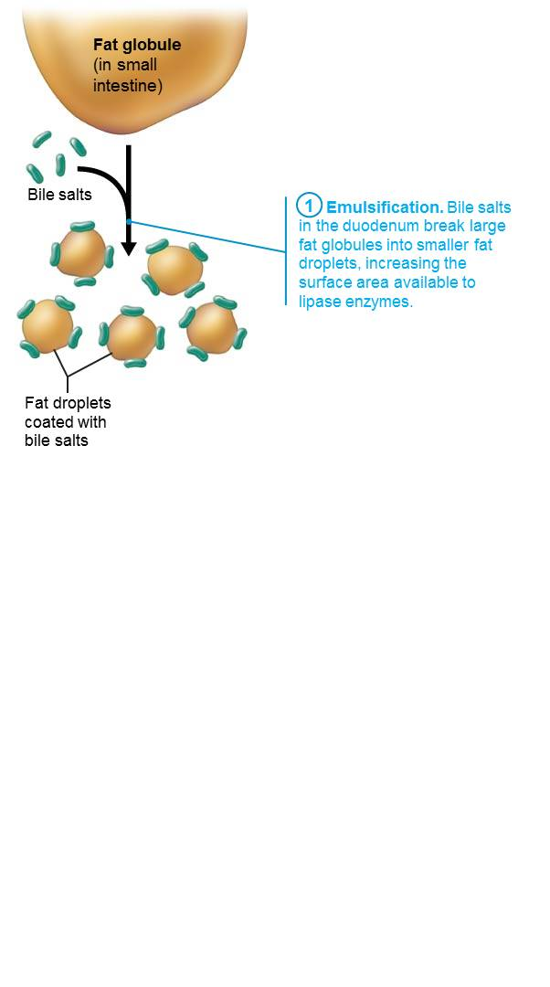
Emulsification, Digestion, and Absorption of Fats (2 of 7)
Figure 23.39 Emulsification, digestion, and absorption of fats.

Slide 95
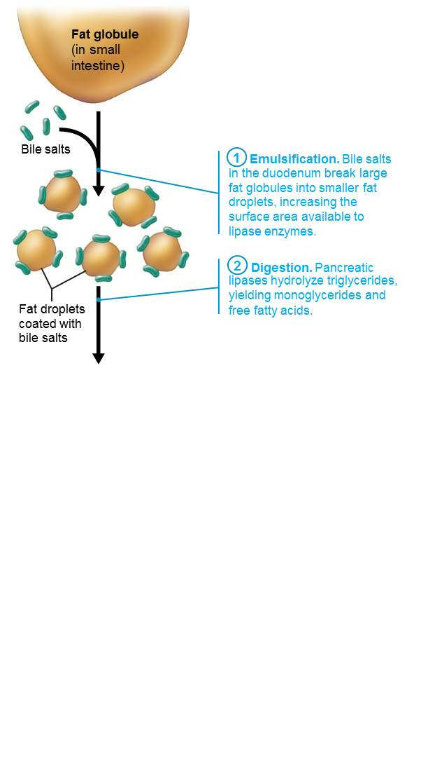
Emulsification, Digestion, and Absorption of Fats (3 of 7)
Figure 23.39 Emulsification, digestion, and absorption of fats.

Slide 96
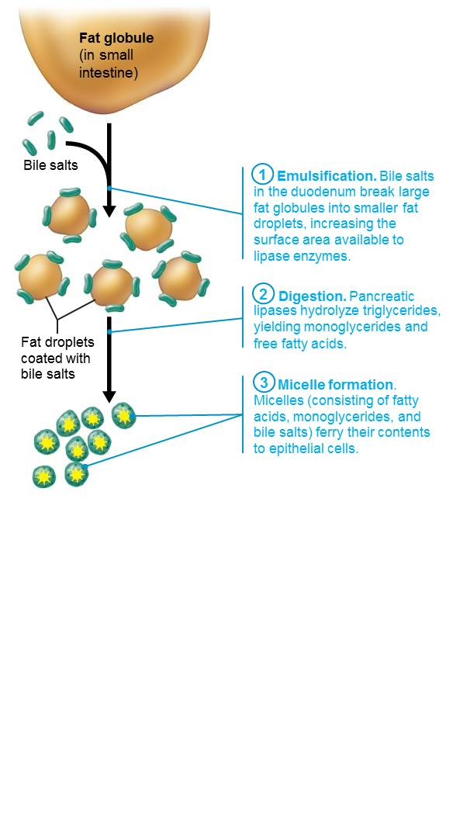
Emulsification, Digestion, and Absorption of Fats (4 of 7)
Figure 23.39 Emulsification, digestion, and absorption of fats.

Slide 97
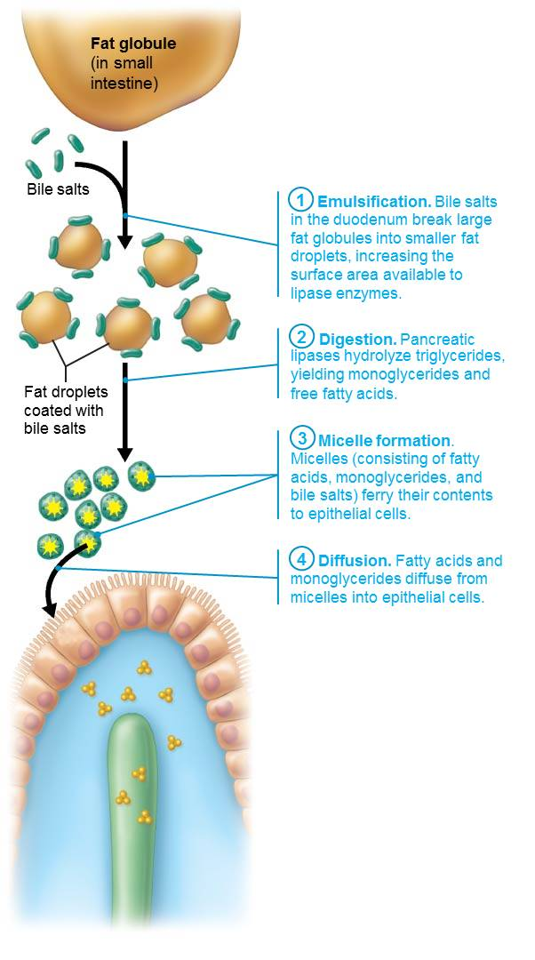
Emulsification, Digestion, and Absorption of Fats (5 of 7)
Figure 23.39 Emulsification, digestion, and absorption of fats.

Slide 98
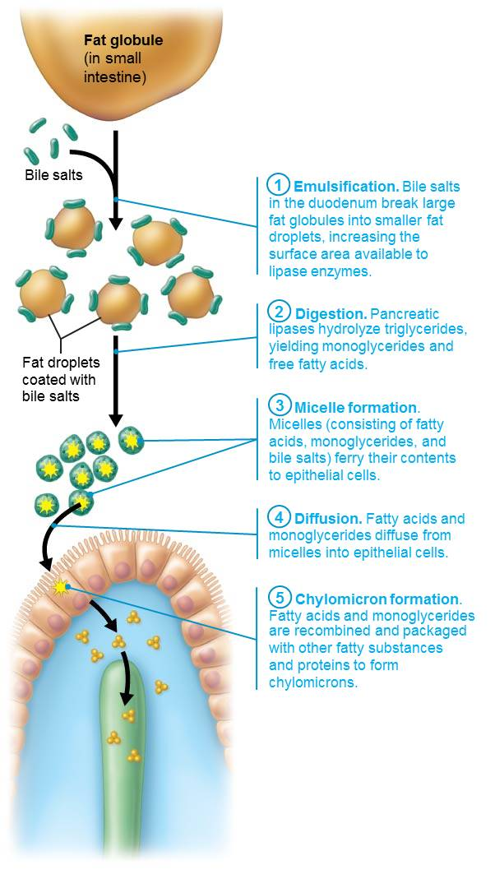
Emulsification, Digestion, and Absorption of Fats (6 of 7)
Figure 23.39 Emulsification, digestion, and absorption of fats.

Slide 99

Emulsification, Digestion, and Absorption of Fats (7 of 7)
Figure 23.39 Emulsification, digestion, and absorption of fats.

Slide 100
Digestion of Nucleic Acids
Nuclei of ingested cells in food contain DNA and RNA
Pancreatic nucleases hydrolyze nucleic acid to nucleotide monomers
Brush border enzymes, nucleosidases, and phosphatases break nucleotides down into free nitrogenous bases, pentose sugars, and phosphate ions
Breakdown products are actively transported by special carriers in epithelium of villi

Slide 101
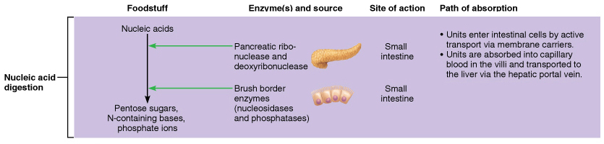
Flowchart of Digestion and Absorption of Foodstuffs (4 of 4)
Figure 23.36 Flowchart of digestion and absorption of foodstuffs.

Slide 102
Absorption of Vitamins, Electrolytes, and Water (1 of 4)
Vitamin absorption
  In small intestine
    Fat-soluble vitamins (A, D, E, and K) are carried by micelles; diffuse into absorptive cells
    Water-soluble vitamins (C and B) are absorbed by diffusion or by passive or active transporters
    Vitamin B₁₂ (large, charged molecule) binds with intrinsic factor and is absorbed by endocytosis
  In large intestine: vitamin K and B vitamins from bacterial metabolism are absorbed

Slide 103
Absorption of Vitamins, Electrolytes, and Water (2 of 4)
Absorption of electrolytes
  Most ions are transported actively along length of small intestine
  Iron and calcium are absorbed in duodenum
  Na⁺ absorption is coupled with active absorption of glucose and amino acids
  Cl⁻ is transported actively
  K⁺ diffuses in response to osmotic gradients; lost if water absorption is poor
  Usually amount in intestine is amount absorbed

Slide 104
Absorption of Vitamins, Electrolytes, and Water (3 of 4)
Absorption of electrolytes (cont.)
  Iron and calcium absorption is related to need
    Ionic iron is stored in mucosal cells with ferritin
    When needed, transported in blood by transferrin
  Ca²⁺ absorption is regulated by vitamin D and parathyroid hormone (PTH)

Slide 105
Absorption of Vitamins, Electrolytes, and Water (4 of 4)
Absorption of water
  9 L water, most from GI tract secretions, enter small intestine
    95% is absorbed in the small intestine by osmosis
    Most of rest is absorbed in large intestine
  Net osmosis occurs if concentration gradient is established by active transport of solutes
  Water uptake is coupled with solute uptake

Slide 106
Clinical – Homeostatic Imbalance 23.17
Malabsorption can be caused by anything that interferes with delivery of bile or pancreatic juice
  Damaged intestinal mucosa (e.g., from bacterial infection or some antibiotics)
Gluten-sensitive enteropathy (celiac disease): common malabsorption disease
  Immune reaction to gluten
  Gluten causes immune cell damage to intestinal villi and brush border
  Treatment: eliminate gluten from diet

Slide 107
Developmental Aspects of Digestive System
(1 of 4)
Primitive gut: epithelial lining is formed from endoderm, with rest of GI tract coming from mesoderm
Oral membrane: will become mouth; formed when foregut of primitive gut fuses with stomodeum
Cloacal membrane: will become anus; formed when hindgut fuses with proctodeum
By week 5, alimentary canal is a continuous tube from mouth to anus
Shortly after, accessory organs bud from mucosa

Slide 108
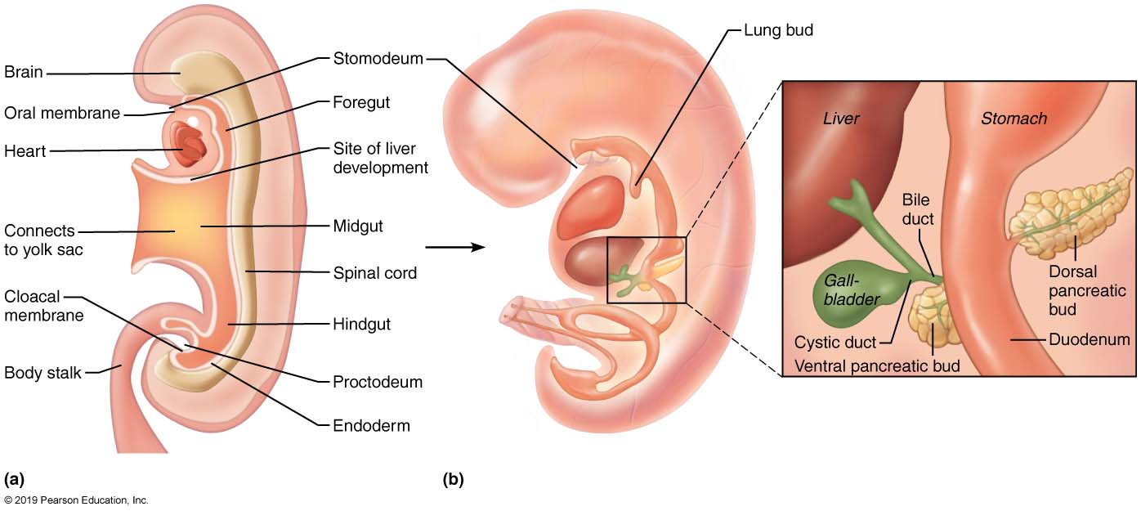
Embryonic Development of the Digestive System
Figure 23.40 Embryonic development of the digestive system.

Slide 109
Clinical – Homeostatic Imbalance 23.18
Cleft palate and cleft lip result when palatine bones or palatine processes of maxillae (or both) fail to fuse
  Dangerous because makes child unable to suck properly
Tracheoesophageal fistula
  Opening between esophagus and trachea
Cystic fibrosis
  Genetic disease that produces thick mucus that can block pancreatic duct

Slide 110
Developmental Aspects of Digestive System
(2 of 4)
Digestive system after birth
  Fetal nutrition occurs via placenta, but GI tract is stimulated to mature by amniotic fluid swallowed in utero
  Newborn’s rooting reflex helps infant find nipple; sucking reflex aids in swallowing
  Newborns double birth weight in 6 months; adult diet by 2 years
  Gastroenteritis: inflammation of GI tract
  Cholecystitis, ulcers: problems of middle age

Slide 111
Developmental Aspects of Digestive System
(3 of 4)
Aging and the digestive system
  GI tract activity declines with age
  GI produces less digestive juice; absorption is less efficient; peristalsis slows, causing decline in frequency of bowel movements
  Taste/smell becomes less acute; periodontal disease often develops
  Diverticulosis, fecal incontinence, and cancer of GI tract are fairly common

Slide 112
Developmental Aspects of Digestive System
(4 of 4)
Aging and the digestive system (cont.)
  Stomach and colon cancers rarely have early signs or symptoms
  Metastasized colon cancers frequently cause secondary liver cancer
  Oral cancers can be detected during dental exams
  Most GI cancers are treatable if caught early
  Prevention: regular dental and medical examinations

Slide 113
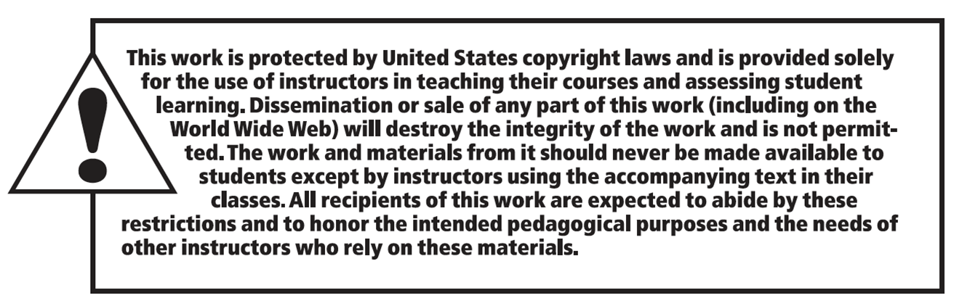
Copyright

